Slide 1

Chapter 5
Lesson 5.2

Slide 2
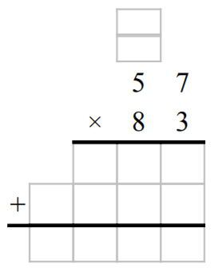
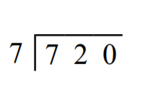
Earlier this year…

Slide 3

Fluency
Division is the inverse of multiplication

Slide 4
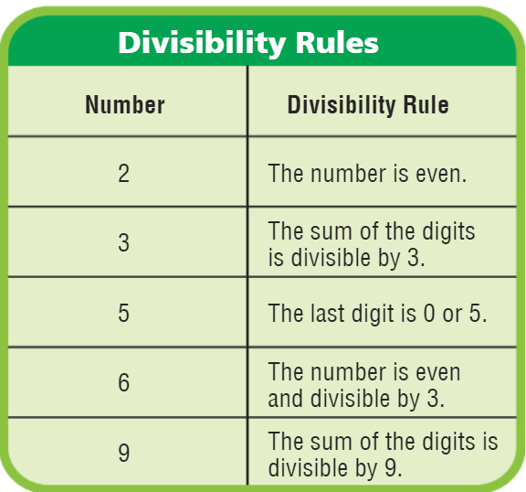
78
144
39
217
3,410

Slide 5
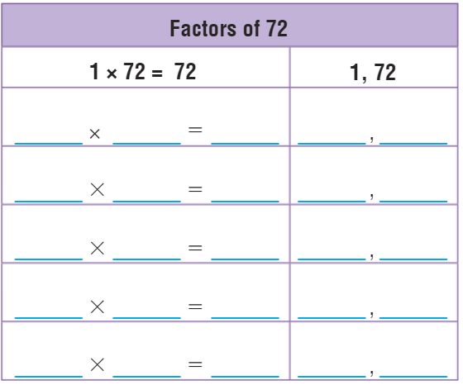
Find the Factors Pairs

Slide 6
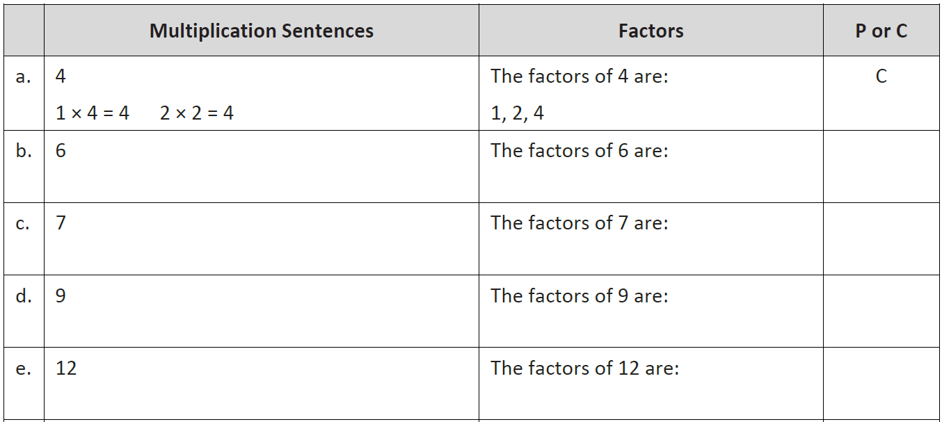

Slide 7
Essential Skill
I can find factors
Will you be able to do this?
Yes! | Maybe | No

Slide 8
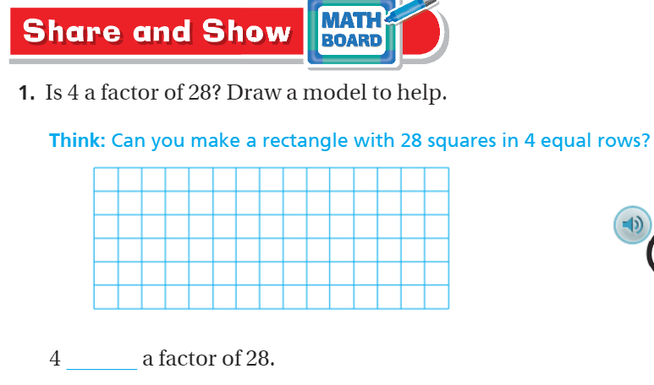

Slide 9
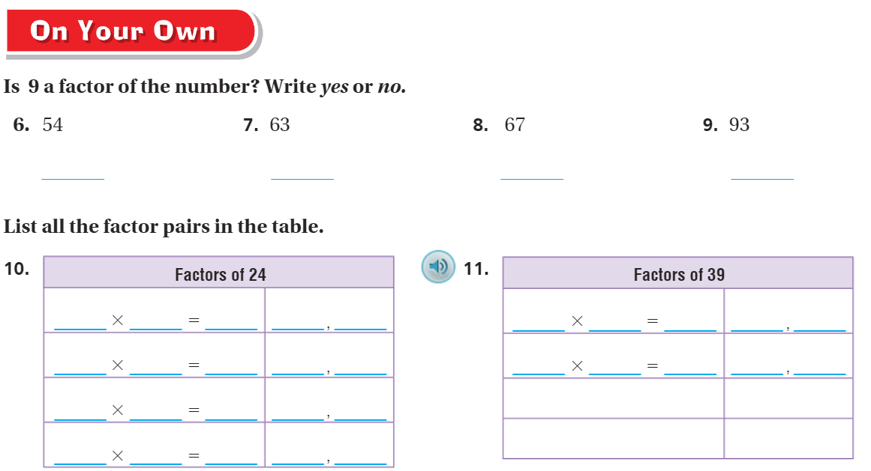
On your own– Pg. 287

Slide 10
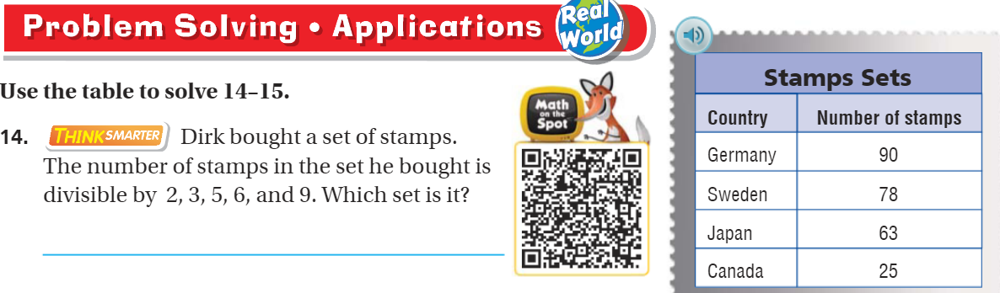
Problem Solving – pg.288

Slide 11
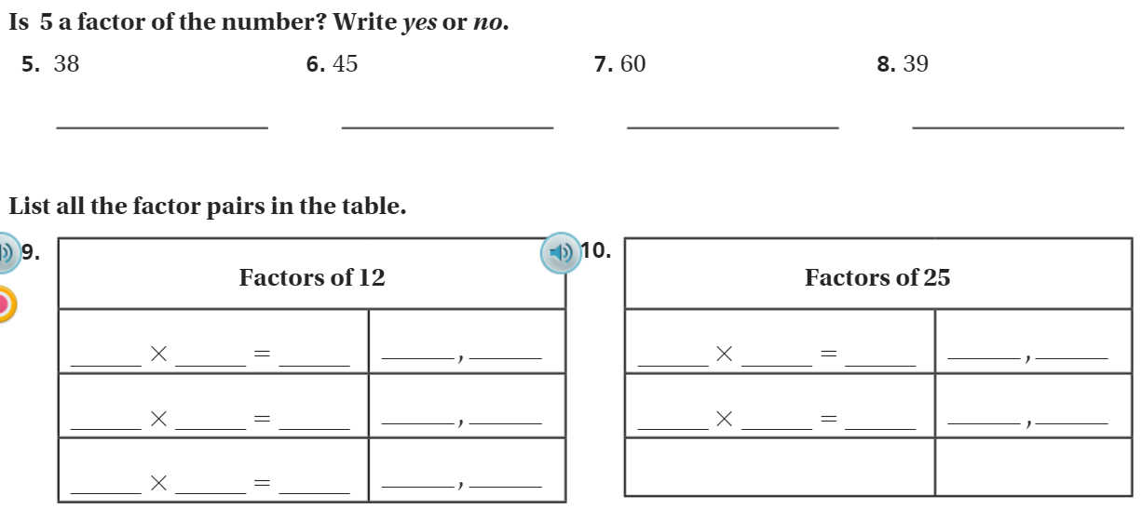
The Friday Quiz – Pg. 289

Slide 12
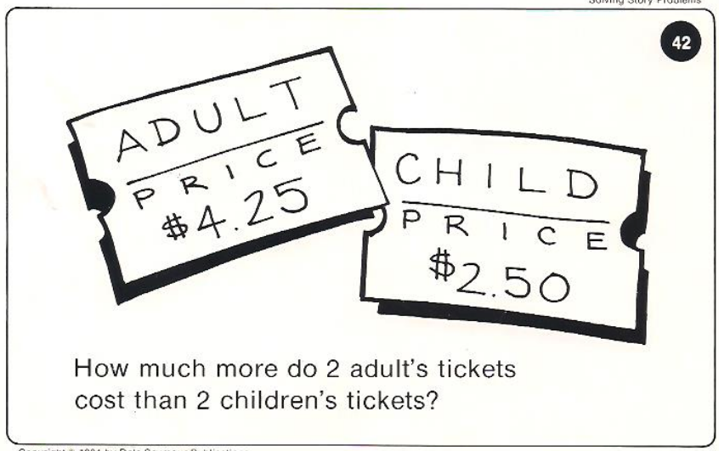
Calculator Problem

Slide 13
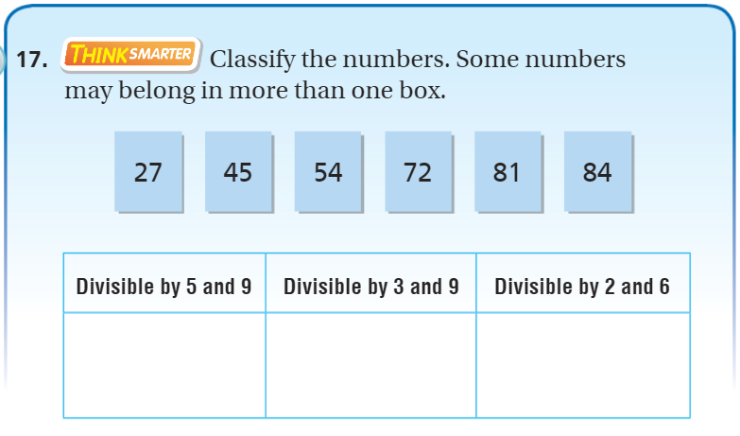
Exit Ticket – pg. 288

