Slide 1

Chapter 5
Lesson 5.4

Slide 2
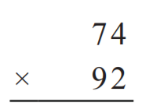

From Earlier This Year…

Slide 3

Fluency
Division is the inverse of multiplication

Slide 4
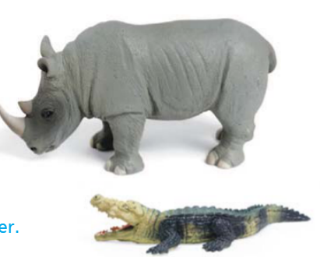
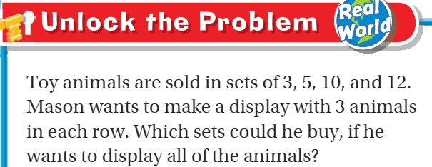
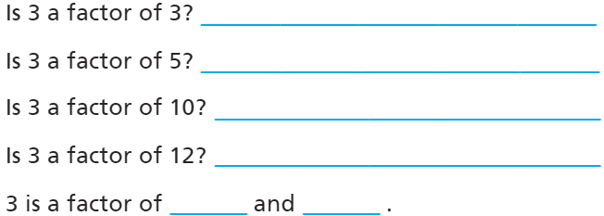
Teach and Reteach – pg. 299

Slide 5
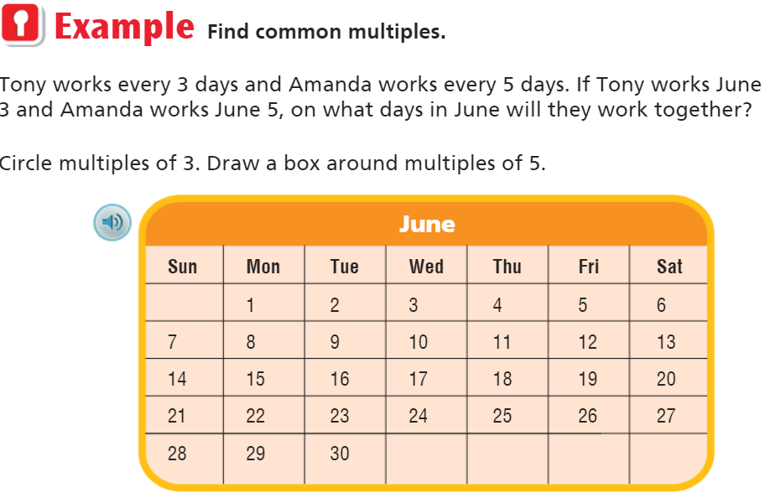
Teach and Reteach – pg. 300

Slide 6
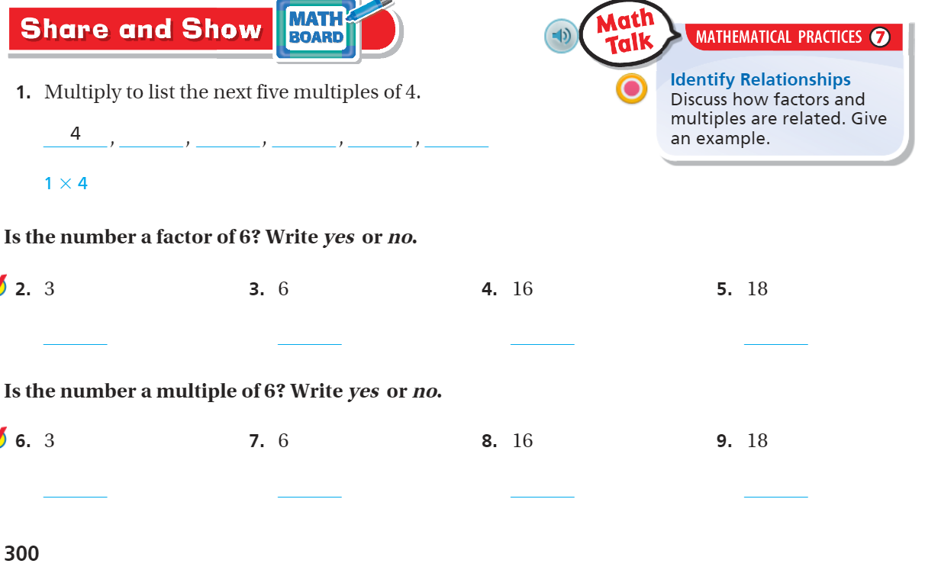
Factors vs. Multiples – pg. 300

Slide 7
Essential Skill
I can find factors and multiples
Will you be able to do this?
Yes! | Maybe | No

Slide 8
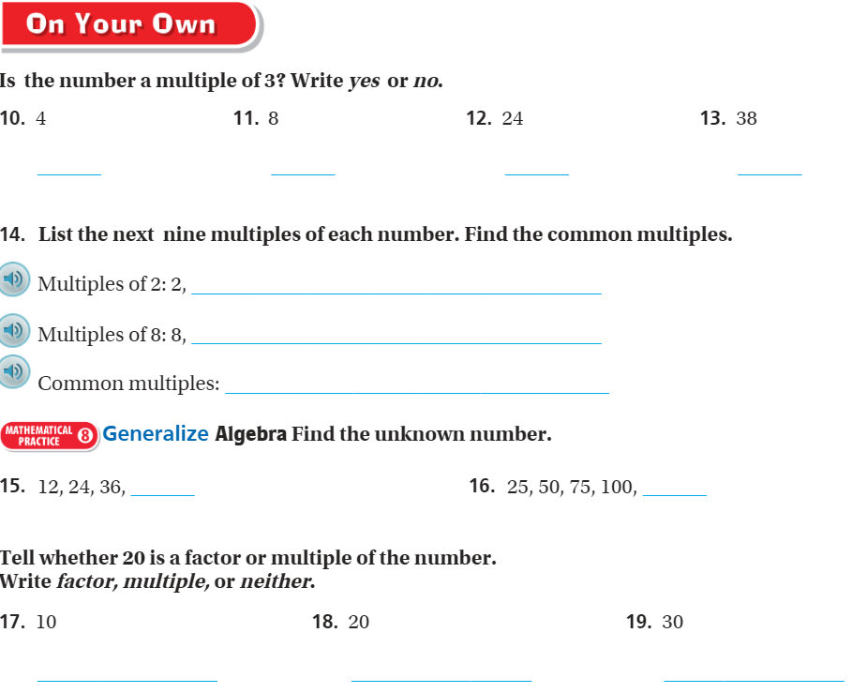
On your own– Pg. 301

Slide 9
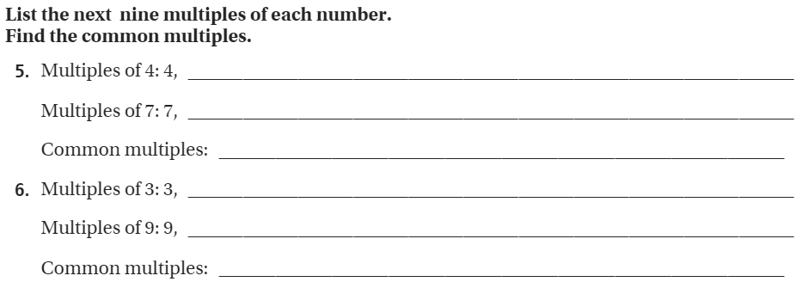
The Friday Quiz – Pg.303

Slide 10
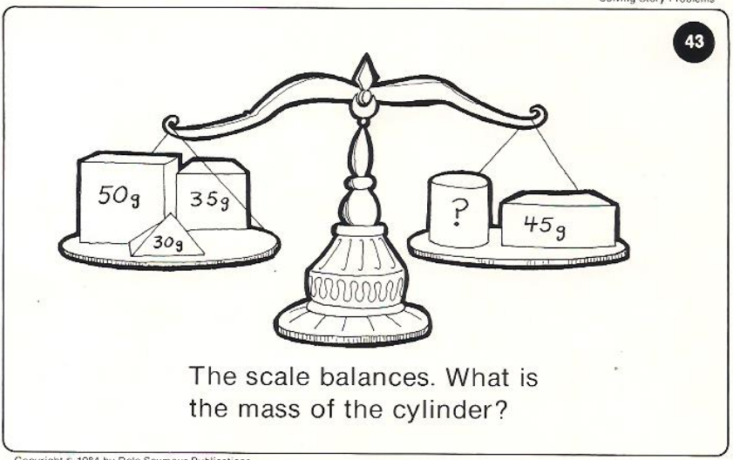
Calculator Problem

Slide 11
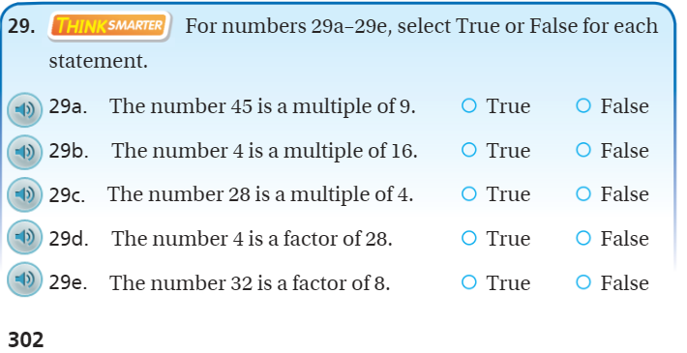
Exit Ticket – pg.302

