Slide 1

Chapter 5
Lesson 5.5

Slide 2
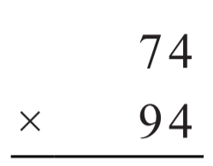

From Earlier This Year…

Slide 3

Fluency
Division is the inverse of multiplication

Slide 4
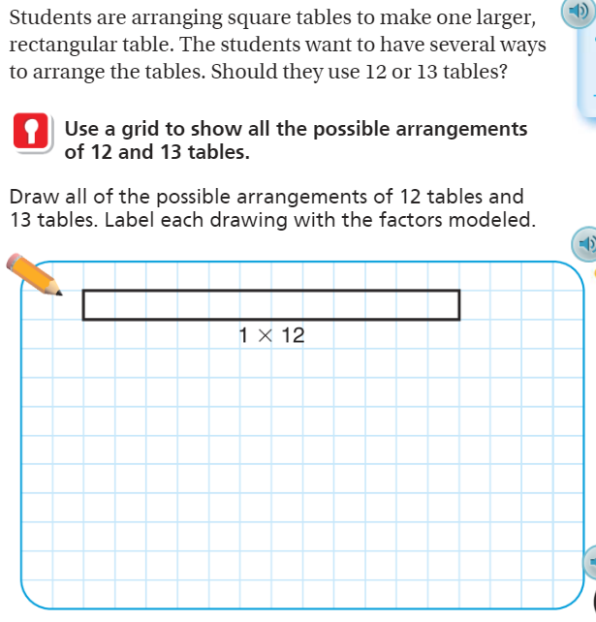
Teach and Reteach – pg. 305

Slide 5
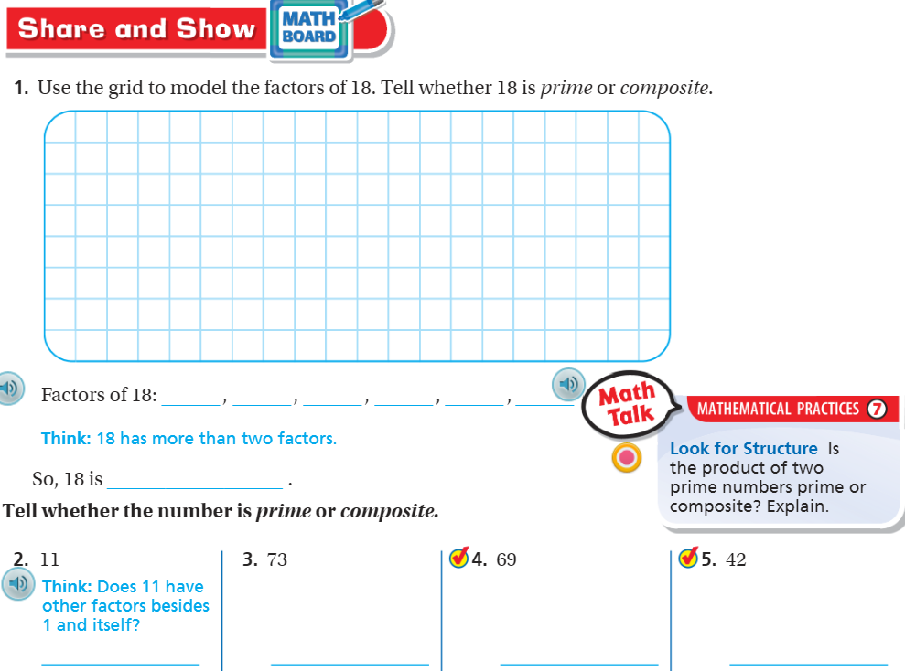
Share and Show– pg. 306

Slide 6
Essential Skill
I can find primes and composites
Will you be able to do this?
Yes! | Maybe | No

Slide 7
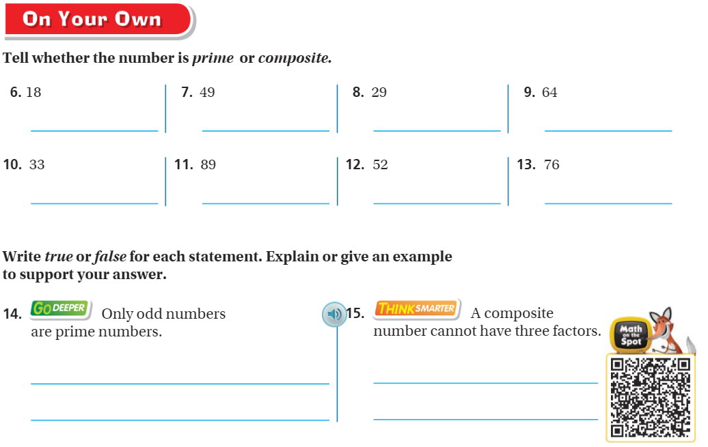
On your own– Pg.307

Slide 8
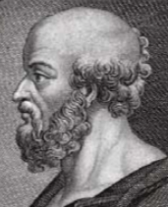
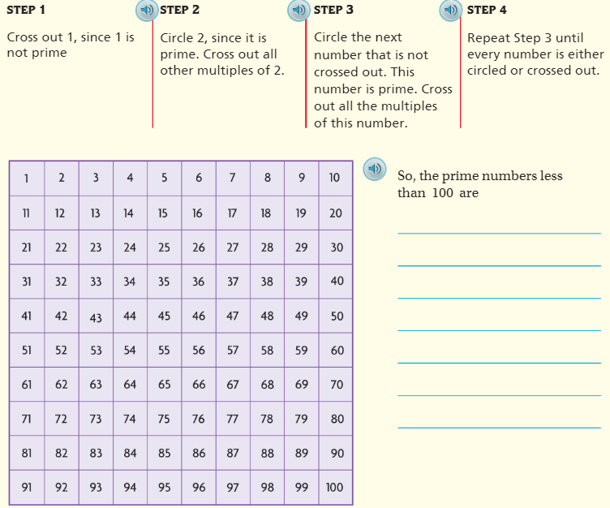
Pg. 308

Slide 9
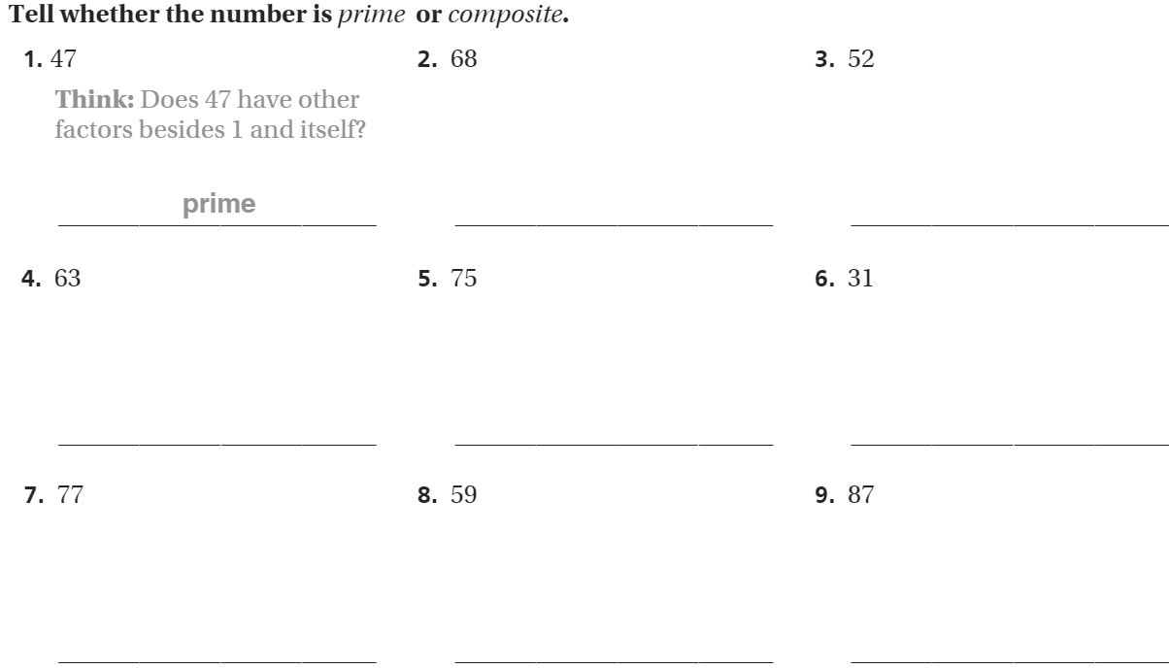
The Friday Quiz – Pg.309

Slide 10
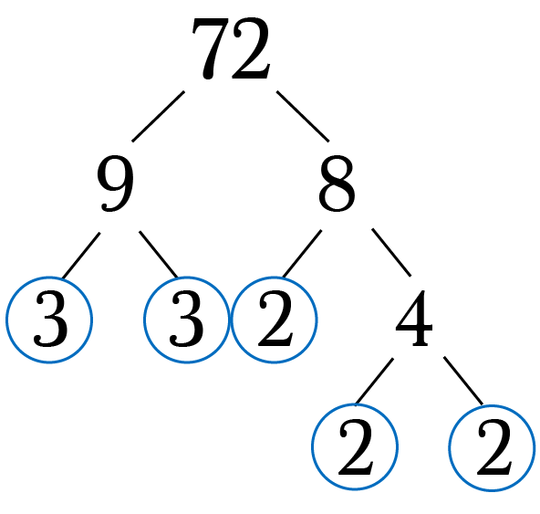
Prime Factorization

Slide 11
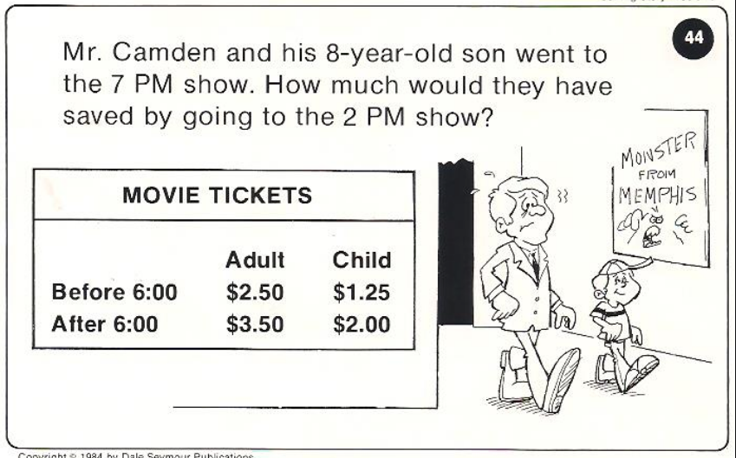
Calculator Problem

Slide 12
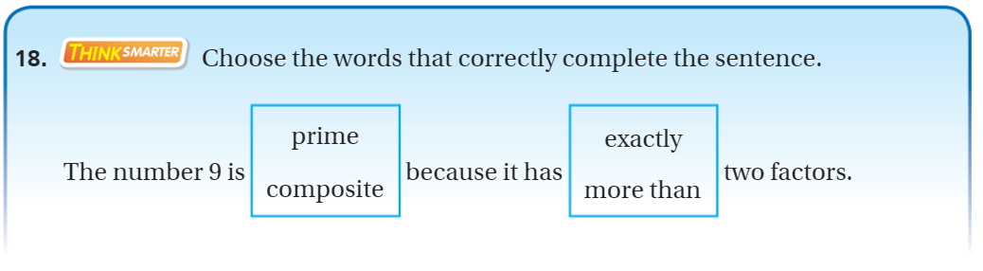
Exit Ticket – pg.307

