Slide 1

Chapter 5
Lesson 5.6

Slide 2
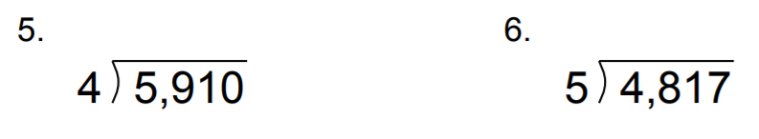
From Earlier This Year….

Slide 3
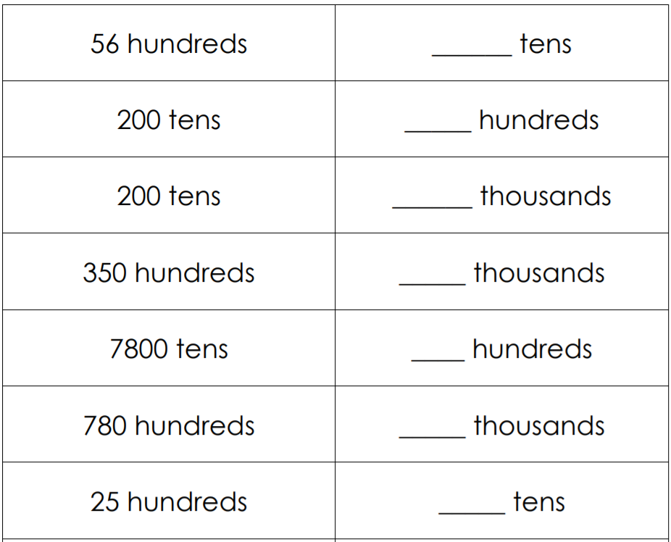
Fluency

Slide 4
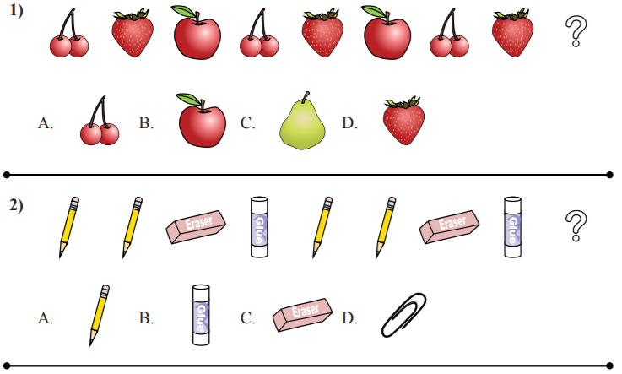
What is the rule?

Slide 5
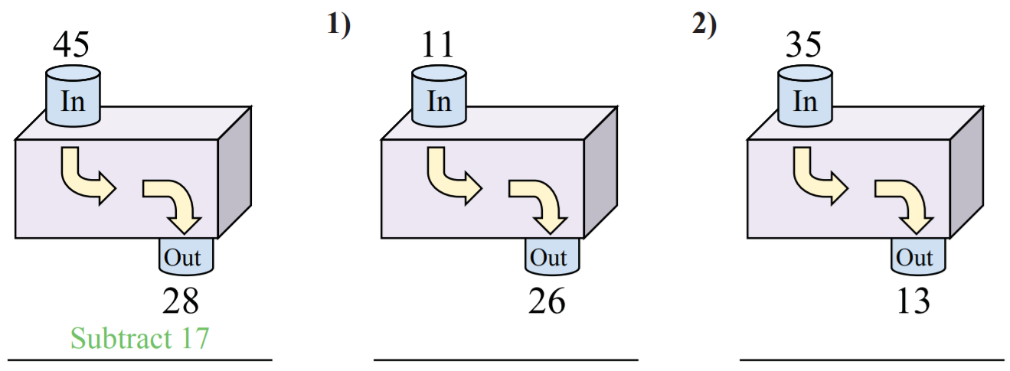
What is the rule?

Slide 6
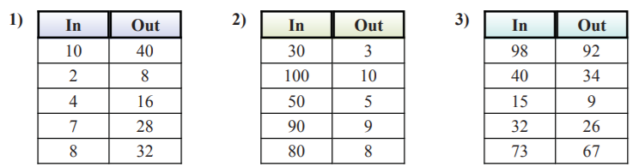
What is the rule?

Slide 7
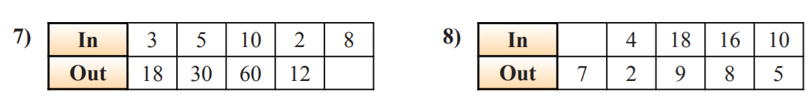
What is the rule?

Slide 8
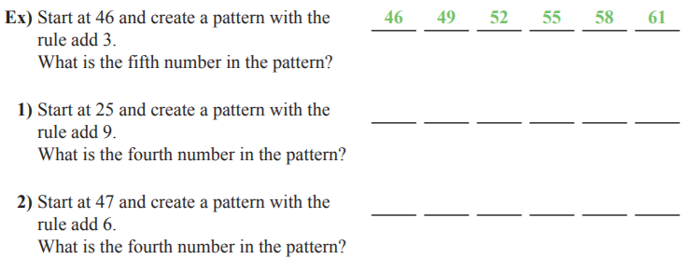
What is the rule?

Slide 9
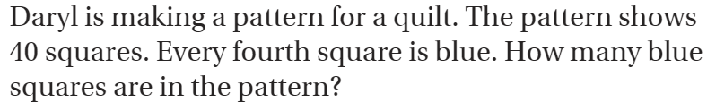
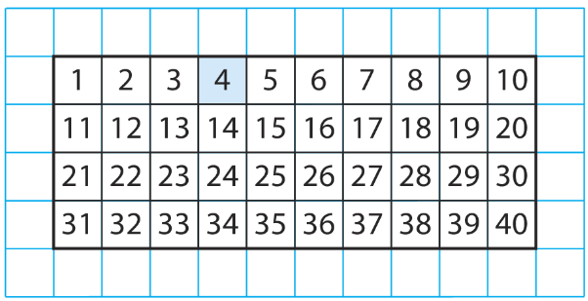
Teach and Reteach – pg. 311

Slide 10
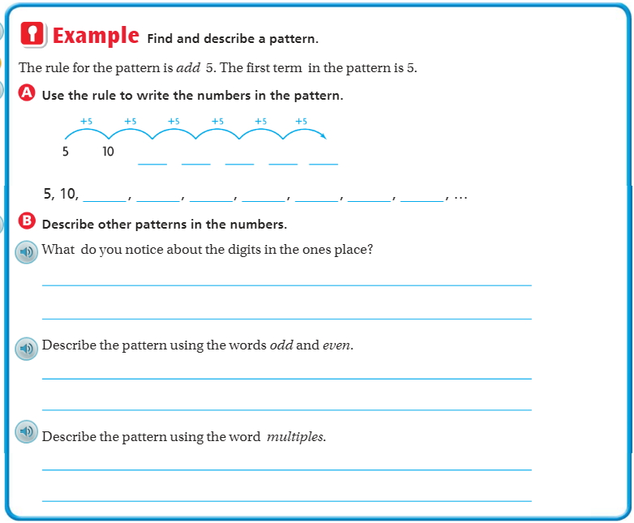
Teach & Reteach– pg. 312

Slide 11
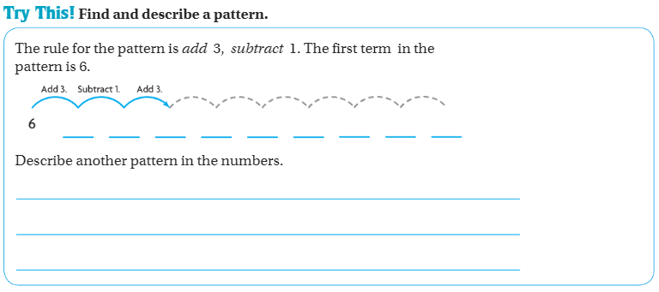
Teach & Reteach– pg. 312

Slide 12
Essential Skill
I can find number patterns
Will you be able to do this?
Yes! | Maybe | No

Slide 13
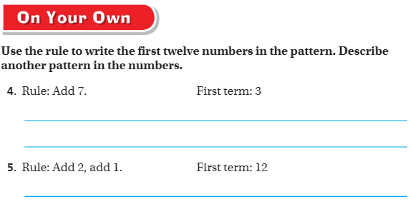
On your own– Pg. 313

Slide 14
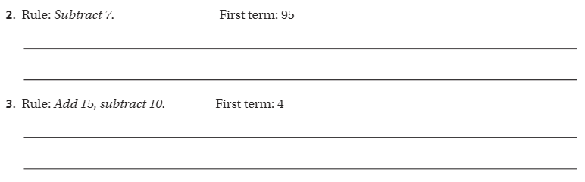
The Friday Quiz – Pg. 315

Slide 15
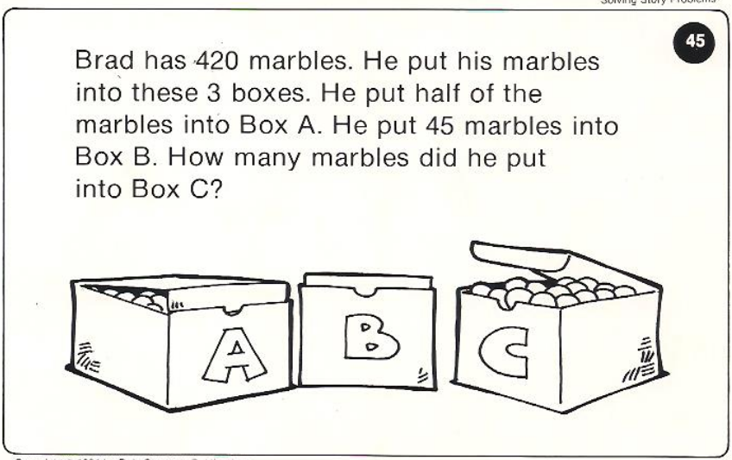
Calculator Problem

Slide 16
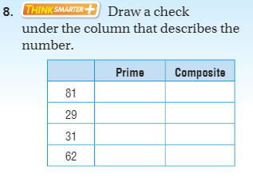
Exit Ticket – pg. 314

