Slide 1

Chapter 6
Lesson 6.1

Slide 2
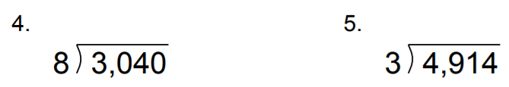
From Earlier

Slide 3
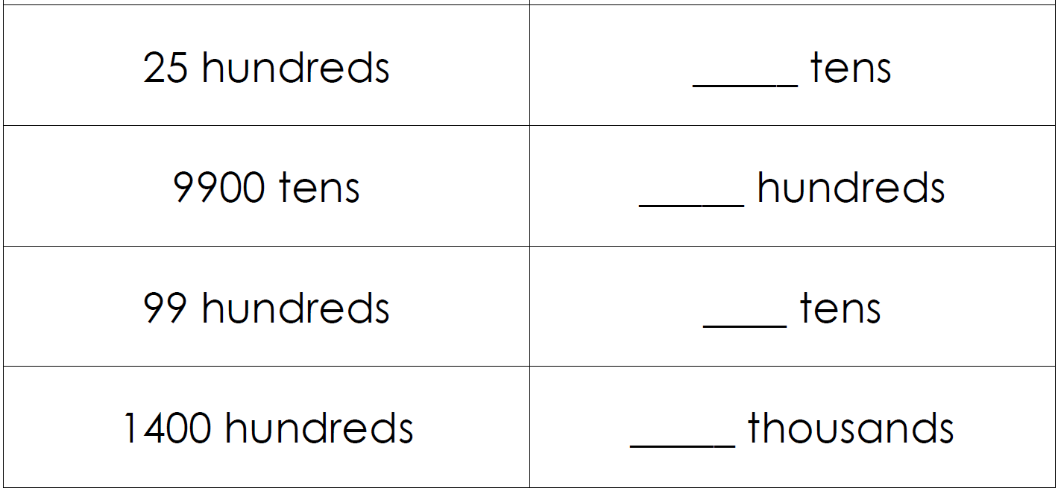
Fluency

Slide 4
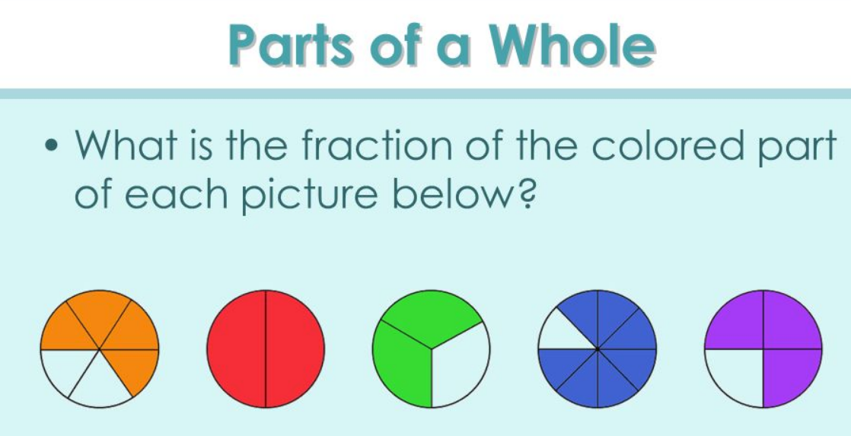
What is a fraction?

Slide 5
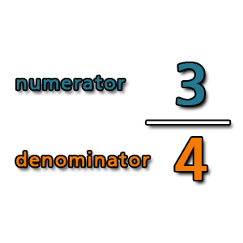

Slide 6
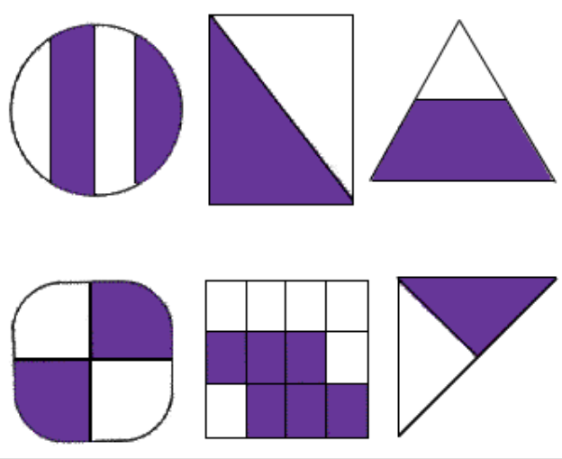
What fraction is shown?

Slide 7
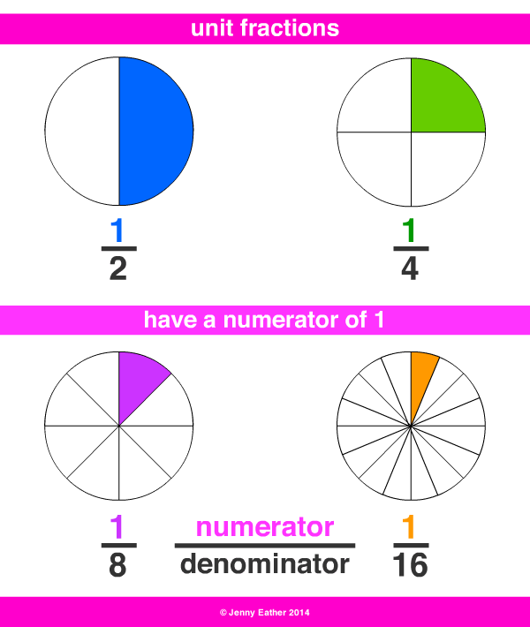

Slide 8

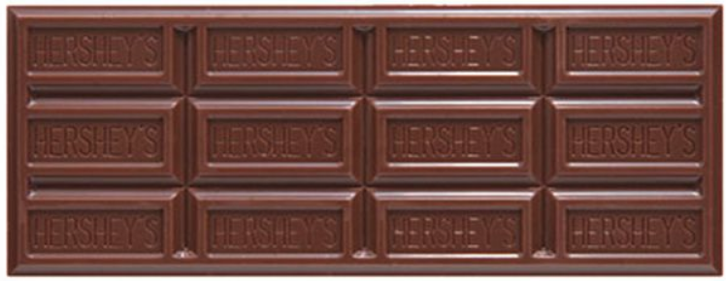

Slide 9
I can use models to show equivalent fractions
Will you be able to do this?
Yes! | Maybe | No

Slide 10
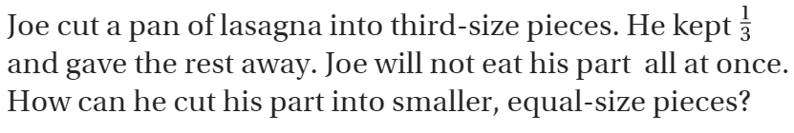
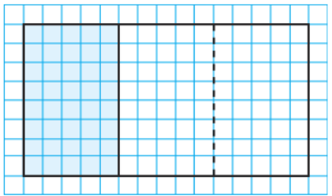
Teach and Reteach – pg. 327

Slide 11
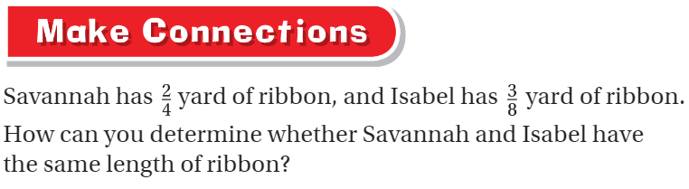
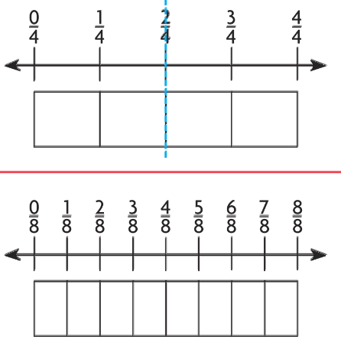
Pg. 328

Slide 12
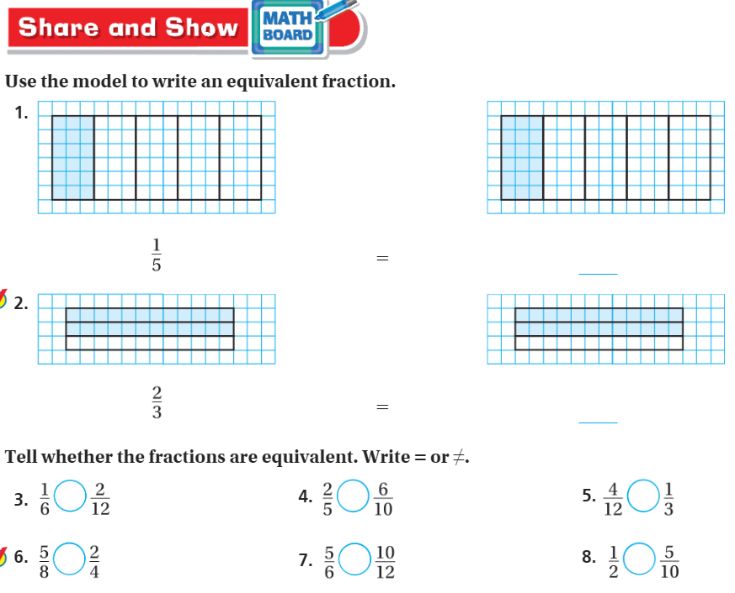
Teach & Reteach– pg. 329

Slide 13
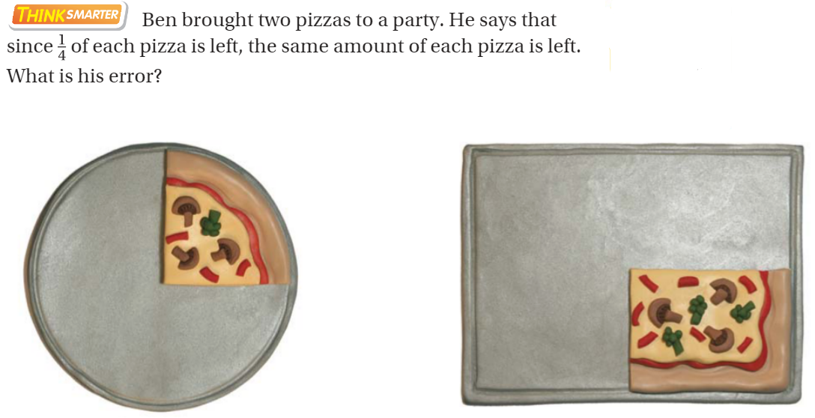
Think Smarter– pg. 330

Slide 14
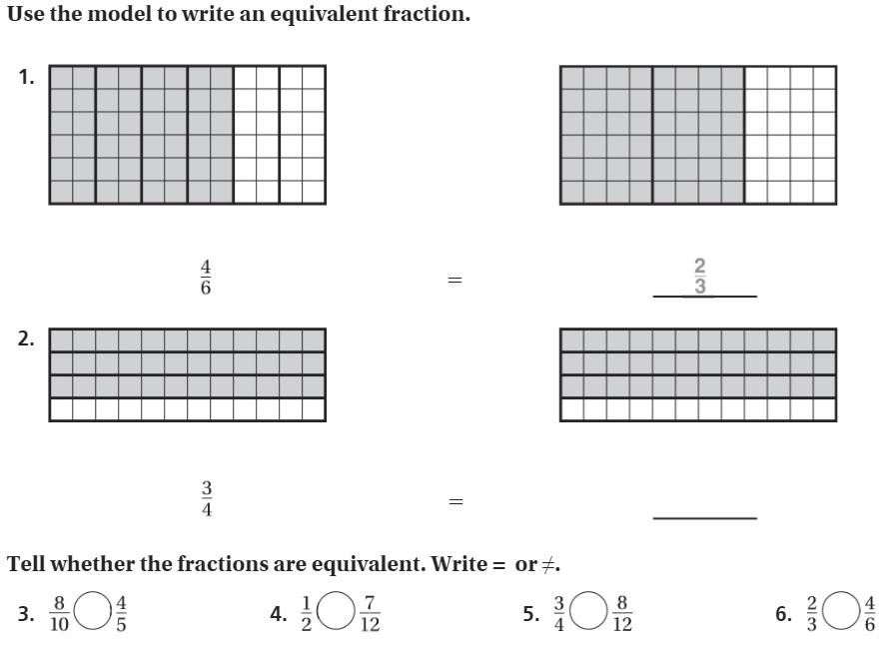
The Friday Quiz – Pg. 331

Slide 15
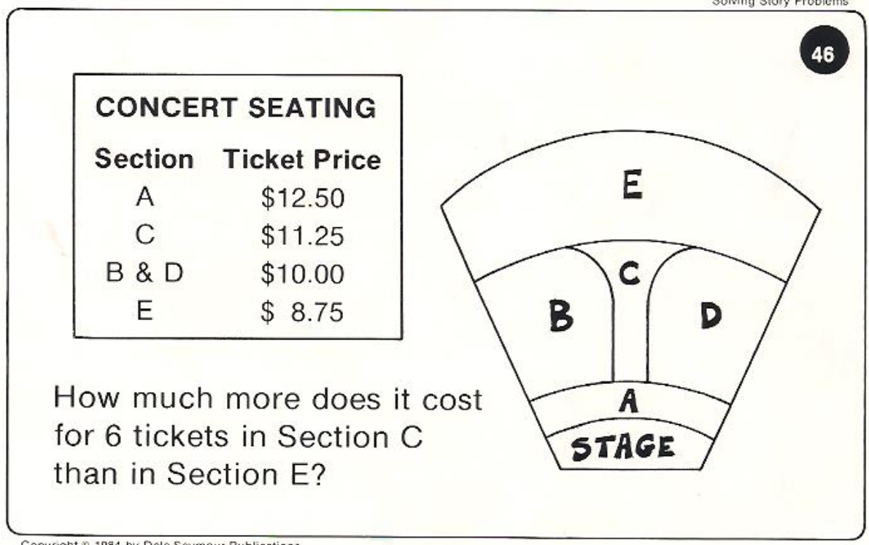
Calculator Problem

Slide 16
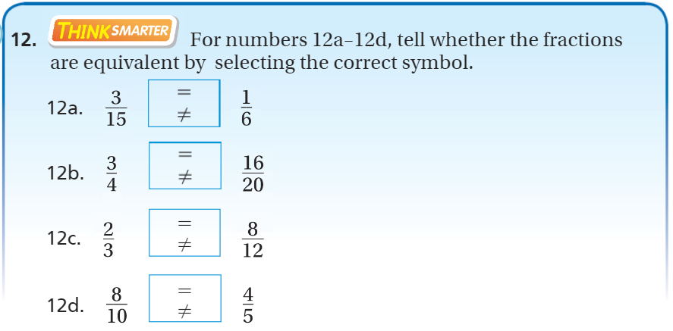
Exit Ticket – pg. 330

Slide 17
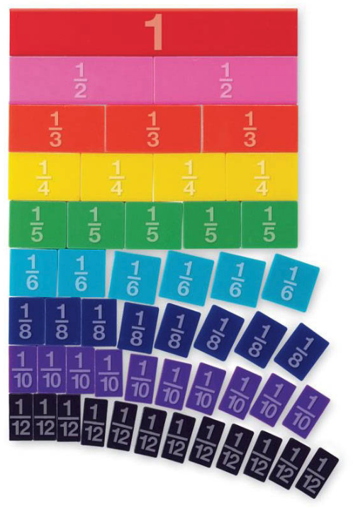
Make a complete set!

