Slide 1

Chapter 6
Lesson 6.2

Slide 2
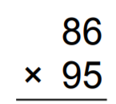

From Earlier…100%

Slide 3
Fluency
17 ÷ _____ = 4 R 1
13 ÷ _____ = 2 R 3
21 ÷ _____ = 3 R 3
14 ÷ _____ = 1 R 6
12 ÷ _____ = 1 R 5
22 ÷ _____ = 2 R 6
19 ÷ _____ = 3 R 4

Slide 4

Make a complete set.
Put them all in the bag.

Slide 5
How many ways can you make ½?

Slide 6
How many ways can you make 1/3?

Slide 7
How many ways can you make 1/4?

Slide 8
How many ways can you make 1/5?

Slide 9
How many ways can you make 1/6?

Slide 10
I can make equivalent fractions
Will you be able to do this?
Yes! | Maybe | No

Slide 11
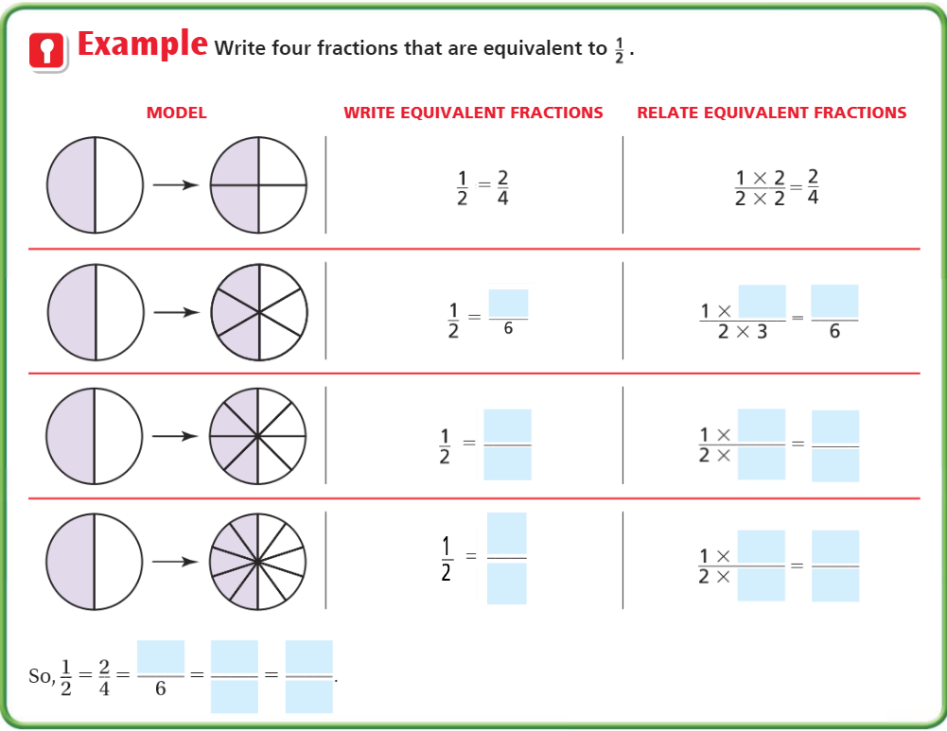
Teach and Reteach – pg. 334

Slide 12
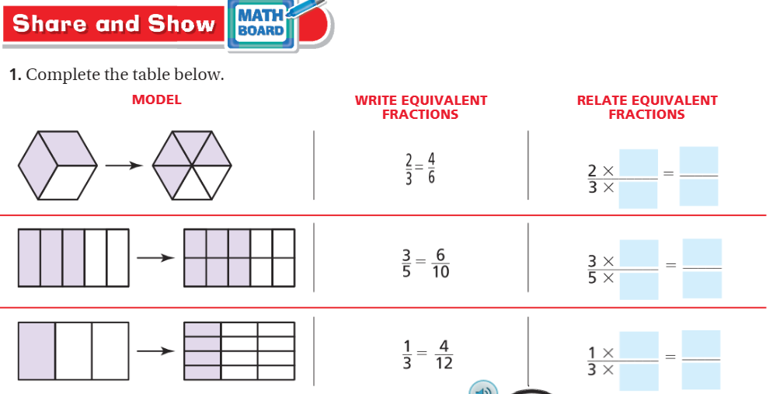
Pg. 335

Slide 13
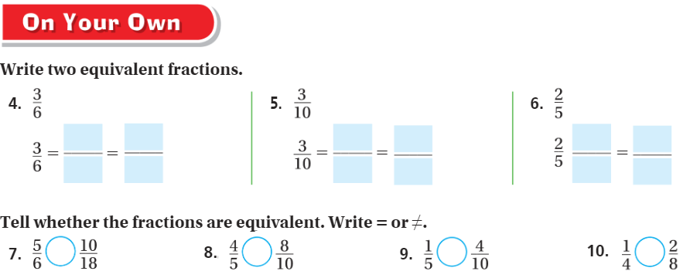
pg. 335

Slide 14
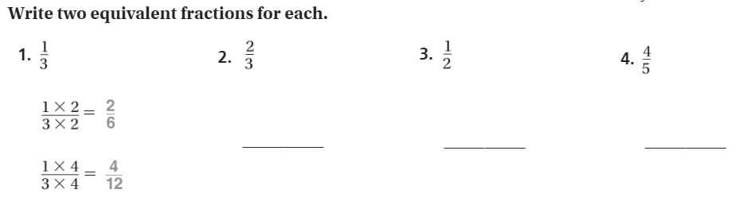
The Friday Quiz – Pg. 337

Slide 15
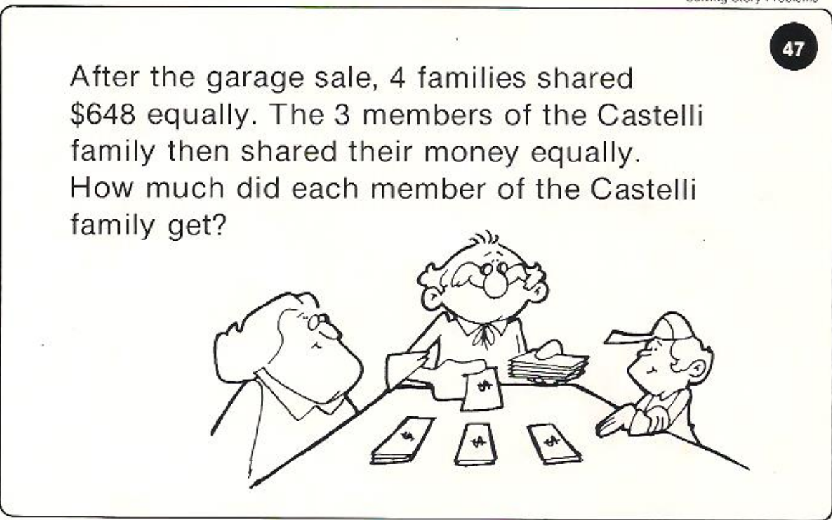
Calculator Problem

Slide 16
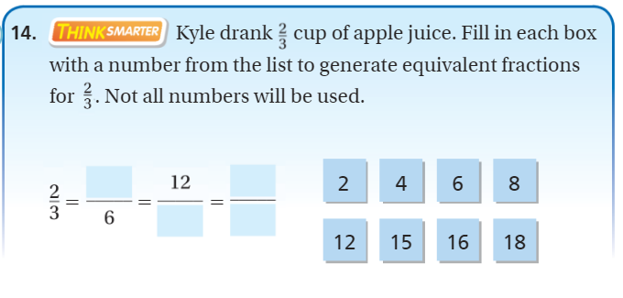
Exit Ticket – pg. 336

