Slide 1

Chapter 6
Lesson 6.3

Slide 2
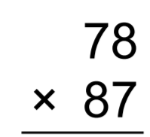

From Earlier. Get this right.

Slide 3
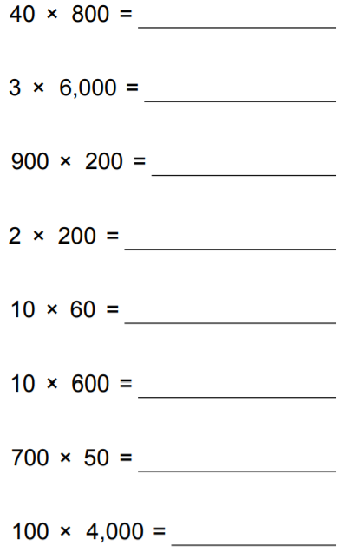
Fluency

Slide 4

Make a complete set.
Put them all in the bag.

Slide 5
Add Fractions

Slide 6



Slide 7



Slide 8



Slide 9

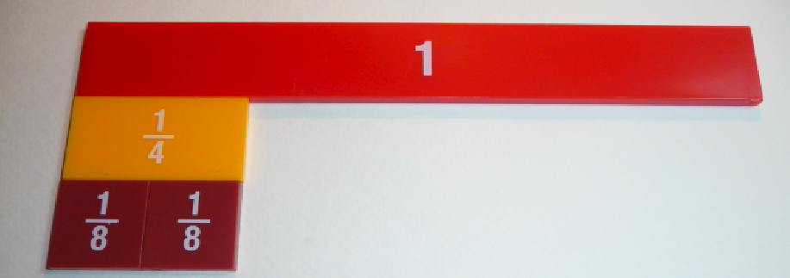

Slide 10



Slide 11

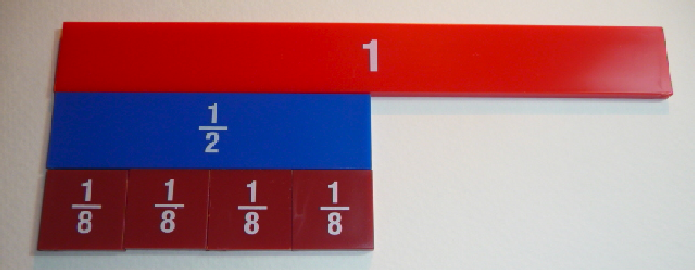

Slide 12



Slide 13



Slide 14



Slide 15
I can make fractions
in simplest form
Will you be able to do this?
Yes! | Maybe | No

Slide 16
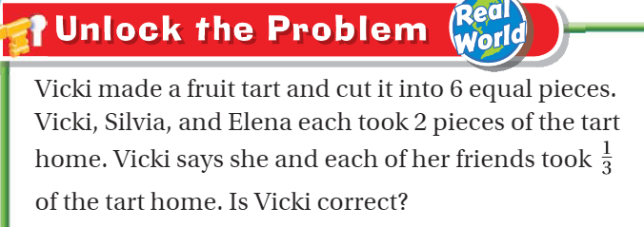
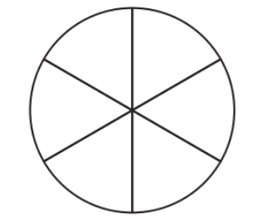
Teach and Reteach – pg. 339

Slide 17
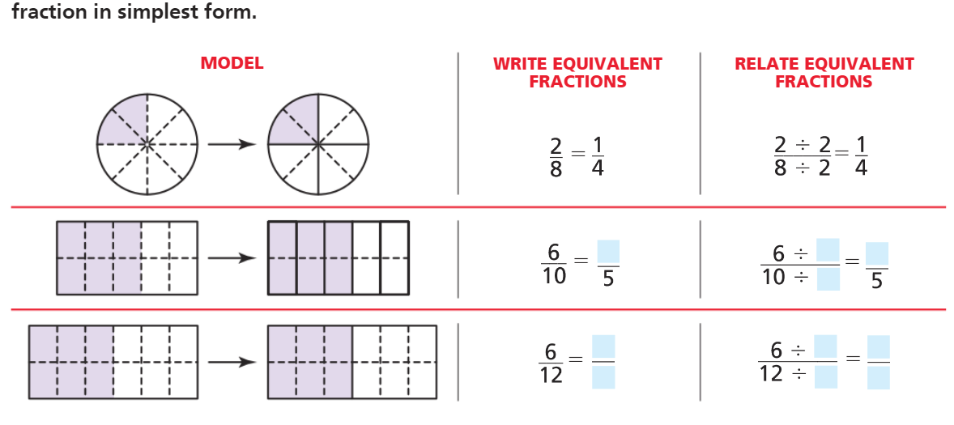
Pg. 340

Slide 18
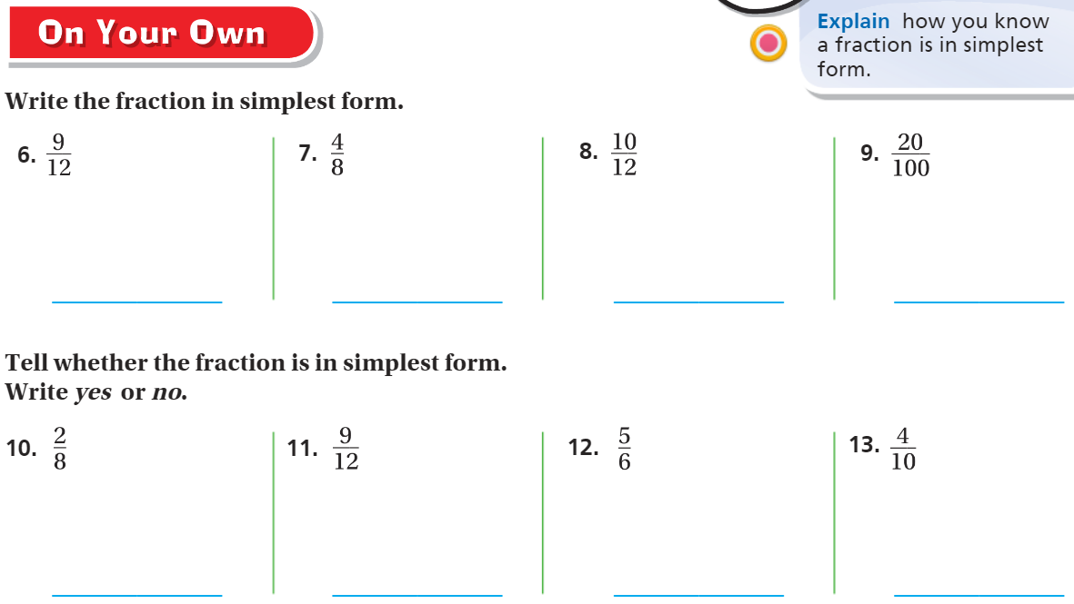
pg. 341

Slide 19
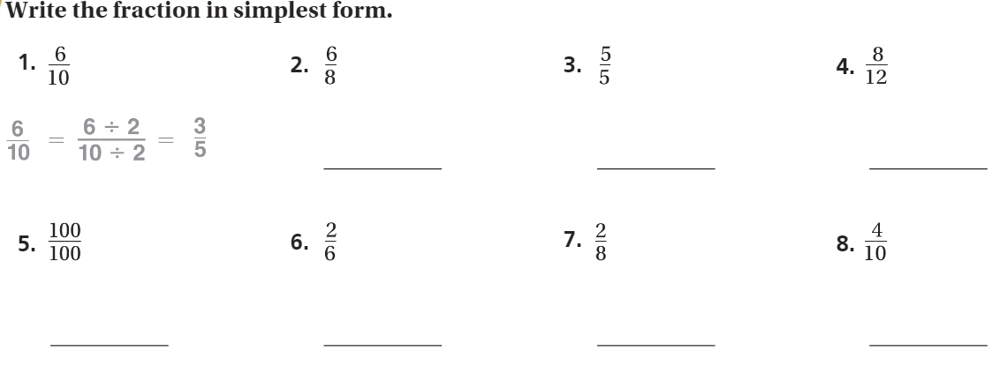
The Friday Quiz – Pg. 343

Slide 20
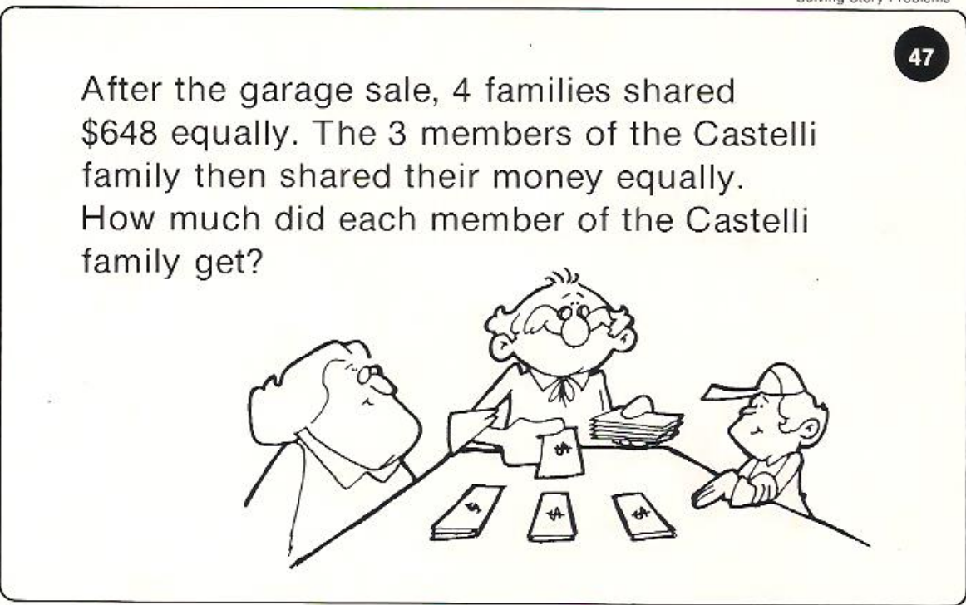
Calculator Problem

Slide 21
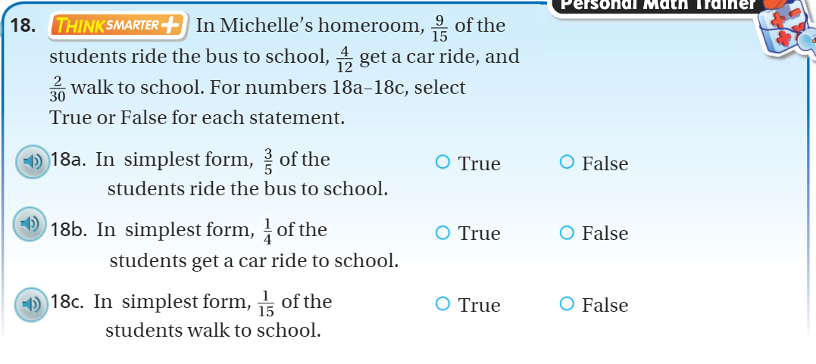
Exit Ticket – pg. 342

