Slide 1

Chapter 6
Lesson 6.4

Slide 2

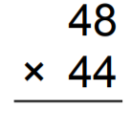
Who can do this?

Slide 3

Fluency
Division is the inverse of multiplication

Slide 4

Make a complete set.
Put them all in the bag.

Slide 5
Subtract Fractions

Slide 6



Slide 7



Slide 8



Slide 9



Slide 10



Slide 11



Slide 12



Slide 13



Slide 14



Slide 15



Slide 16
I can make common denominators
Will you be able to do this?
Yes! | Maybe | No

Slide 17

Teach and Reteach – pg.346

Slide 18

Pg. 346

Slide 19
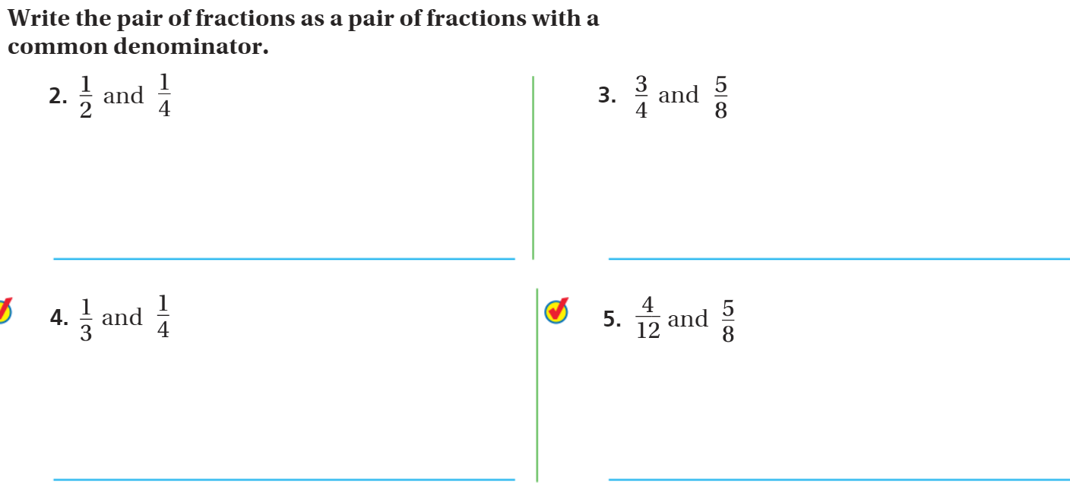
pg. 347

Slide 20
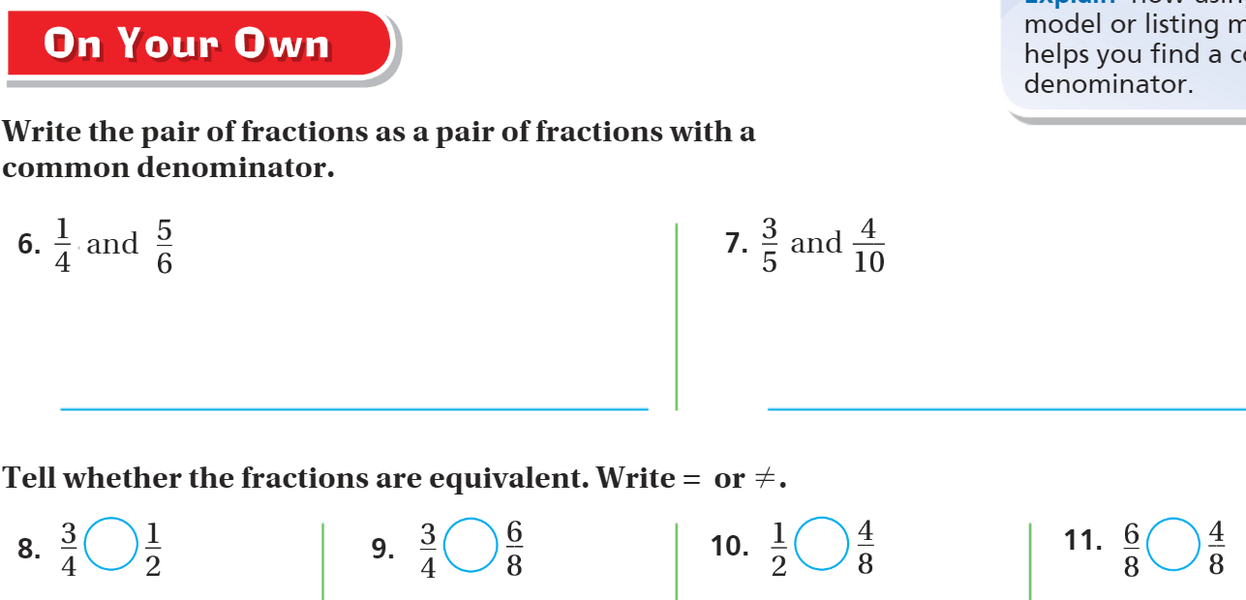
Pg. 347

Slide 21
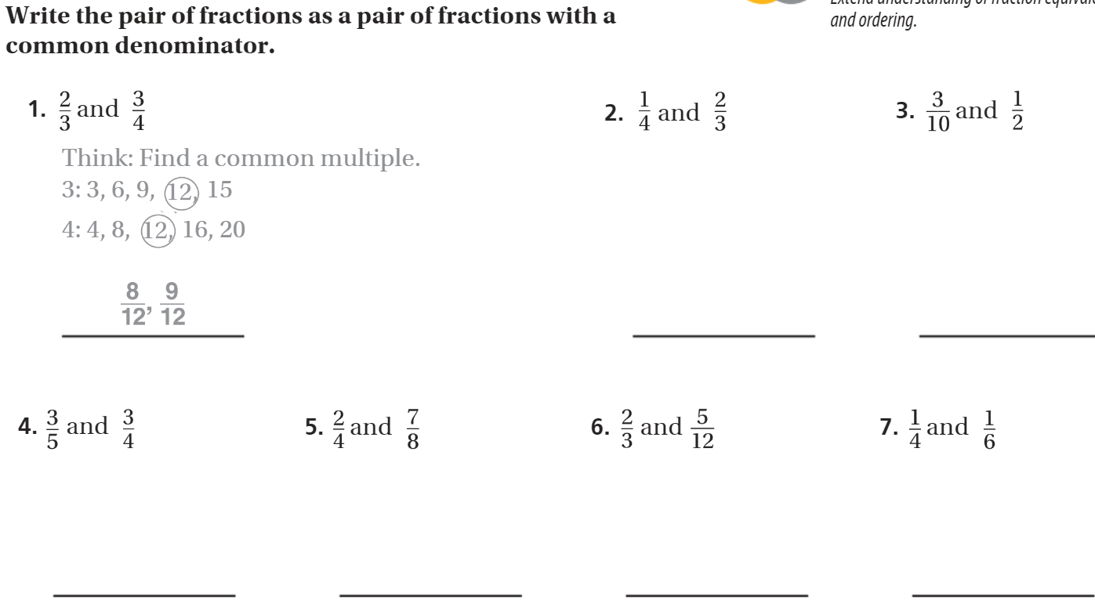
The Friday Quiz – Pg. 349

Slide 22
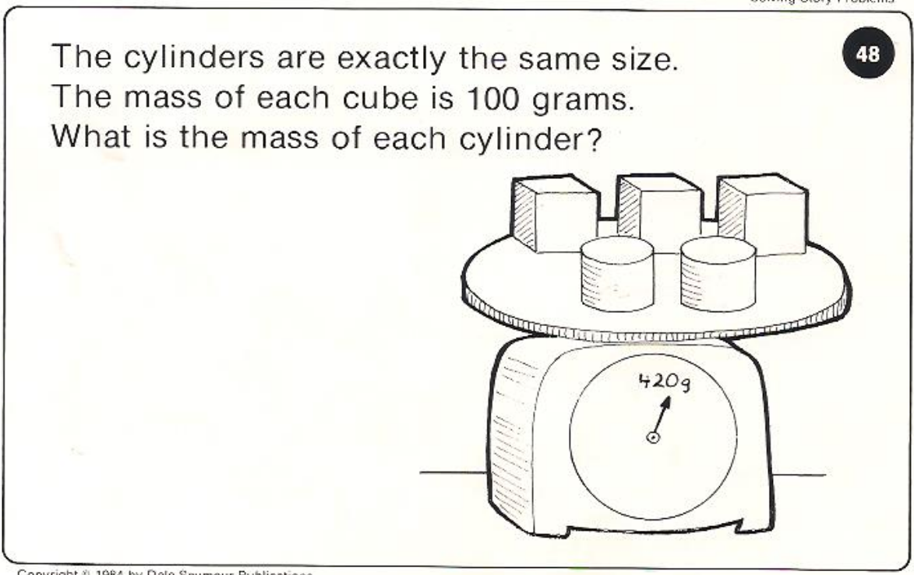
Calculator Problem

Slide 23
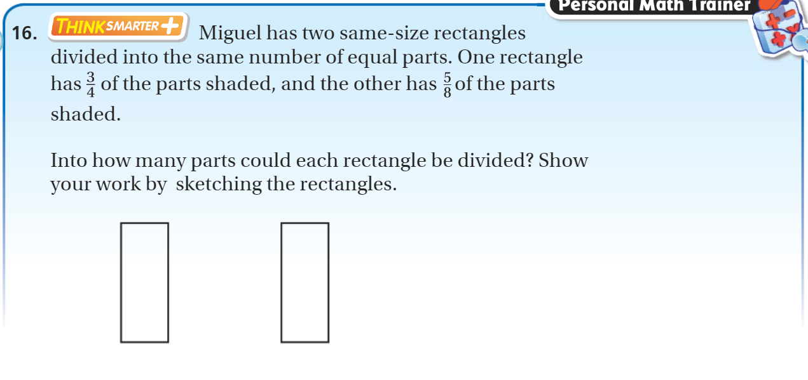
Exit Ticket – pg. 348

