Slide 1

Chapter 6
Lesson 6.6

Slide 2
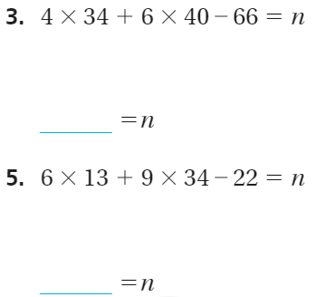
From Earlier…

Slide 3
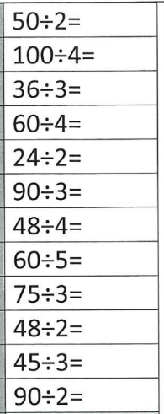
Fluency
Division is the inverse of multiplication

Slide 4
Reduce
(Simplify) Fractions

Slide 5
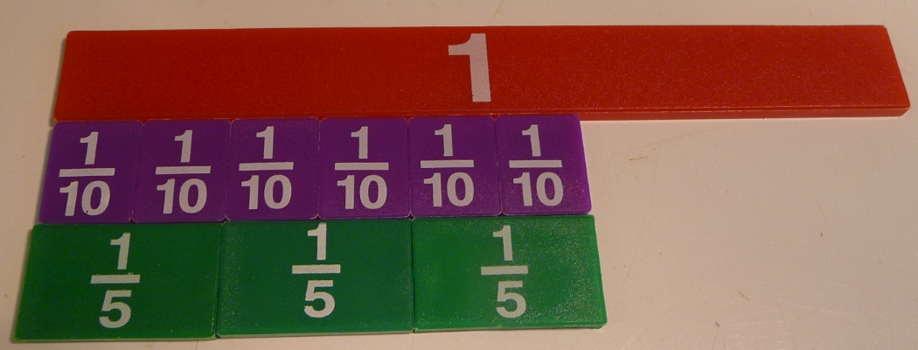
Six Tenths

Slide 6
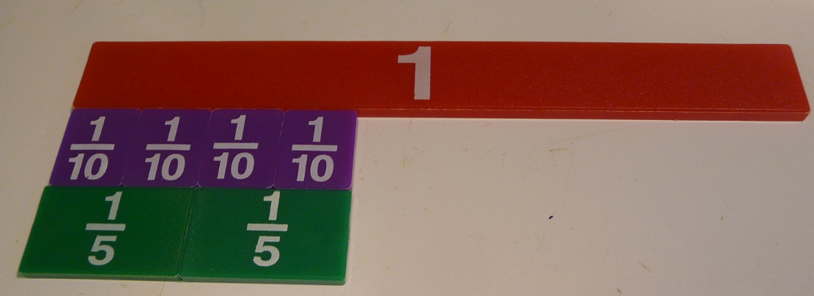
Four Tenths

Slide 7
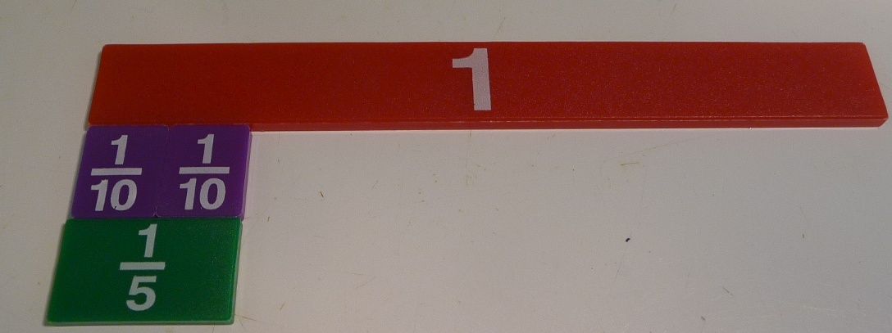
Two Tenths

Slide 8
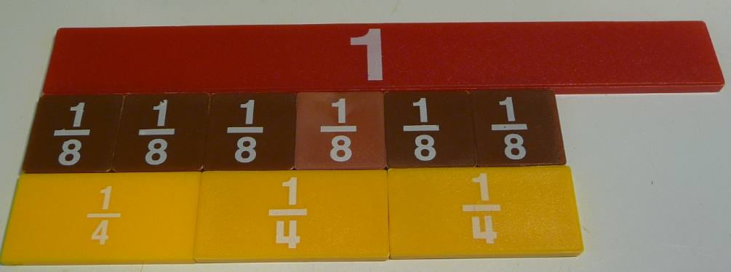
Six Eighths

Slide 9
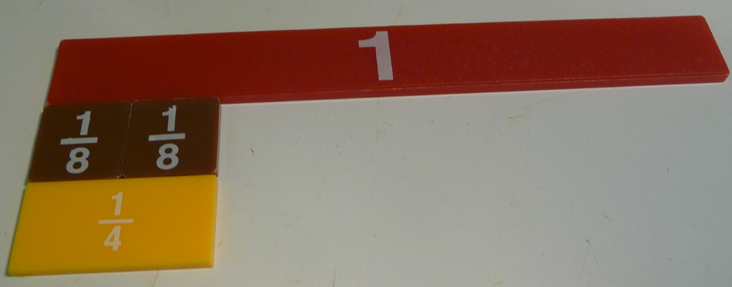
Two Eighths

Slide 10
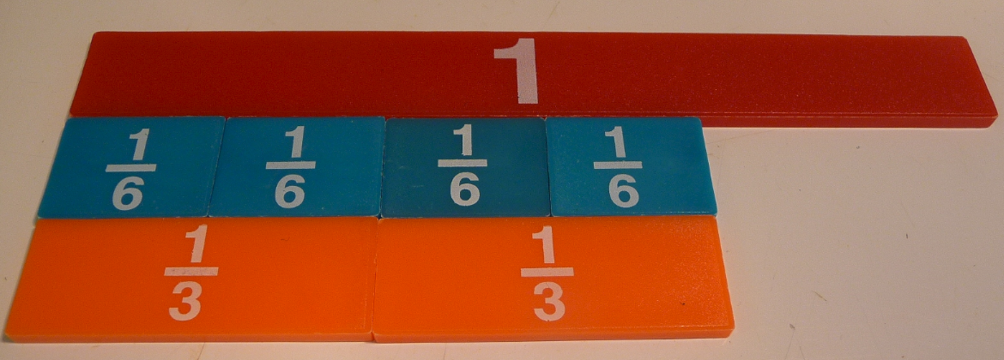
Four Sixths

Slide 11
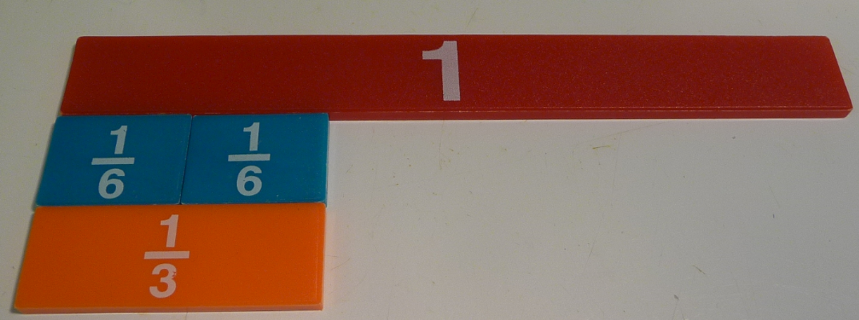
Two Sixths

Slide 12
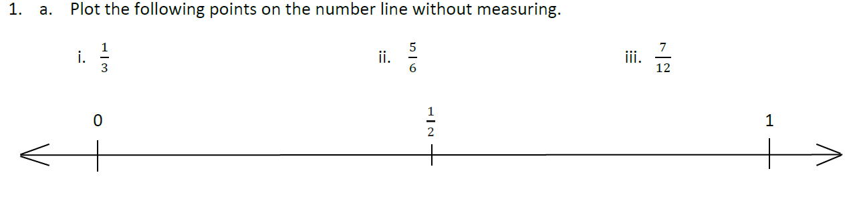
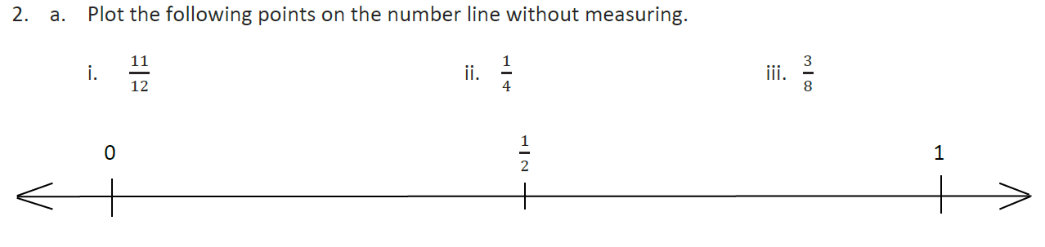
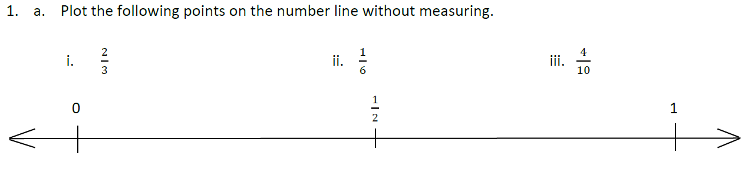

Slide 13
I can compare fractions using benchmarks
Will you be able to do this?
Yes! | Maybe | No

Slide 14
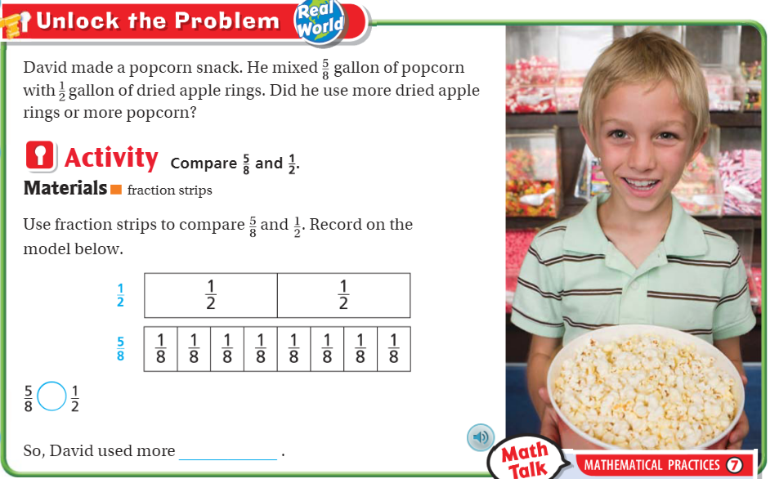
Teach and Reteach – pg.359

Slide 15
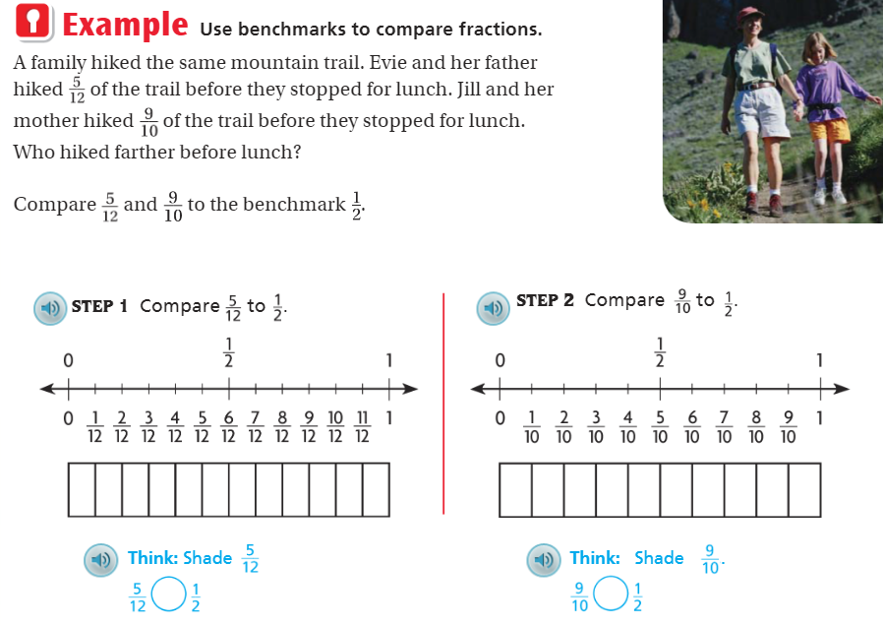
Teach and Reteach Pg.360

Slide 16
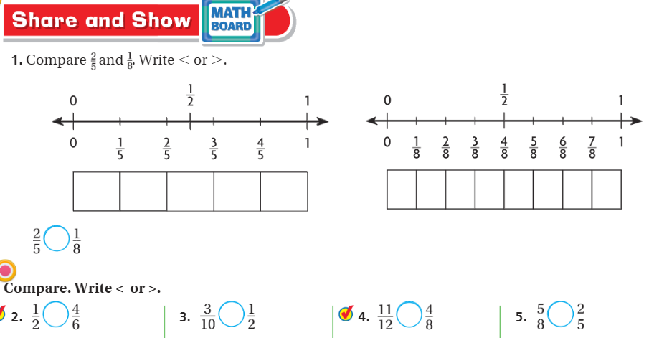
Draw a visual representation pg. 361

Slide 17
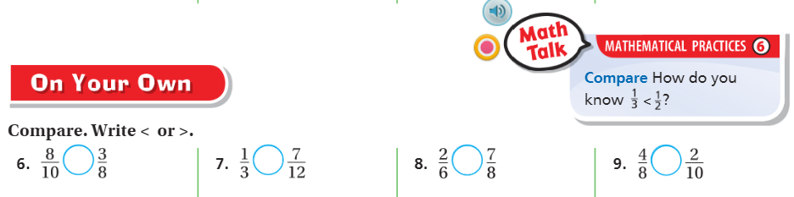
Pg. 361

Slide 18
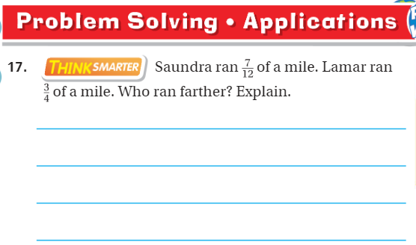
Pg. 362

Slide 19
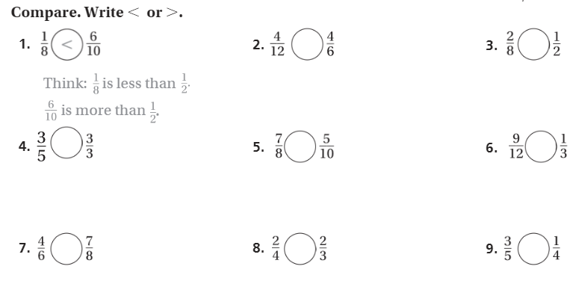
The Friday Quiz – Pg. 363

Slide 20
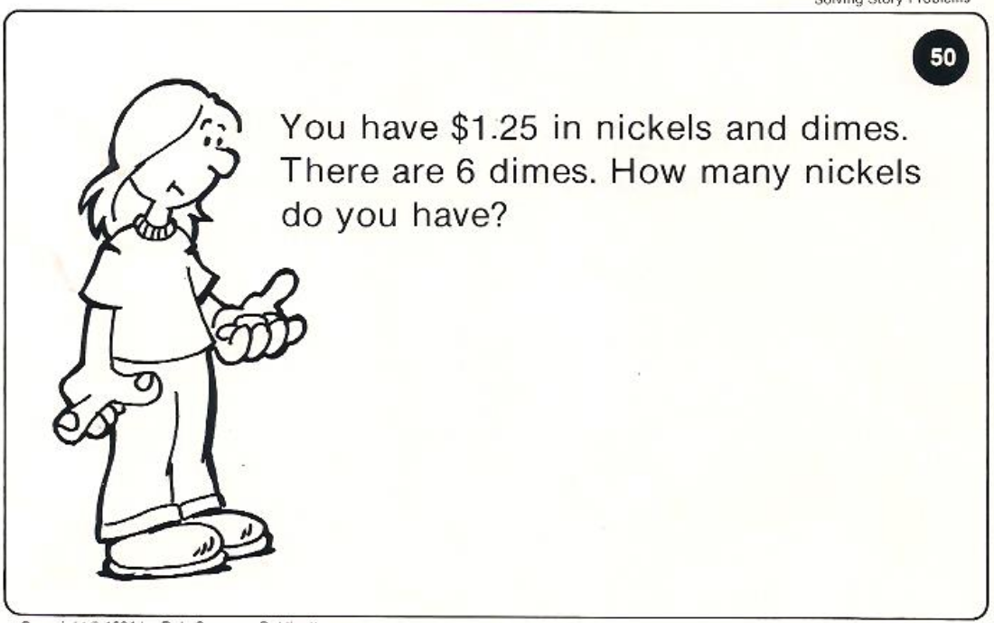
Calculator Problem

Slide 21
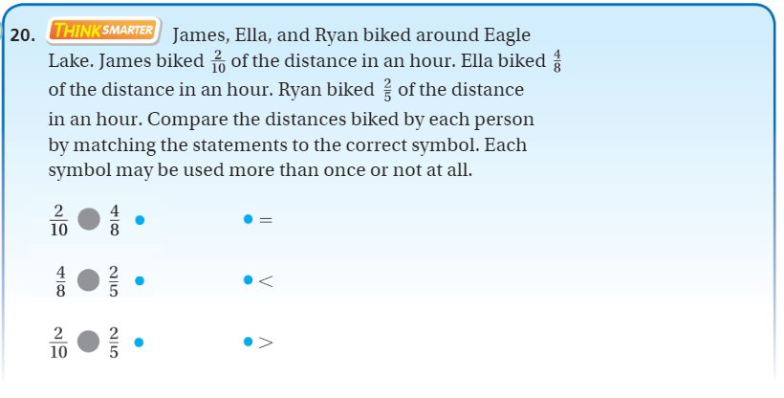
Exit Ticket – pg. 362

