Slide 1

Chapter 6
Lesson 6.7

Slide 2
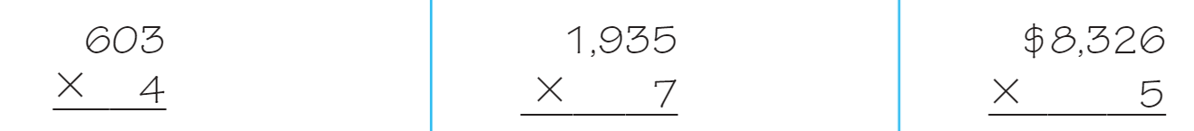
From earlier…

Slide 3
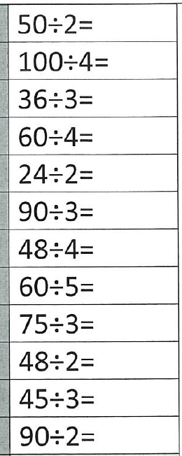
Fluency
Division is the inverse of multiplication

Slide 4
Reduce
(Simplify) Fractions

Slide 5
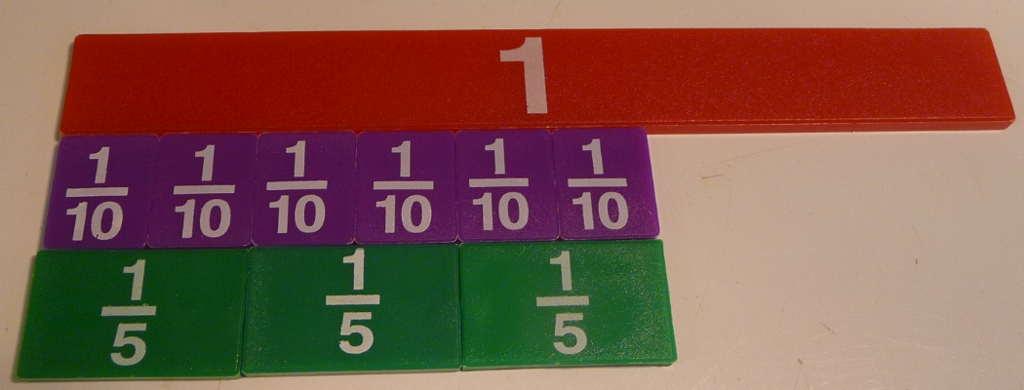
Six Tenths

Slide 6
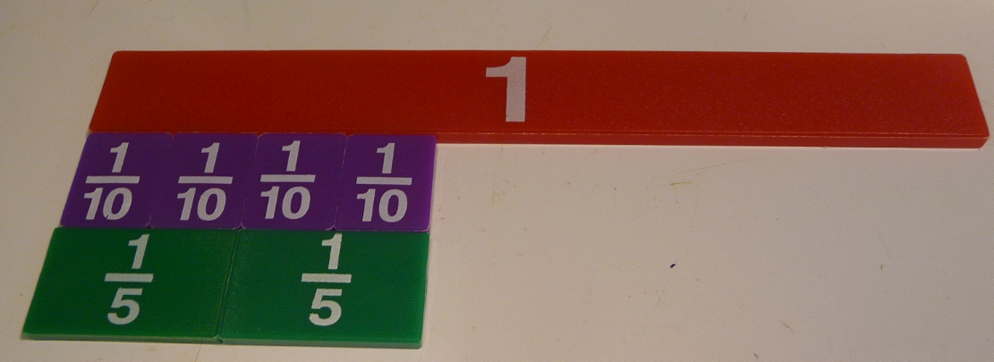
Four Tenths

Slide 7
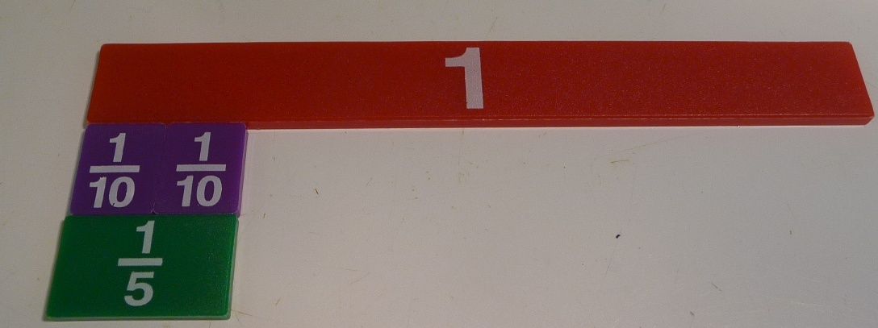
Two Tenths

Slide 8
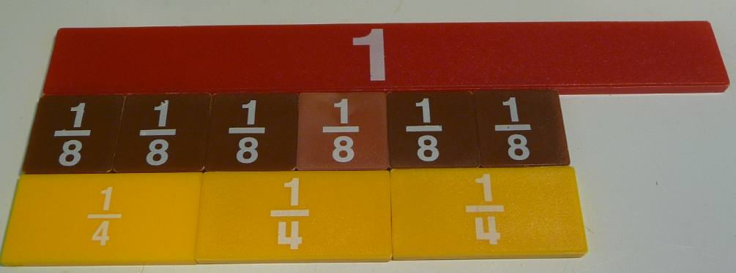
Six Eighths

Slide 9
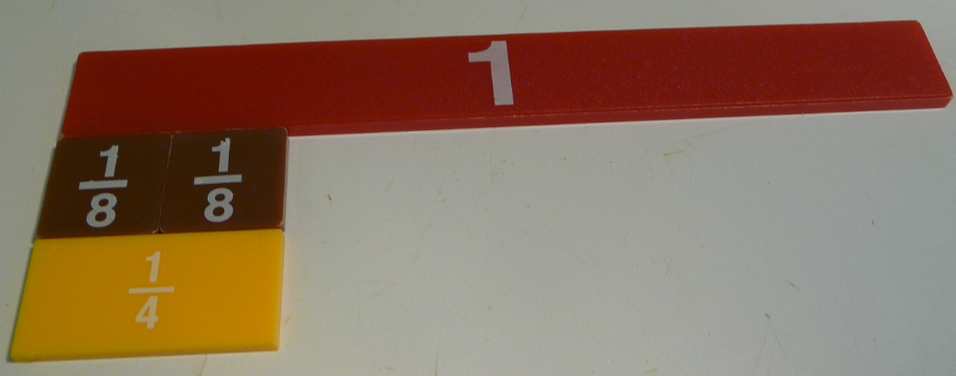
Two Eighths

Slide 10
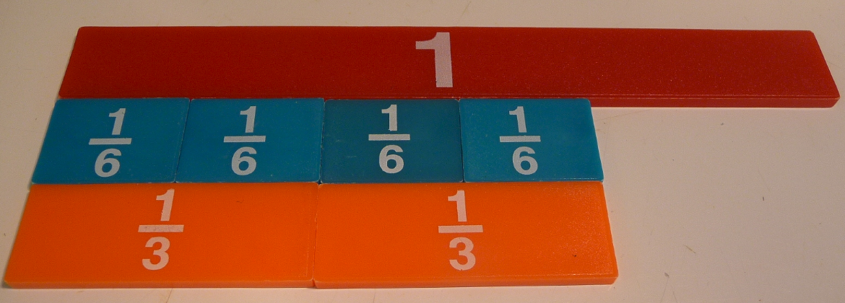
Four Sixths

Slide 11
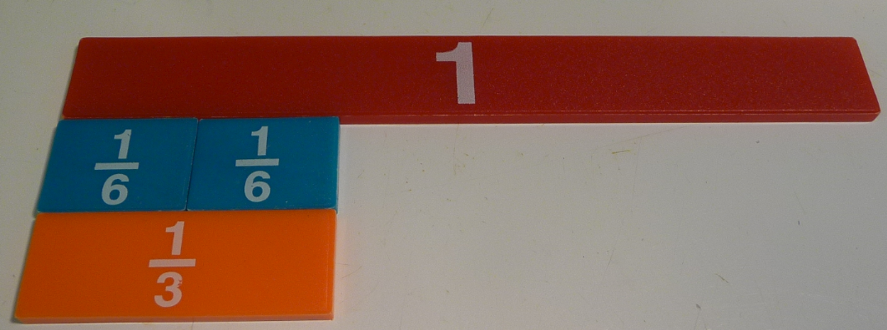
Two Sixths

Slide 12
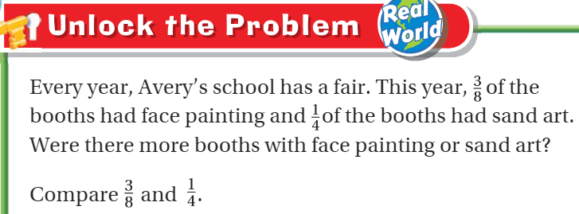
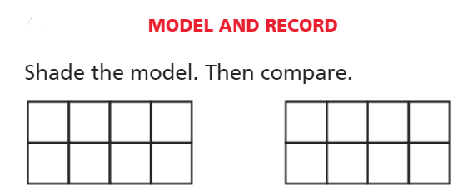
Teach and Reteach - Pg. 365

Slide 13
I can compare fractions using common denominators
Will you be able to do this?
Yes! | Maybe | No

Slide 14
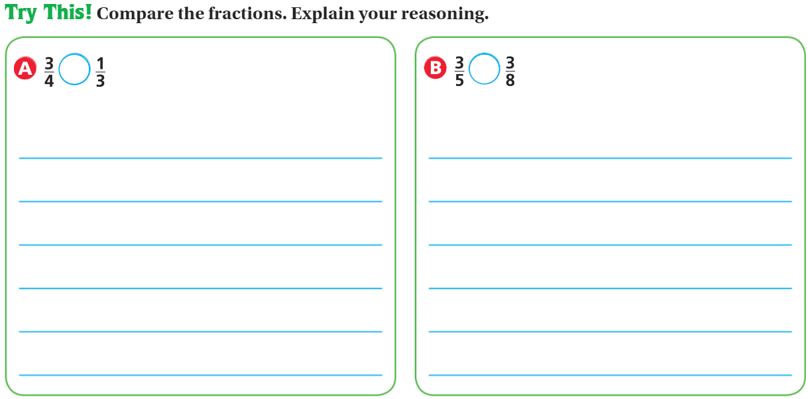
Teach and Reteach – pg.366

Slide 15
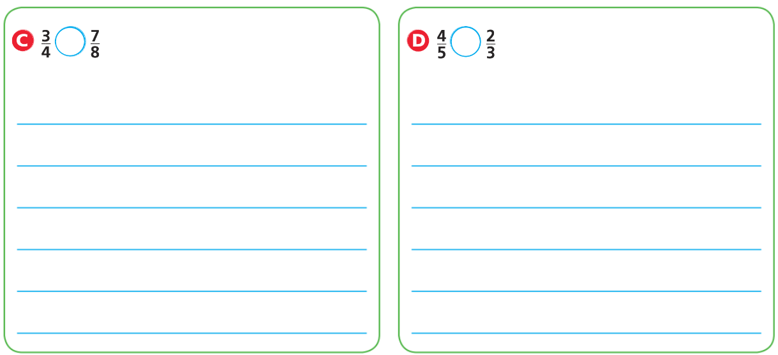
Explain your thinking - Pg.366

Slide 16
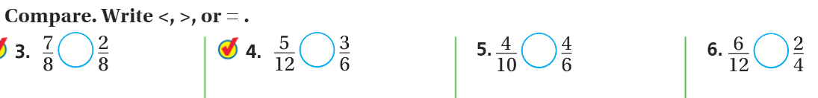
Model your thinking – pg. 367

Slide 17
Model your thinking
Pg. 367

Slide 18
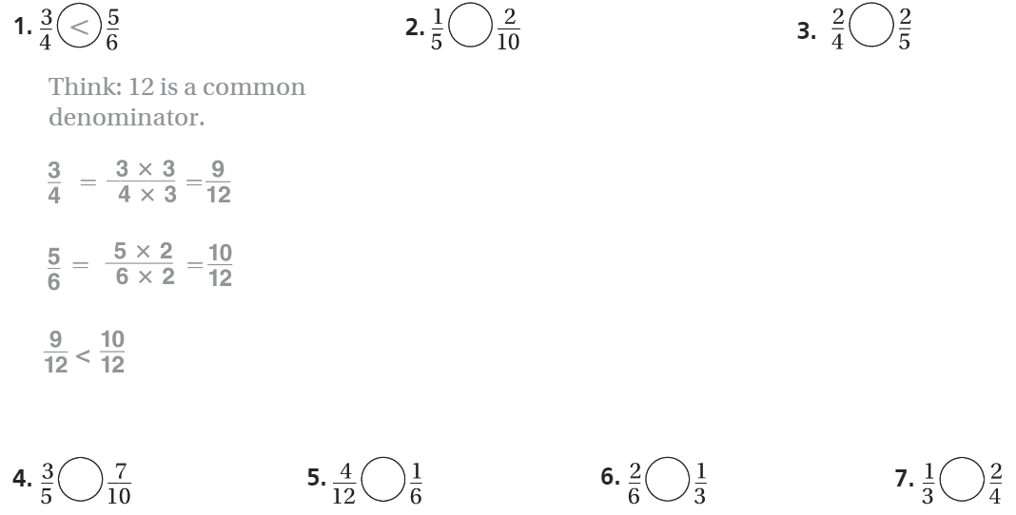
The Friday Quiz – Pg. 369

Slide 19
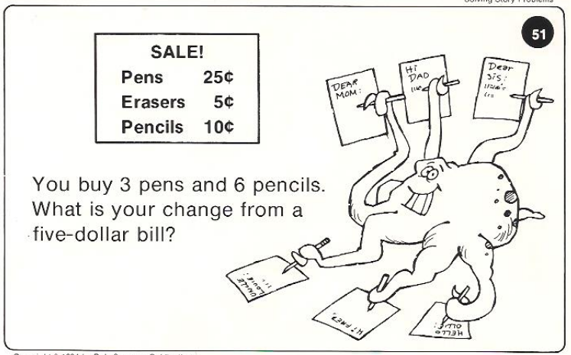
Calculator Problem

Slide 20
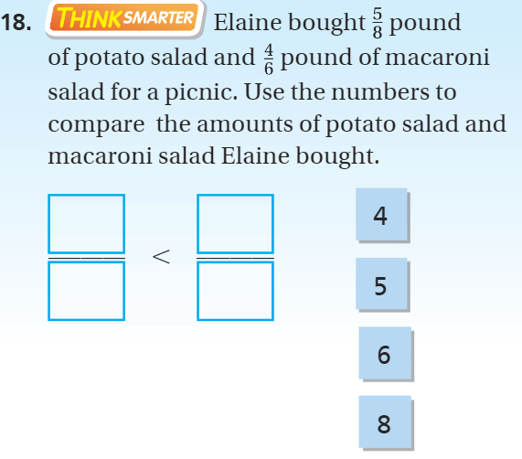
Exit Ticket – pg. 368

