Slide 1

Chapter 6
Lesson 6.8

Slide 2


From Earlier…

Slide 3

Fluency
Division is the inverse of multiplication

Slide 4
Multiply Fractions

Slide 5



Slide 6



Slide 7



Slide 8

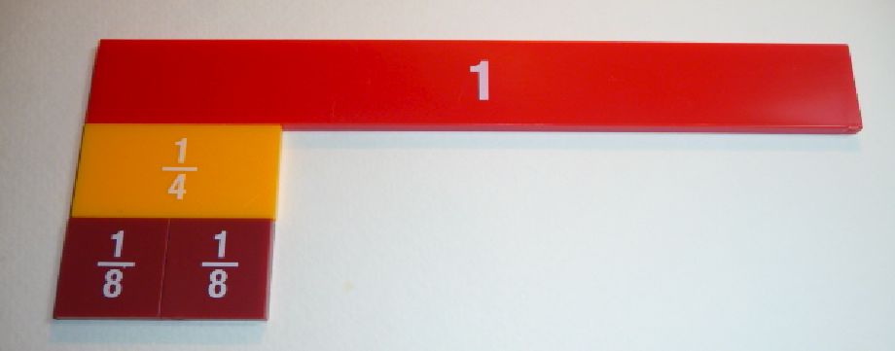

Slide 9



Slide 10



Slide 11



Slide 12



Slide 13

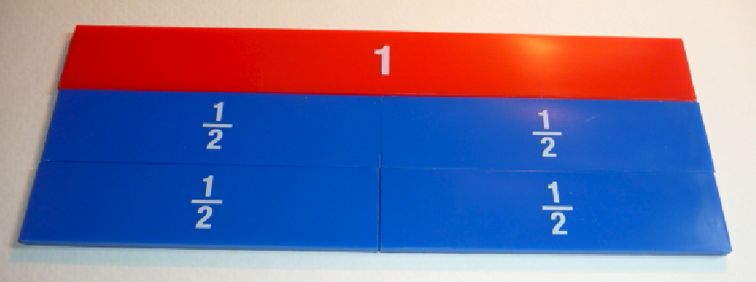

Slide 14



Slide 15



Slide 16

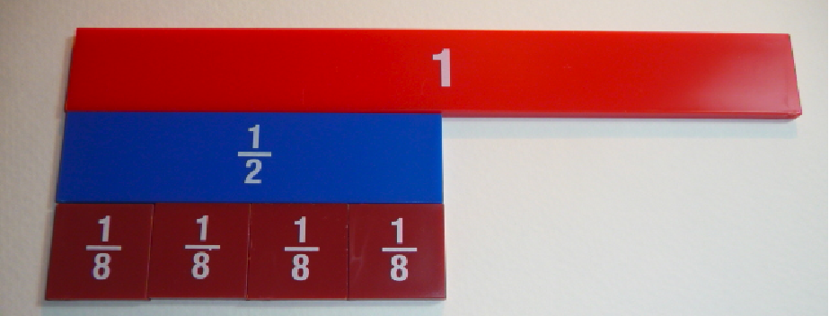

Slide 17
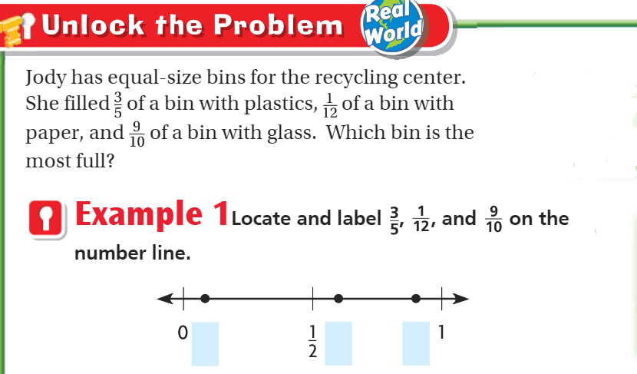
Teach and Reteach - Pg. 371

Slide 18
I can compare and order fractions
Will you be able to do this?
Yes! | Maybe | No

Slide 19

Teach and Reteach – pg.372

Slide 20
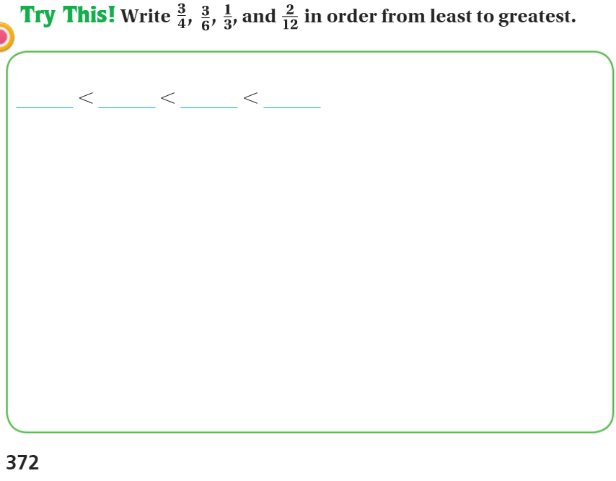
Explain your thinking - Pg.372

Slide 21
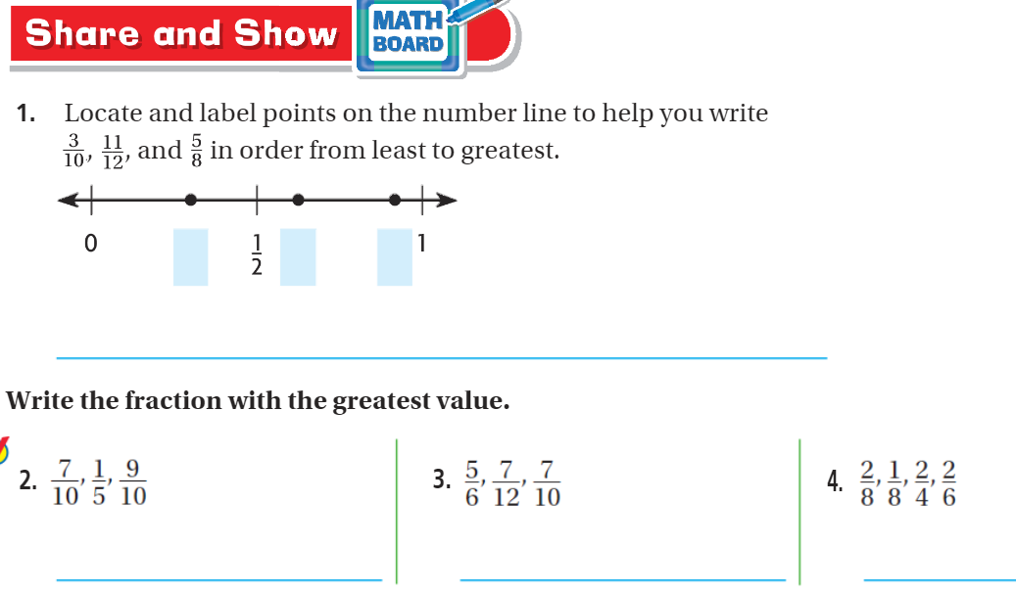
Model your thinking – pg. 373

Slide 22

On your own -
Pg. 373

Slide 23
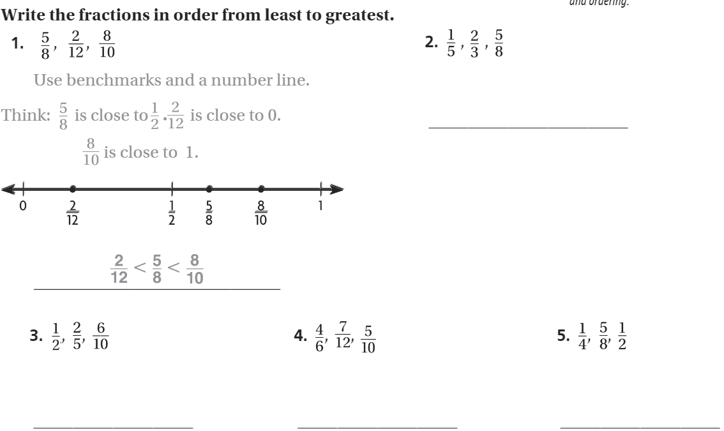
The Friday Quiz – Pg. 375

Slide 24
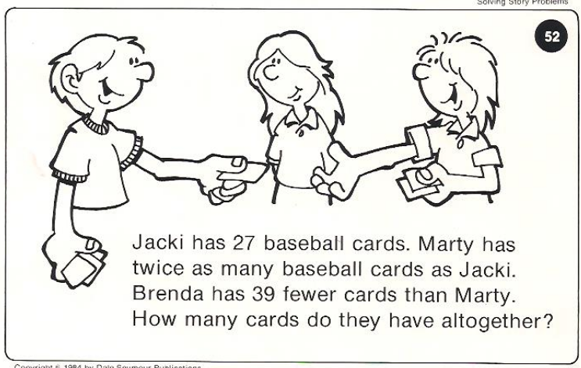
Calculator Problem

Slide 25
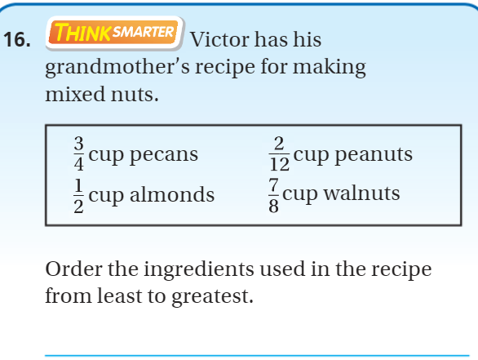
Exit Ticket – pg. 374

