Slide 1

Chapter 7
Lesson 7.1

Slide 2
From Earlier…
Make factor rainbows
18 | 24
2 | 51

Slide 3
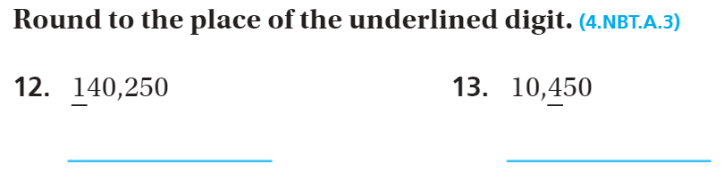
From Earlier…

Slide 4
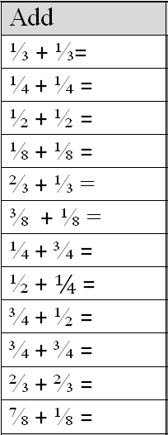
Fluency
Imagine the fraction strips

Slide 5
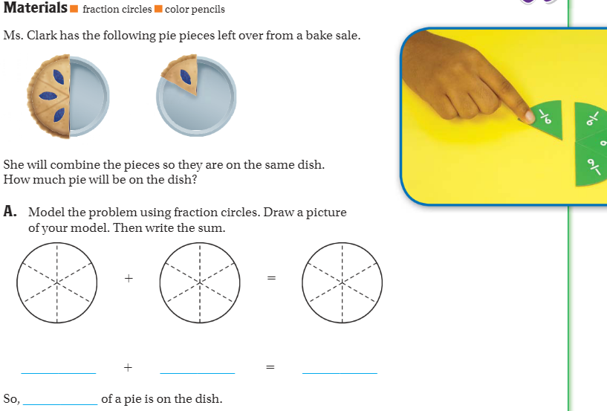
Teach and Reteach - Pg. 385

Slide 6
I can add and subtract fraction models
Will you be able to do this?
Yes! | Maybe | No

Slide 7
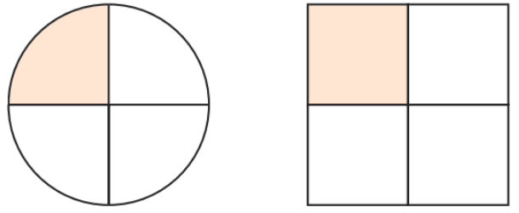
If I were to add these two pieces together, what would I get?

Slide 8
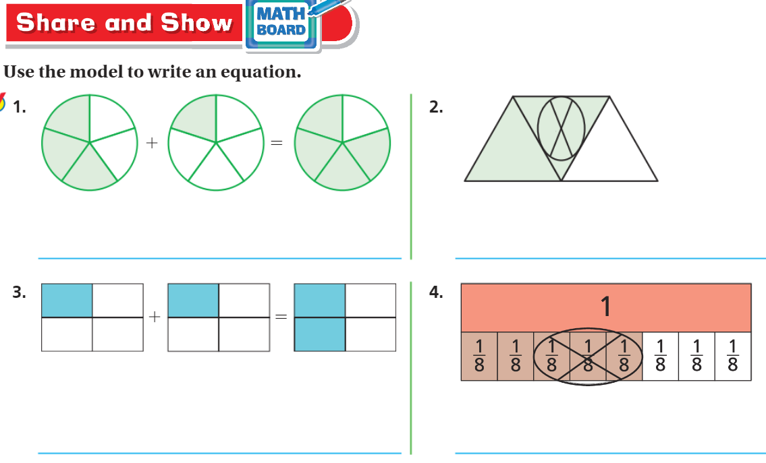
Share and Show- Pg.387

Slide 9
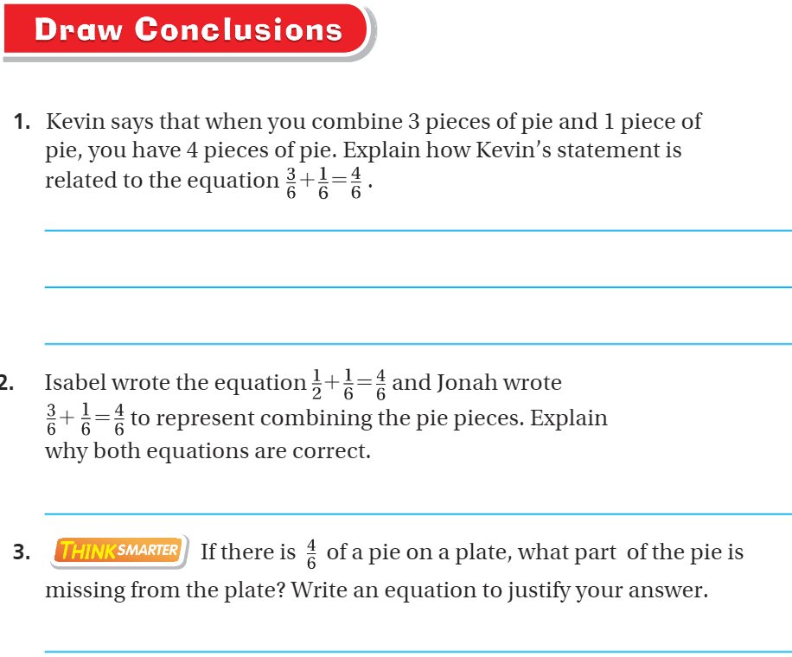
Model with stencils– pg. 386

Slide 10
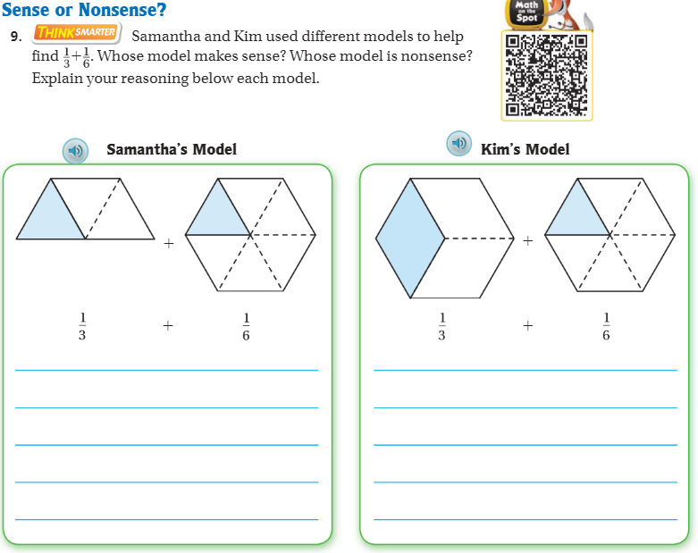
Sense or Nonsense-
Pg. 388

Slide 11
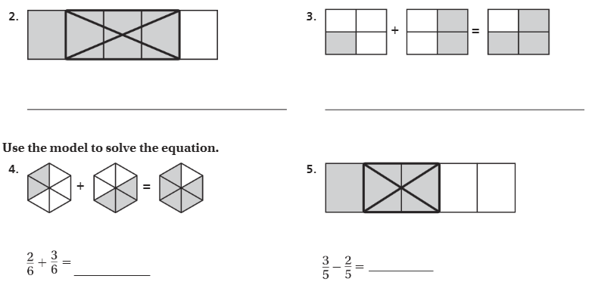
The Friday Quiz – Pg. 389

Slide 12
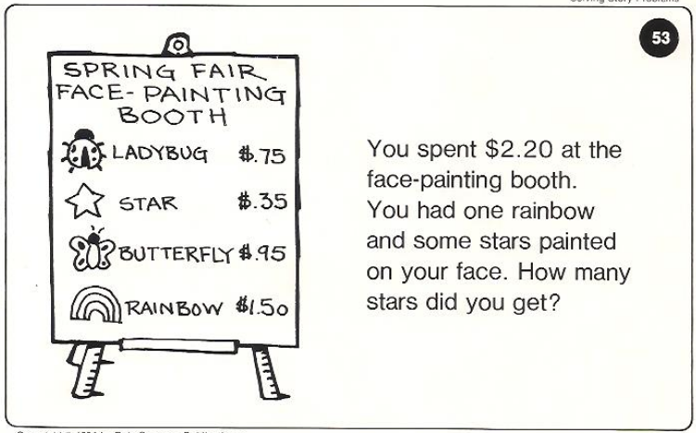
Calculator Problem

Slide 13
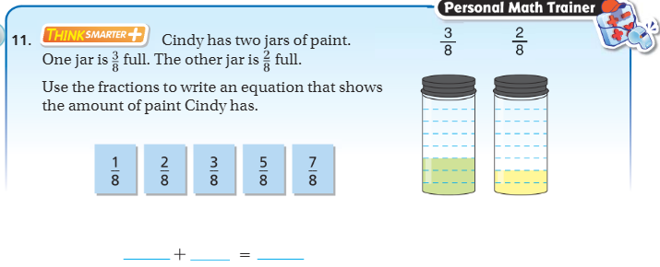
Exit Ticket – pg. 374

