Slide 1

Chapter 7
Lesson 7.2

Slide 2
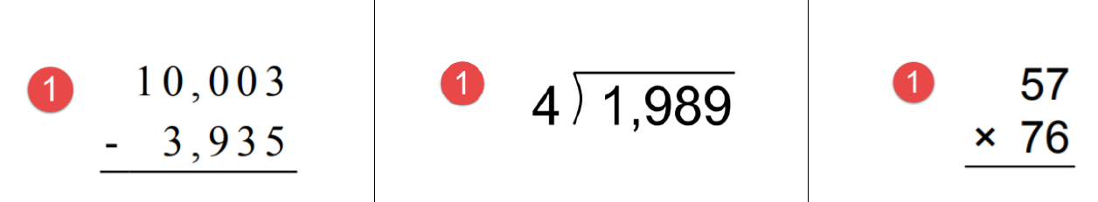
From earlier…

Slide 3
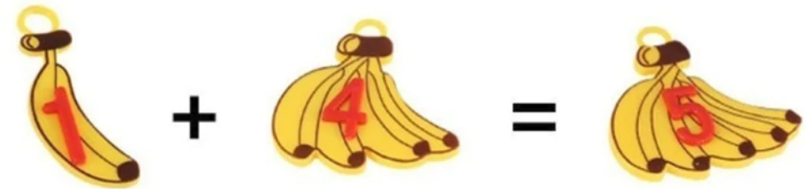


Slide 4
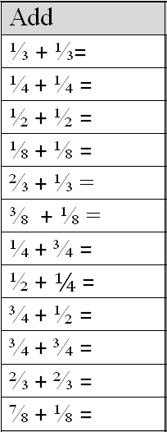
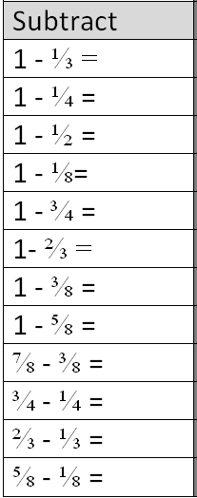
Fluency
Use fraction strips

Slide 5
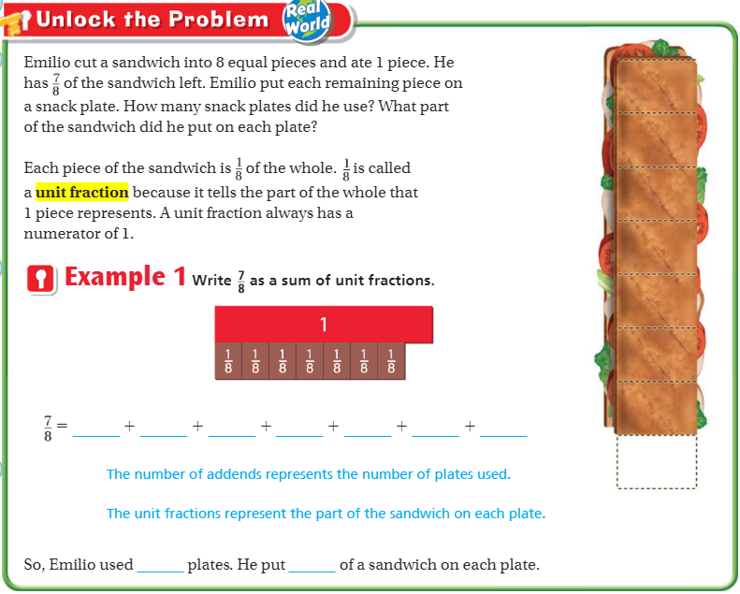
Teach and Reteach - Pg. 391

Slide 6
I can add and subtract fraction models
Will you be able to do this?
Yes! | Maybe | No

Slide 7
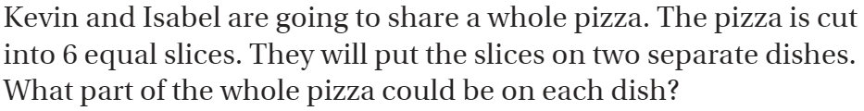
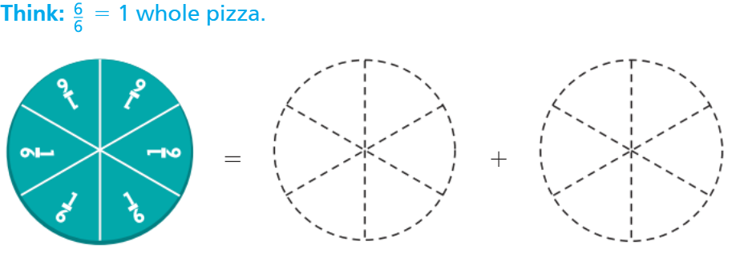
Teach and Reteach - Pg. 392

Slide 8
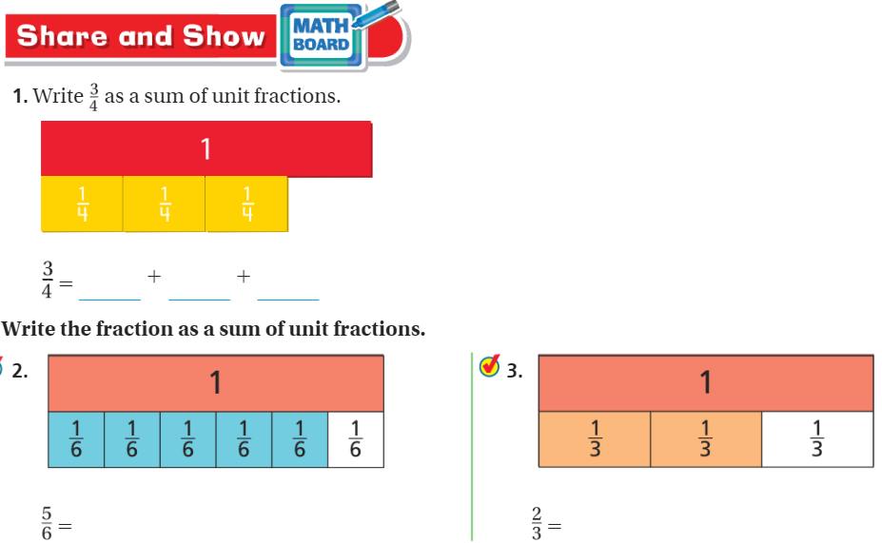
Share and Show- Pg. 393

Slide 9
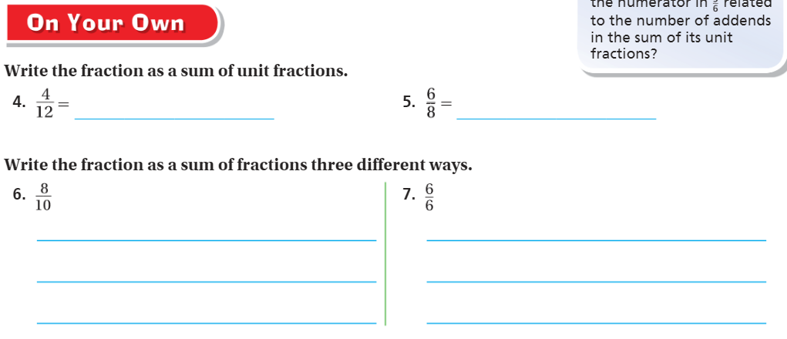
On your own – pg. 393

Slide 10
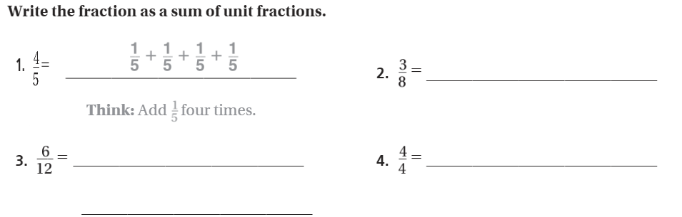
The Friday Quiz – Pg. 395

Slide 11
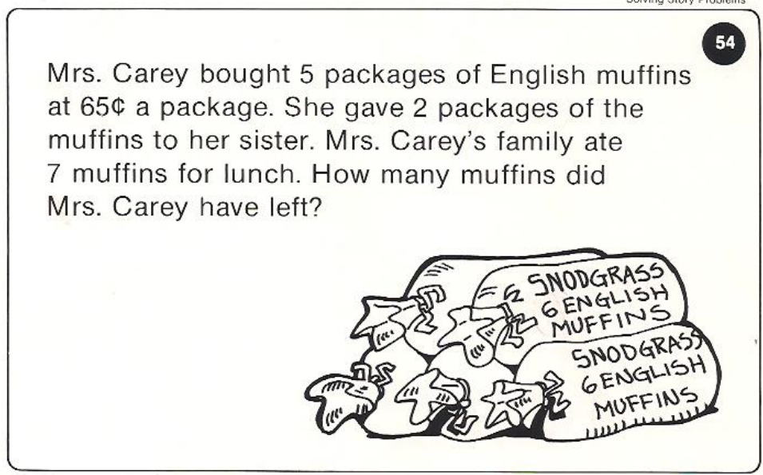
Calculator Problem

Slide 12
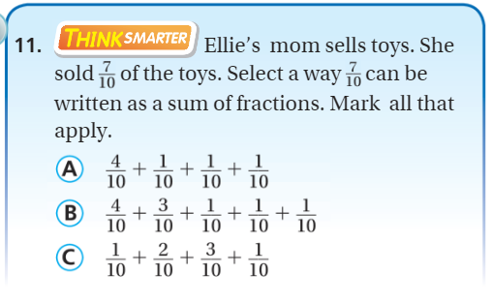
Exit Ticket – pg. 394

