Slide 1

Chapter 7
Lesson 7.3

Slide 2
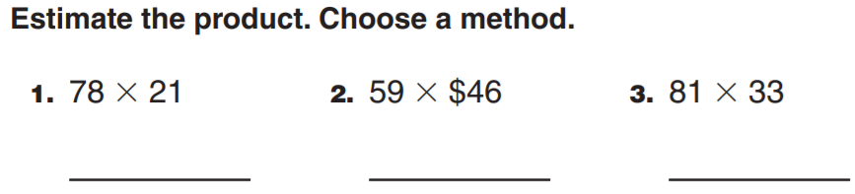
From earlier this year…

Slide 3
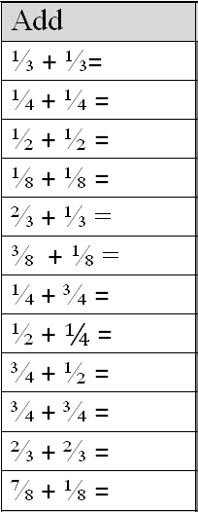
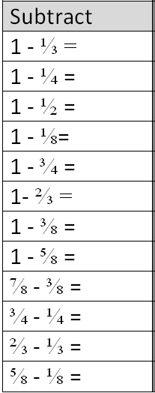
Fluency
Use fraction strips

Slide 4
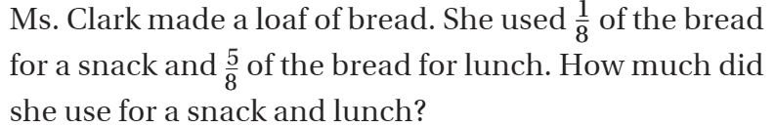
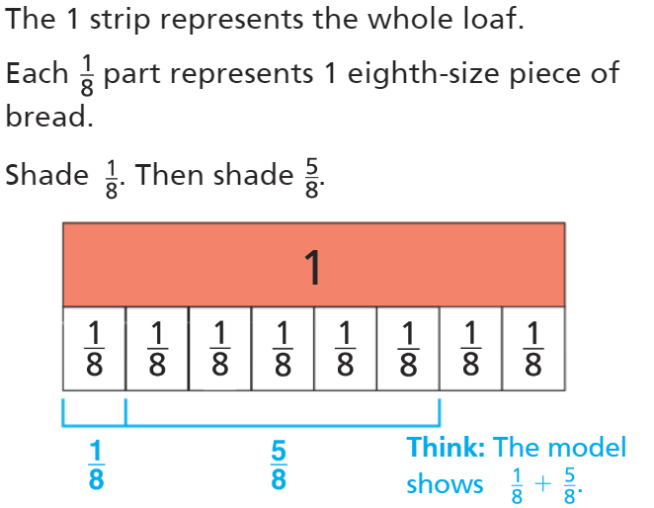
Teach and Reteach - Pg. 397

Slide 5
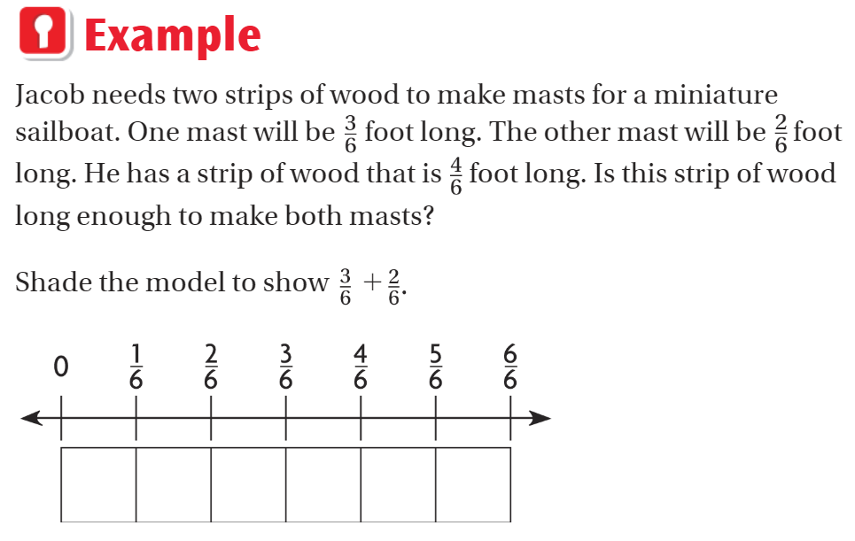
Teach and Reteach - Pg. 398

Slide 6
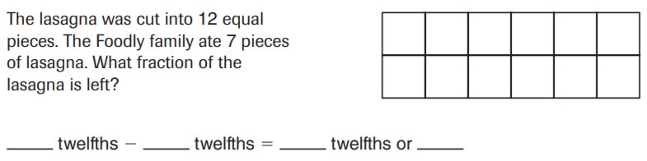
Together…

Slide 7
I can add fraction models
Will you be able to do this?
Yes! | Maybe | No

Slide 8
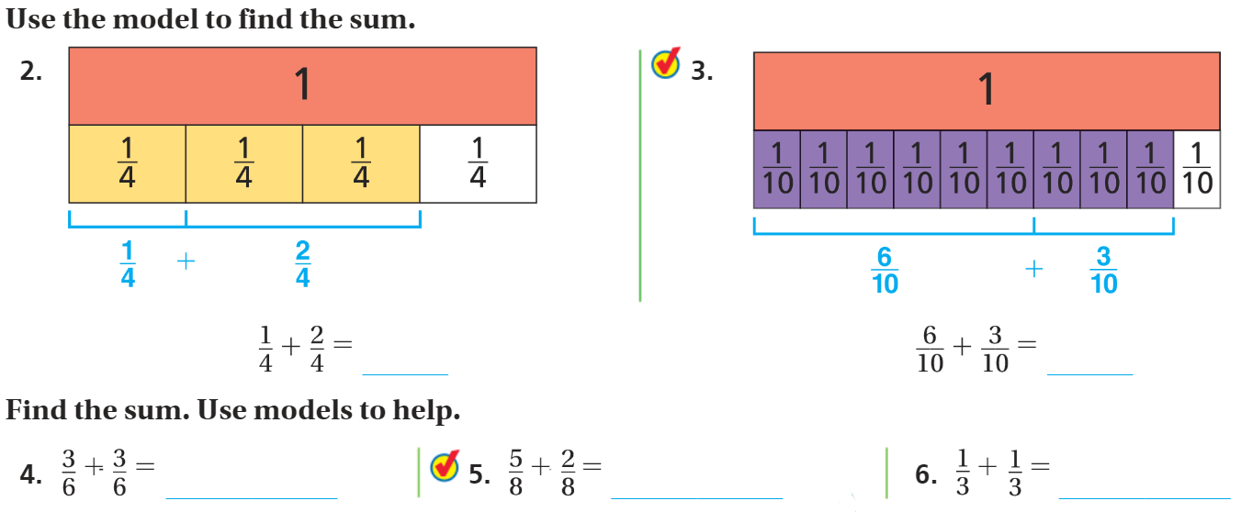
Share and Show- Pg. 399

Slide 9
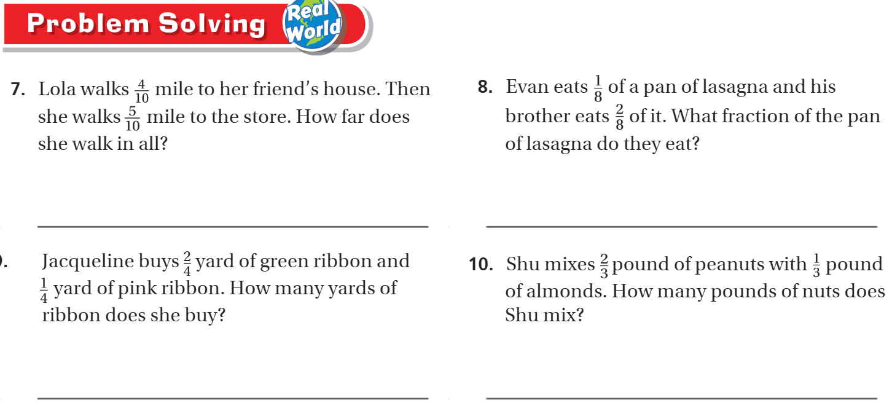
On your own – pg. 401

Slide 10
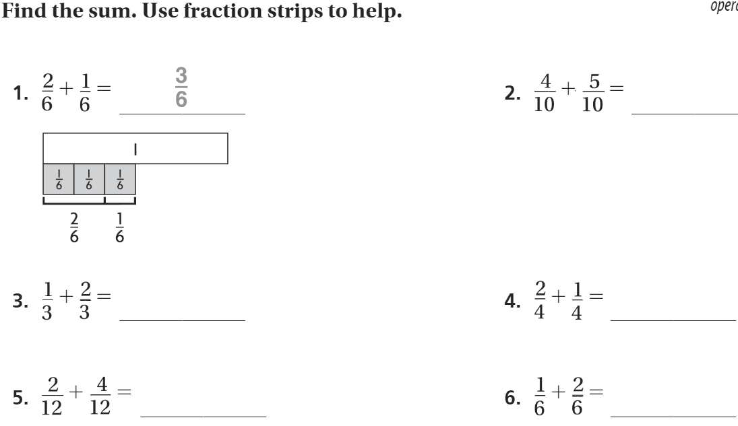
The Friday Quiz – Pg. 401

Slide 11
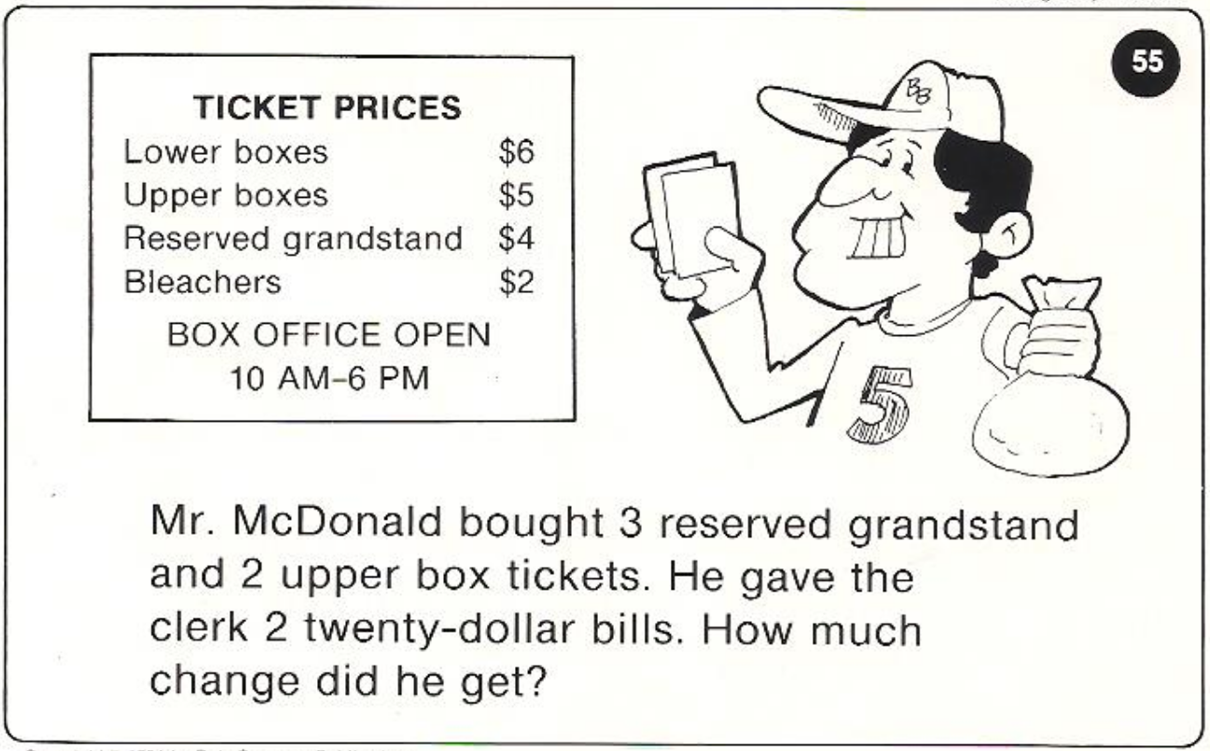
Calculator Problem

Slide 12
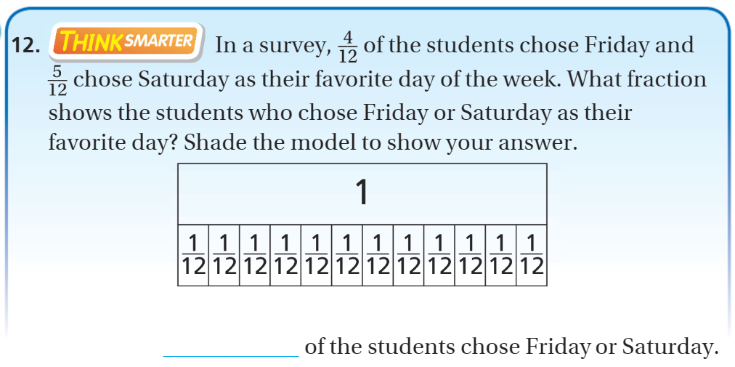
Exit Ticket – pg. 399

