Slide 1

Chapter 7
Lesson 7.4

Slide 2
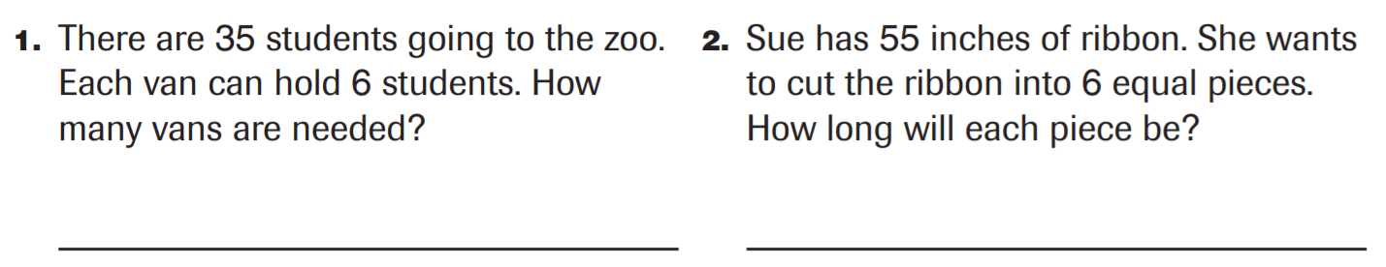
From earlier this year…

Slide 3
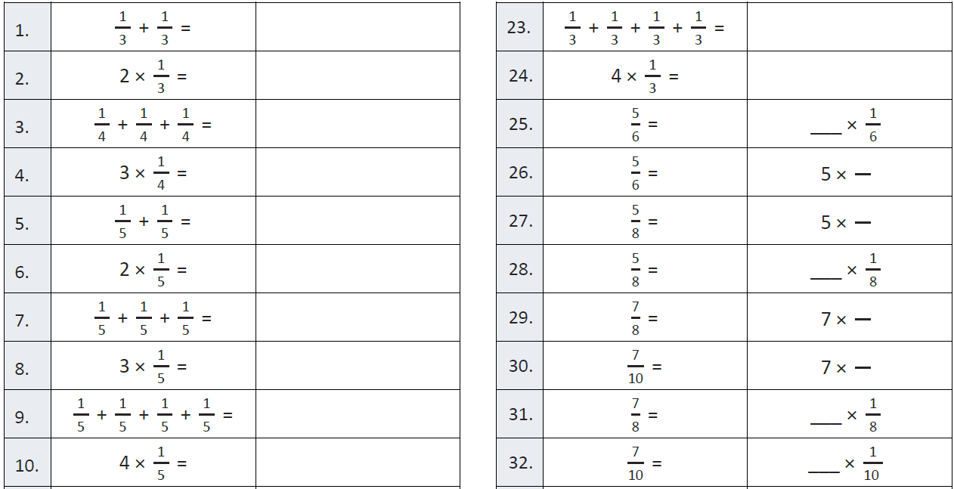
Fluency

Slide 4
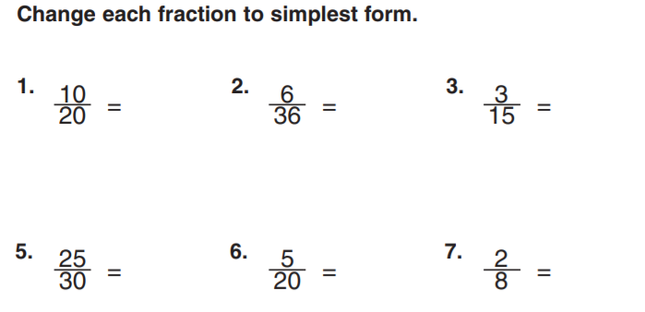
Simplify…

Slide 5
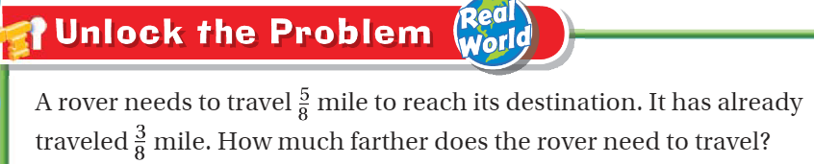
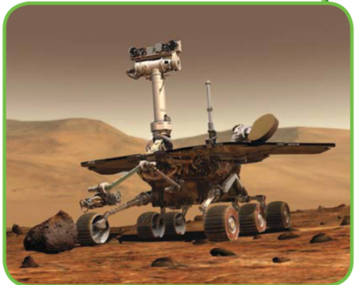
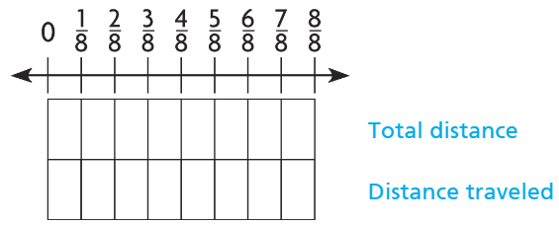
Teach and Reteach - Pg.403

Slide 6
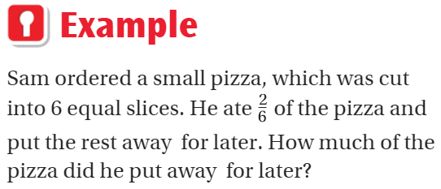
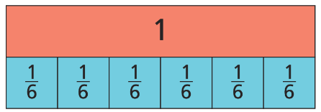
Teach and Reteach - Pg. 404

Slide 7
I can subtract
fraction models
Will you be able to do this?
Yes! | Maybe | No

Slide 8
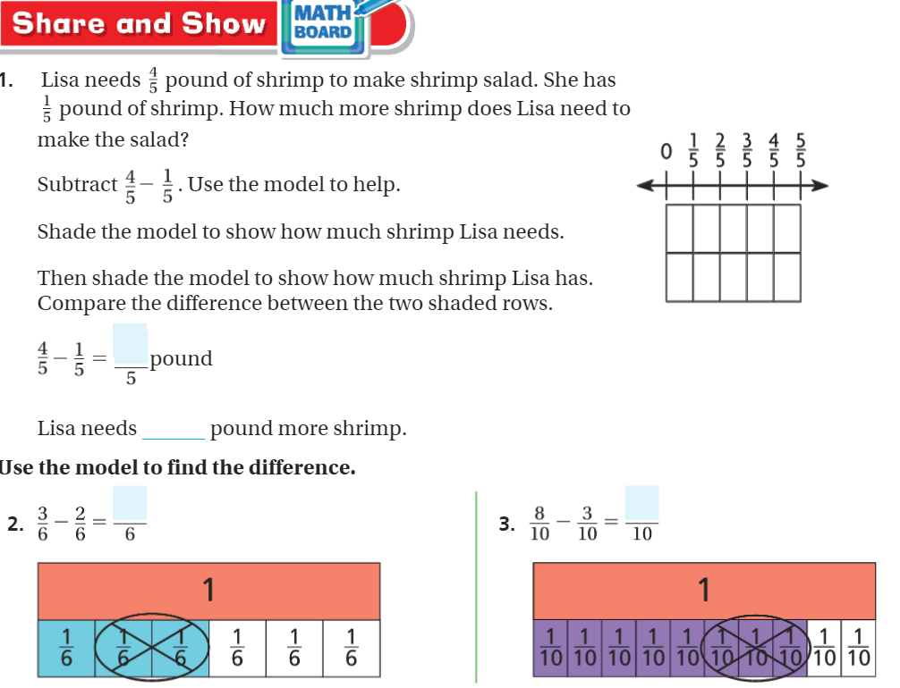
Share and Show- Pg.405

Slide 9
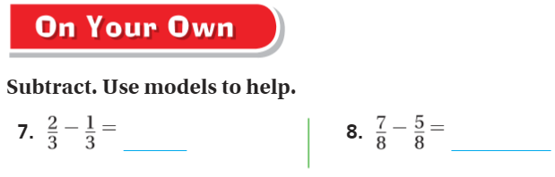
DRAW! On your own – pg. 405

Slide 10
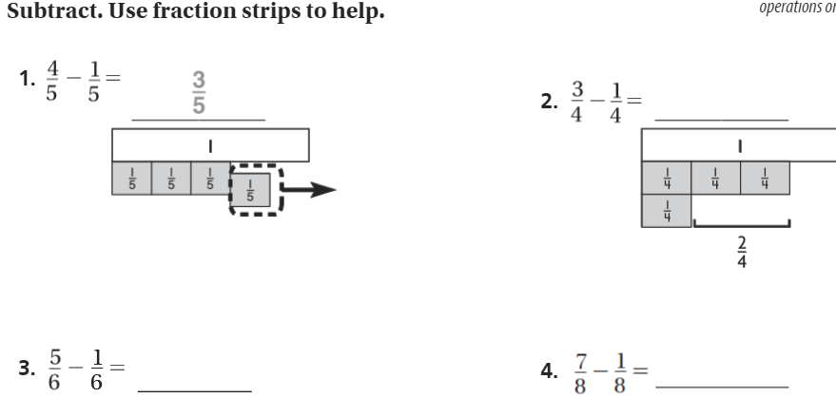
The Friday Quiz – Pg.407
Draw a quick pic

Slide 11
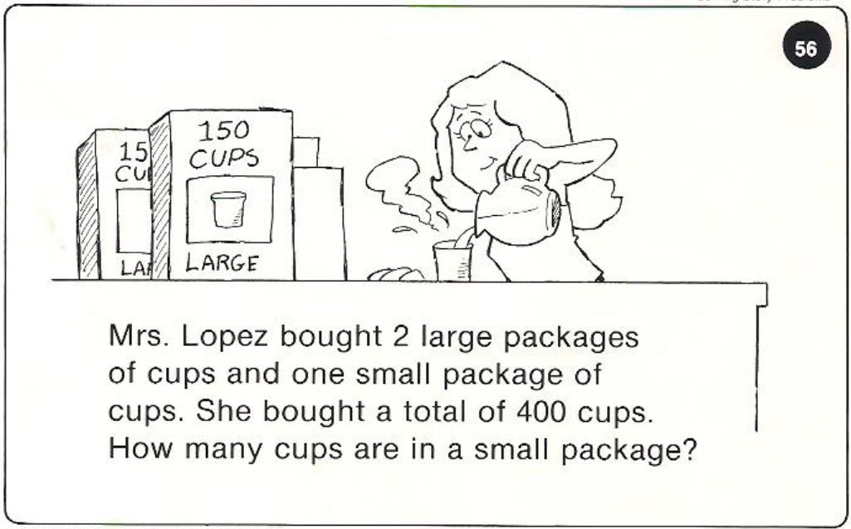
Calculator Problem

Slide 12
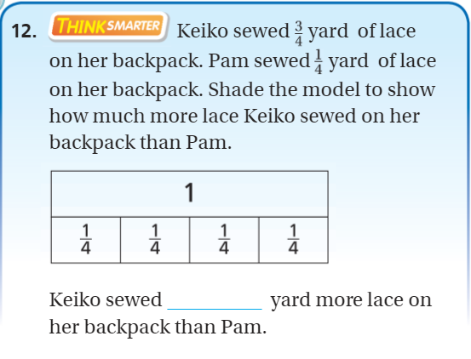
Exit Ticket – pg.406

