Slide 1

Chapter 7
Lesson 7.6

Slide 2

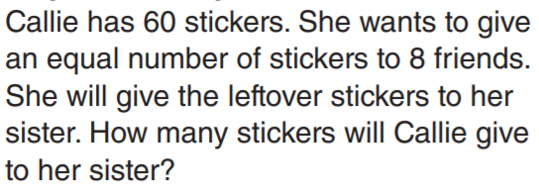
From earlier…

Slide 3
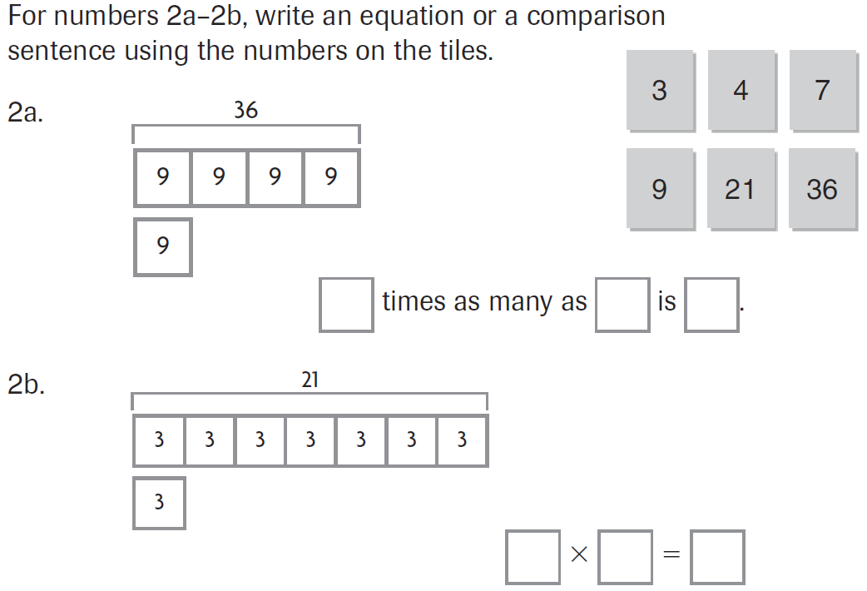
PARCC Practice

Slide 4

Fluency

Slide 5
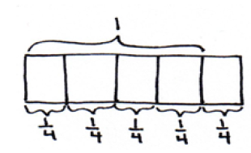
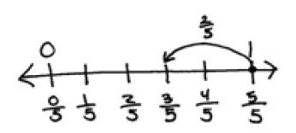
Write an equation!

Slide 6



Teach and Reteach - Pg. 423

Slide 7

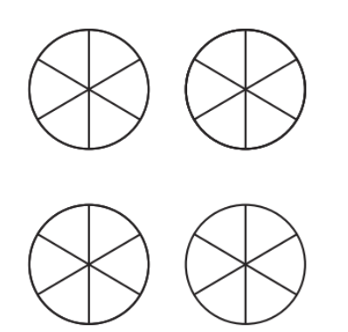
Teach and Reteach - Pg.424

Slide 8
I can add and subtract mixed numbers
Will you be able to do this?
Yes! | Maybe | No

Slide 9
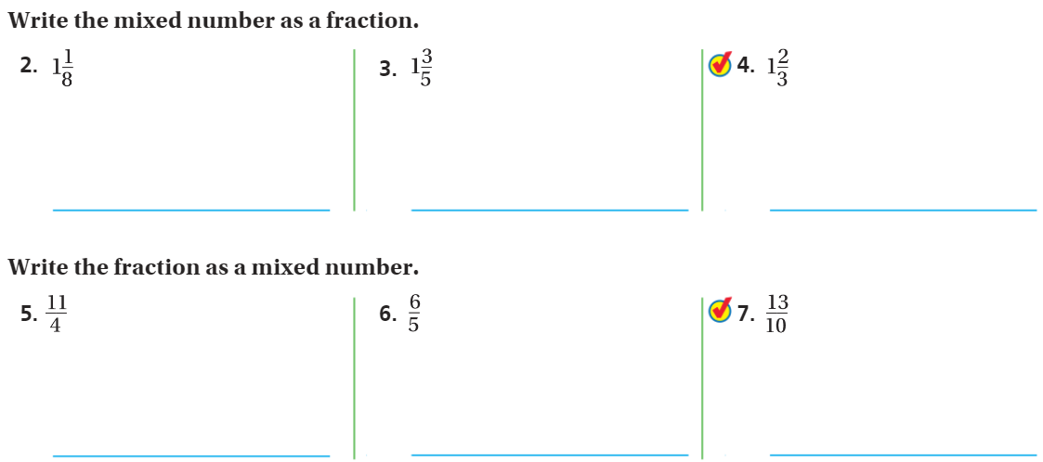
Share and Show- Review

Slide 10
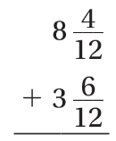
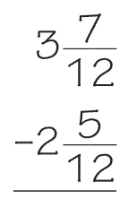
Watch this kids…

Slide 11
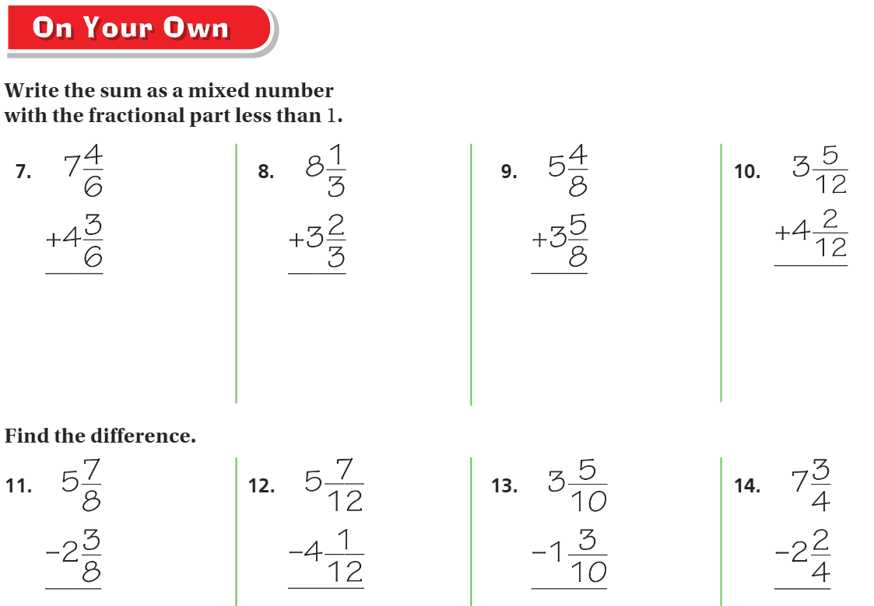
On your own – pg. 425

Slide 12


The Friday Quiz – Pg. 421

Slide 13
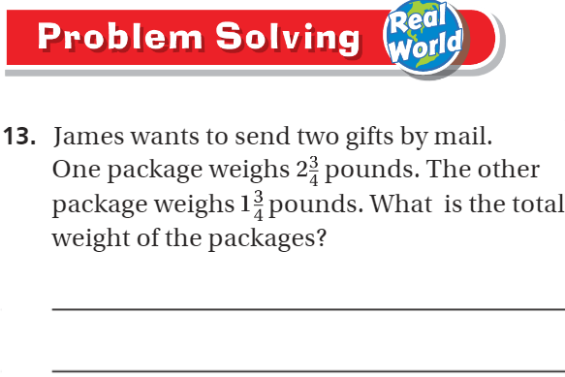
Pg. 427

Slide 14
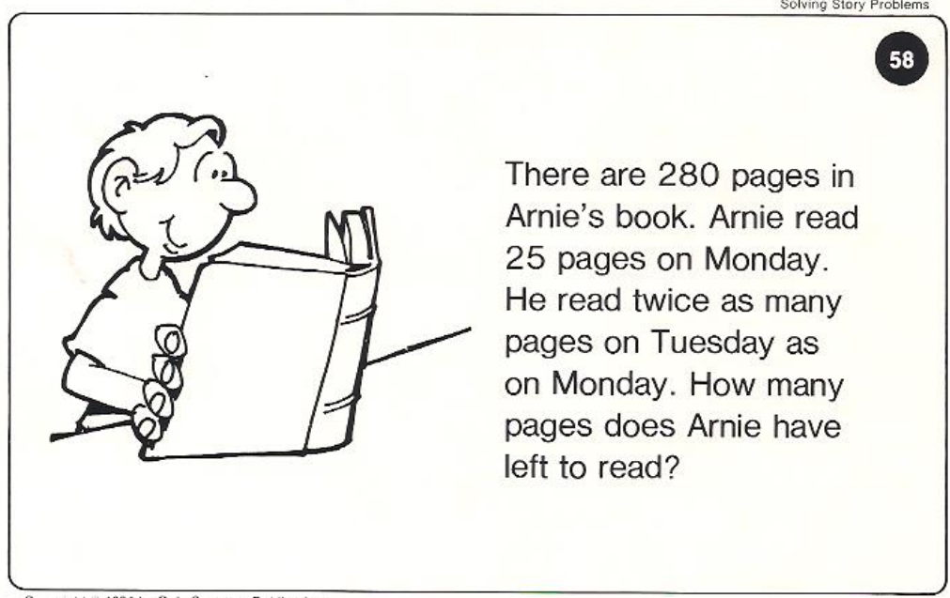
Calculator Problem

Slide 15
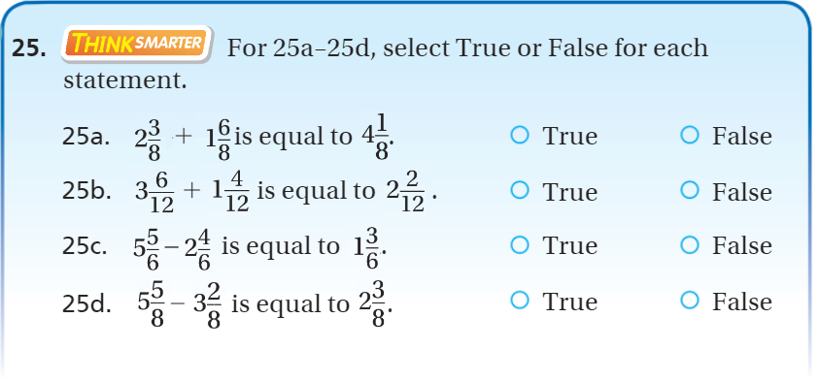
Exit Ticket – pg.426

