Slide 1

Chapter 7
Lesson 7.8

Slide 2



From Earlier…
Decompose & divide using the distributive property.

Slide 3
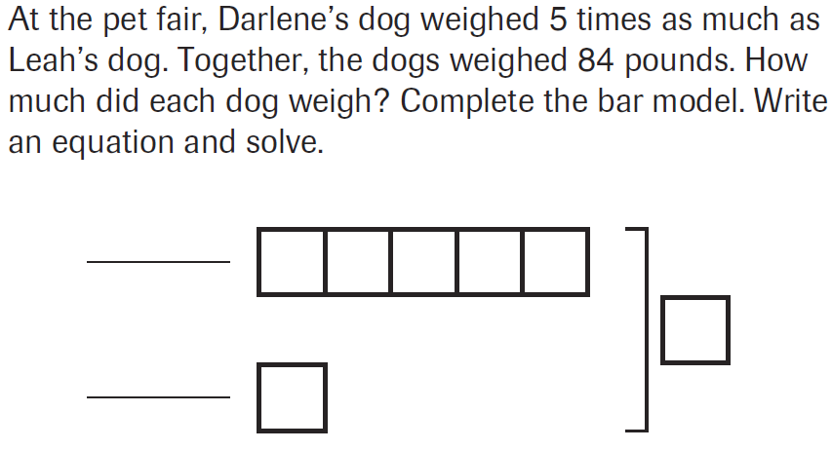
PARCC Practice

Slide 4
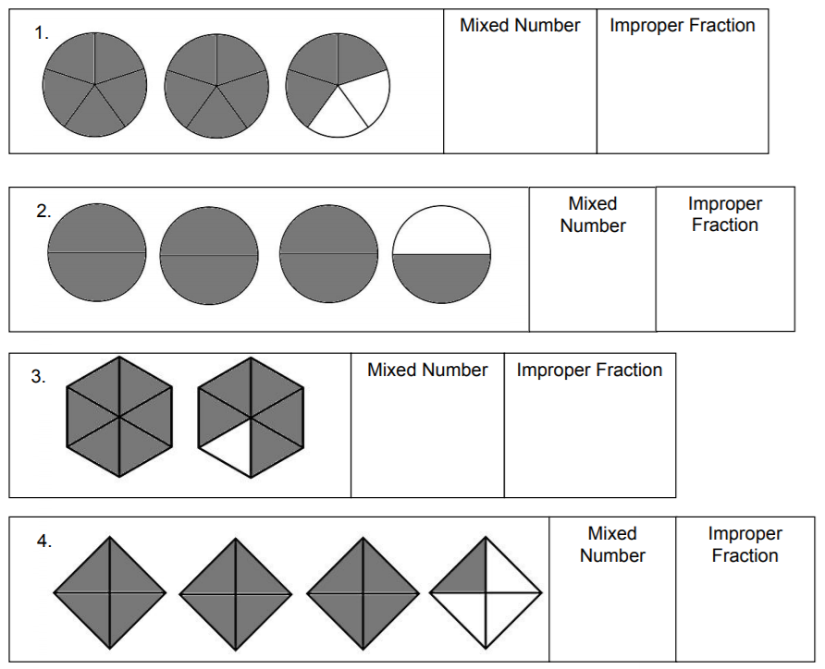
Let’s Look Back

Slide 5
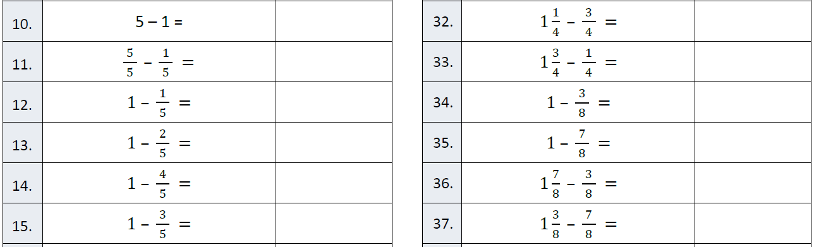
Fluency

Slide 6
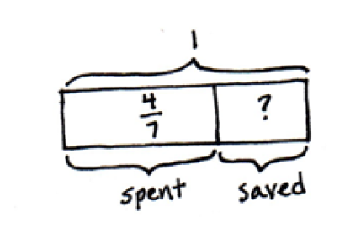
Write an equation!

Slide 7
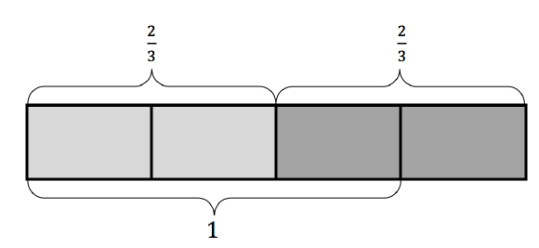
Write an equation!

Slide 8
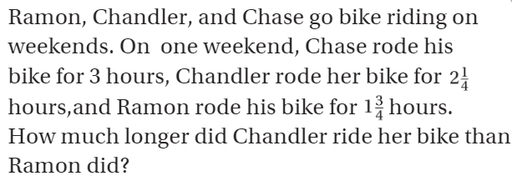
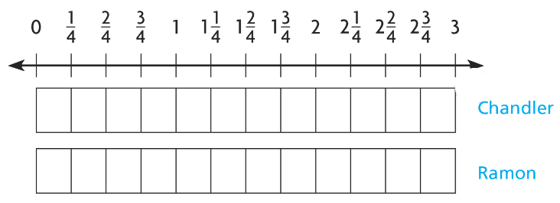
Teach and Reteach - Pg. 429

Slide 9
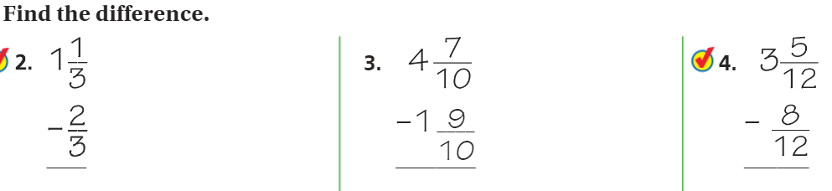
Watch This Kids - Pg.431

Slide 10
I can add and subtract mixed numbers with renaming
Will you be able to do this?
Yes! | Maybe | No

Slide 11
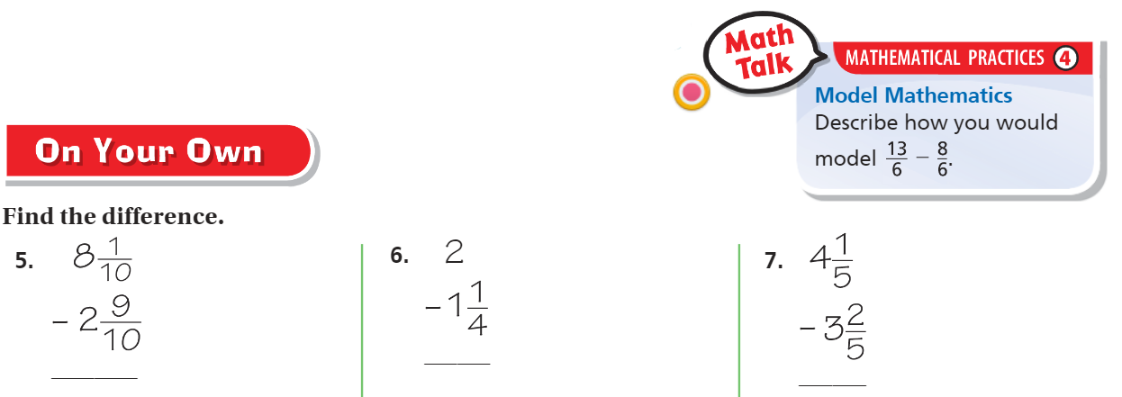
On Your Own - Pg.431

Slide 12
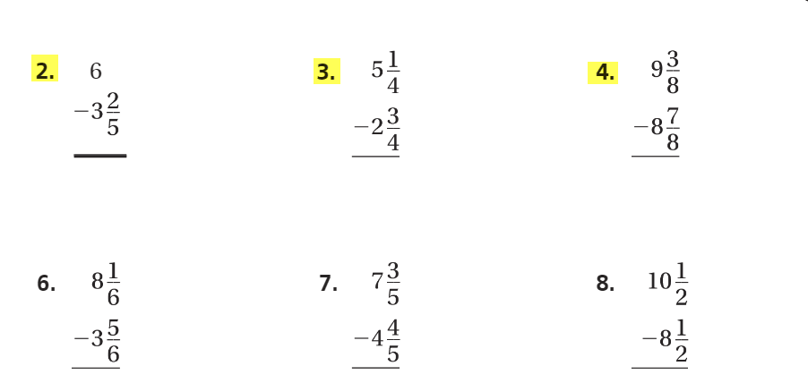
The Friday Quiz – Pg. 433

Slide 13
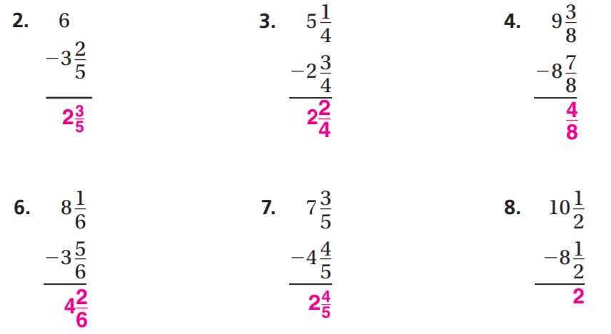
The Friday Quiz – Pg.433

Slide 14
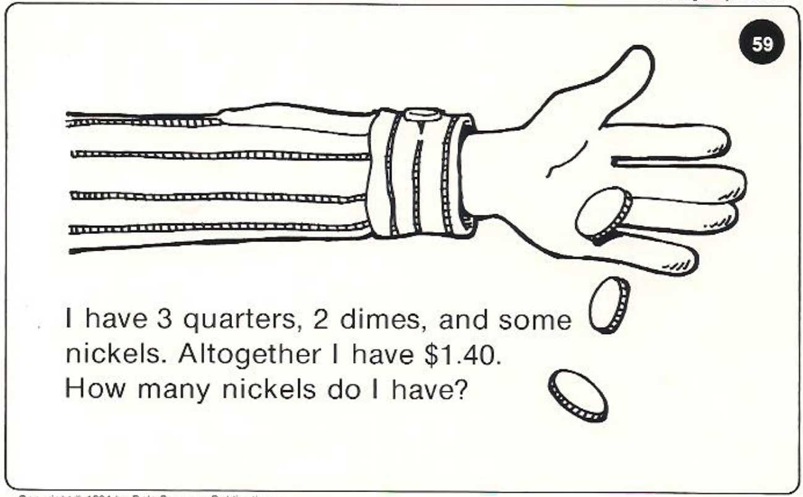
Calculator Problem

Slide 15
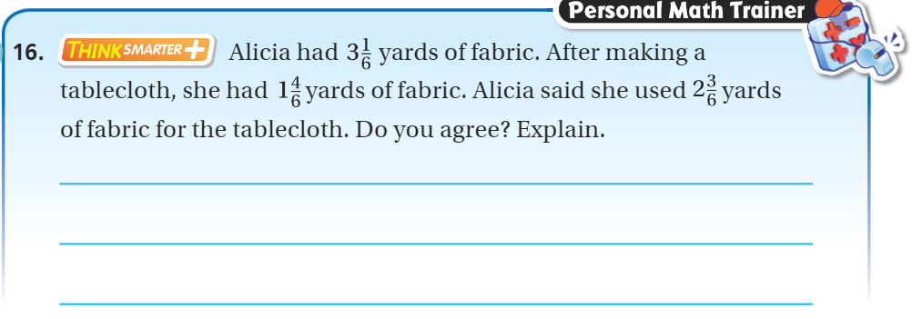
Exit Ticket – pg.432

