Slide 1

Chapter 8
Lesson 8.1

Slide 2
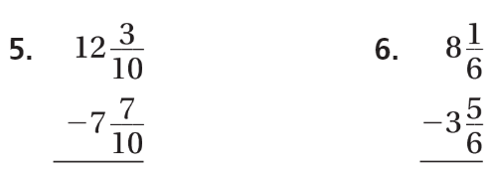
From earlier…

Slide 3
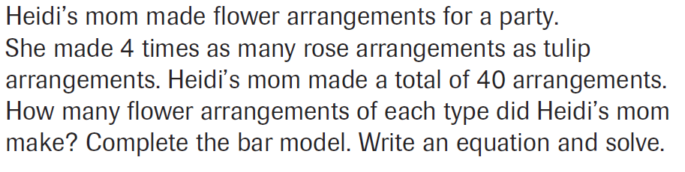
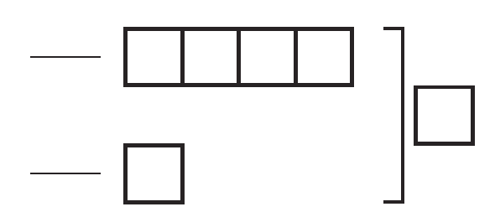
PARCC Practice

Slide 4
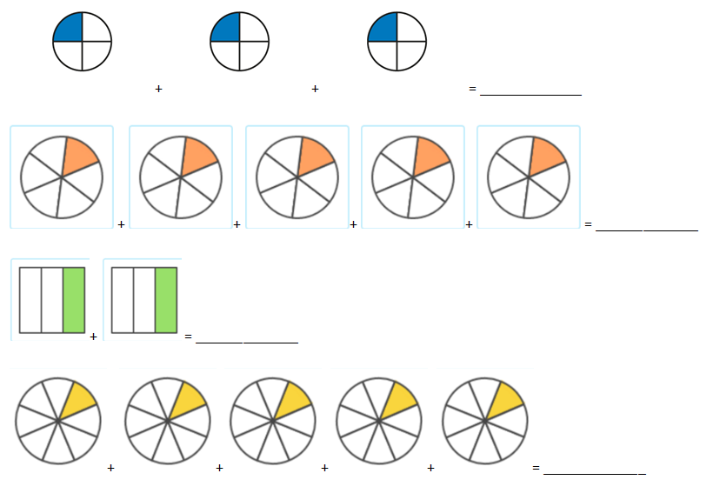
Let’s Look Back

Slide 5
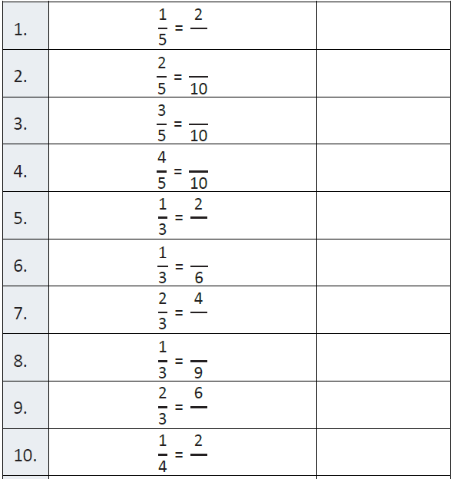
Fluency

Slide 6
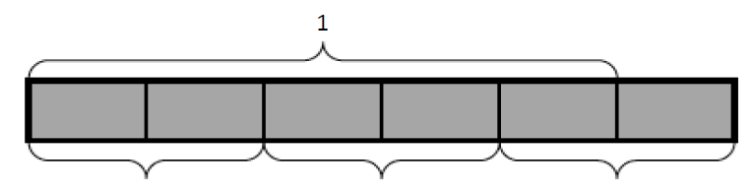
Write an equation!

Slide 7
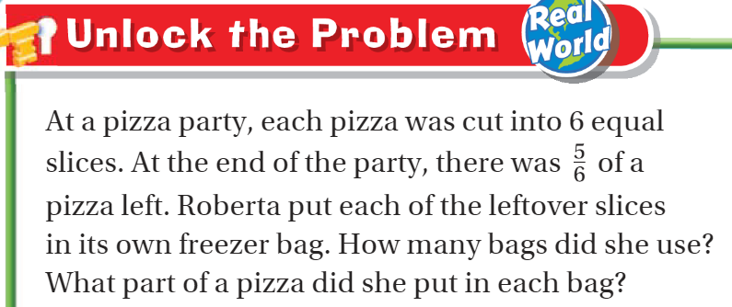
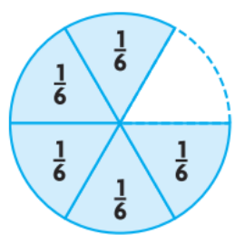
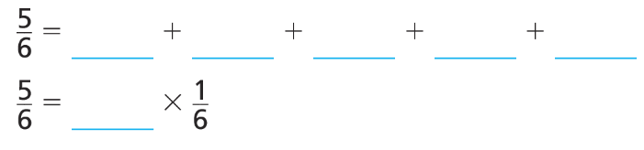
Teach and Reteach - Pg.455

Slide 8
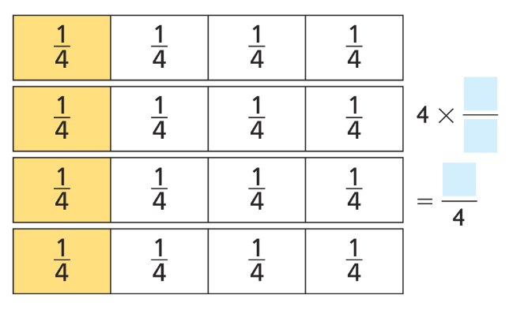

Watch This Kids - Pg.456

Slide 9
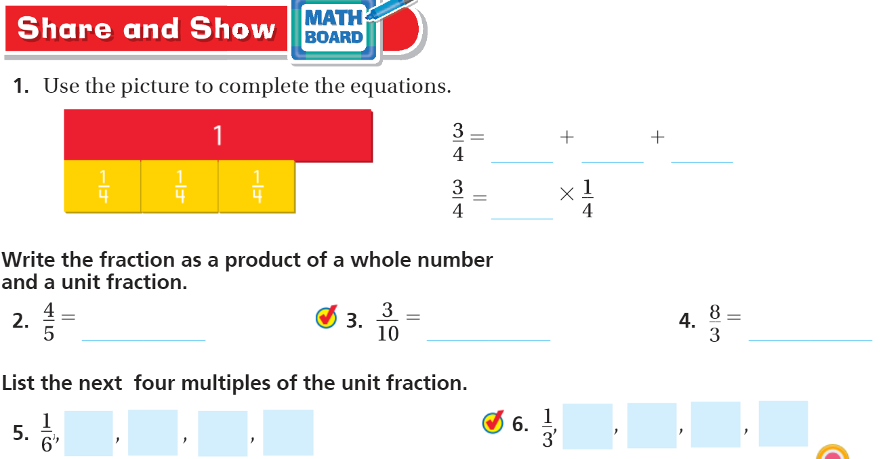
Share and Show pg. 457

Slide 10
I can write multiples of unit fractions as a product
Will you be able to do this?
Yes! | Maybe | No

Slide 11
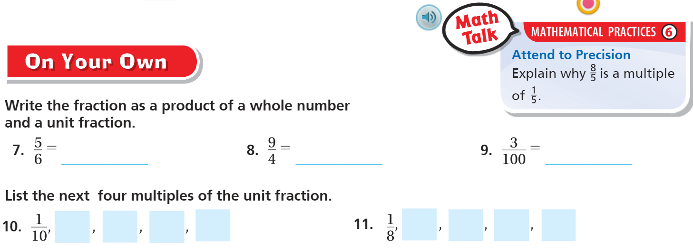
On Your Own - Pg. 457

Slide 12
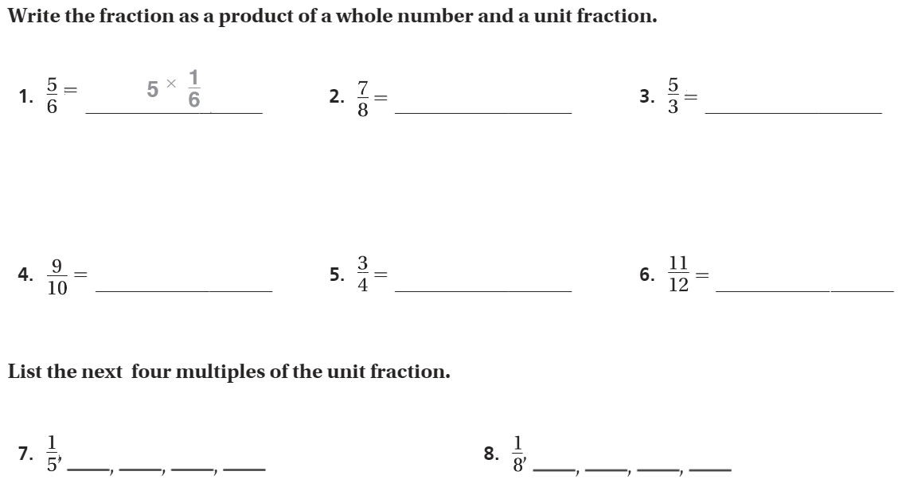
The Friday Quiz – Pg. 459

Slide 13
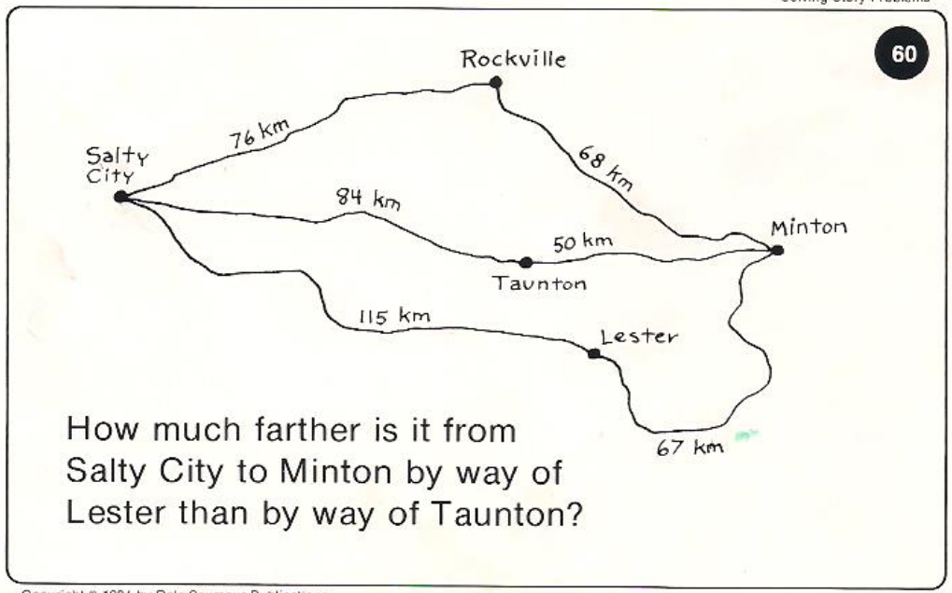
Calculator Problem

Slide 14
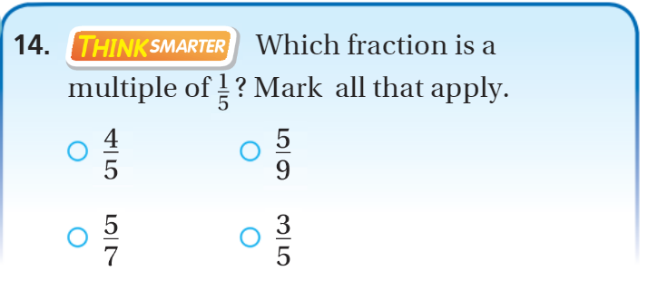
Exit Ticket – pg.457

