Slide 1

Chapter 8
Lesson 8.2

Slide 2
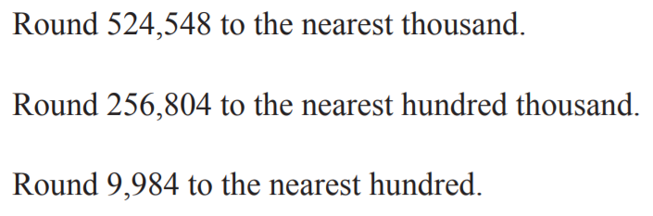
From earlier…

Slide 3
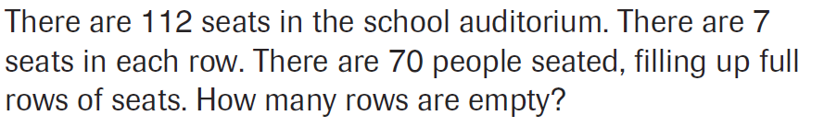
PARCC Practice

Slide 4
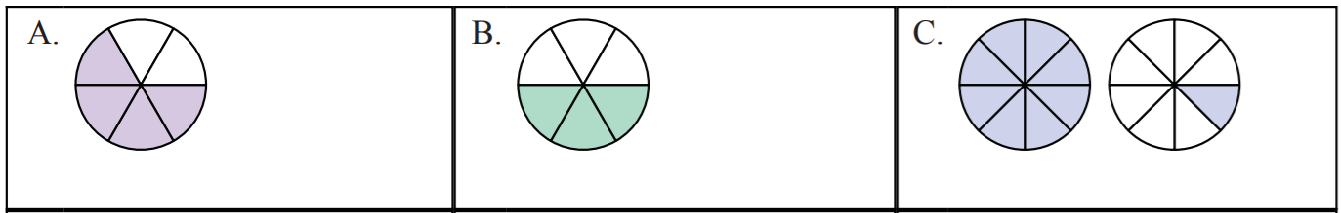
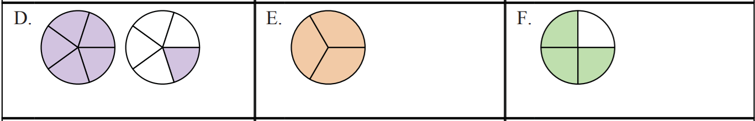
Let’s Look Back!

Slide 5
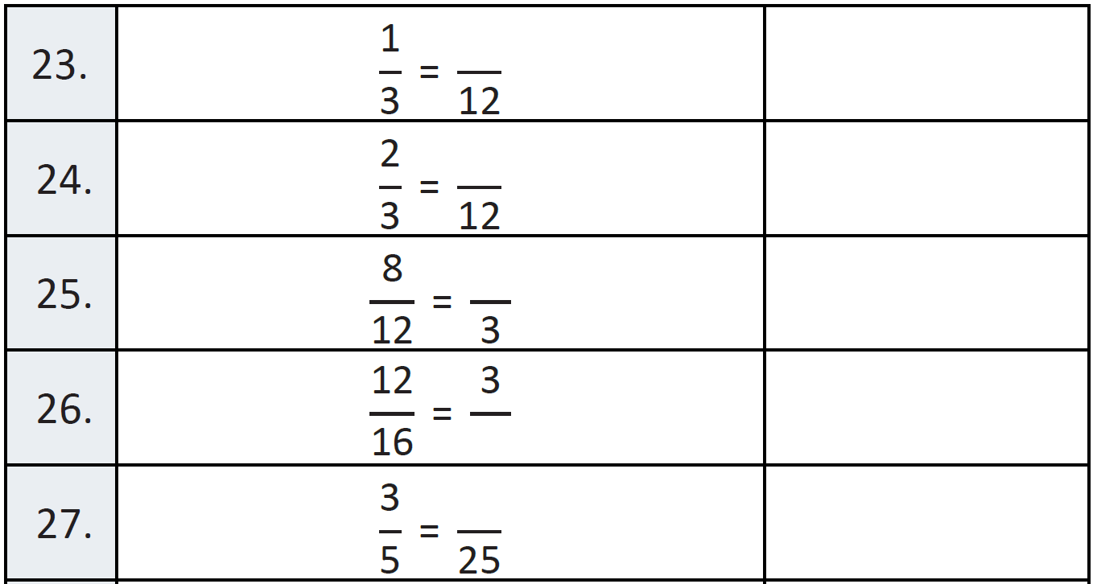
Fluency

Slide 6
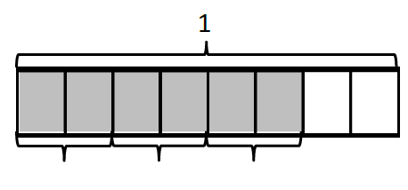
Write an equation

Slide 7
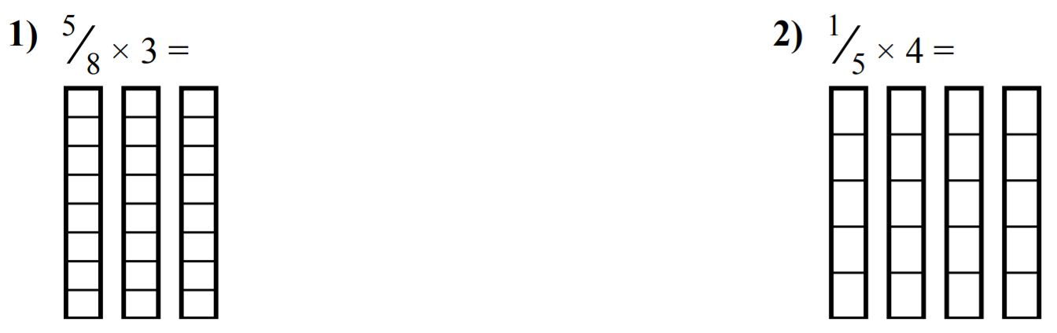
Watch This Kids

Slide 8
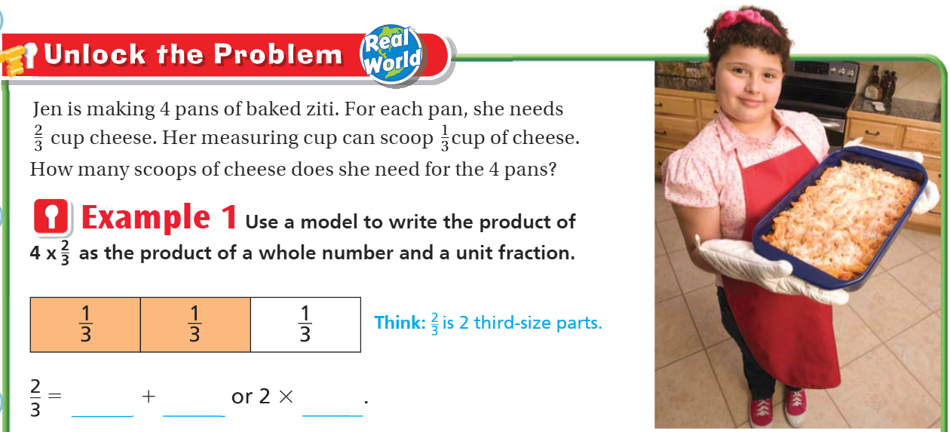
Teach and Reteach - Pg.461

Slide 9
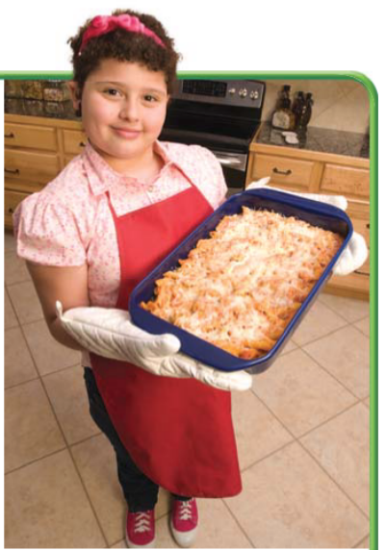
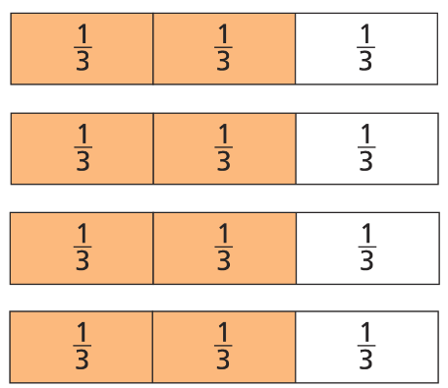
Teach and Reteach - Pg.461
Cheese!

Slide 10
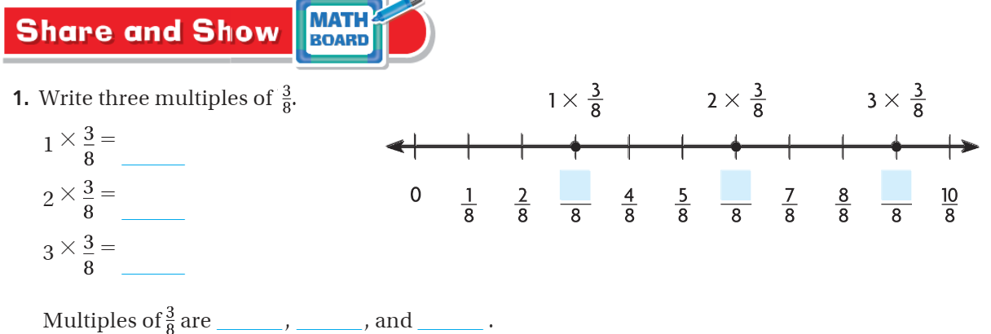
Share and Show pg.462

Slide 11
I can write multiples of fractions as a product
Will you be able to do this?
Yes! | Maybe | No

Slide 12
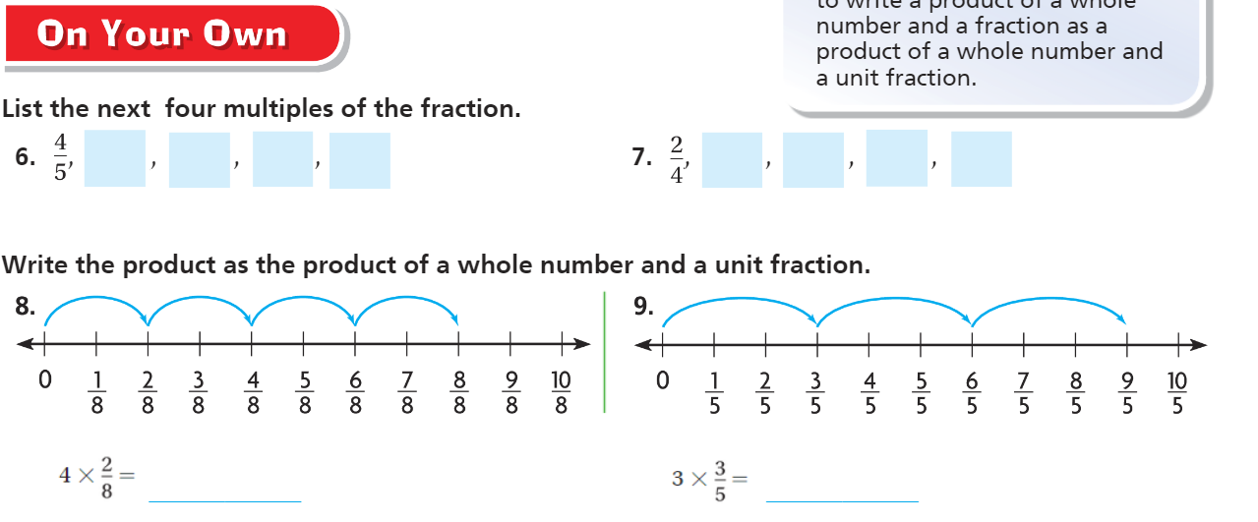
On Your Own - Pg. 463

Slide 13
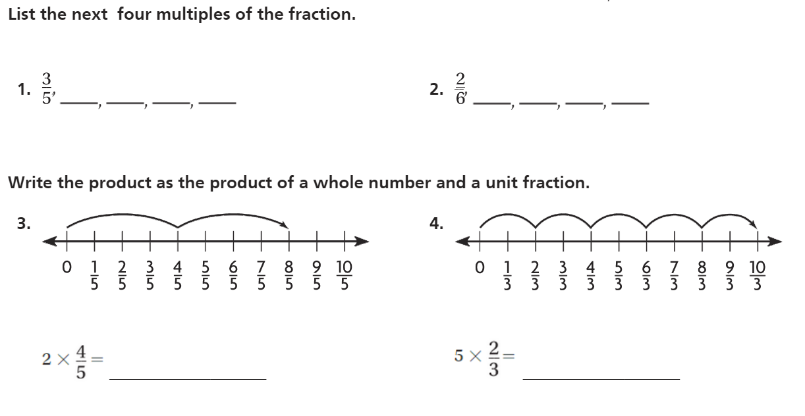
The Friday Quiz – Pg.465

Slide 14
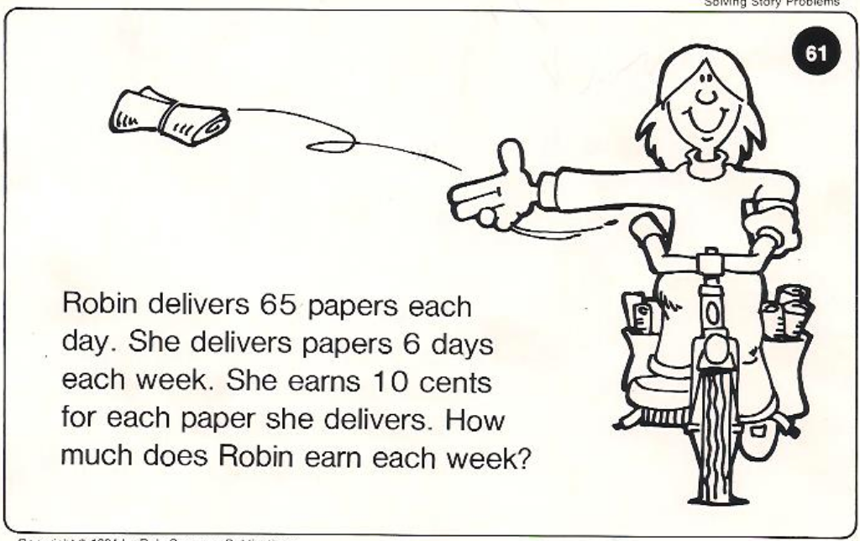
Calculator Problem

Slide 15
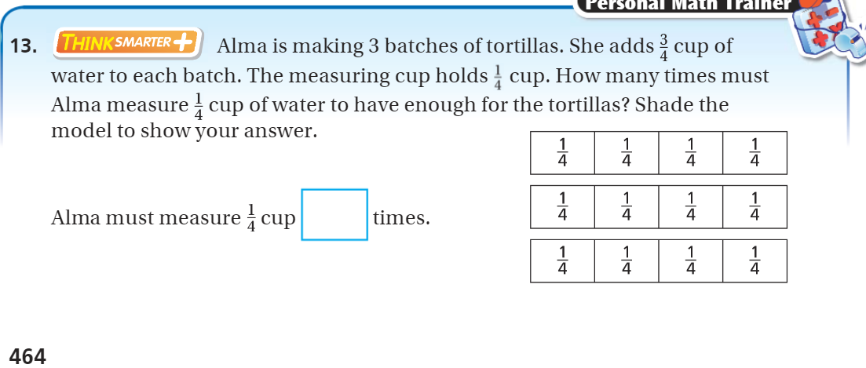
Exit Ticket – pg. 464

