Slide 1

Chapter 8
Lesson 8.3

Slide 2

From Earlier…

Slide 3
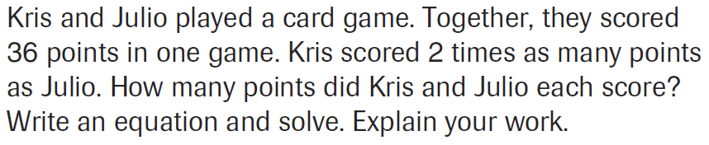
PARCC Practice

Slide 4
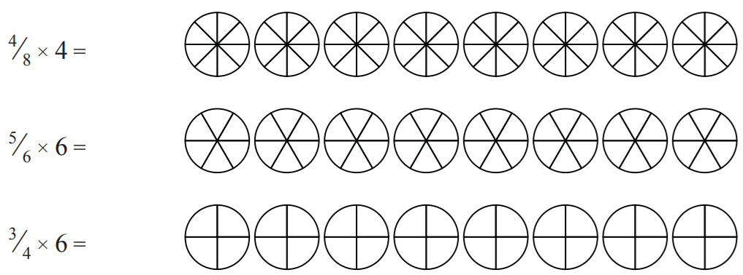
Let’s Look Back!

Slide 5
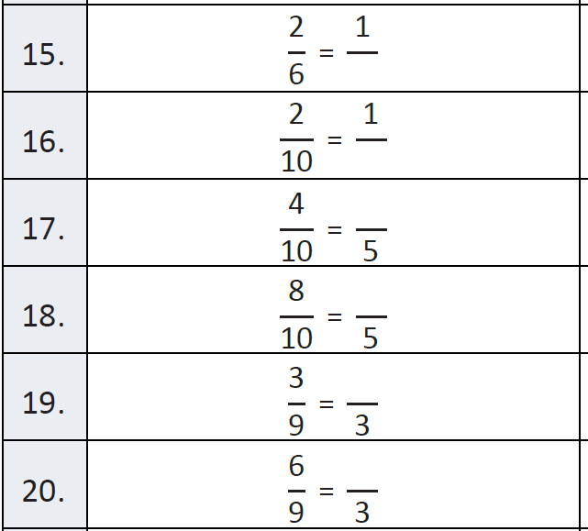
Fluency

Slide 6
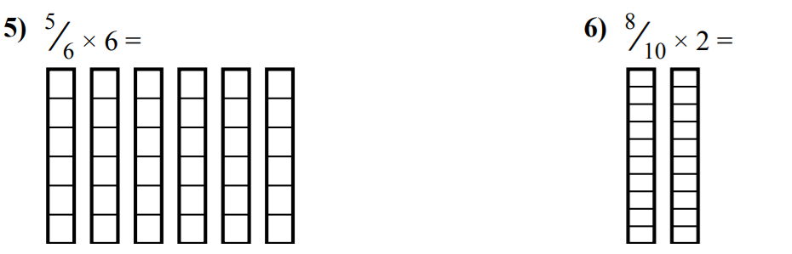
Watch This Kids

Slide 7
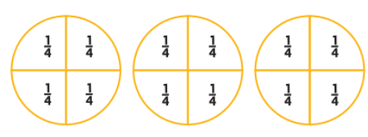
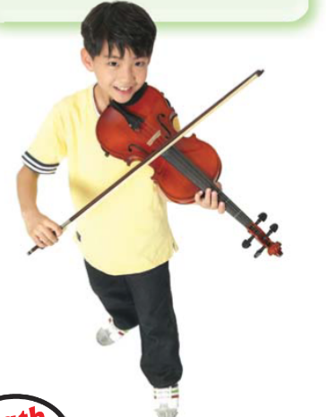
Teach and Reteach - Pg. 469

Slide 8
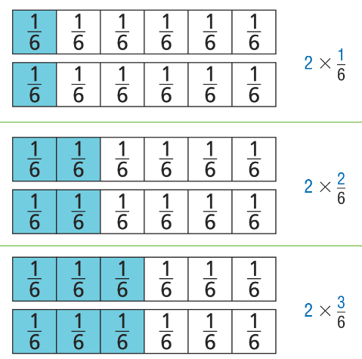
Teach and Reteach - Pg. 470

Slide 9
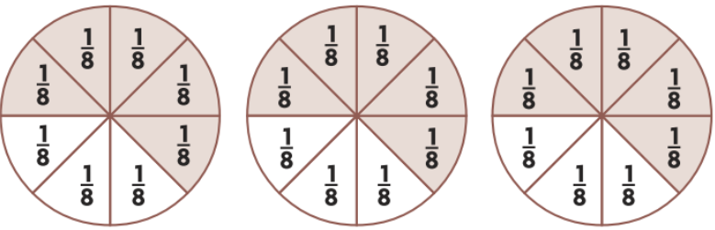
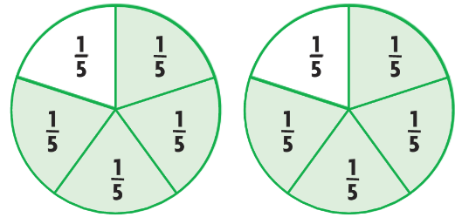
Share and Show pg. 471

Slide 10
I can multiply whole numbers and fractions
Will you be able to do this?
Yes! | Maybe | No

Slide 11
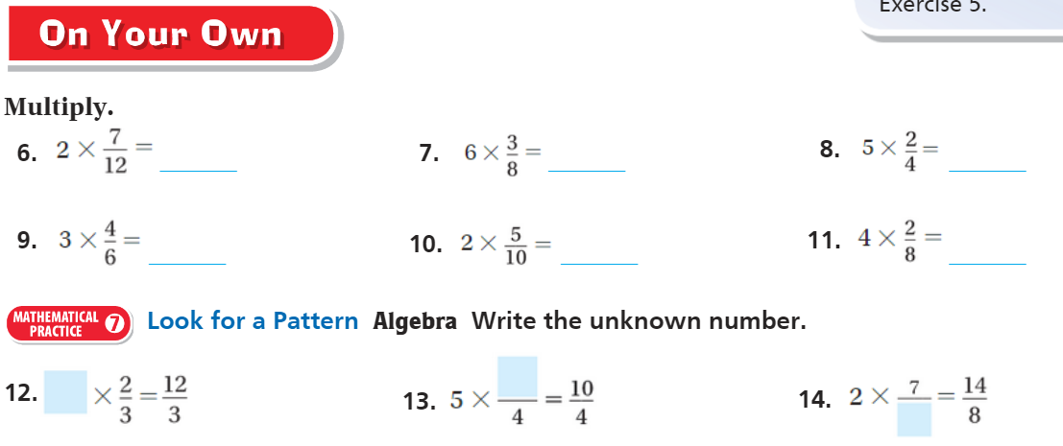
On Your Own - Pg. 471

Slide 12
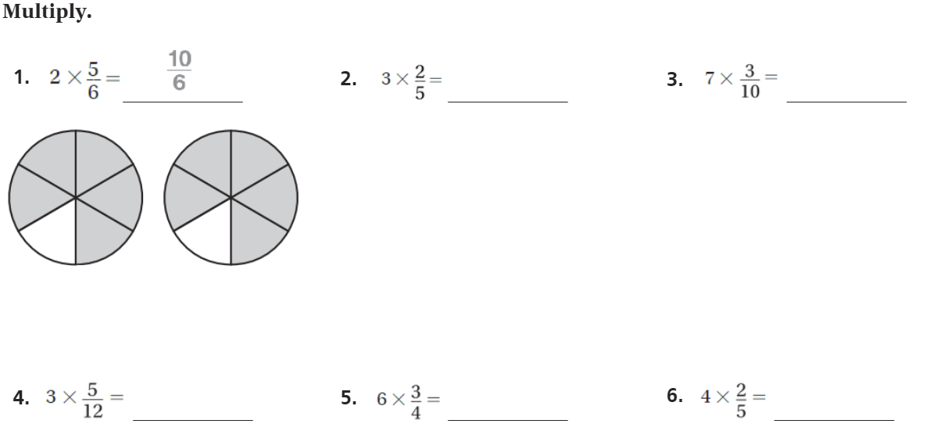
The Friday Quiz – Pg. 473

Slide 13
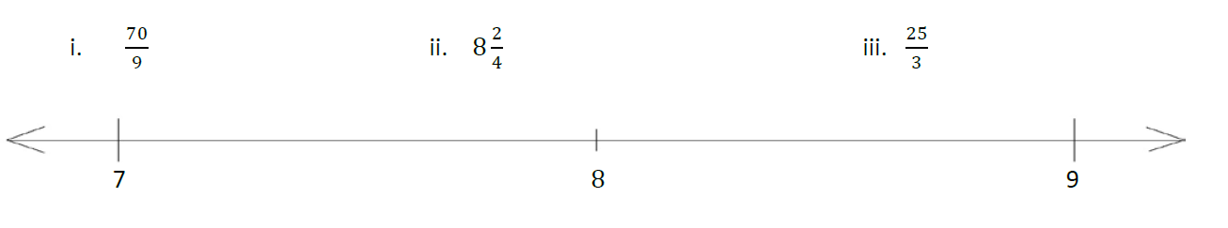
Bet you can’t solve this..

Slide 14
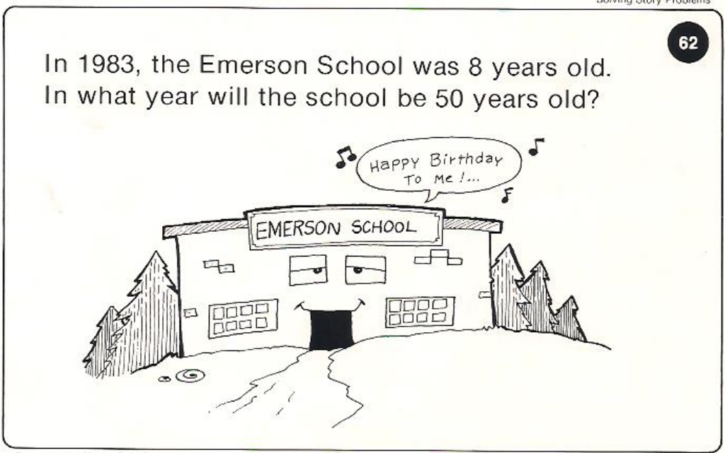
Calculator Problem

Slide 15
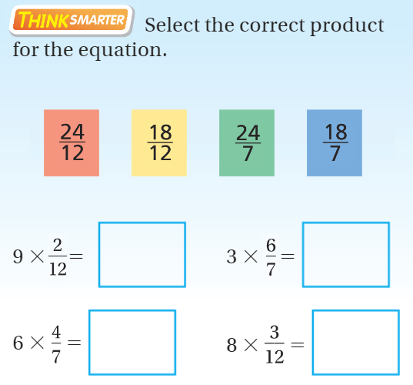
Exit Ticket – pg.

