Slide 1

Chapter 8
Lesson 8.4

Slide 2
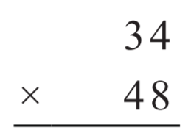

From earlier…

Slide 3
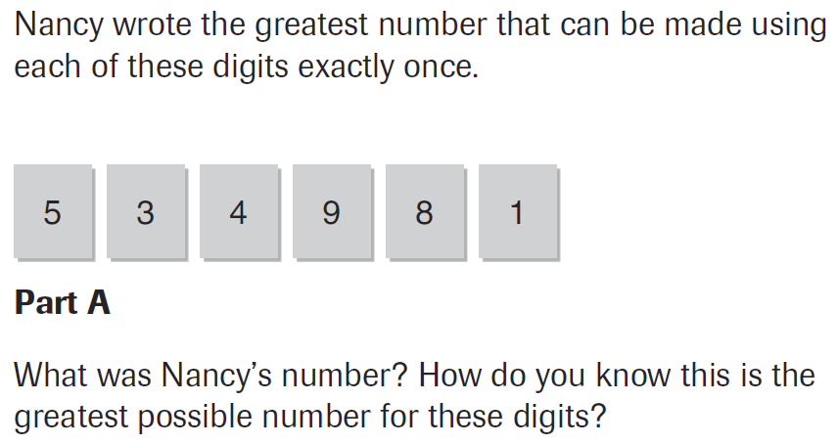
PARCC Practice

Slide 4
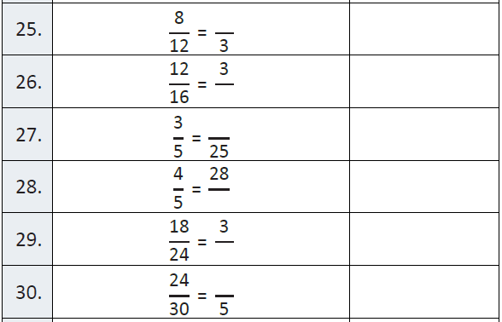
Fluency

Slide 5
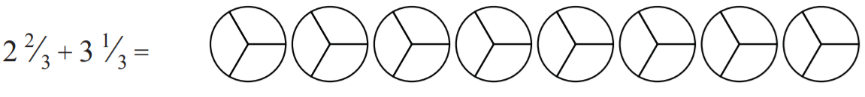
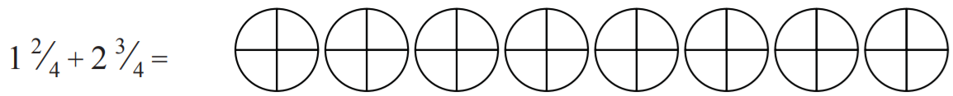
Let’s Look Back!

Slide 6
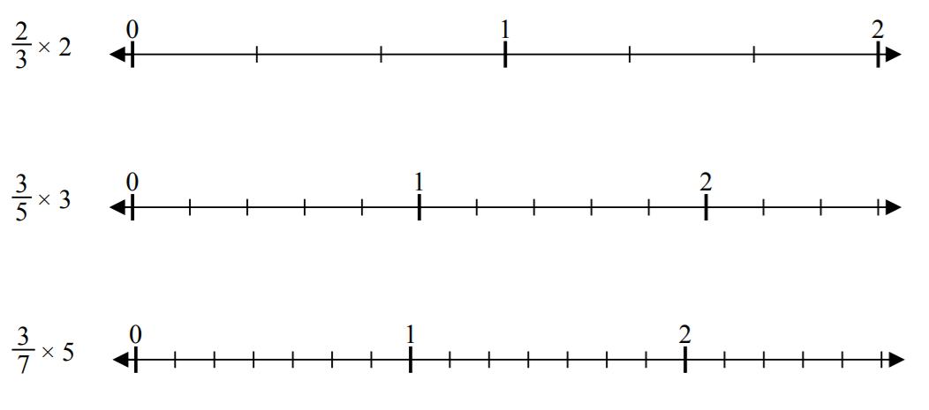
Let’s Look Back!

Slide 7
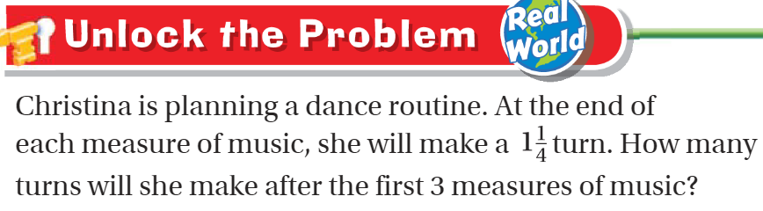
Teach and Reteach - Pg. 475

Slide 8
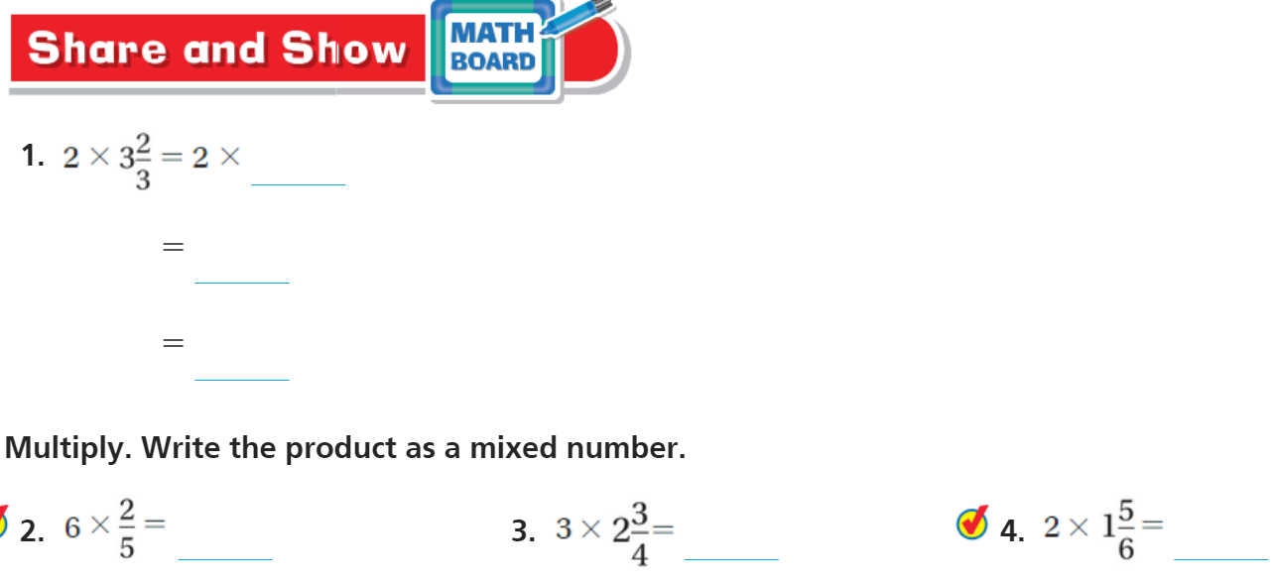
Share and Show pg. 477

Slide 9
I can multiply whole numbers and mixed numbers
Will you be able to do this?
Yes! | Maybe | No

Slide 10
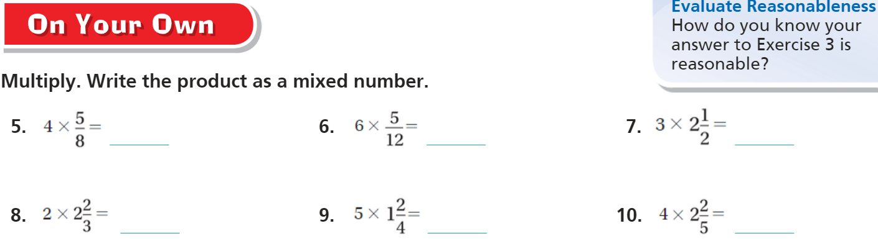
On Your Own - Pg. 477

Slide 11
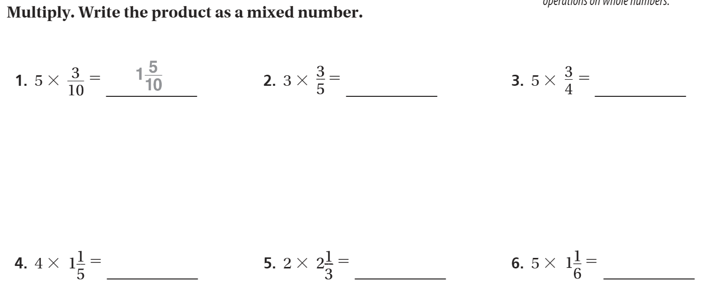
The Friday Quiz – Pg. 479

Slide 12
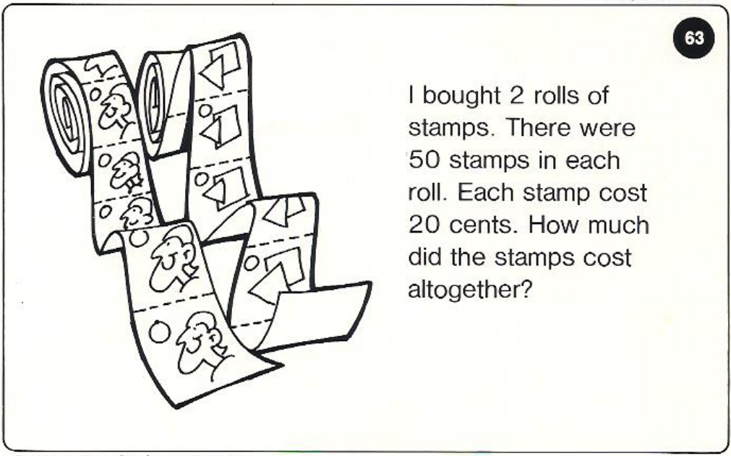
Calculator Problem

Slide 13
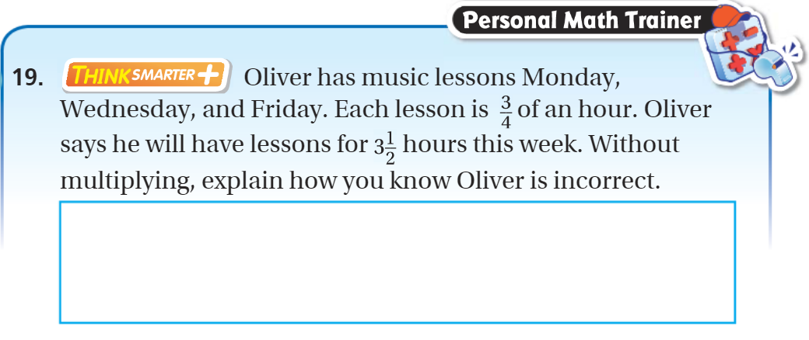
Exit Ticket – pg. 478

