Slide 1

Chapter 9
Lesson 9.1

Slide 2
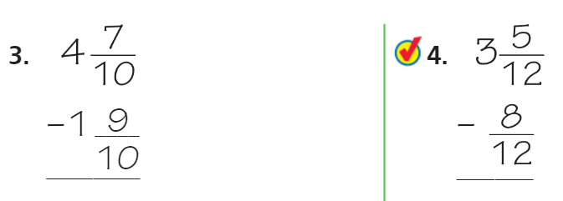
Let’s look back…

Slide 3
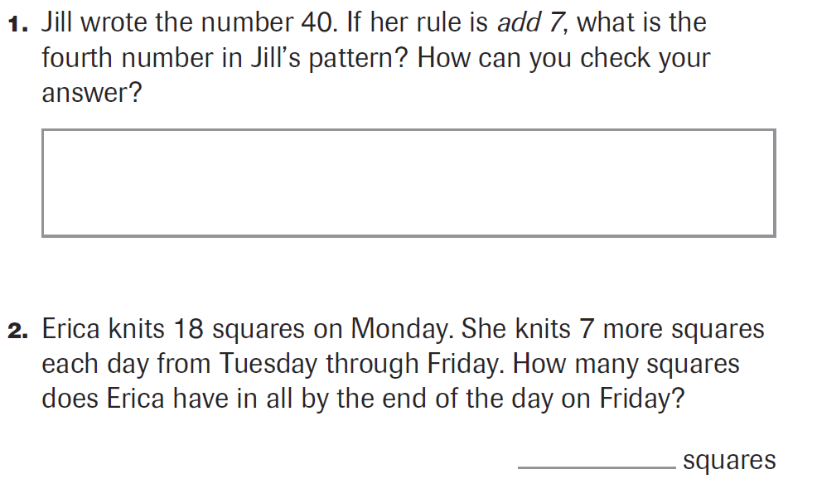
PARCC Practice

Slide 4
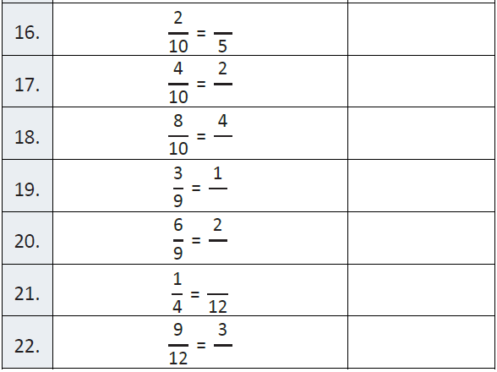
Fluency

Slide 5
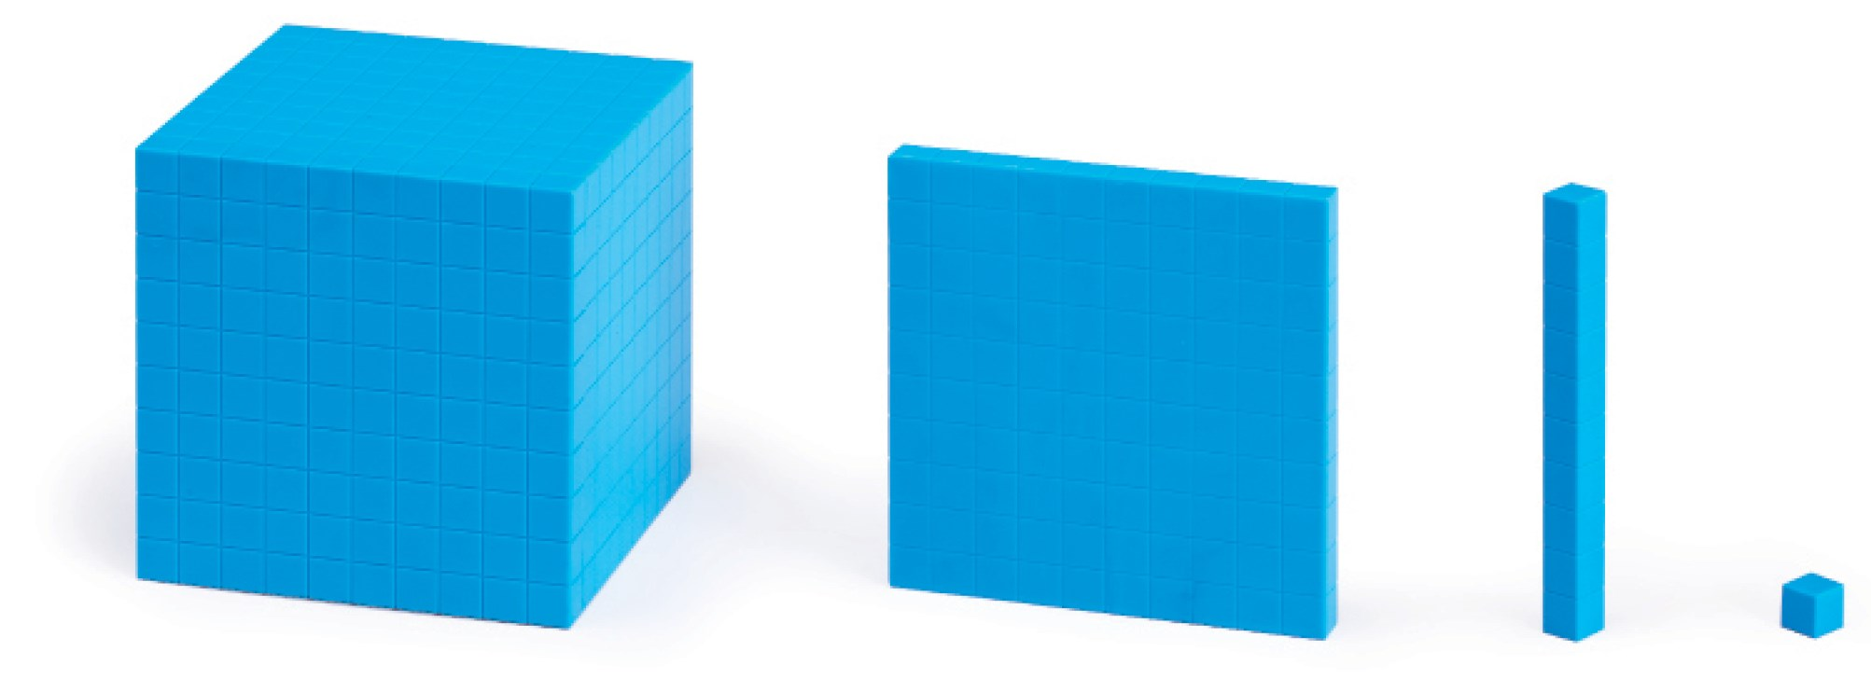
Let’s Look Back!

Slide 6
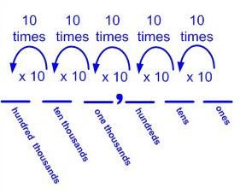

Slide 7
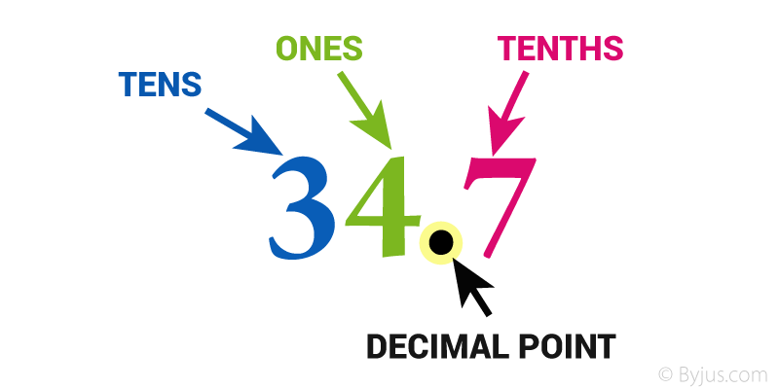

Slide 8
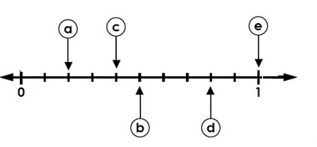
Let’s Look Back!

Slide 9
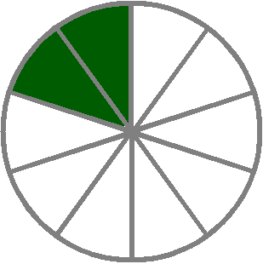
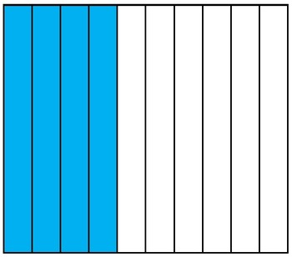
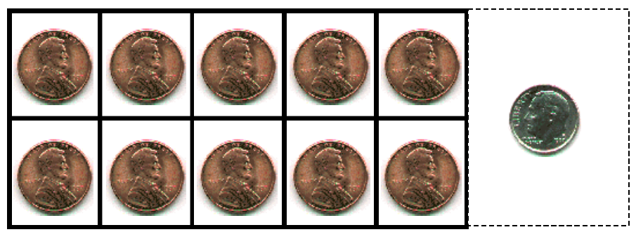

Slide 10
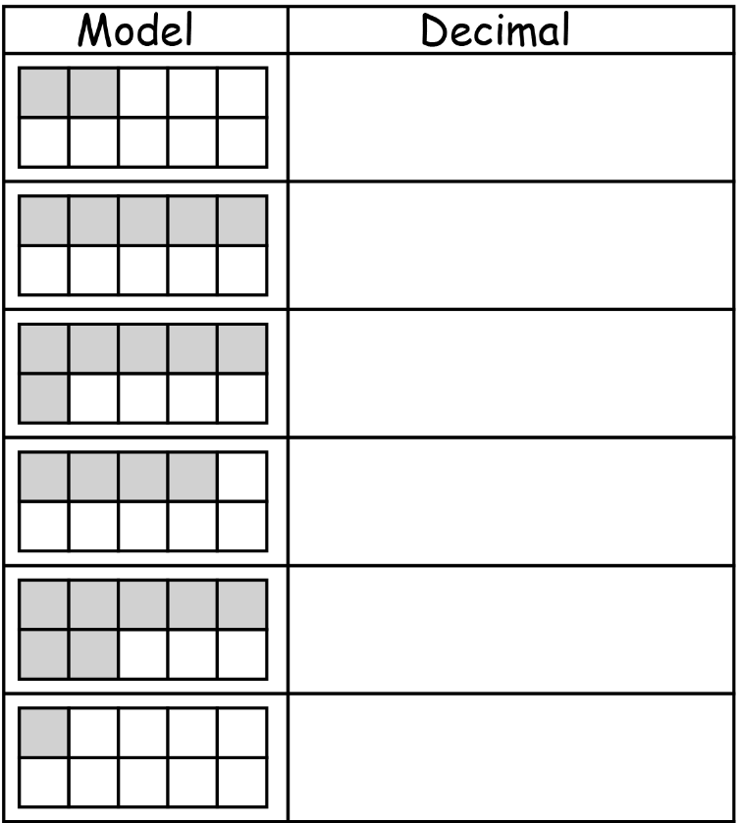

Slide 11


Teach and Reteach - Pg. 495

Slide 12


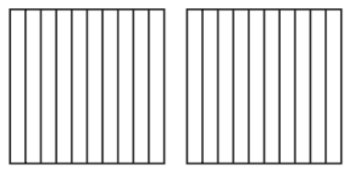

Teach and Reteach - Pg. 496

Slide 13
I can change fractions to decimals
Will you be able to do this?
Yes! | Maybe | No

Slide 14
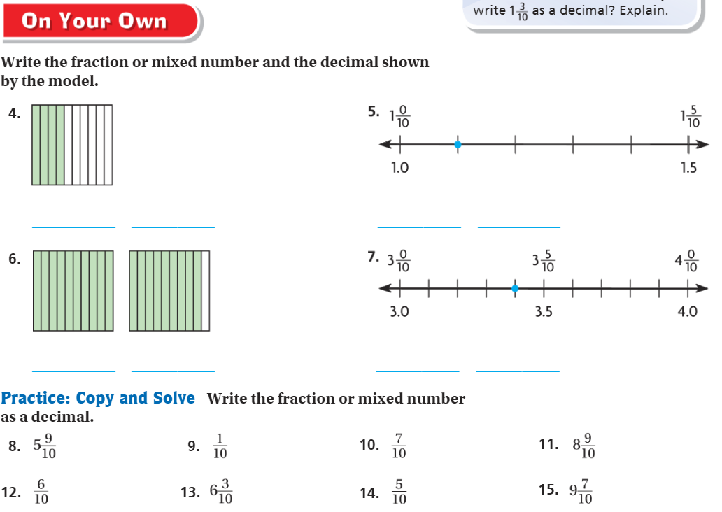
On your own – Pg. 497

Slide 15
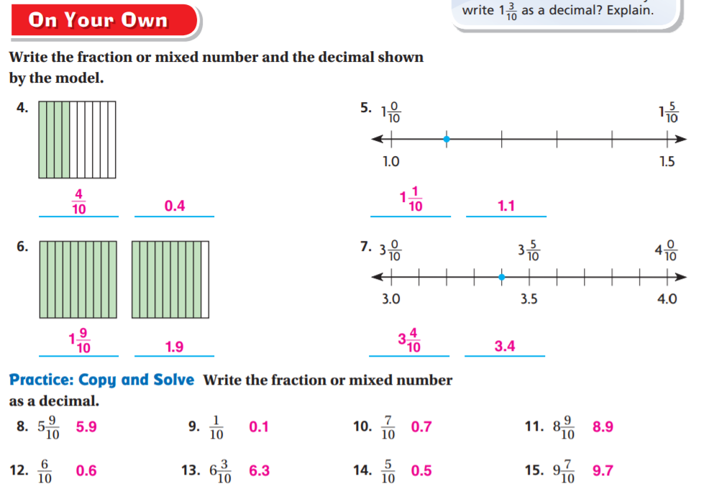
On your own – Pg. 497

Slide 16
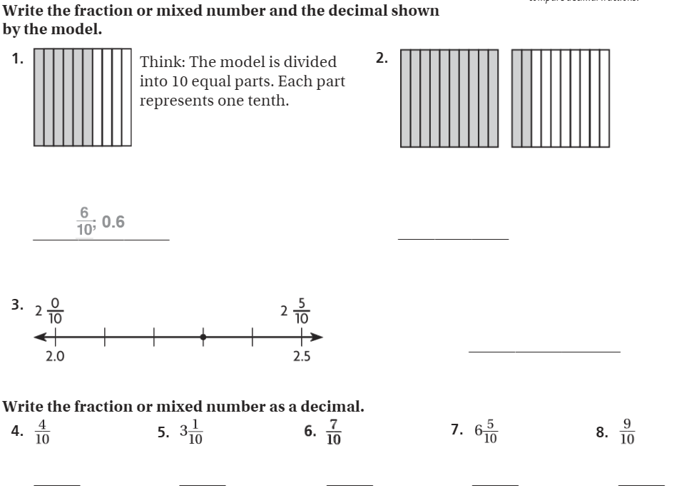
The Friday Quiz – Pg.499

Slide 17
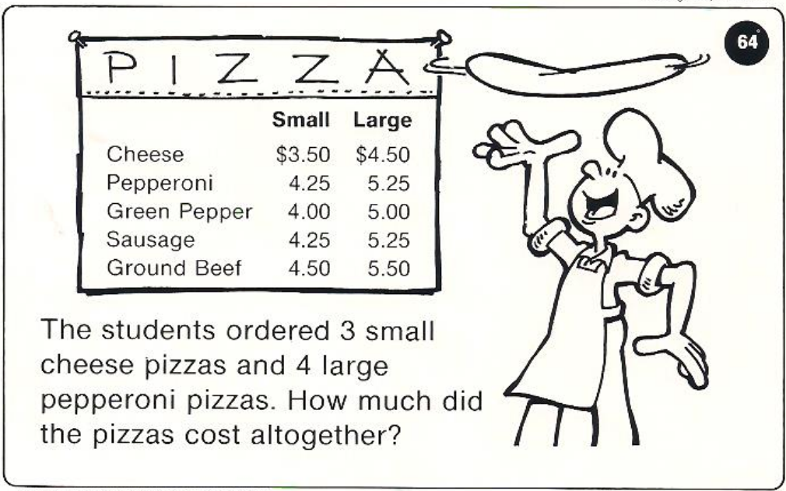
Calculator Problem

Slide 18

Exit Ticket – pg. 498

