Slide 1

Chapter 9
Lesson 9.2

Slide 2
From earlier…
Which numbers are composite?
17 | 15 | 19 | 21 | 3 | 5
7 | 9 | 13 | 2 | 14 | 23
25 | 22 | 27 | 31 | 33 | 35
37 | 39 | 41 | 43 | 45 | 47
49 | 51 | 53 | 55 | 57 | 63

Slide 3
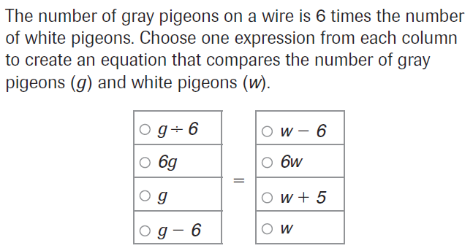
PARCC Practice

Slide 4
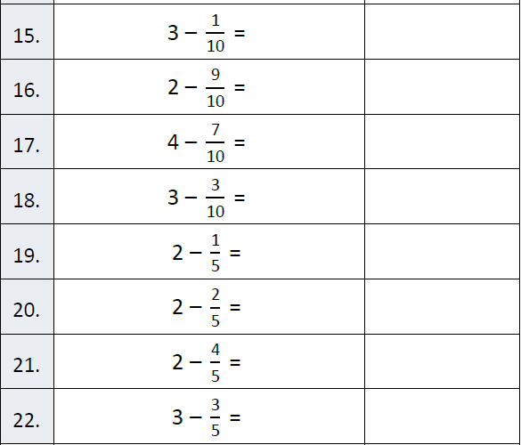
Fluency

Slide 5
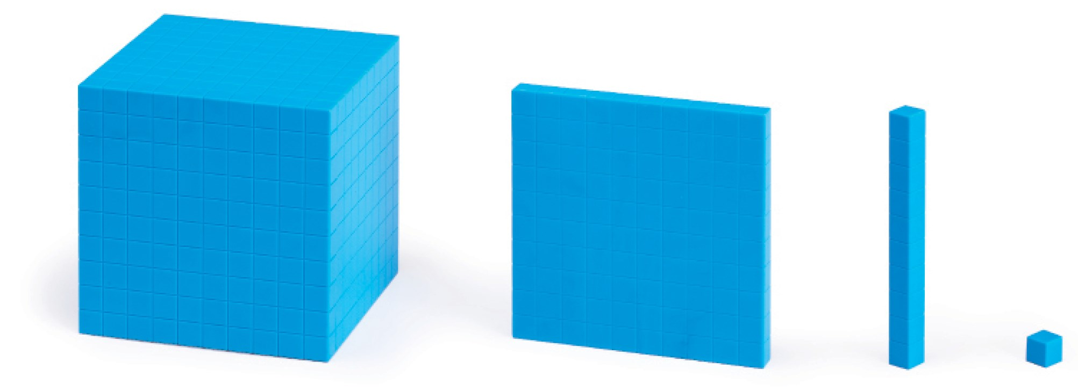
Let’s Look Back!

Slide 6
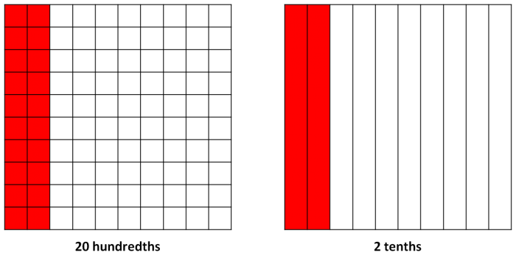

Slide 7


Slide 8
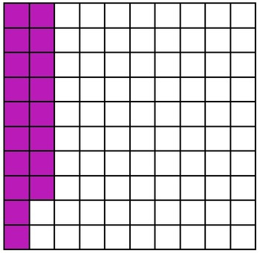

Slide 9


Slide 10
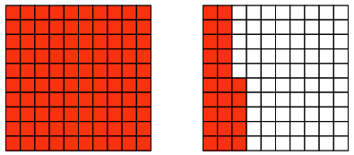

Slide 11
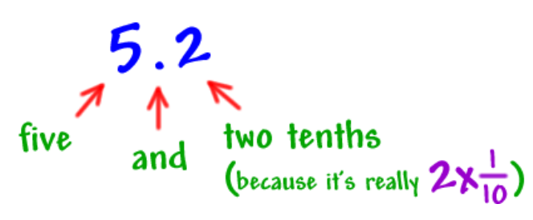
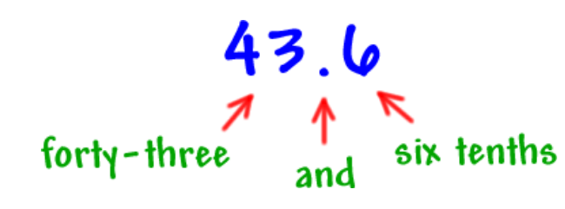

Slide 12
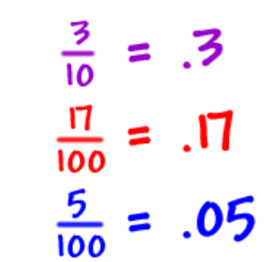
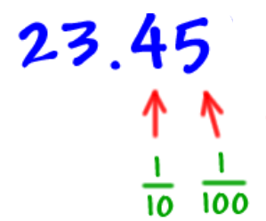

Slide 13
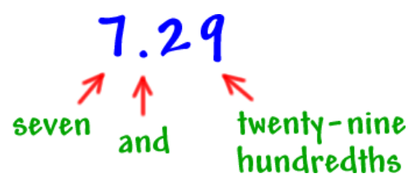
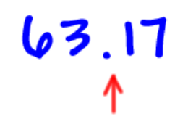

Slide 14
Read it out loud!
23.75
144.6
763.30
9,852.3
15,001.03

Slide 15
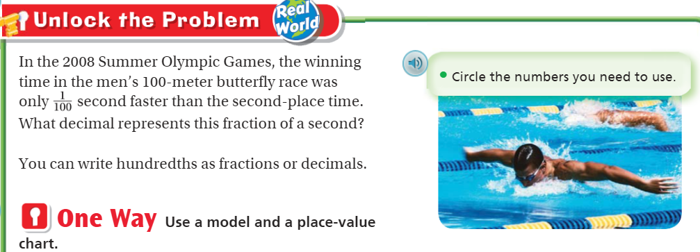

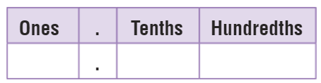
Teach and Reteach - Pg. 501

Slide 16
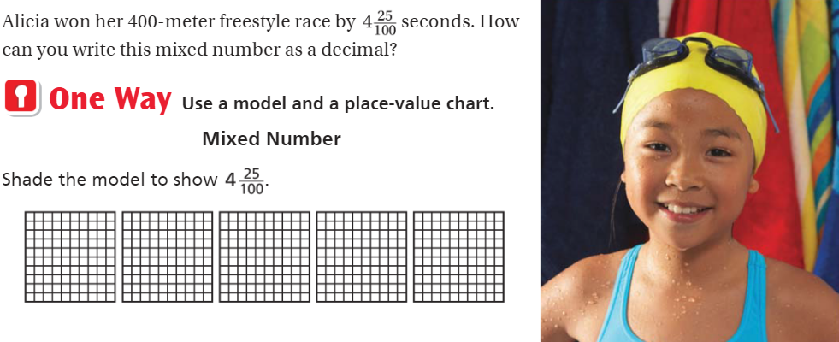

Teach and Reteach - Pg.502

Slide 17
I can change fractions to decimals - Hundredths
Will you be able to do this?
Yes! | Maybe | No

Slide 18
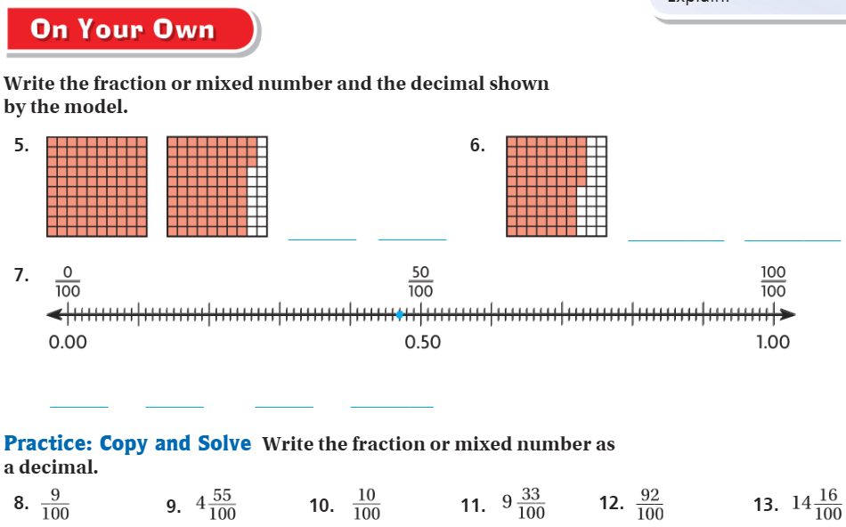
On your own – Pg. 503

Slide 19
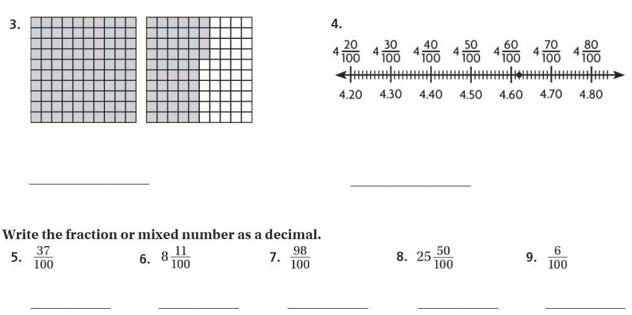
The Friday Quiz – Pg. 505

Slide 20
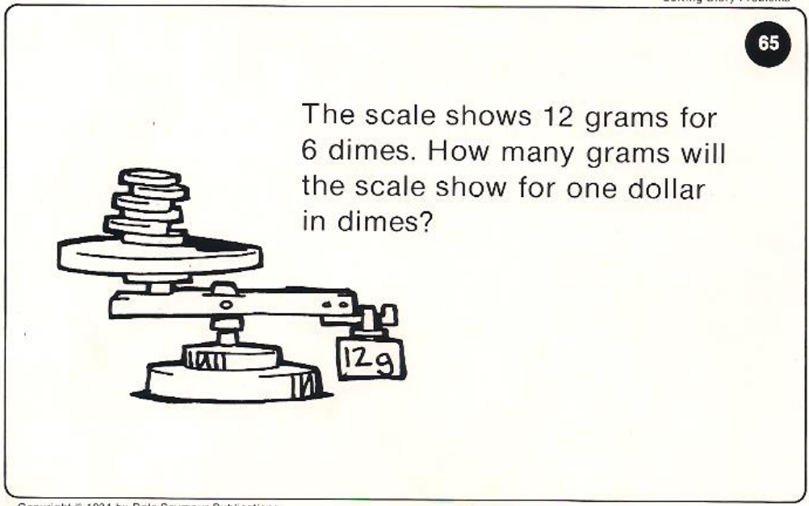
Calculator Problem

Slide 21

Exit Ticket – pg. 504

