Slide 1

Chapter 9
Lesson 9.3

Slide 2
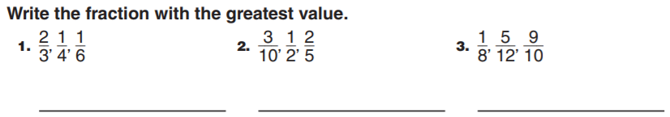
From Earlier…

Slide 3
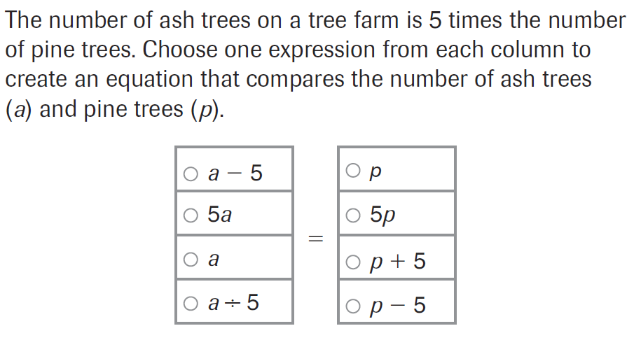
PARCC Practice

Slide 4
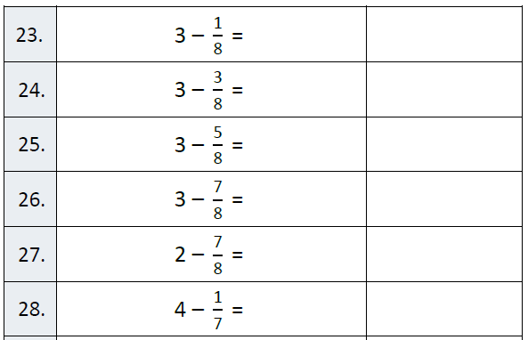
Fluency

Slide 5
Read it out loud!
123.05
344.7
1,763.30
2,852.3
5,001.03

Slide 6
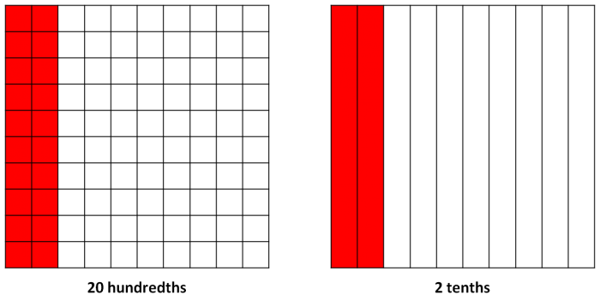
Let’s Look Back!

Slide 7
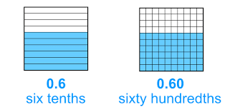

Slide 8
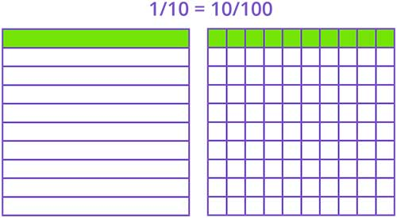

Slide 9
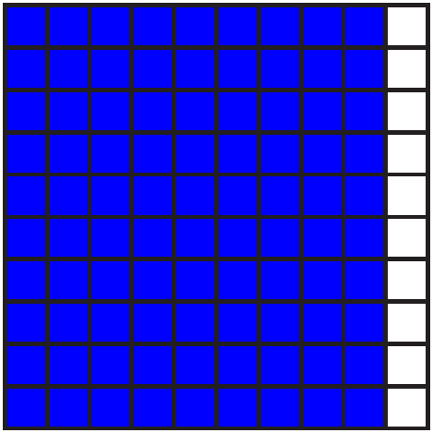

Slide 10


Slide 11


Slide 12


Slide 13


Slide 14
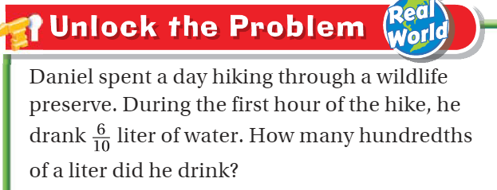

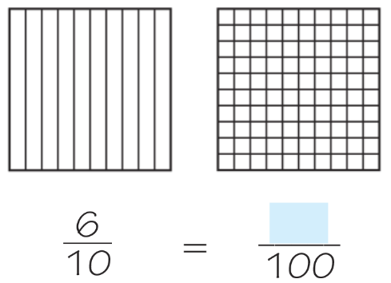
Teach and Reteach - Pg. 507

Slide 15
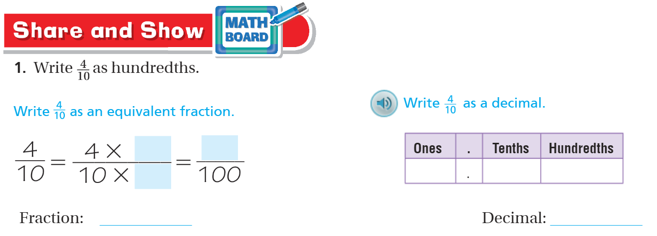
Teach and Reteach - Pg. 508

Slide 16
I can convert tenths and hundredths
Will you be able to do this?
Yes! | Maybe | No

Slide 17
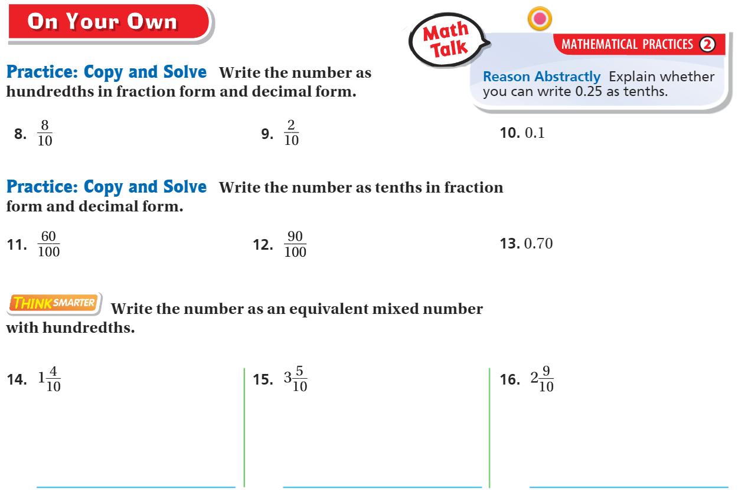
On your own – Pg. 509

Slide 18
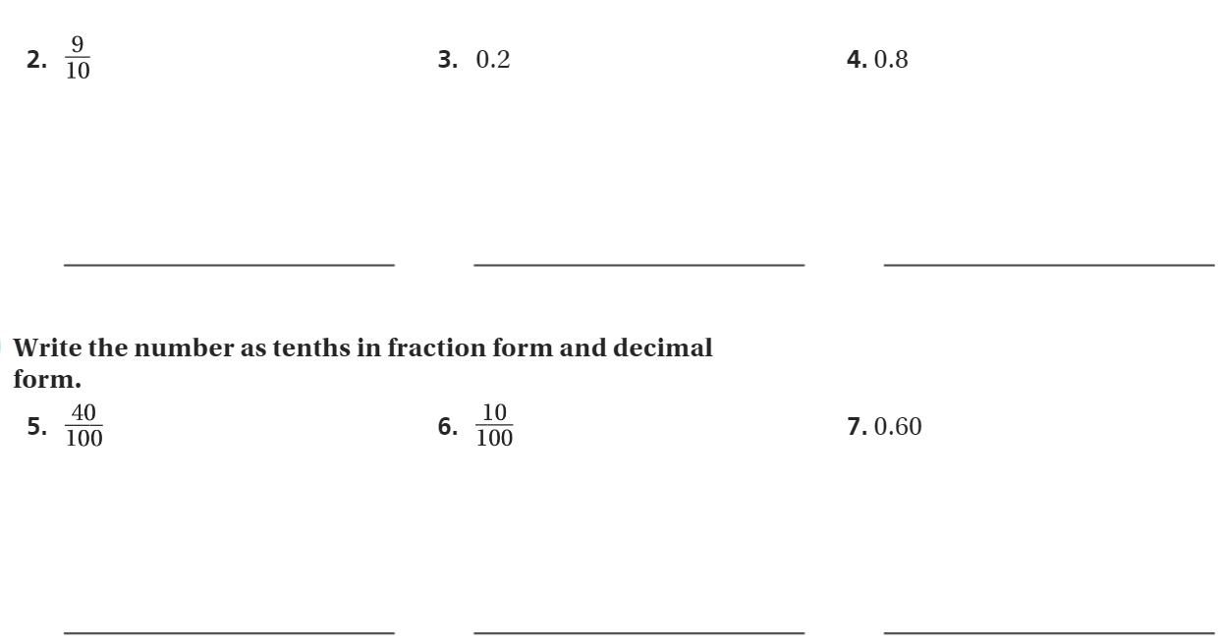
The Friday Quiz – Pg. 511

Slide 19
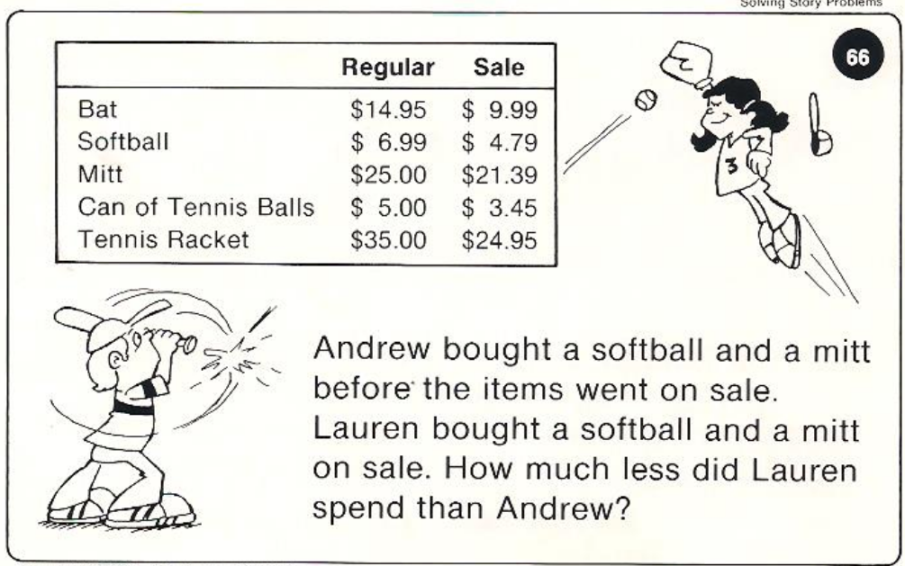
Calculator Problem

Slide 20
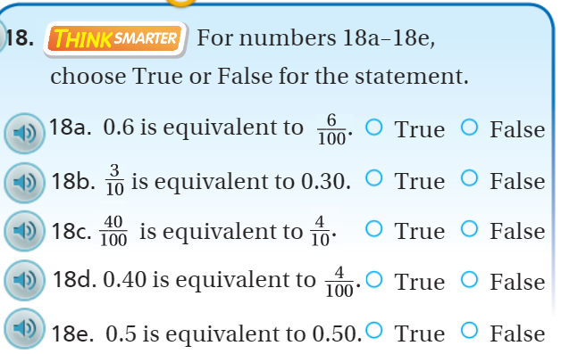
Exit Ticket – pg. 510

