Slide 1

Chapter 9
Lesson 9.4

Slide 2
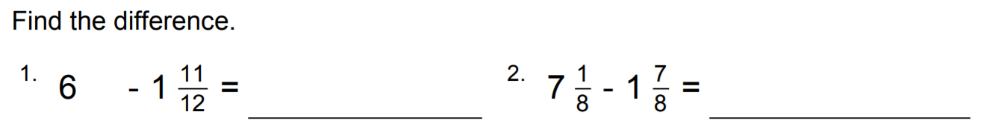
From Earlier….

Slide 3
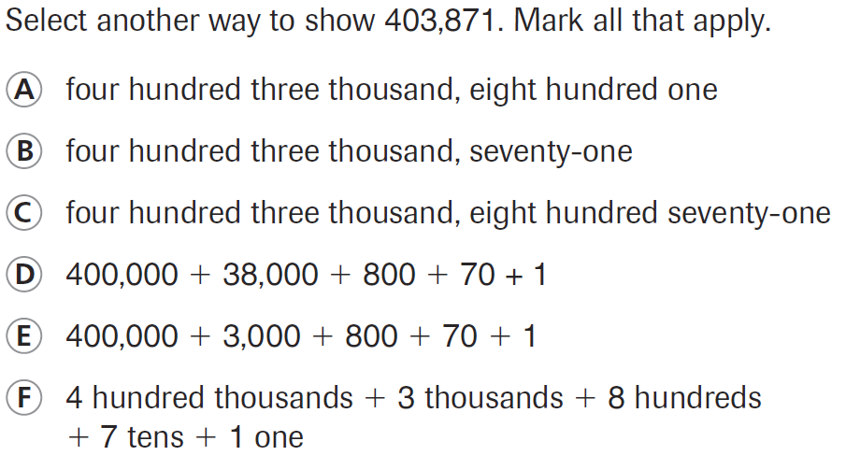
PARCC Practice

Slide 4
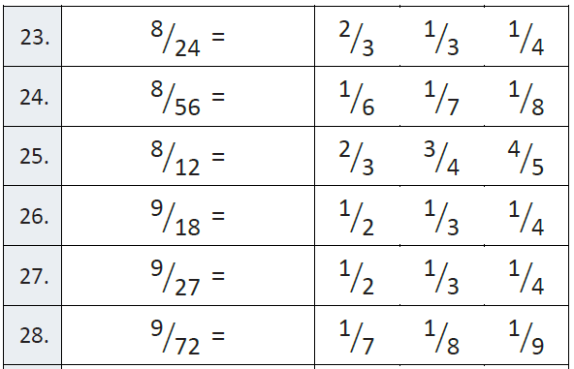
Fluency

Slide 5
Read it out loud!
23.75
44.7
63.30
852.3
301.03

Slide 6
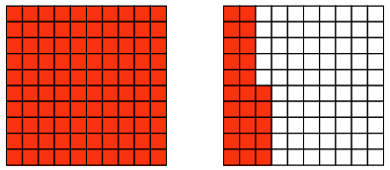
Let’s Look Back!

Slide 7
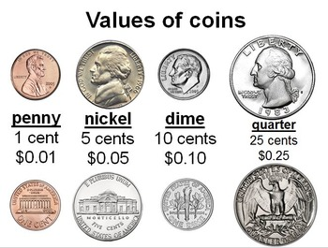

Slide 8
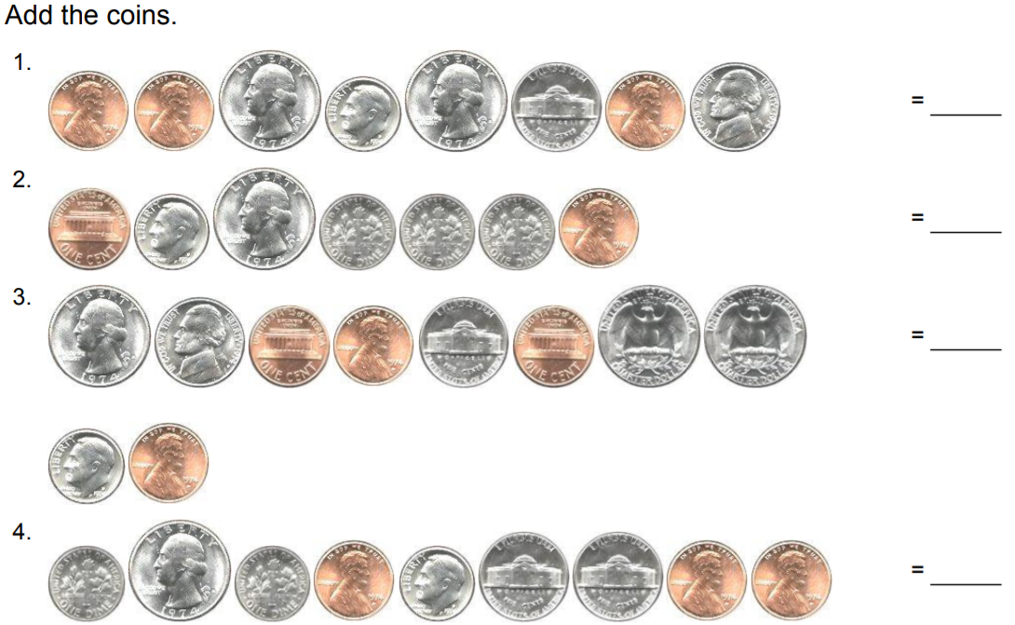
From Third Grade…

Slide 9
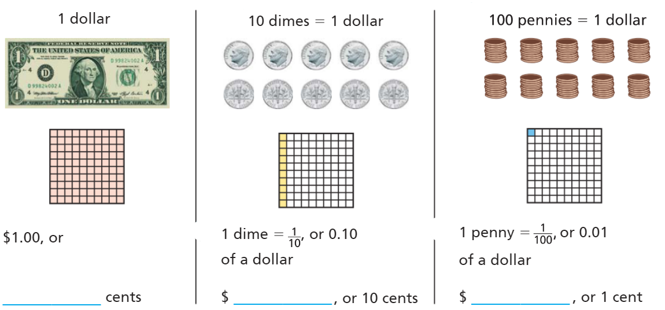
Teach and Reteach - Pg. 513

Slide 10
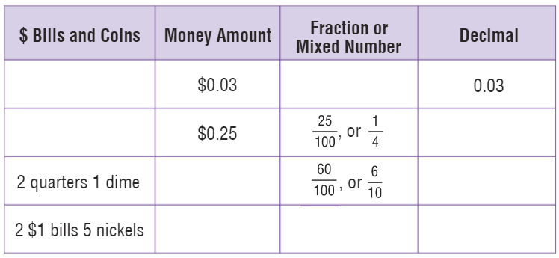
Teach and Reteach - Pg. 514

Slide 11
I can evaluate money in tenths and hundredths
Will you be able to do this?
Yes! | Maybe | No

Slide 12
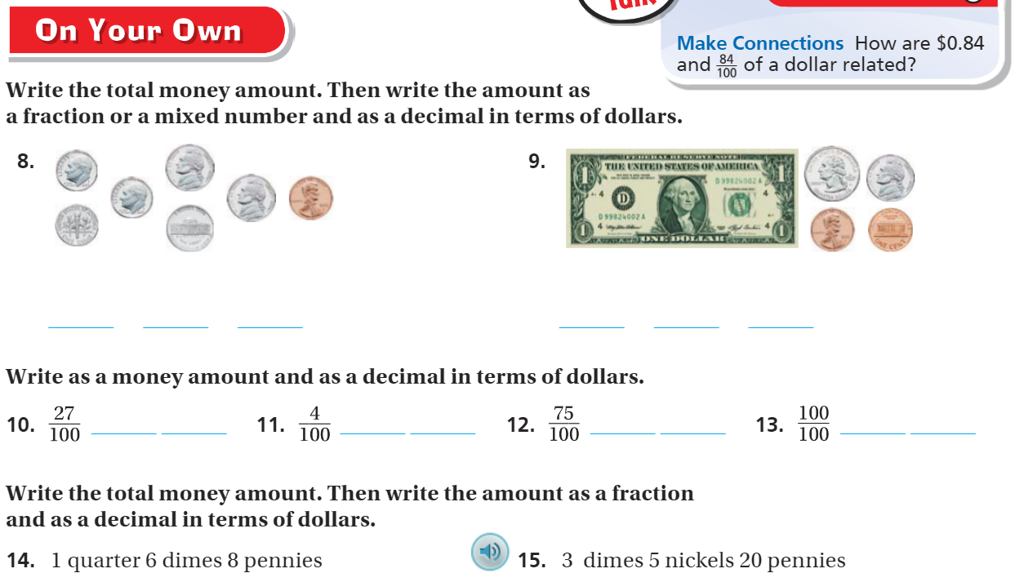
On your own – Pg. 515

Slide 13
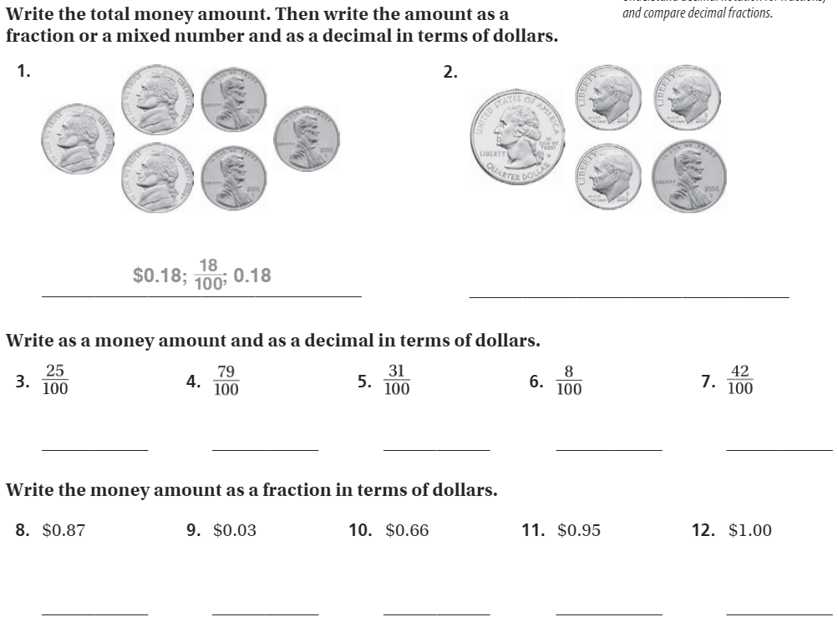
The Friday Quiz – Pg. 517

Slide 14
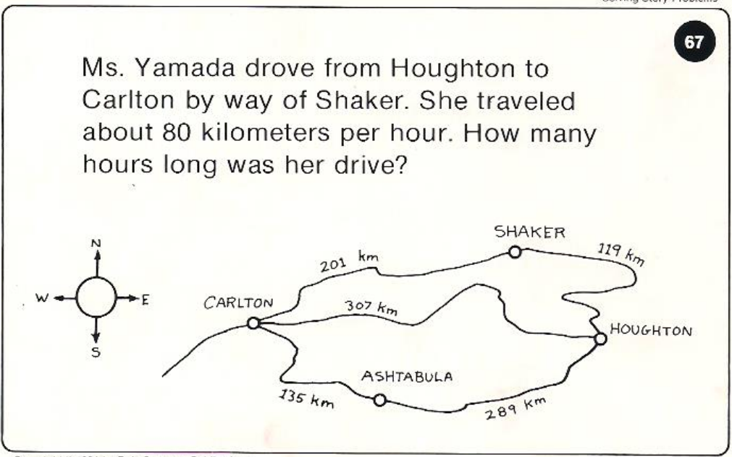
Calculator Problem

Slide 15
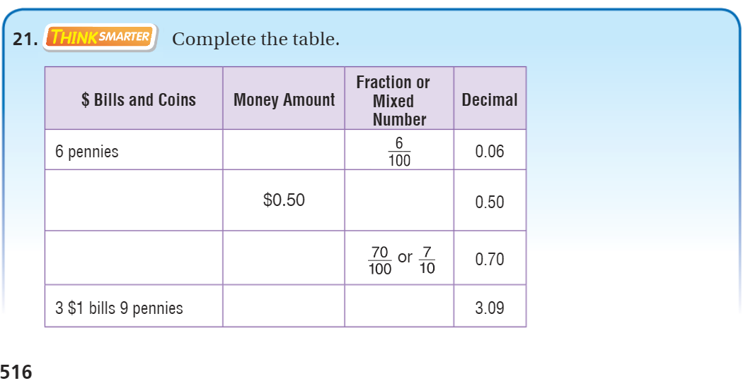
Exit Ticket – pg. 516

