Slide 1

Chapter 9
Lesson 9.6

Slide 2
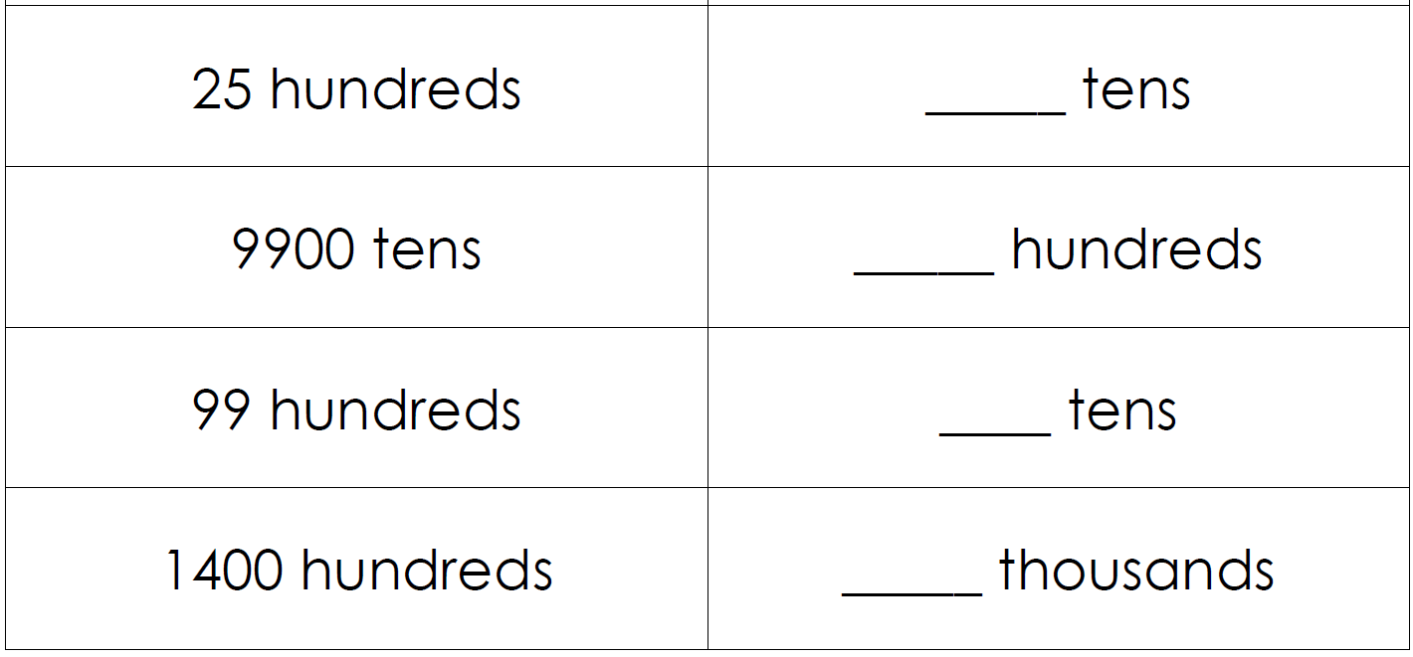
From Earlier…

Slide 3
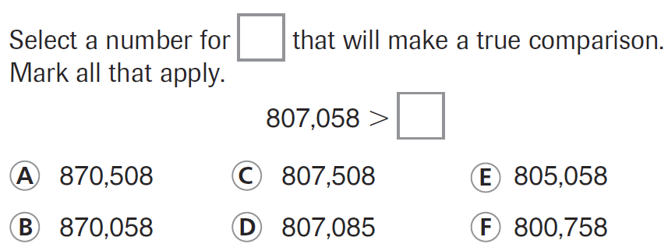
PARCC Practice

Slide 4
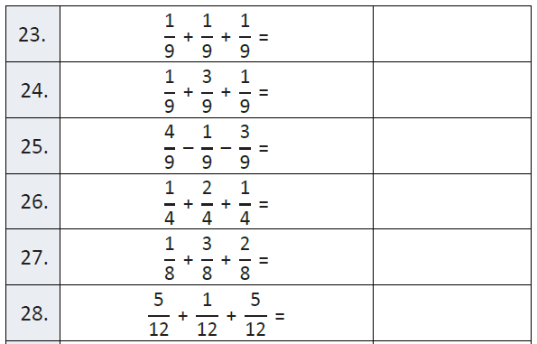
Fluency

Slide 5
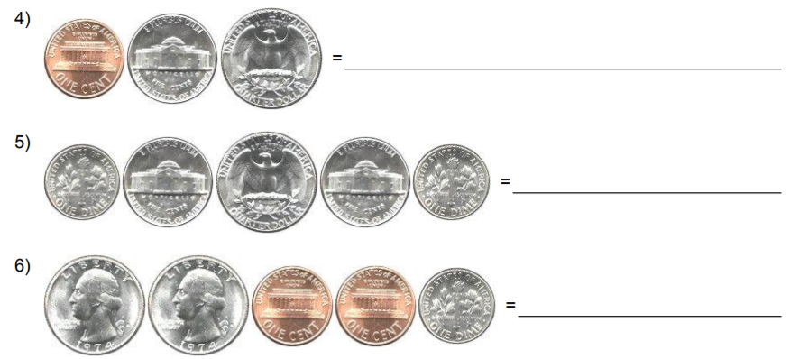
Let’s Look Back!

Slide 6
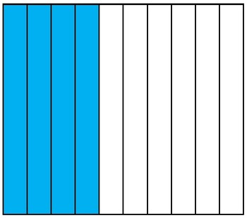
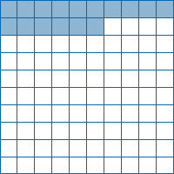

Slide 7
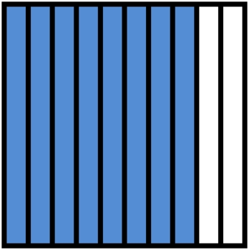
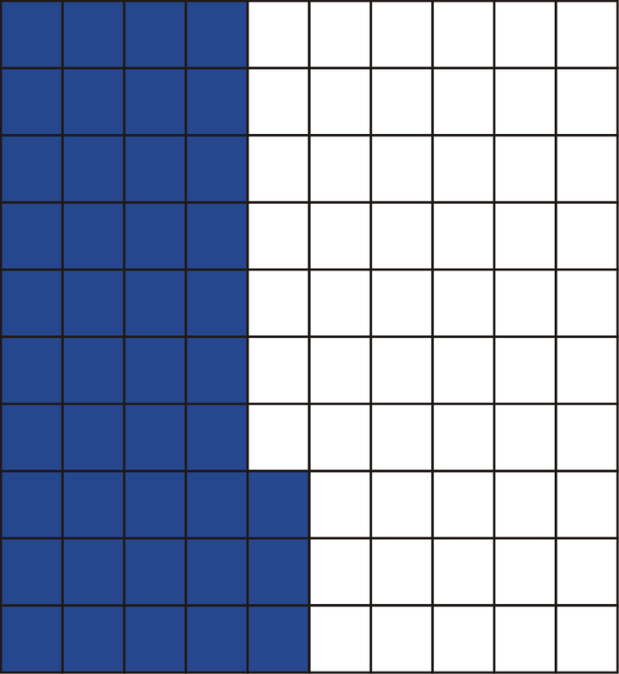

Slide 8
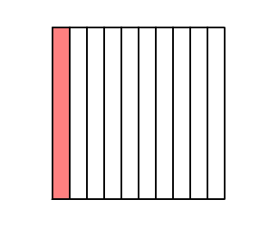
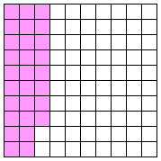

Slide 9

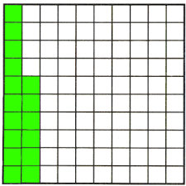

Slide 10
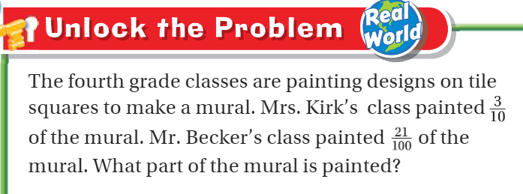

Teach and Reteach - Pg. 527

Slide 11

Teach and Reteach - Pg. 528

Slide 12
I can add fractions and decimals
Will you be able to do this?
Yes! | Maybe | No

Slide 13
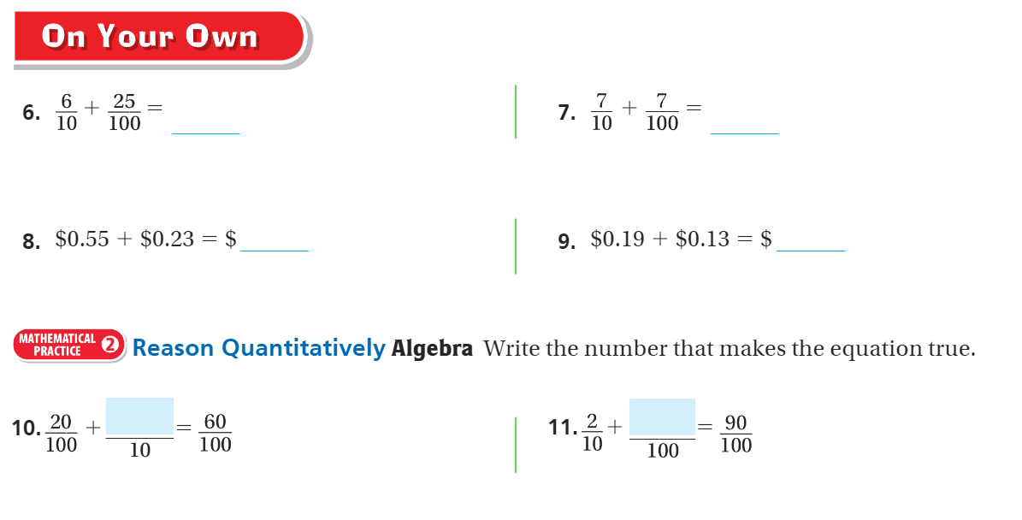
On your own – Pg. 529

Slide 14
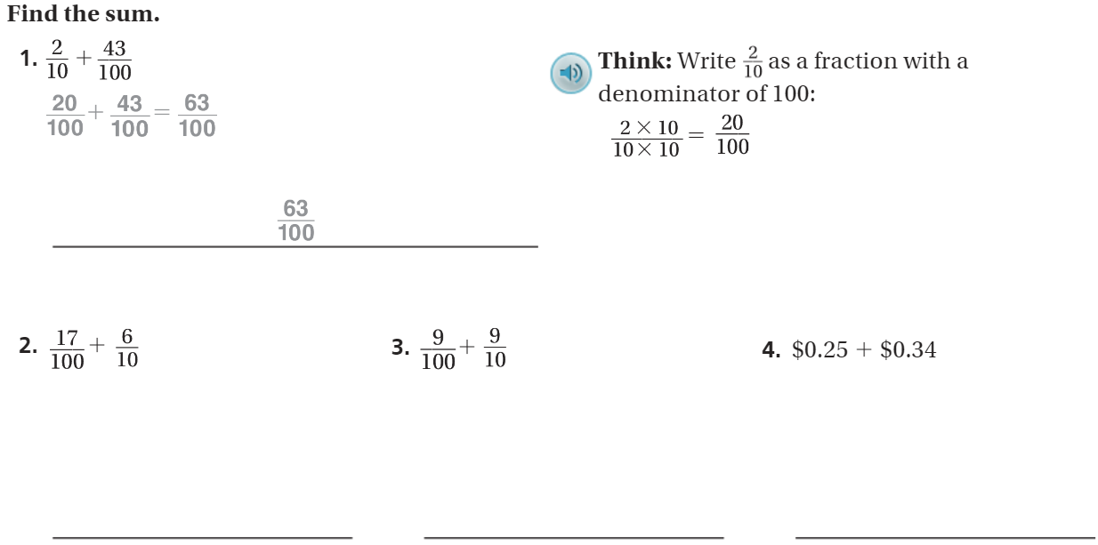
The Friday Quiz – Pg. 531

Slide 15
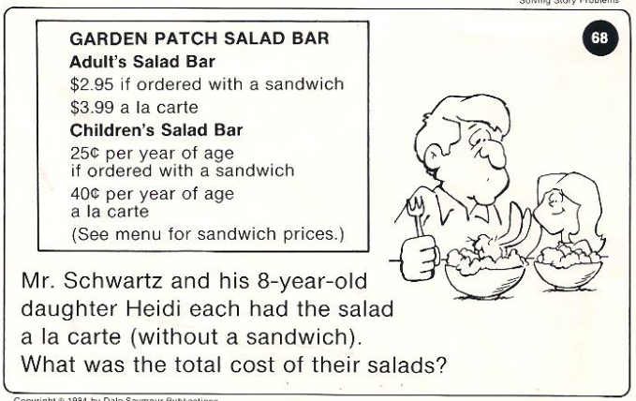
Calculator Problem

Slide 16
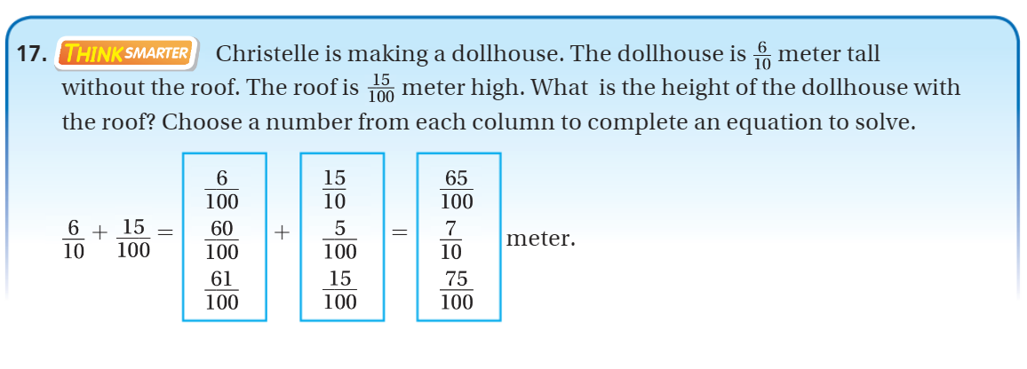
Exit Ticket – pg. 530

Slide 17

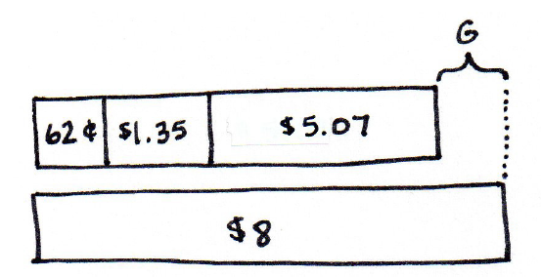
Team Think

