Slide 1

Chapter 9
Lesson 9.7

Slide 2
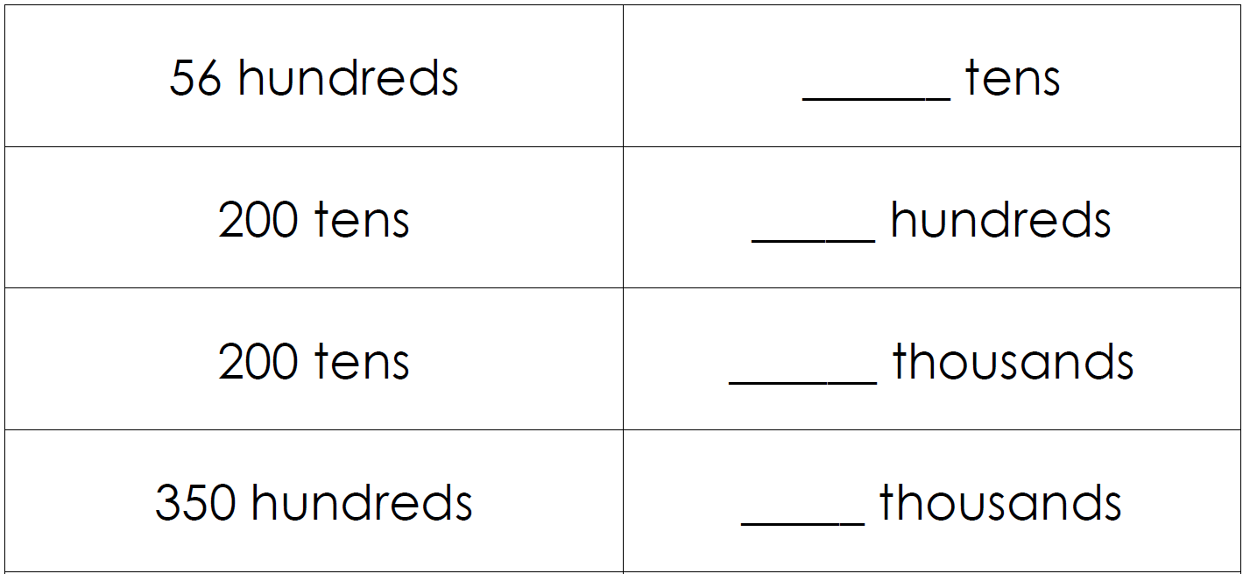
From Earlier…

Slide 3
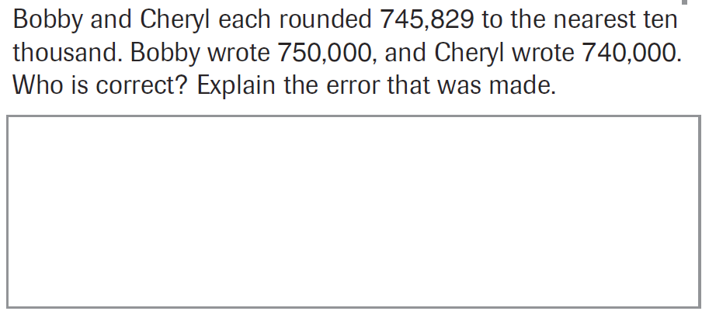
PARCC Practice

Slide 4
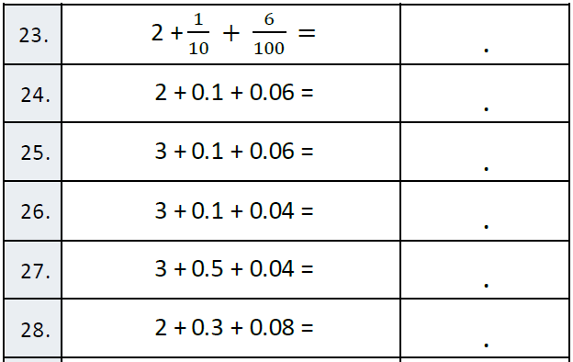
Fluency

Slide 5
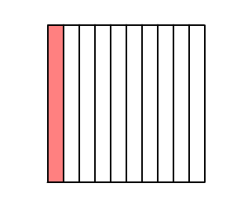
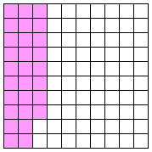
Let’s Look Back!
Add these amounts

Slide 6
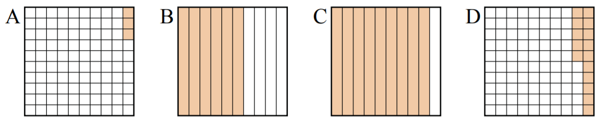
Write the decimal value of each
Order from least to greatest

Slide 7
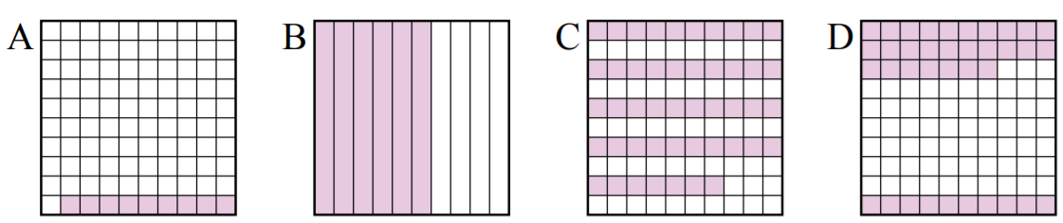
Write the decimal value of each
Order from least to greatest

Slide 8
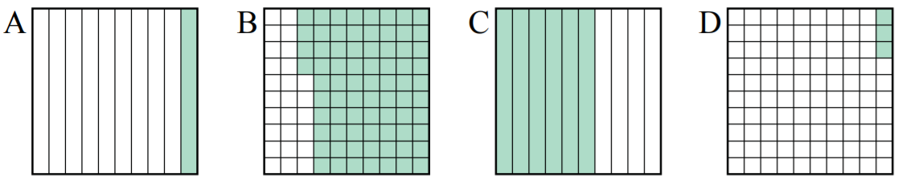
Write the decimal value of each
Order from least to greatest

Slide 9
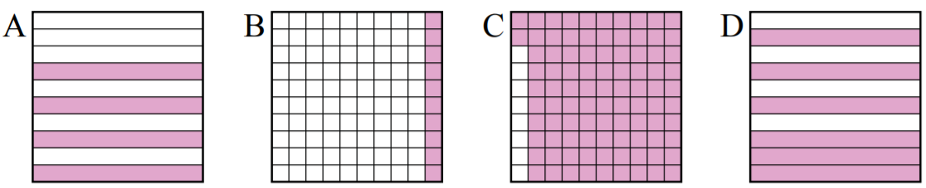
Write the decimal value of each
Order from least to greatest

Slide 10
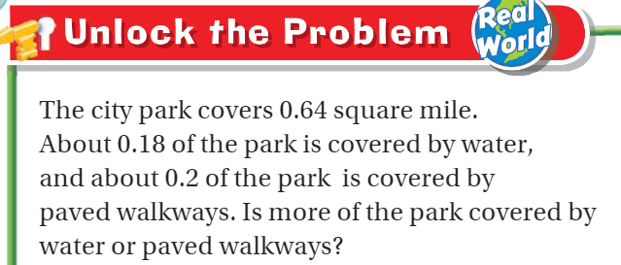
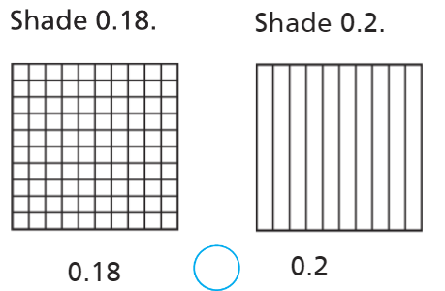
Teach and Reteach - Pg. 533

Slide 11
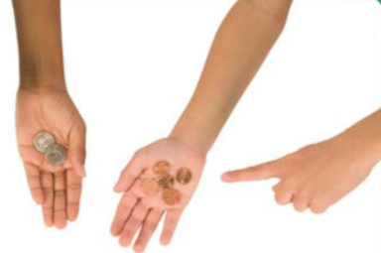
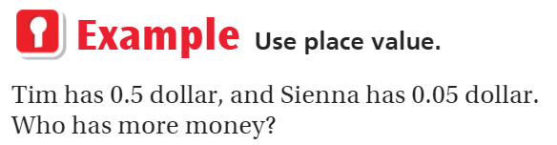
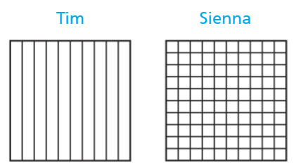
Teach and Reteach - Pg. 534

Slide 12
I can compare fractions and decimals
Will you be able to do this?
Yes! | Maybe | No

Slide 13
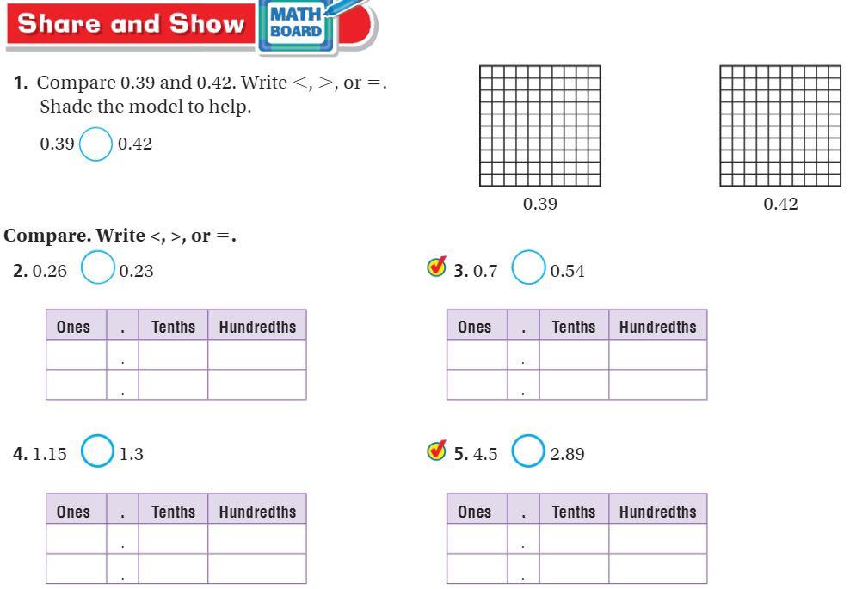
Do this – Share & Show – pg. 535

Slide 14
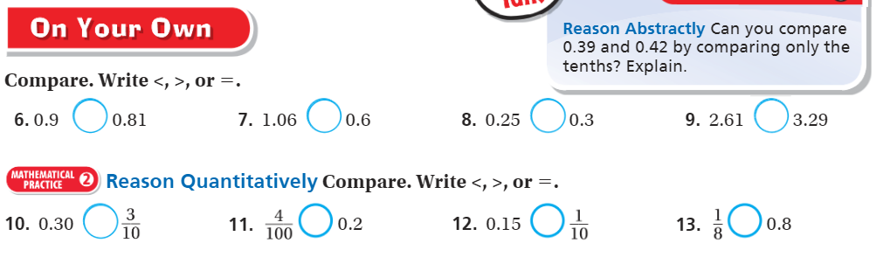
Do this - On your own – Pg. 535

Slide 15
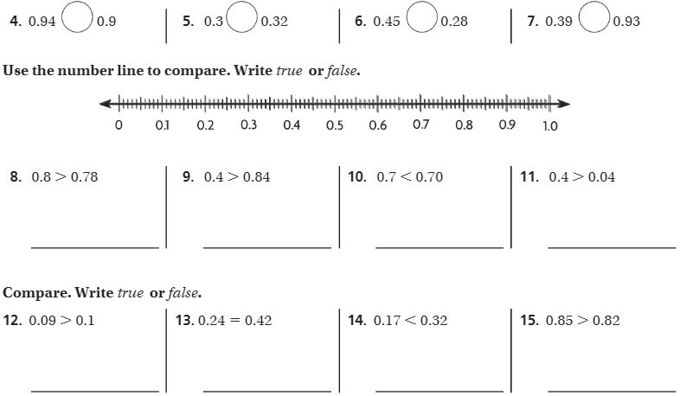
Do this - The Friday Quiz – Pg. 537

Slide 16
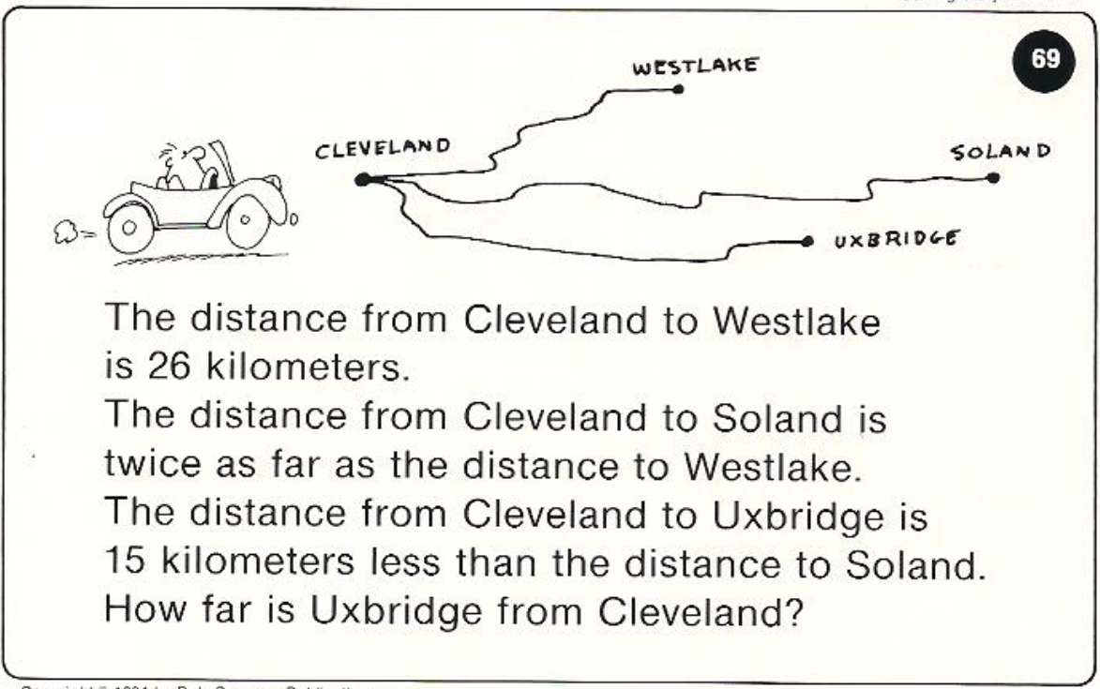
Calculator Problem

Slide 17
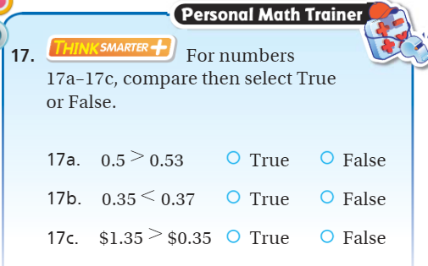
Exit Ticket – pg. 536

