Slide 1

Chapter 7
Lesson 7.6

Slide 2
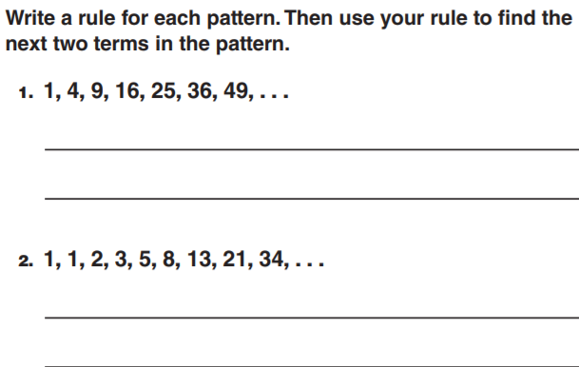
From earlier

Slide 3
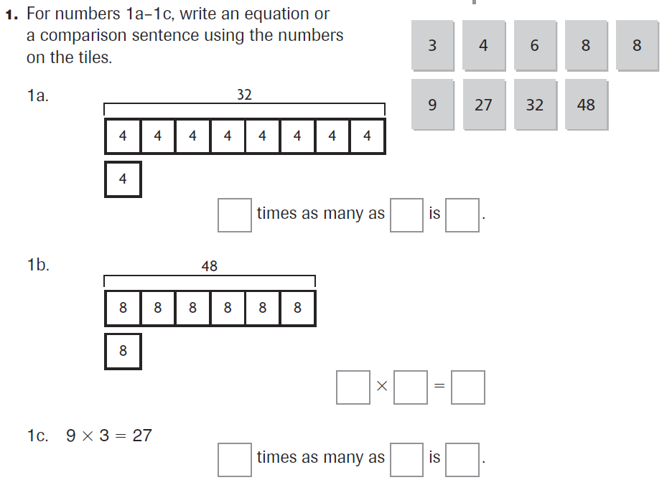
PARCC Practice

Slide 4

Fluency

Slide 5



Slide 6



Slide 7

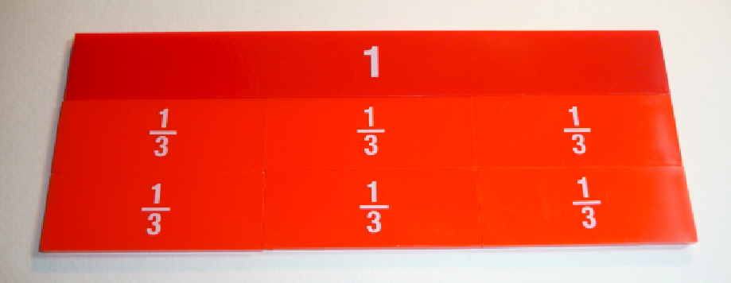

Slide 8

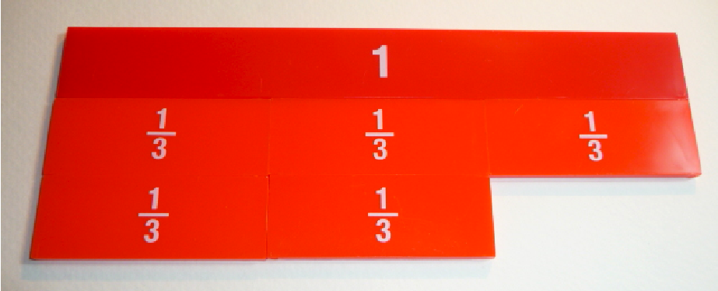

Slide 9



Slide 10



Slide 11



Slide 12

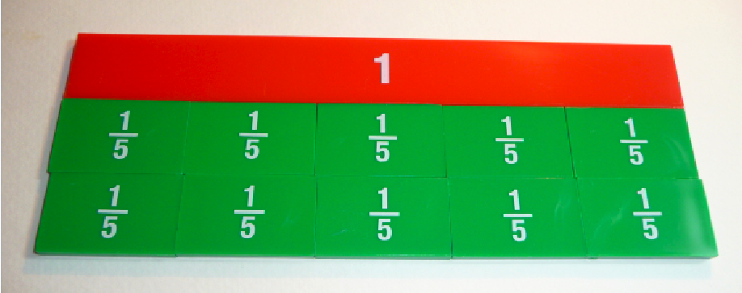

Slide 13

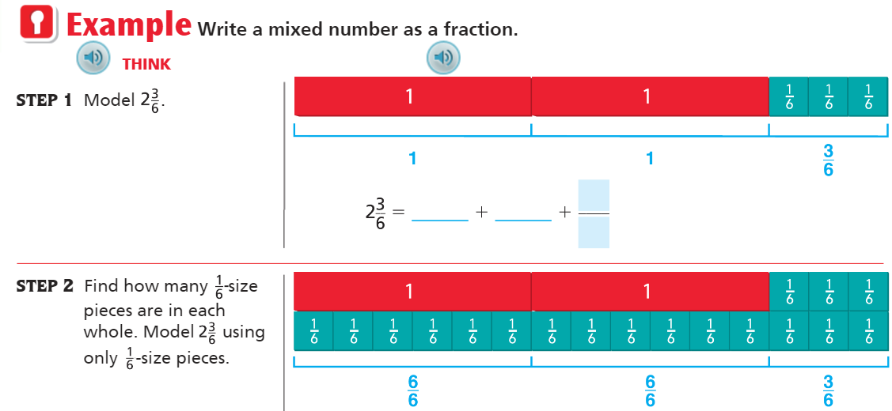
Teach and Reteach - Pg. 417

Slide 14

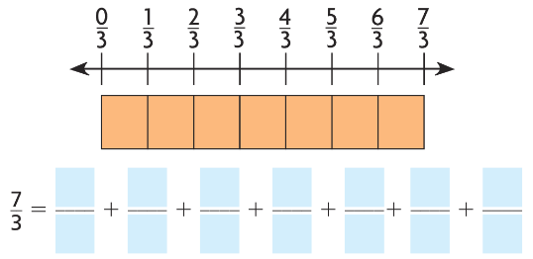
Teach and Reteach - Pg.418

Slide 15
I can show improper fractions and mixed numbers
Will you be able to do this?
Yes! | Maybe | No

Slide 16
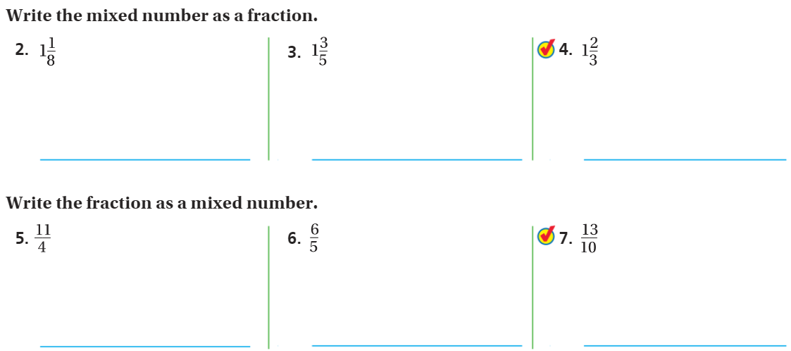
Share and Show- Pg. 419

Slide 17
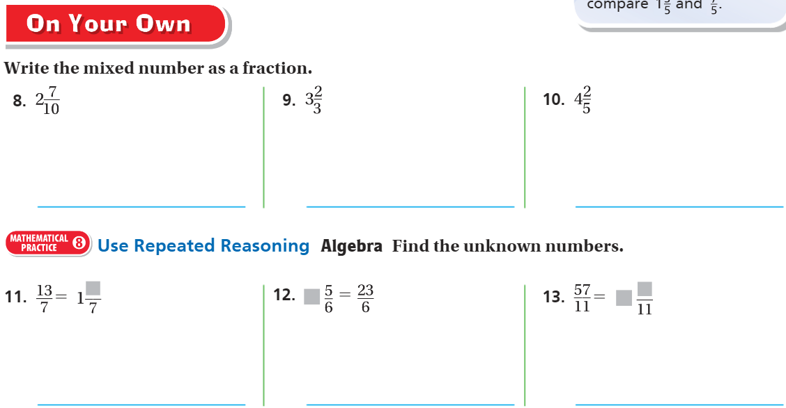
On your own – pg. 419

Slide 18


The Friday Quiz – Pg. 421

Slide 19
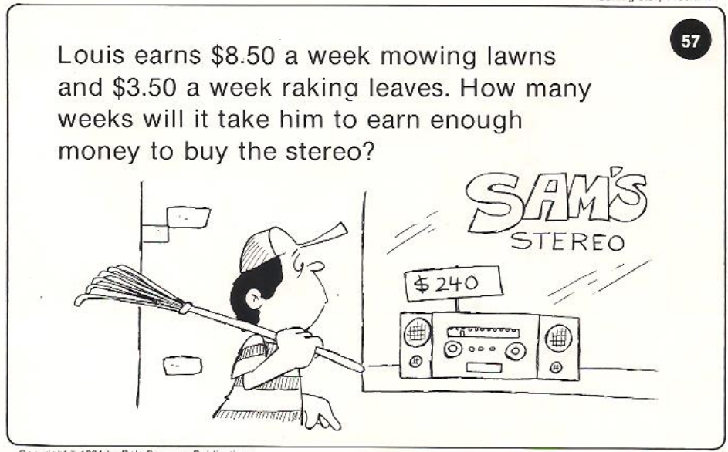
Calculator Problem

Slide 20
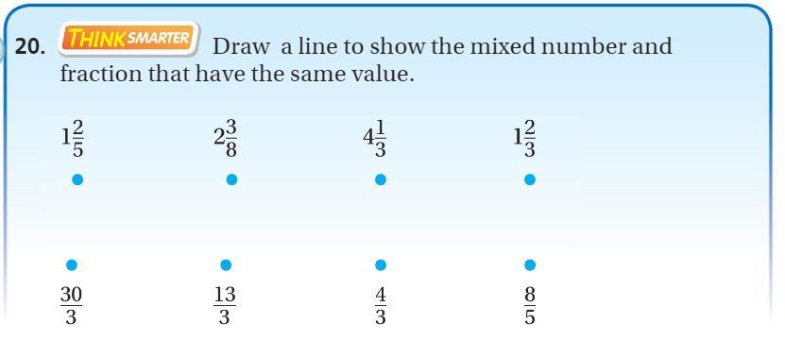
Exit Ticket – pg.420

