Slide 1

Chapter 10
Lesson 10.1

Slide 2

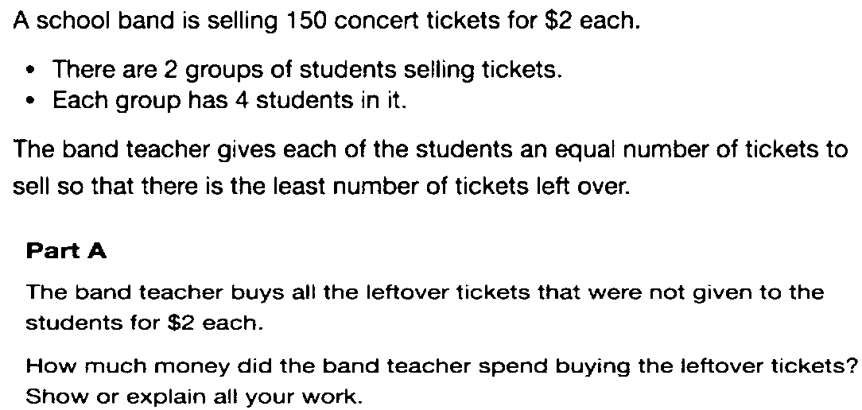

Slide 3

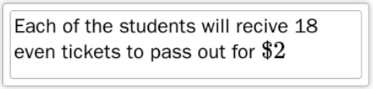
No Points
Timmy Snodgrass

Slide 4
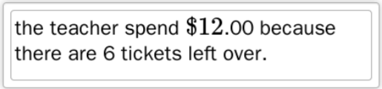
Half Points

Slide 5
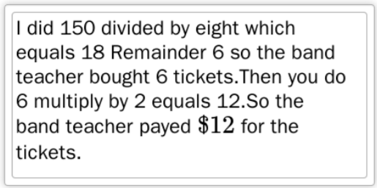
Full Points

Slide 6
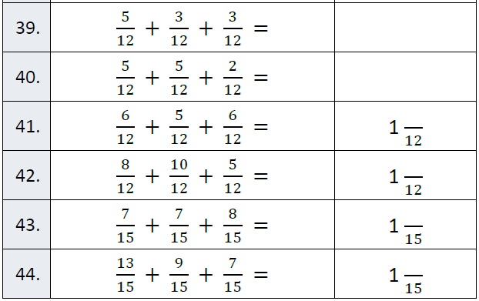
Fluency

Slide 7
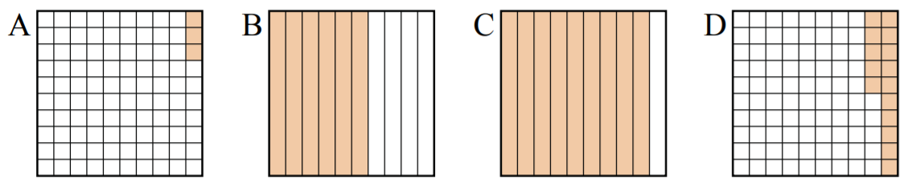
Let’s Look Back!
Order decimals from least to greatest

Slide 8
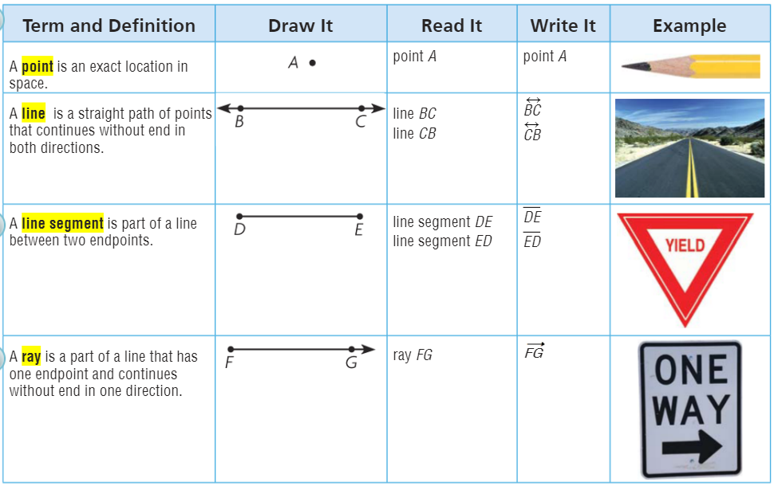
Teach and Reteach - Pg. 549

Slide 9
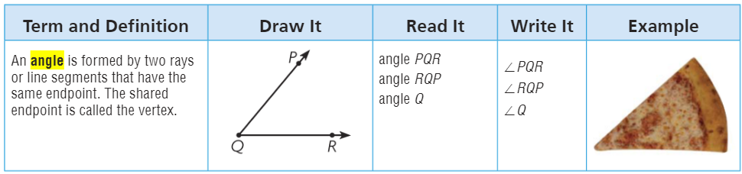
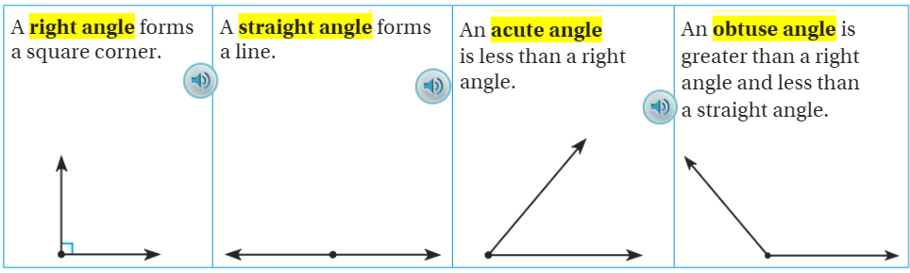
Teach and Reteach - Pg.550

Slide 10
I can name points, lines, rays, and segments
Will you be able to do this?
Yes! | Maybe | No

Slide 11
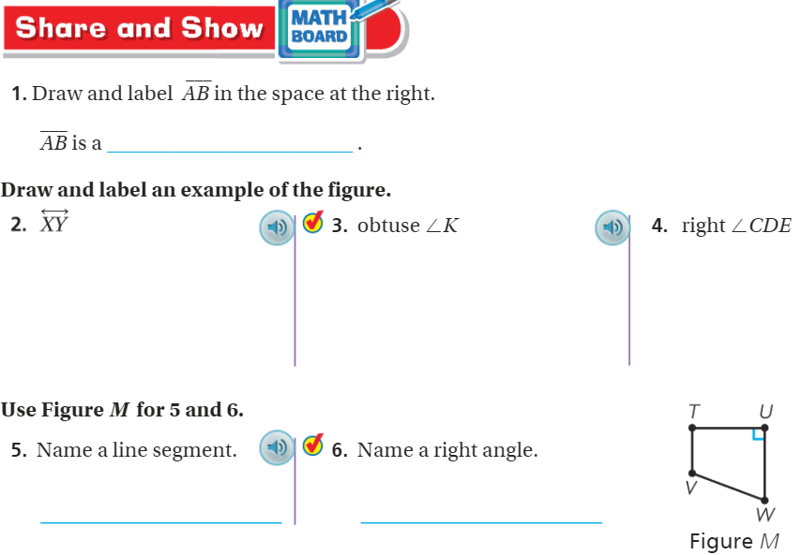
Share & Show – pg. 551

Slide 12
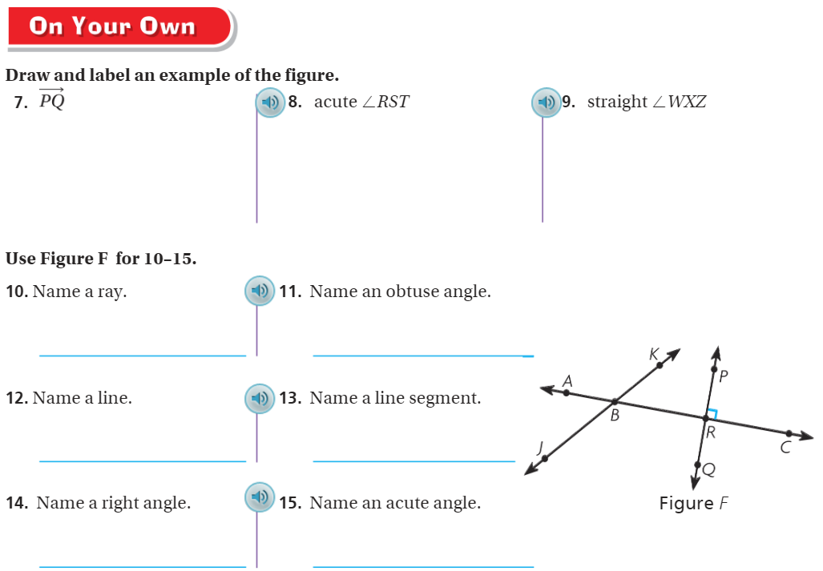
On your own – Pg.

Slide 13
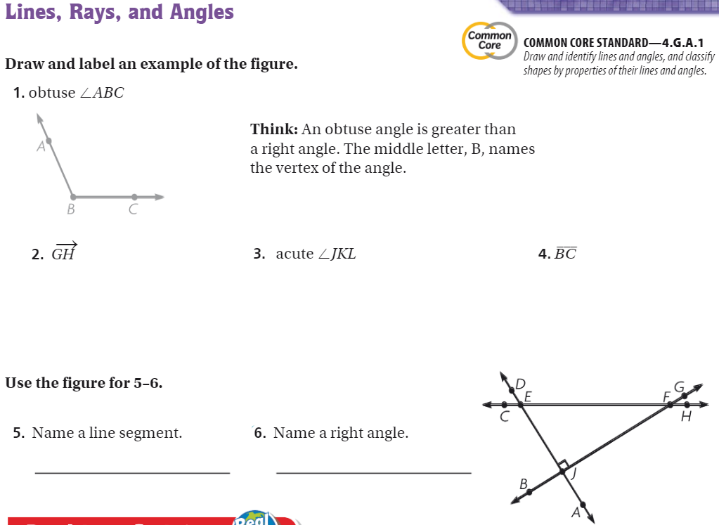
The Friday Quiz – Pg. 553

Slide 14
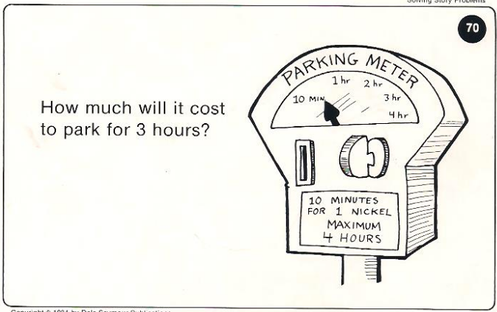
Calculator Problem

Slide 15
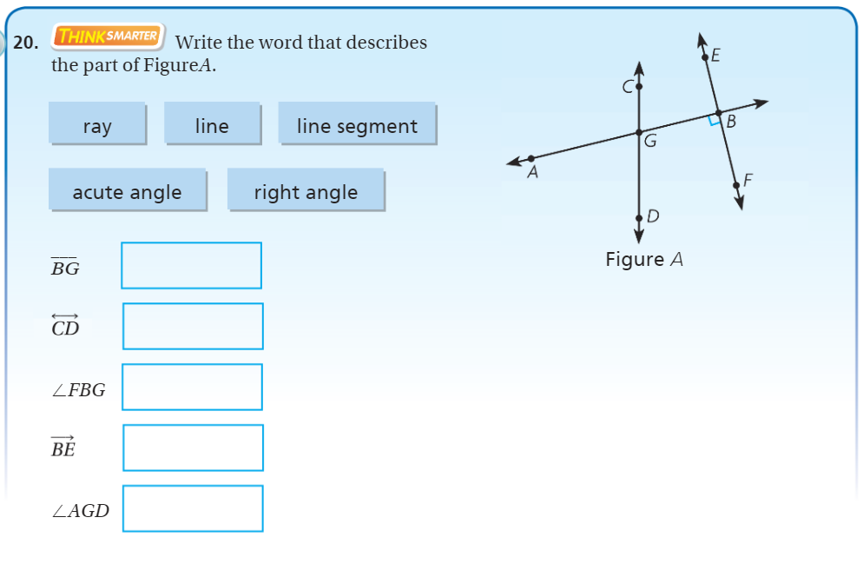
Exit Ticket – pg. 552

