Slide 1

Chapter 10
Lesson 10.2

Slide 2

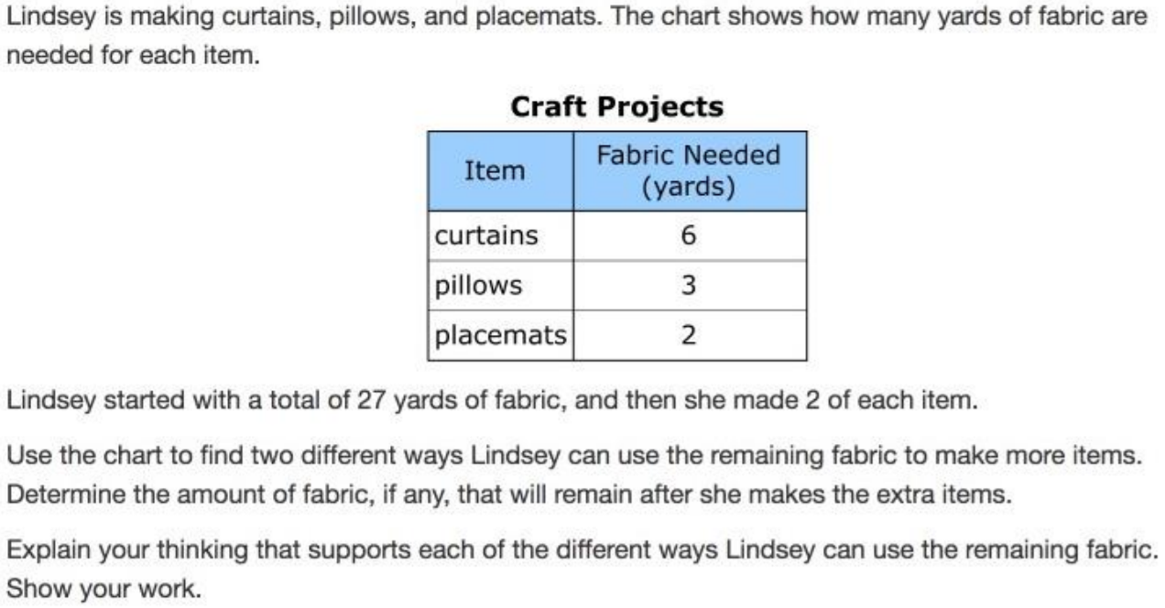

Slide 3

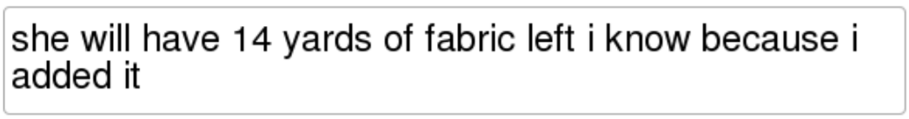
No Points
Brady Toecrabs

Slide 4
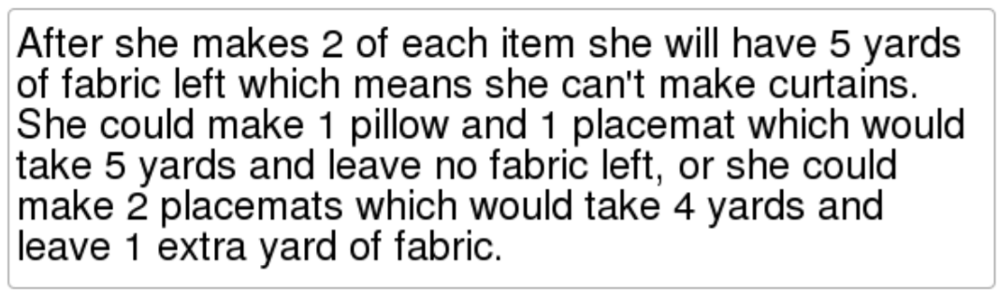
Half Points
Amber Dripdunk

Slide 5
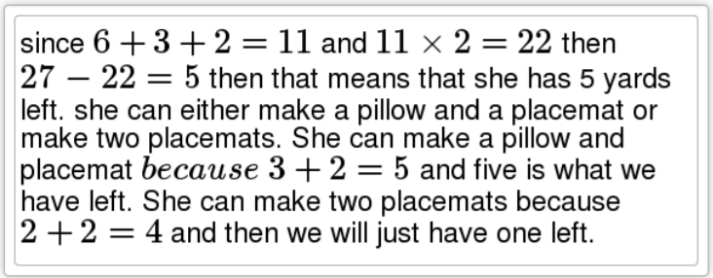
Full Points
Parker Plopping

Slide 6
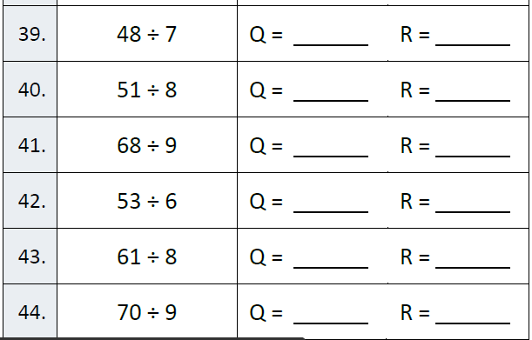
Fluency

Slide 7
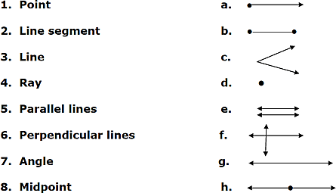
Match it up!

Slide 8
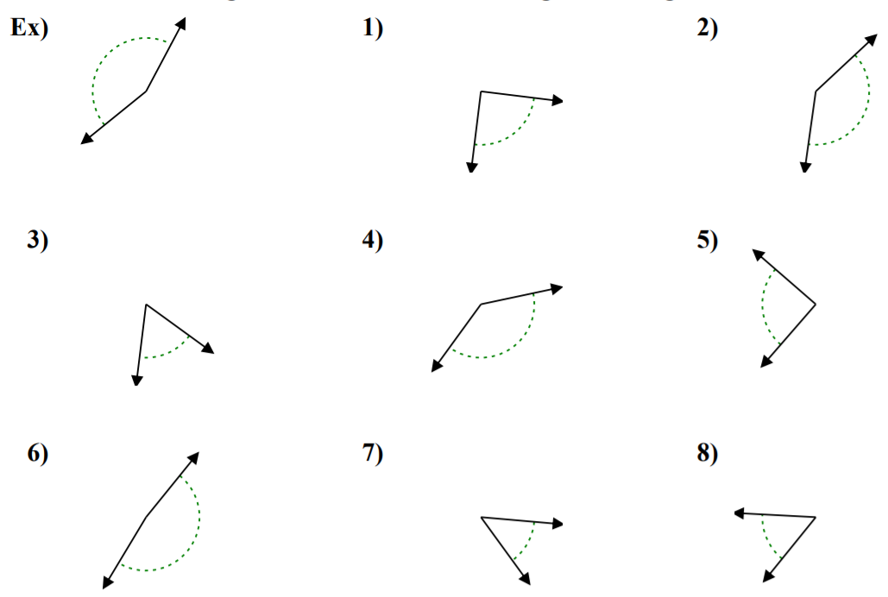
Let’s Look Back!

Slide 9
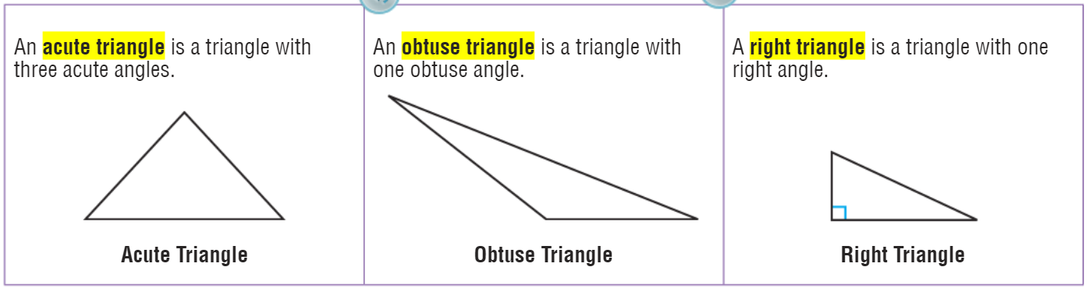
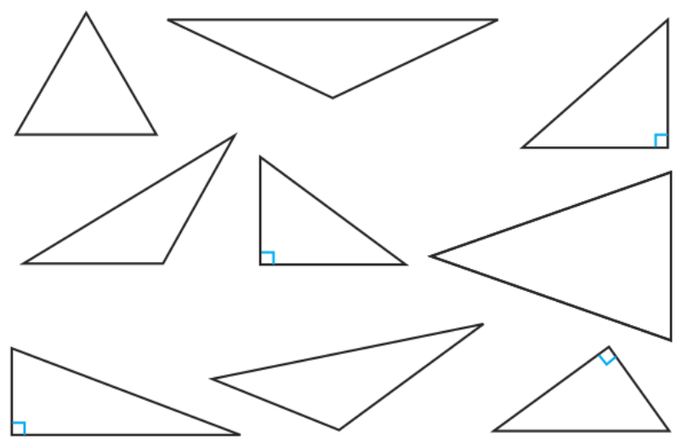
Teach and Reteach - Pg. 555

Slide 10
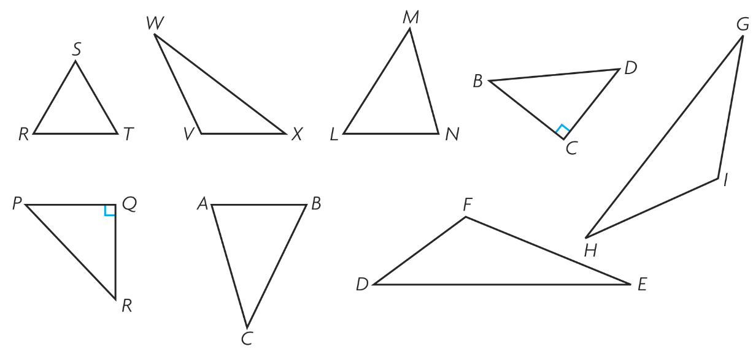
Teach and Reteach - Pg. 556

Slide 11
I can classify triangles by angles.
Will you be able to do this?
Yes! | Maybe | No

Slide 12
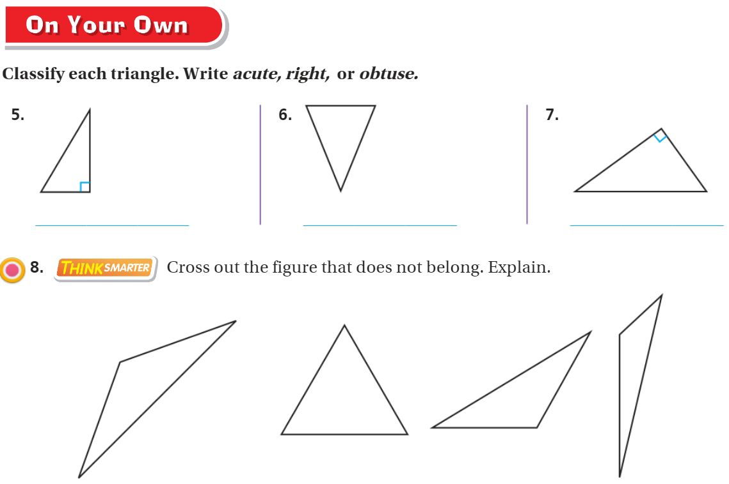
On your own – Pg. 557

Slide 13
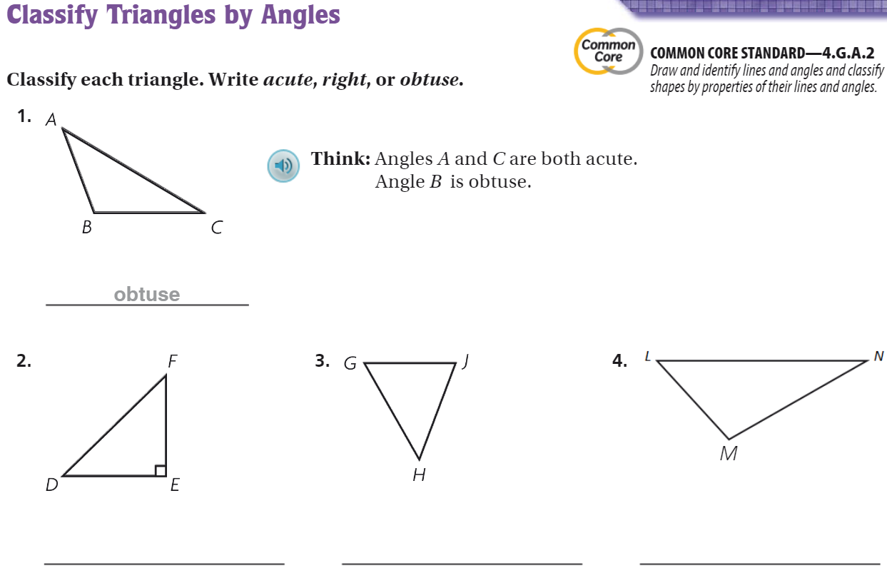
The Friday Quiz – Pg. 559

Slide 14
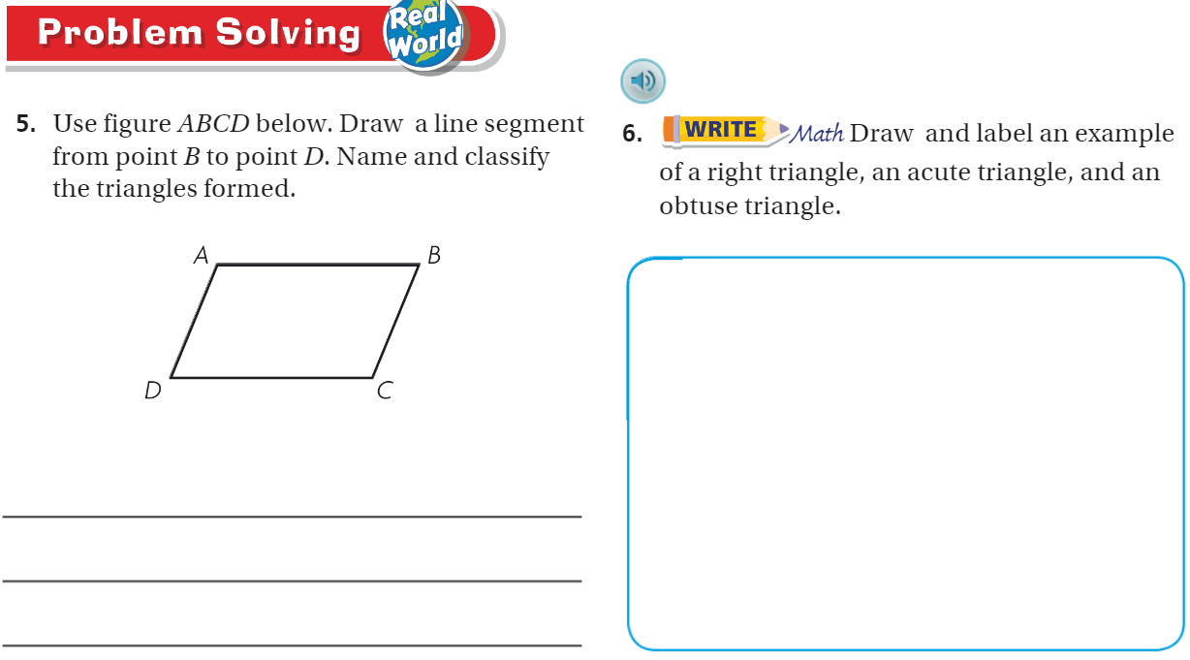

Slide 15
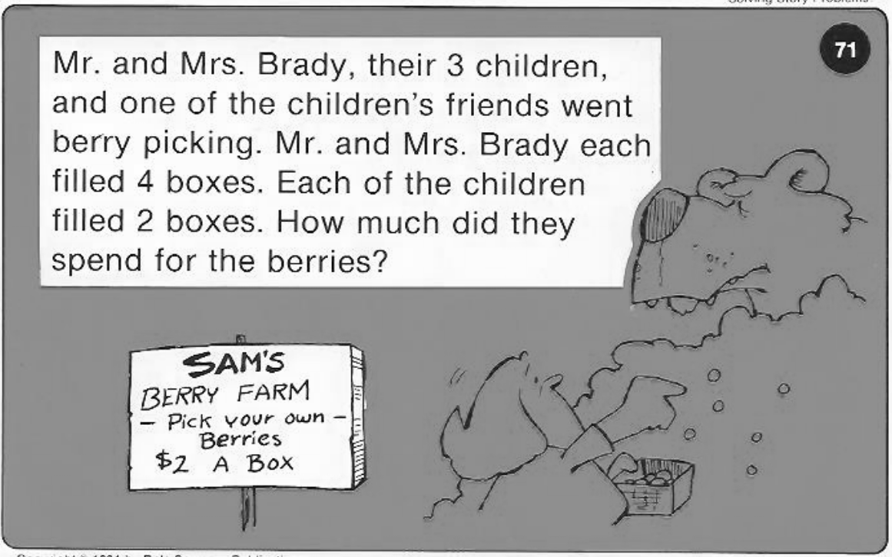
Calculator Problem

Slide 16
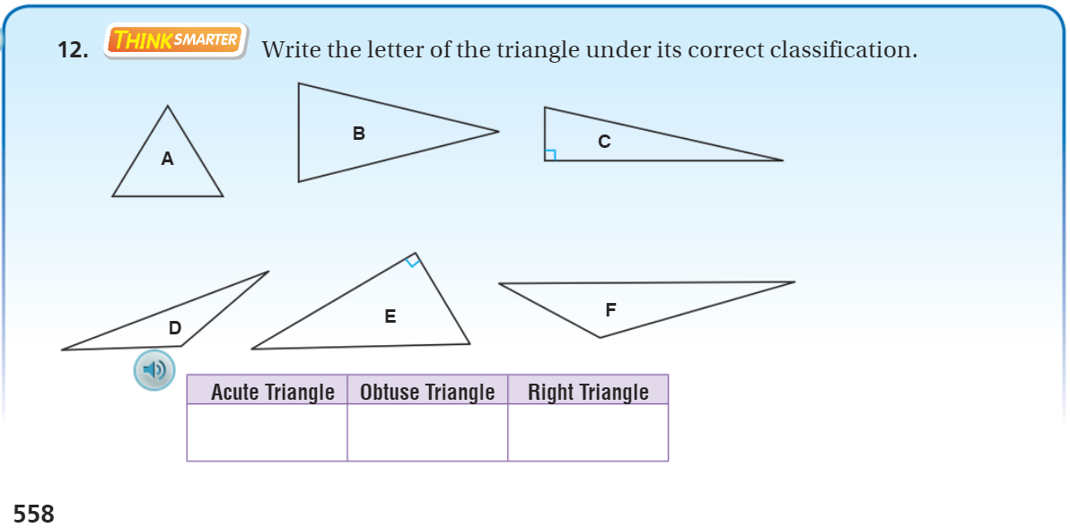
Exit Ticket – pg. 558

