Slide 1

Chapter 10
Lesson 10.3

Slide 2

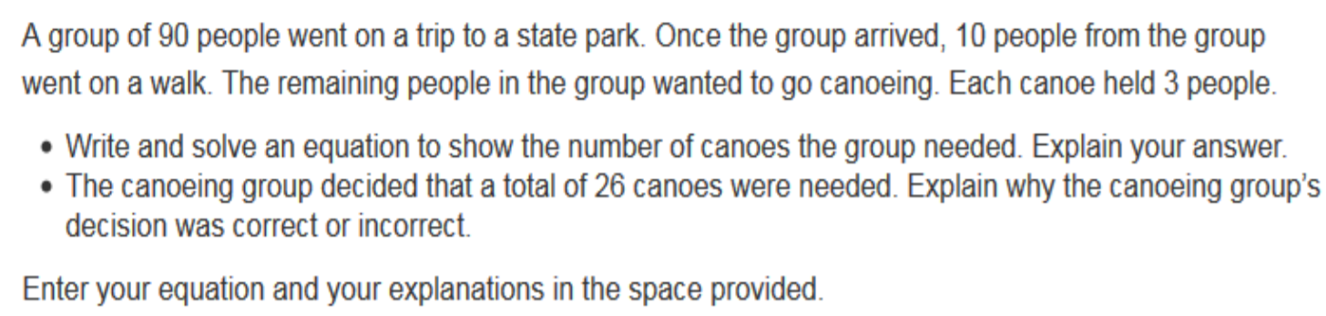

Slide 3


No Points
Emma Djibouti

Slide 4
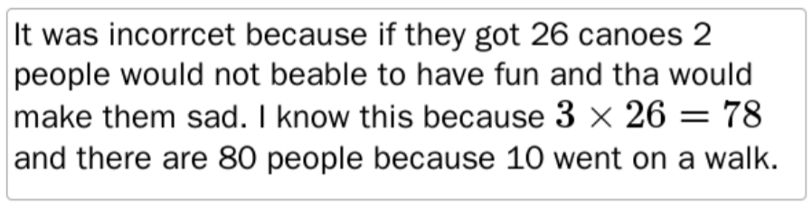
Half Points
Brad Antspit

Slide 5
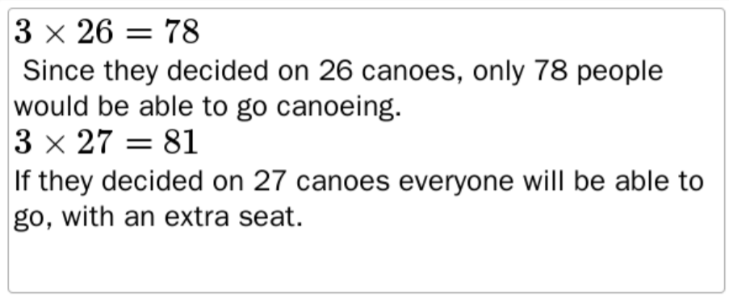
Full Points
Erin Dingle

Slide 6
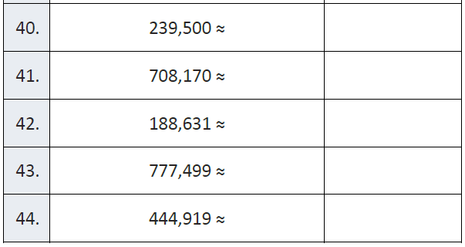
Fluency
Round to the nearest ten-thousand

Slide 7
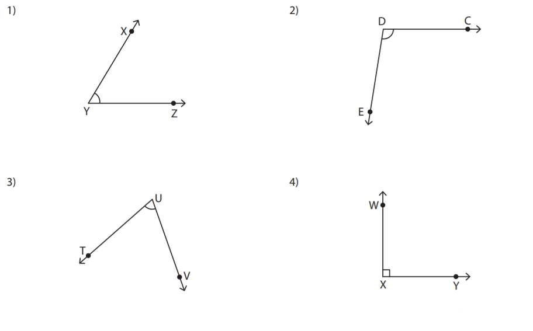
Name the angle….

Slide 8
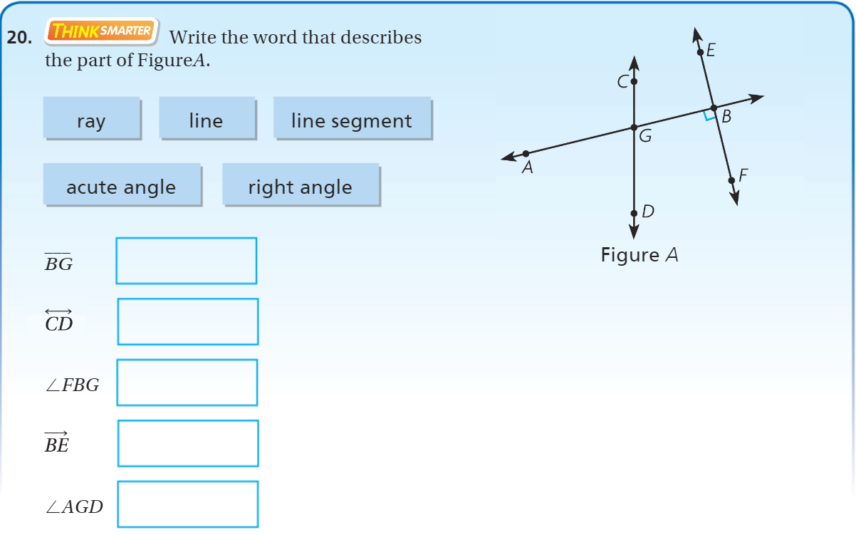
Let’s Look Back!

Slide 9
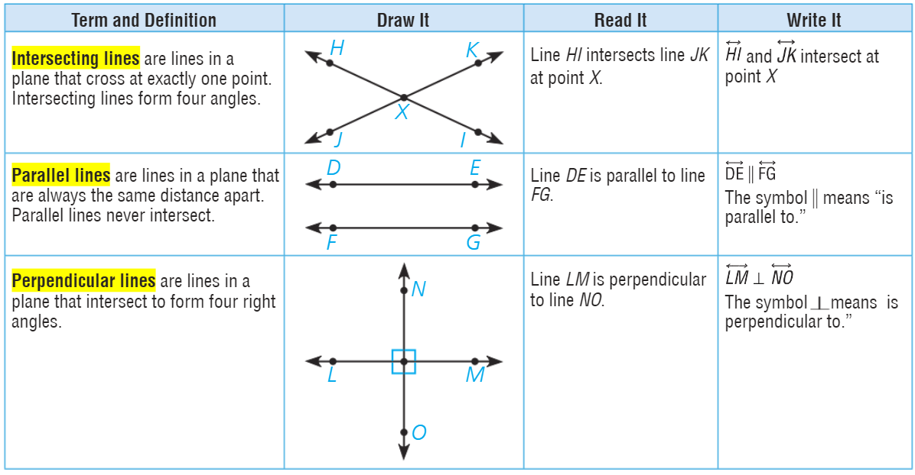
Teach and Reteach - Pg. 561

Slide 10
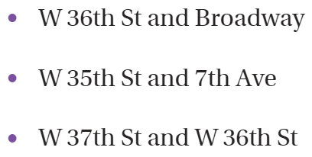
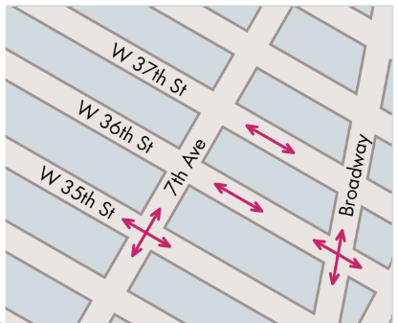
Teach and Reteach - Pg. 561

Slide 11


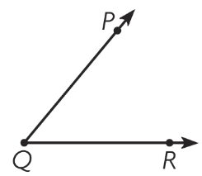





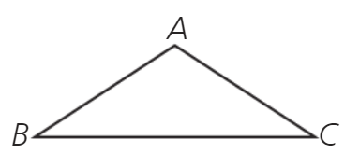
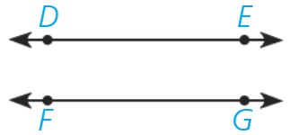


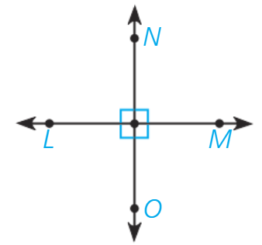

Read this!

Slide 12
I can name parallel and perpendicular lines.
Will you be able to do this?
Yes! | Maybe | No

Slide 13
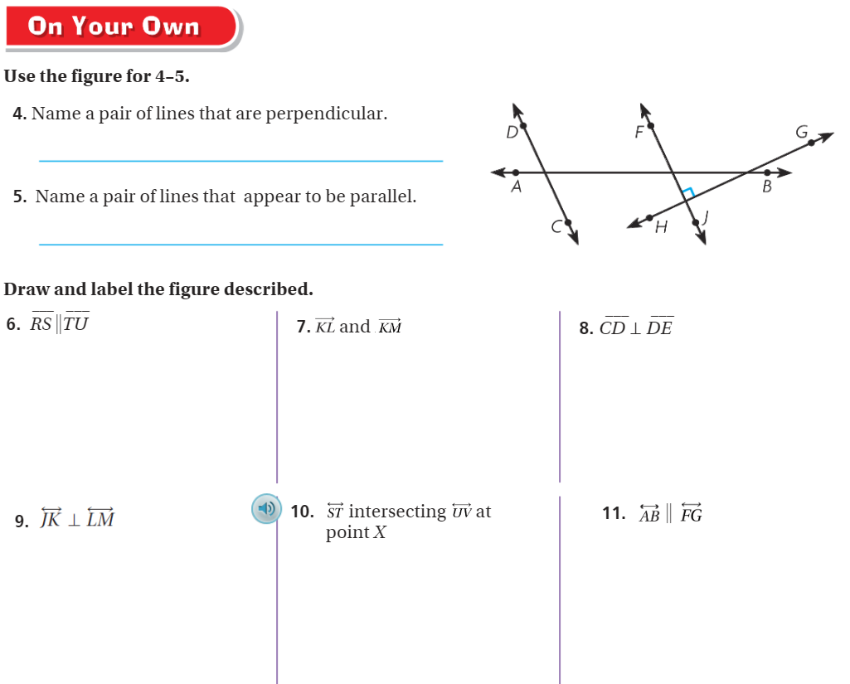
On your own – Pg. 563

Slide 14
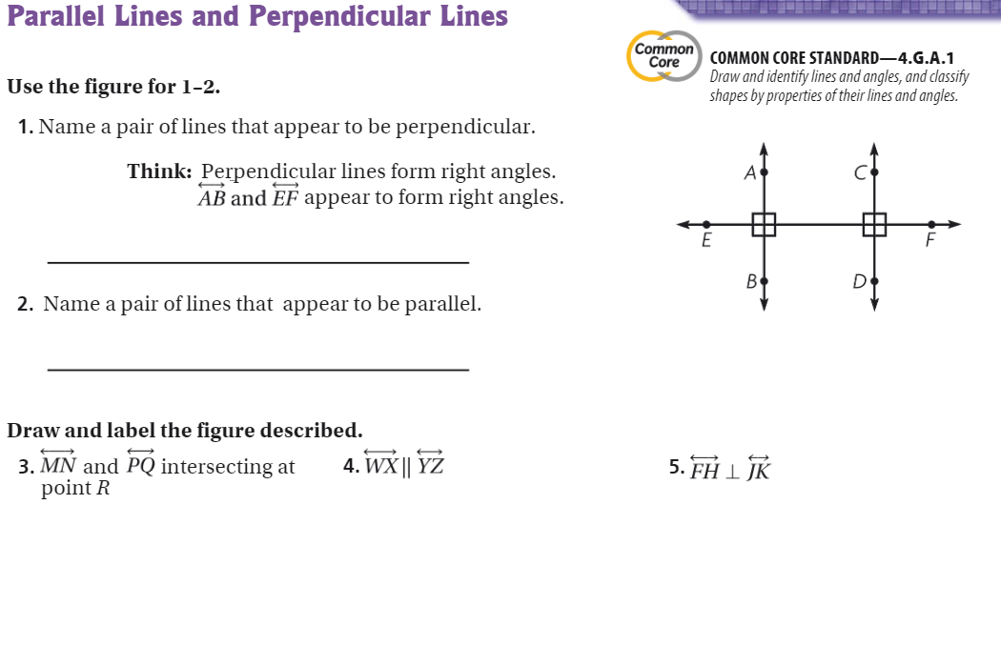
The Friday Quiz – Pg. 565

Slide 15
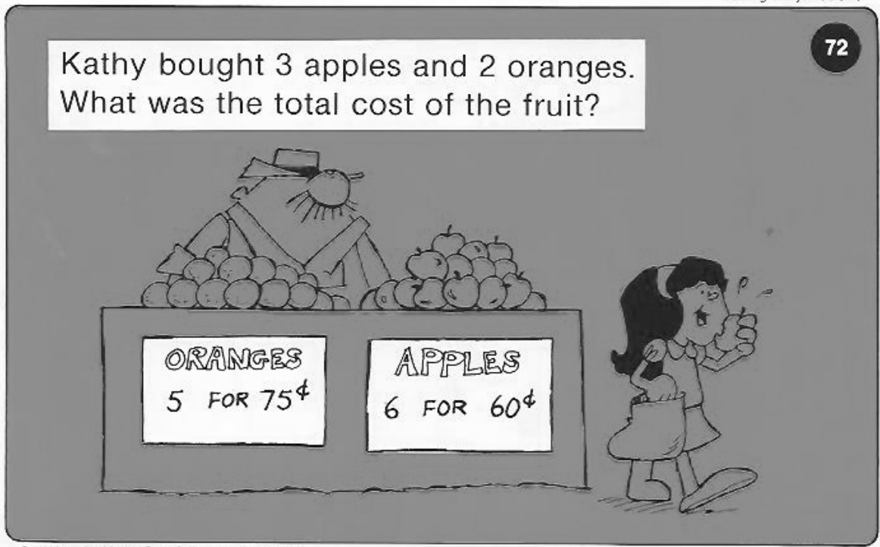
Calculator Problem

Slide 16
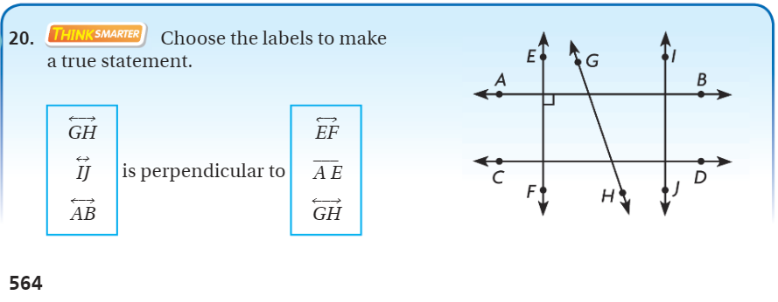
Exit Ticket – pg. 564

