Slide 1

Chapter 10
Lesson 10.4

Slide 2

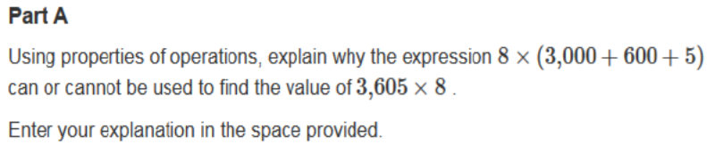
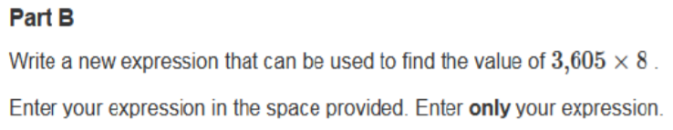

Slide 3

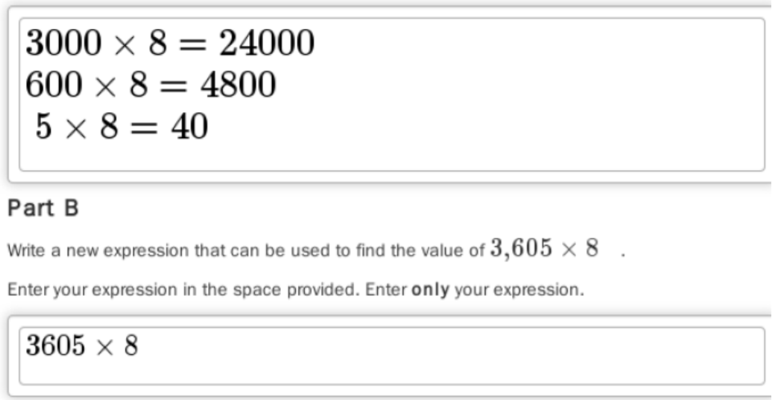
No Points
Bethany Ratslapper

Slide 4
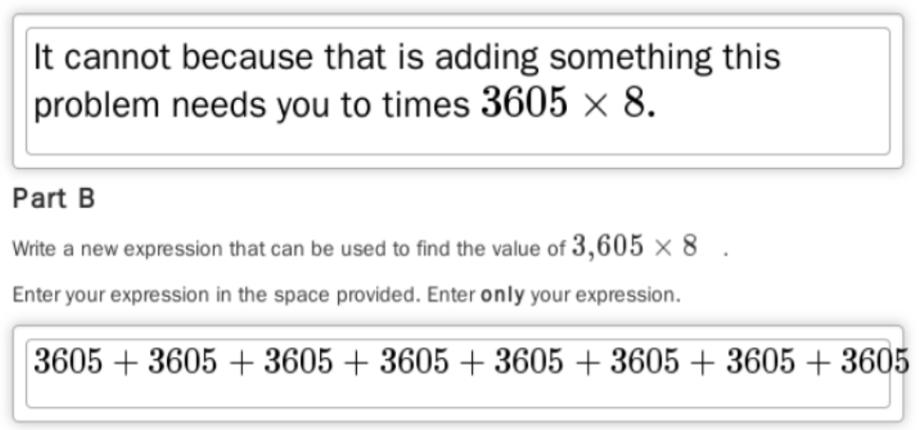
Half Points
Bob Tubbubble

Slide 5
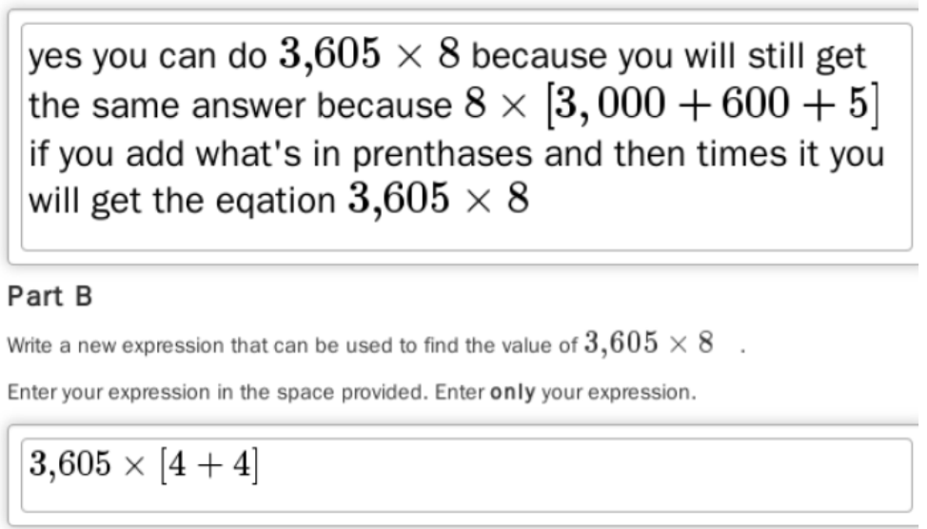
Full Points
Louie Stank

Slide 6
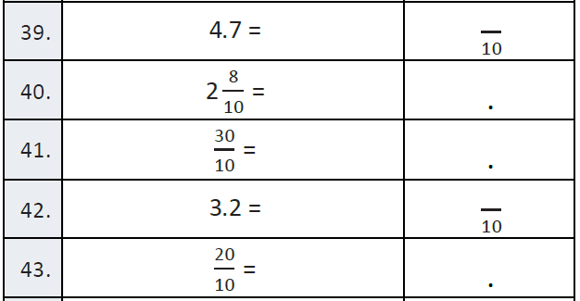
Fluency

Slide 7
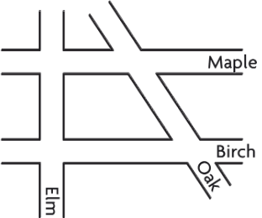
Let’s Look Back!
What streets are parallel?
What streets intersect?
What streets are perpendicular?
What streets cross at an acute angle?

Slide 8
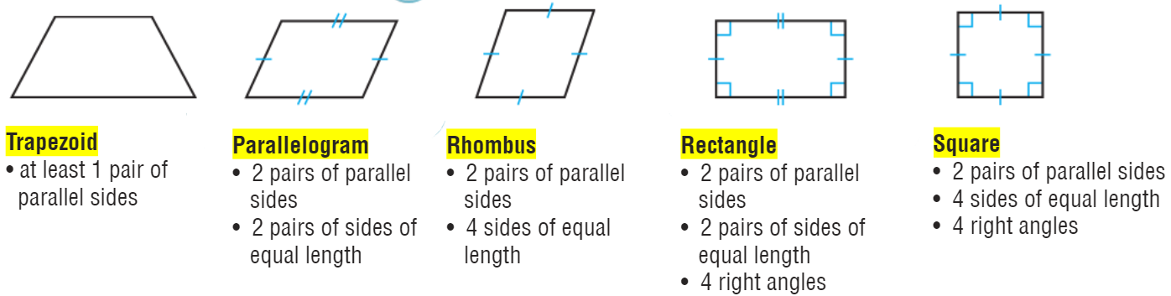
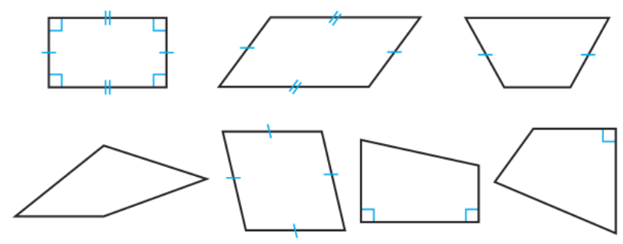
Teach and Reteach - Pg. 567

Slide 9
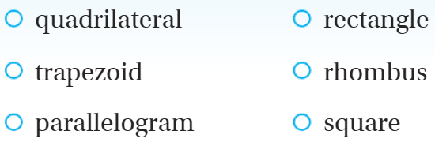
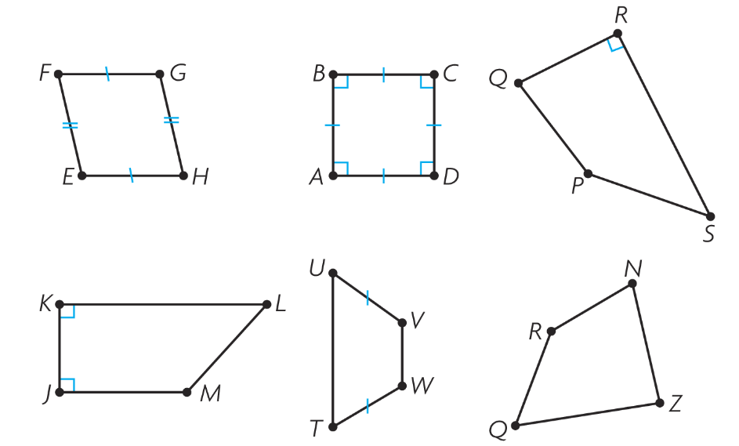
Teach and Reteach - Pg. 570

Slide 10
I can name parallel and perpendicular lines.
Will you be able to do this?
Yes! | Maybe | No

Slide 11
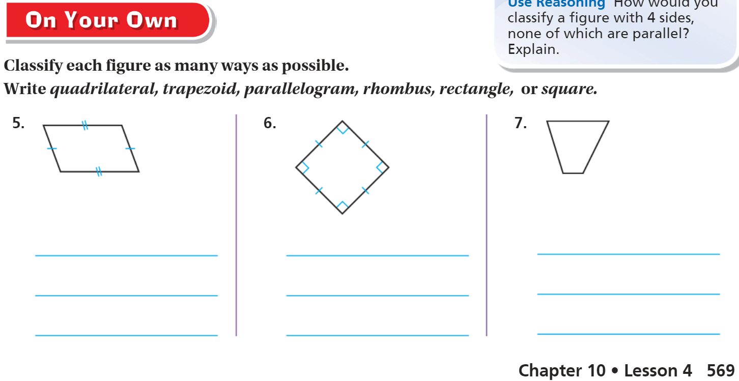
On your own – Pg. 569

Slide 12
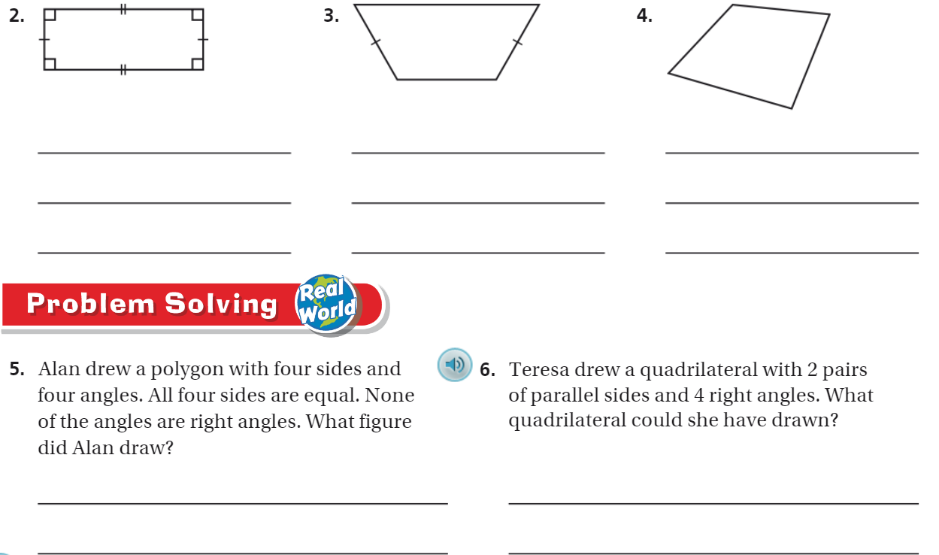
The Friday Quiz – Pg. 571

Slide 13
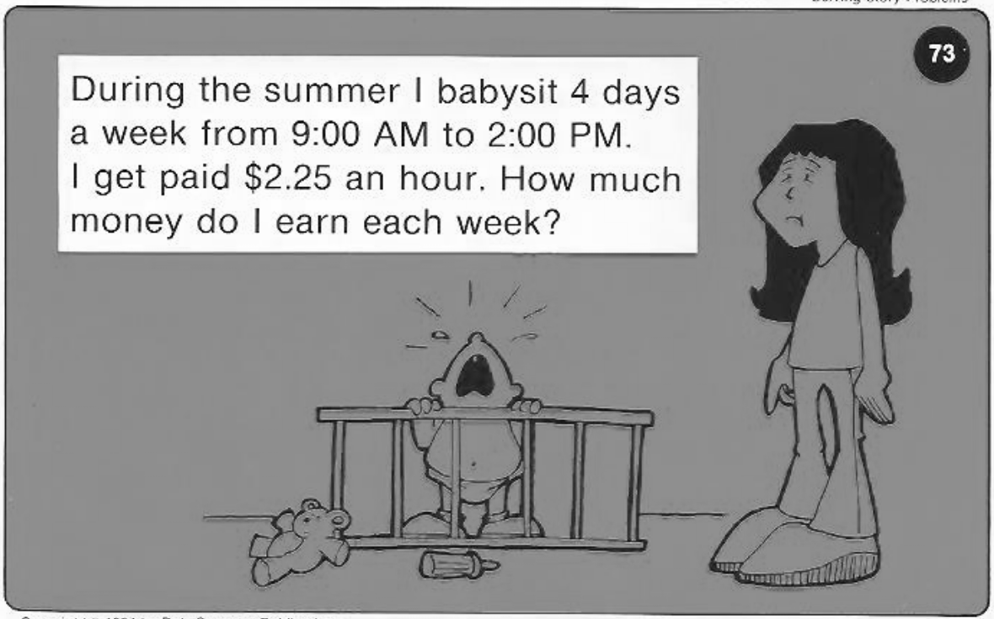
Calculator Problem

Slide 14
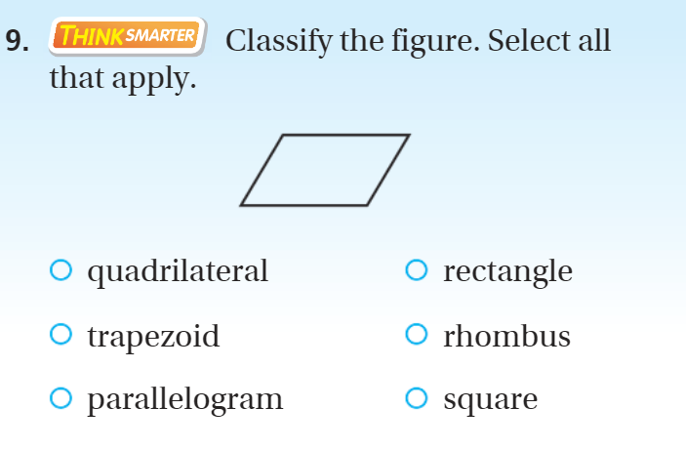
Exit Ticket – pg. 570

