Slide 1

Chapter 10
Lesson 10.7

Slide 2

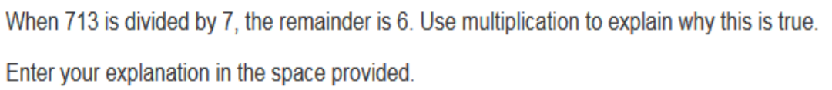

Slide 3

No Points
Billy Button

Slide 4
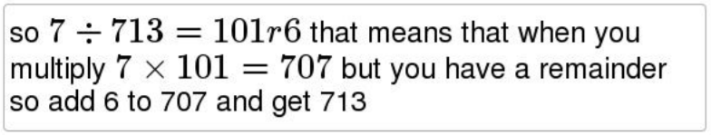
Half Points
Harry Apepit

Slide 5
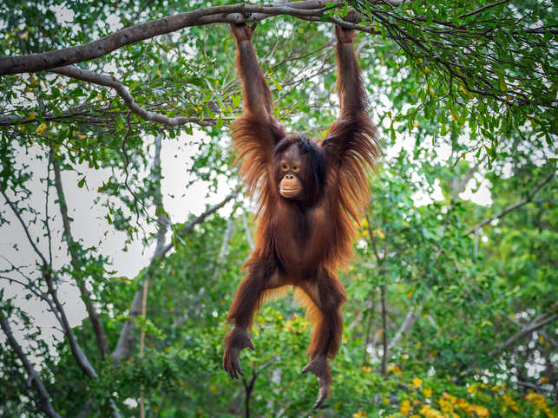

Slide 6
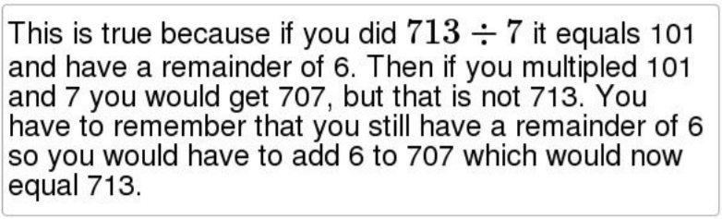
Full Points
Hannah Anna Dingdong

Slide 7
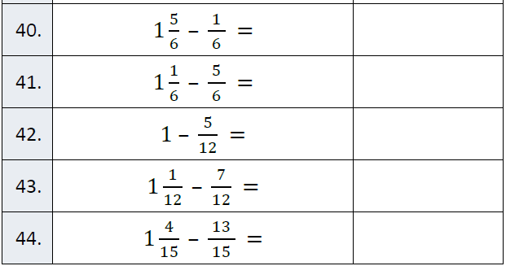
Fluency

Slide 8
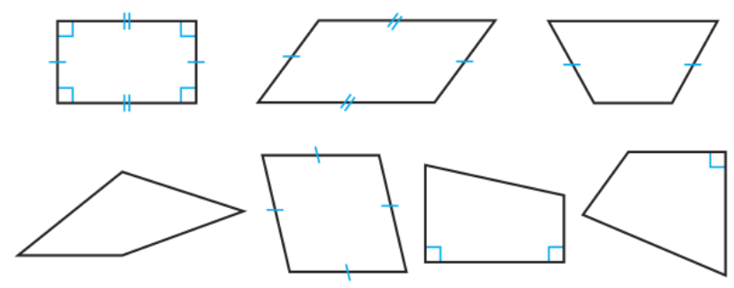
Let’s Look Back!

Slide 9
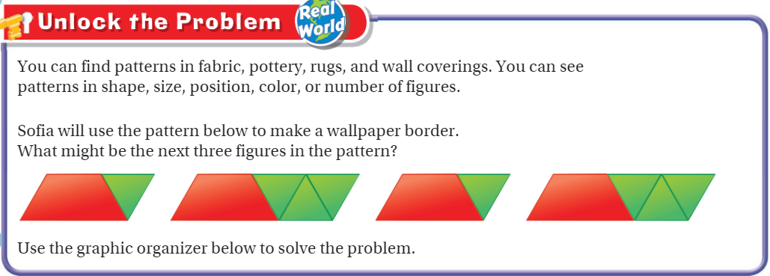
Teach and Reteach - Pg. 587

Slide 10
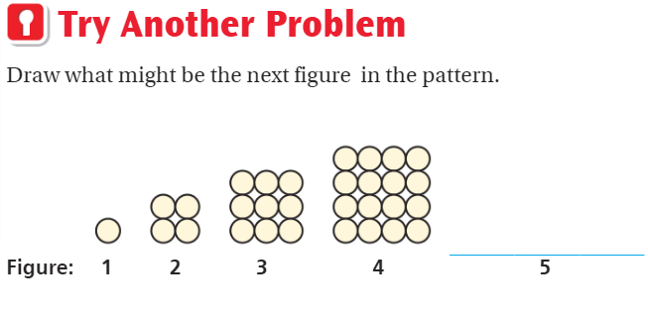
Teach and Reteach - Pg. 588

Slide 11
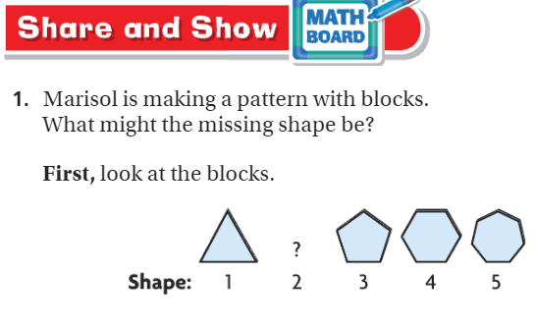
Share and Show pg. 589

Slide 12
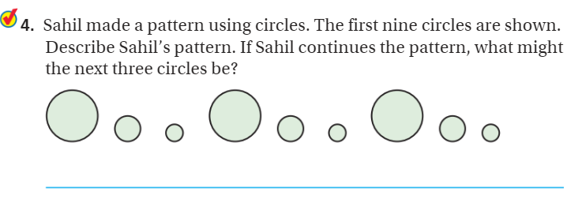
Share and Show pg. 589

Slide 13
I can solve patterns.
Will you be able to do this?
Yes! | Maybe | No

Slide 14
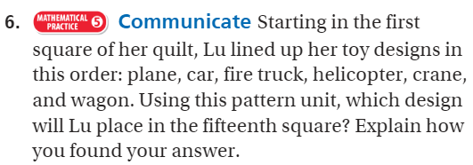
On your own - pg. 590

Slide 15
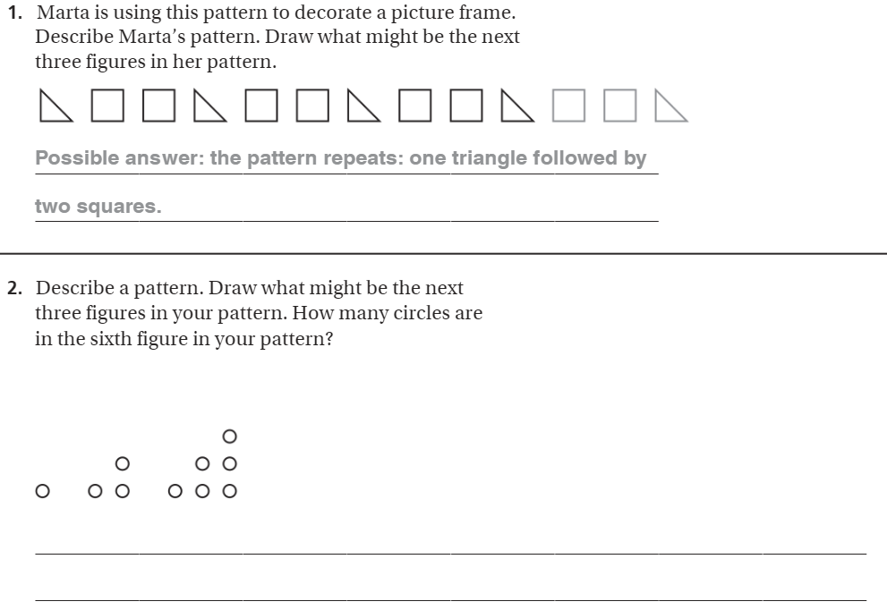
The Friday Quiz – Pg. 591

Slide 16
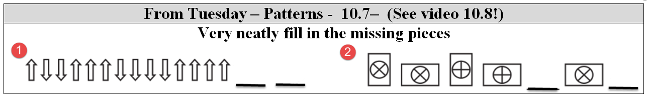

Slide 17
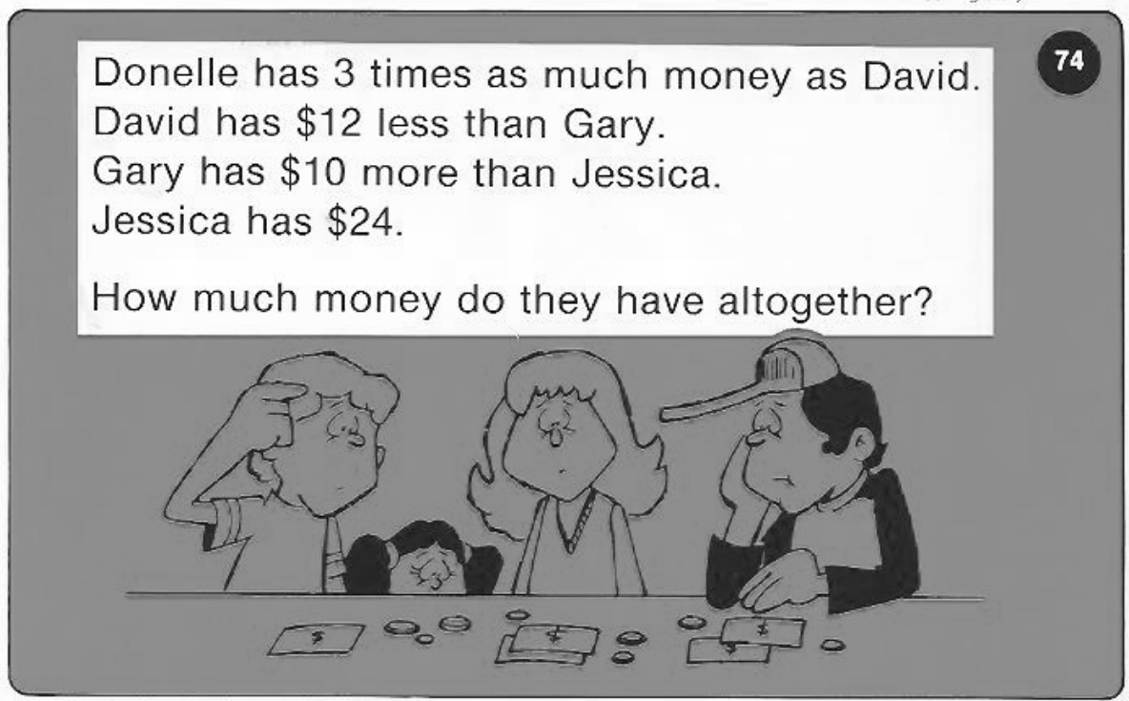
Calculator Problem

Slide 18
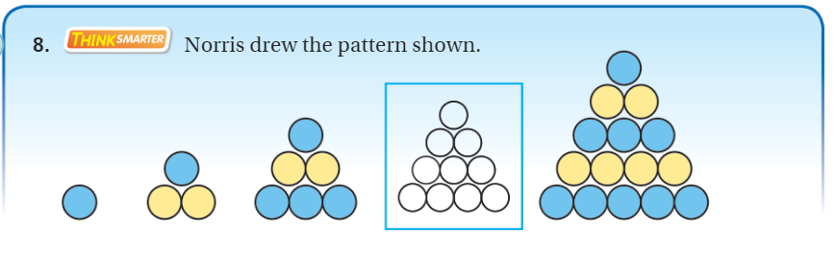
Exit Ticket – pg. 590

