Slide 1

Chapter 11
Lesson 11.1

Slide 2

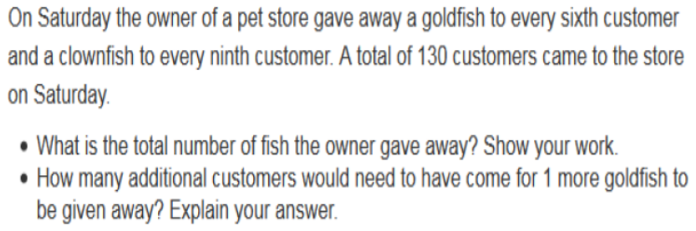

Slide 3


No Points
Cal Q. Lator

Slide 4
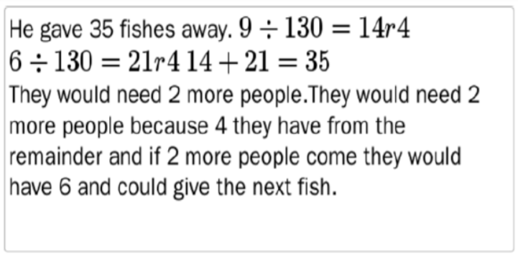
Half Points
Izzy Dead

Slide 5
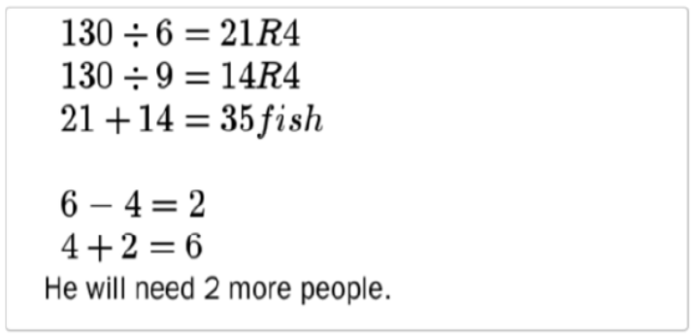
Full Points
Seymour Bones

Slide 6
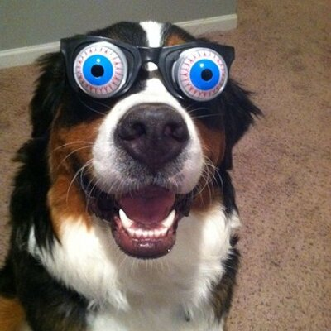

Slide 7
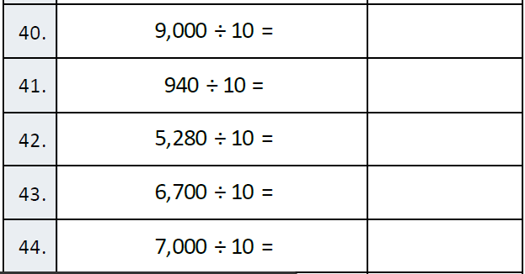
Fluency

Slide 8
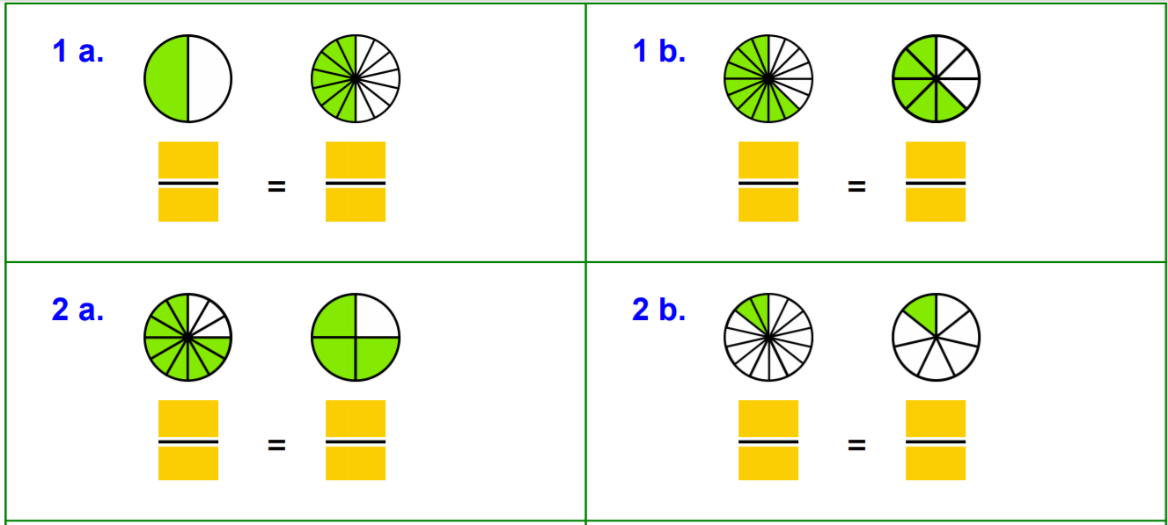
Let’s Look Back!

Slide 9
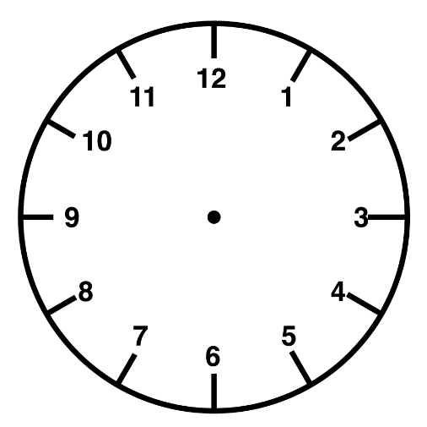
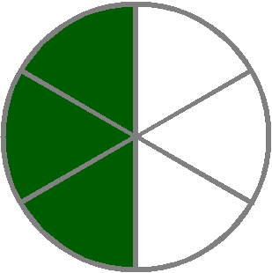
Fractions to Minutes

Slide 10
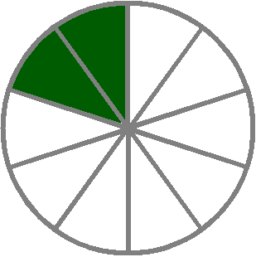
Fractions to Minutes

Slide 11

Fractions to Minutes

Slide 12

Fractions to Minutes

Slide 13
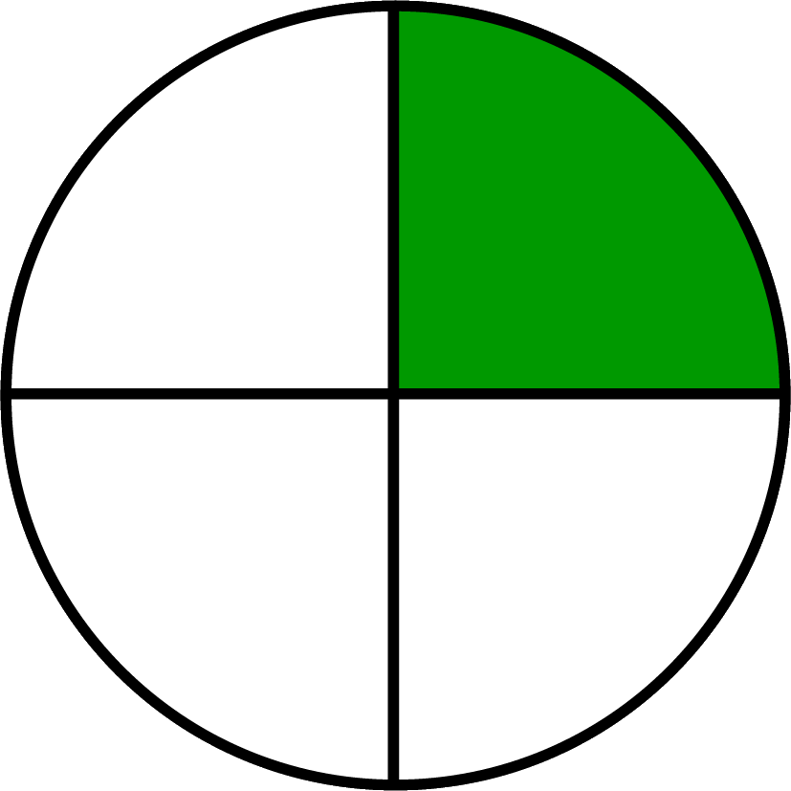
Fractions to Minutes

Slide 14
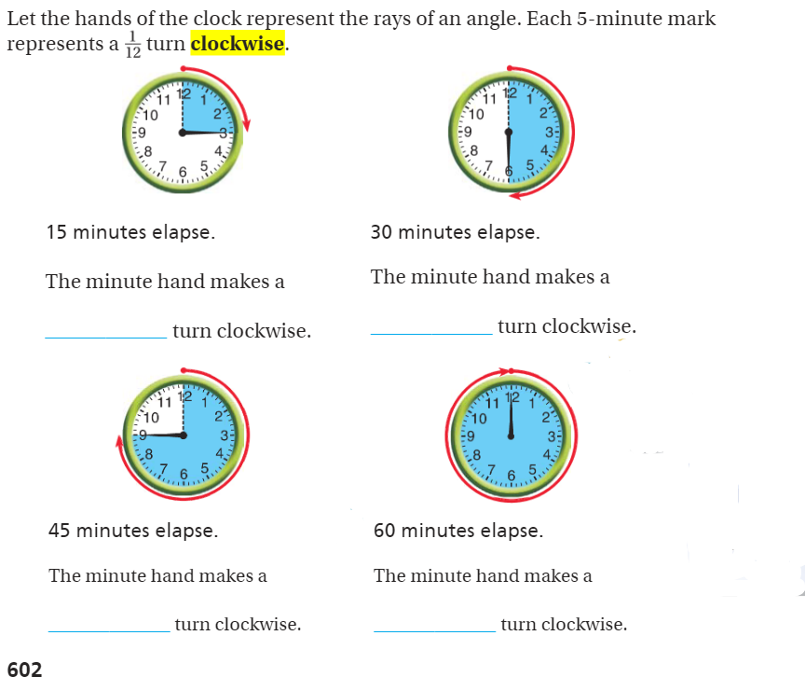
Teach and Reteach - Pg. 602

Slide 15
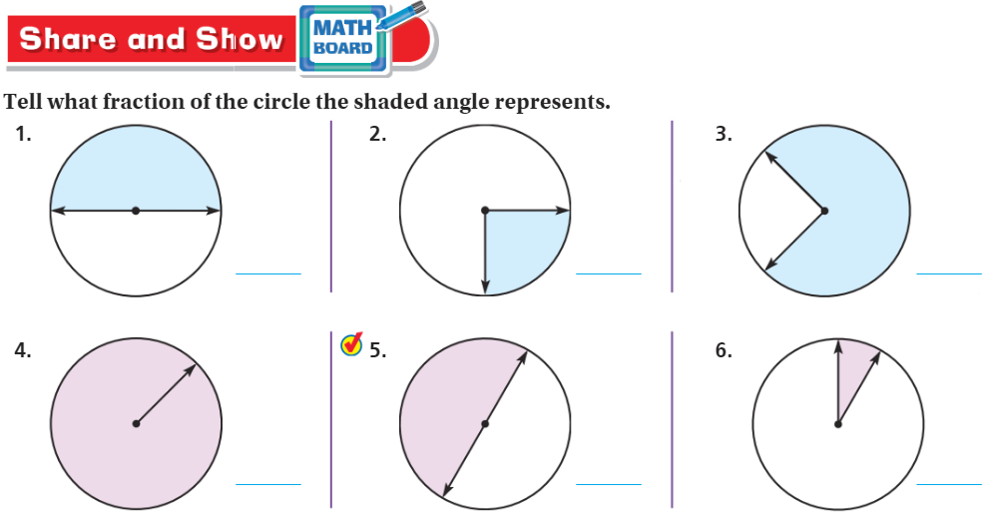
Share and Show pg. 603

Slide 16
I can name fractions of a circle.
Will you be able to do this?
Yes! | Maybe | No

Slide 17
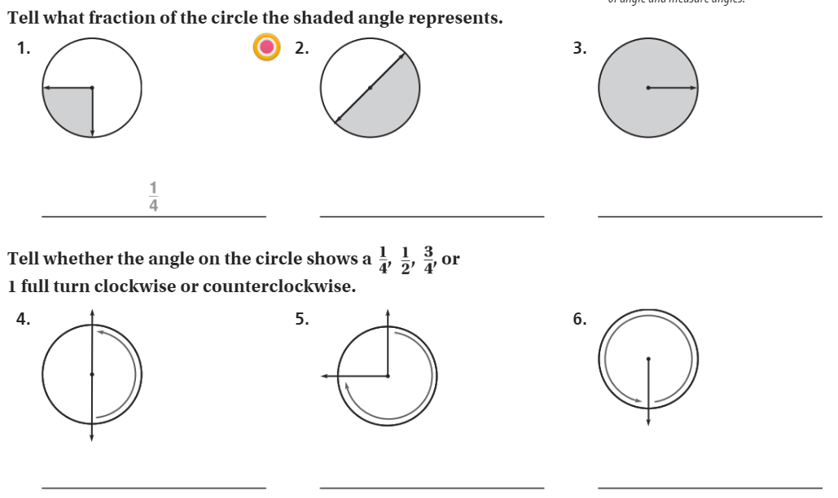
The Friday Quiz – Pg. 605

Slide 18
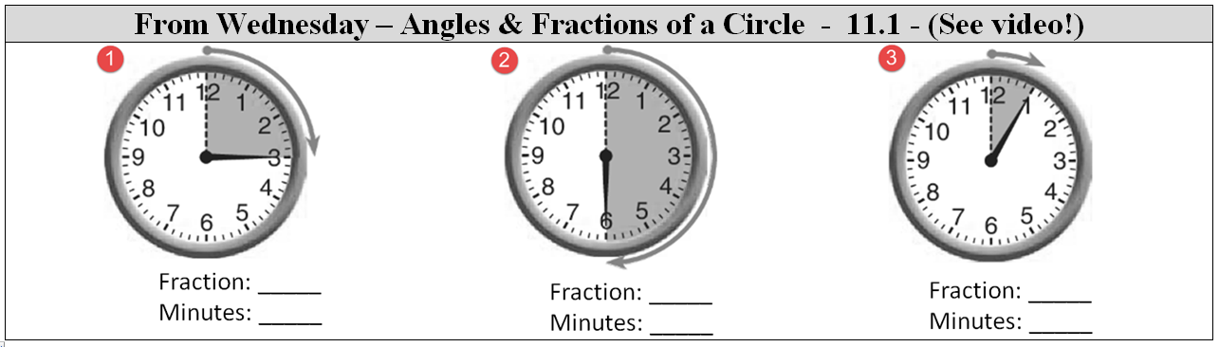

Slide 19
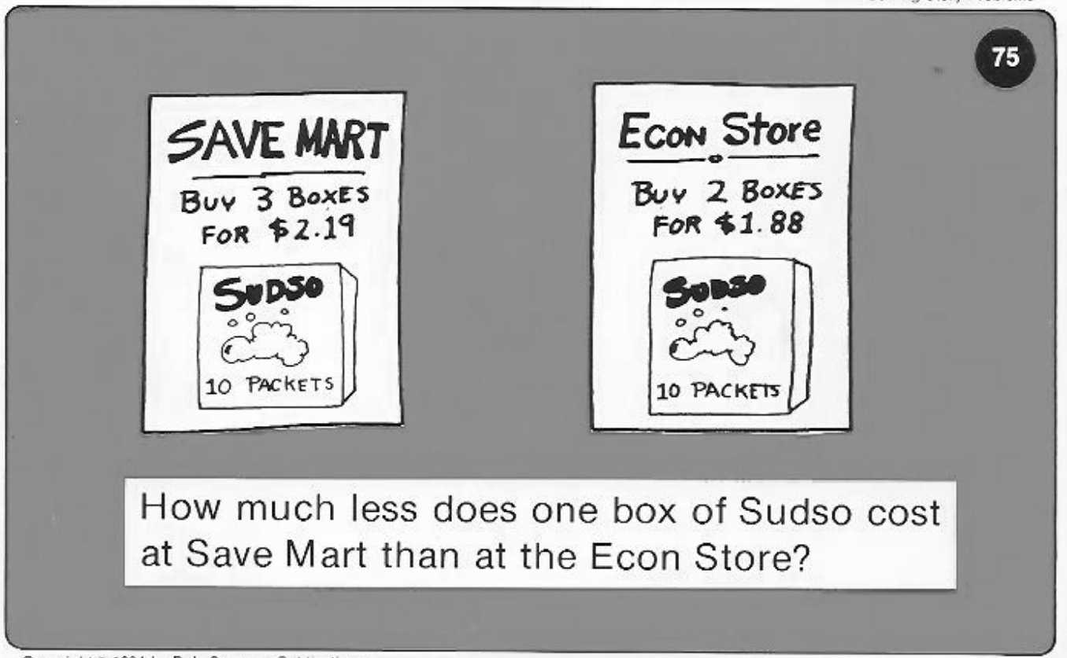
Calculator Problem

Slide 20
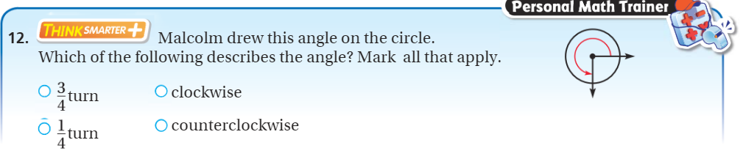
Exit Ticket – pg. 604

