Slide 1

Chapter 11
Lesson 11.3

Slide 2

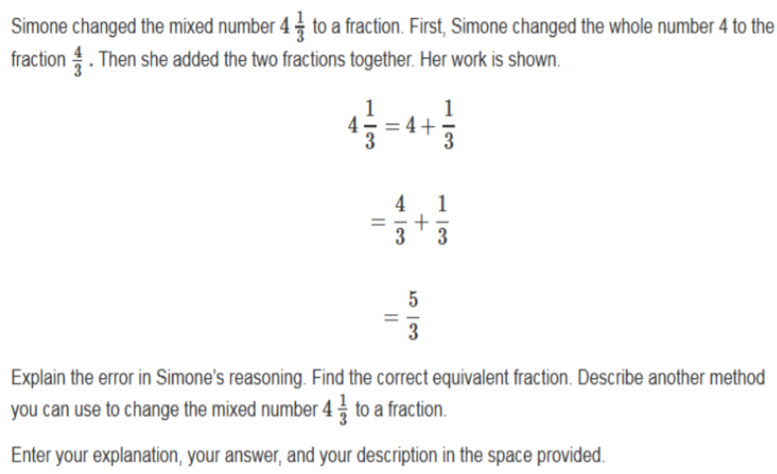

Slide 3


No Points
Sarah Itchynee

Slide 4

Half Points
Betty Scratchy

Slide 5
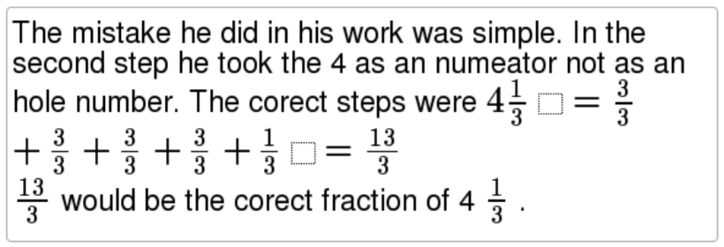
Full Points
Henry Heehaw

Slide 6
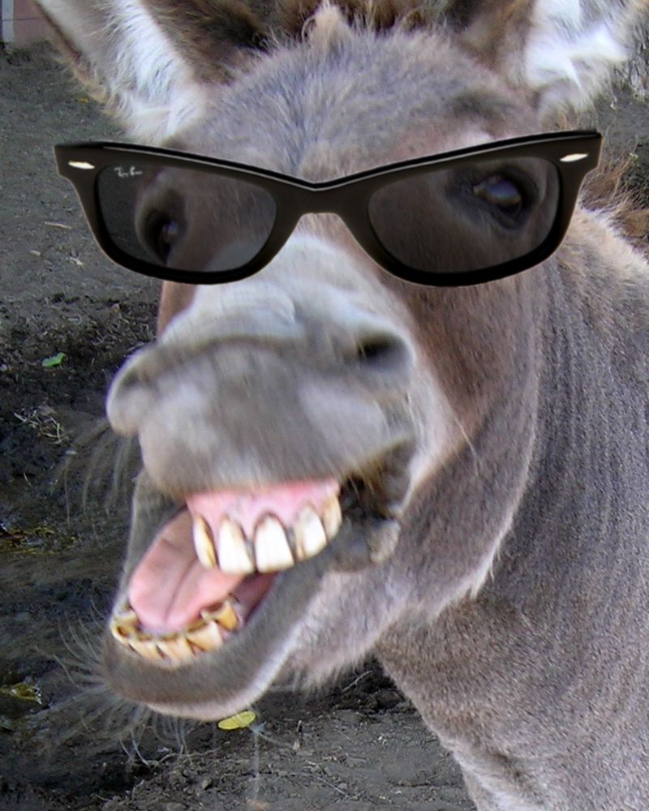

Slide 7
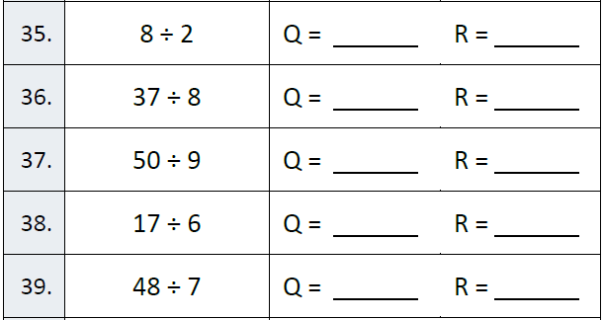
Fluency

Slide 8
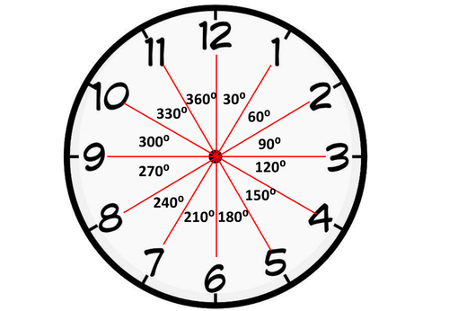
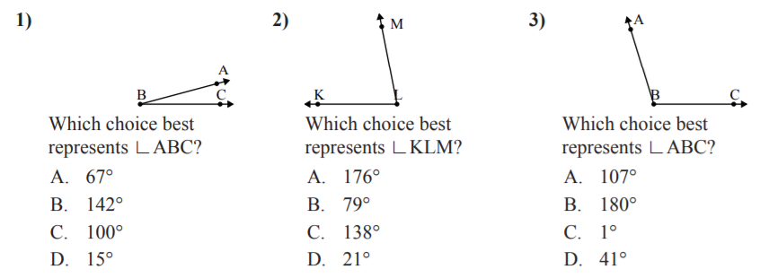
Let’s Look Back!

Slide 9
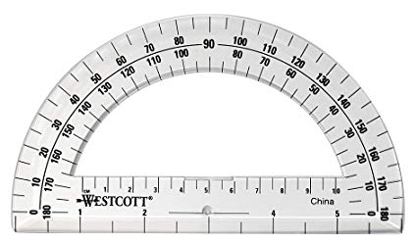
Protractor Observations

Slide 10

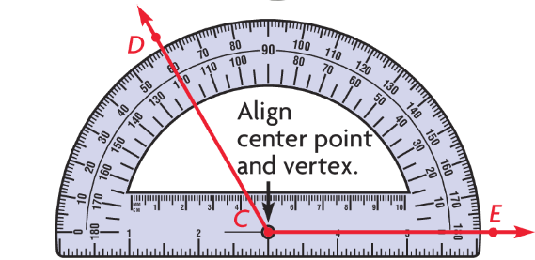
Teach and Reteach - Pg. 613

Slide 11
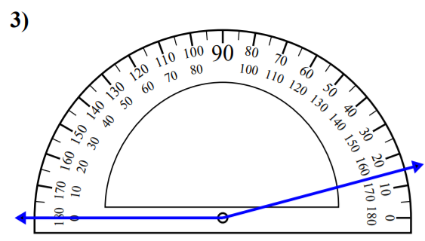

Slide 12
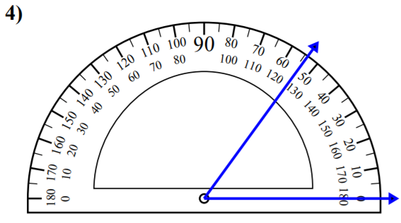

Slide 13
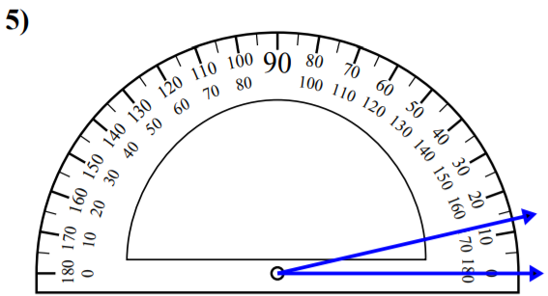

Slide 14
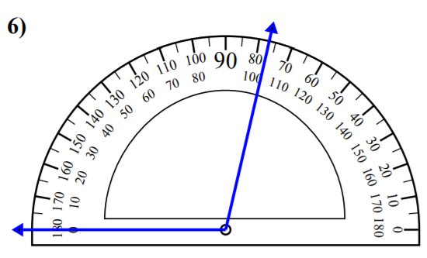

Slide 15
I can measure angles with a protractor.
Will you be able to do this?
Yes! | Maybe | No

Slide 16
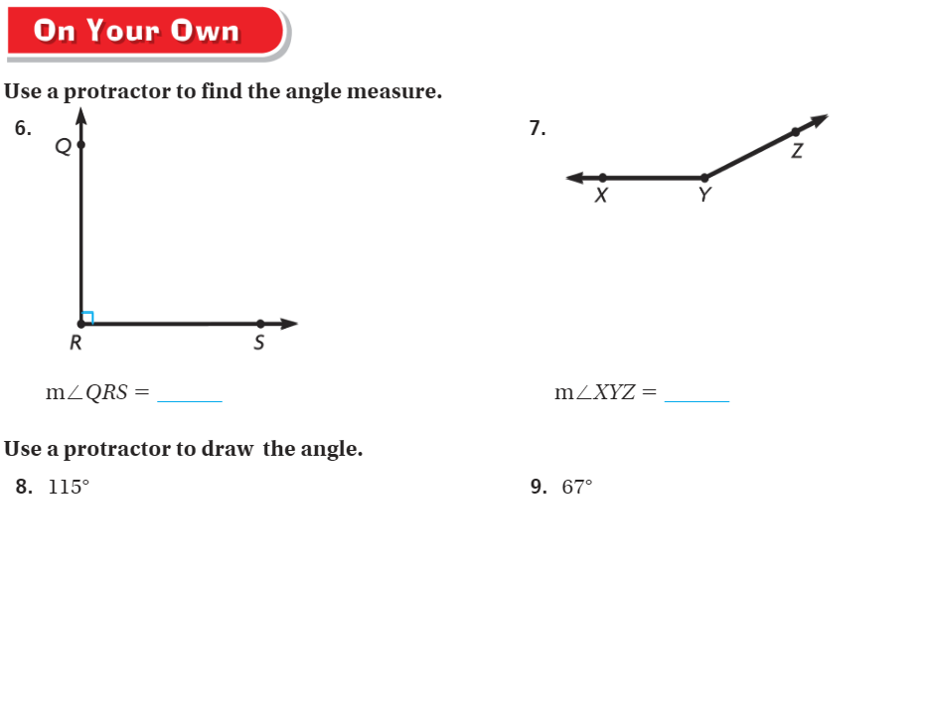
On Your Own - Pg. 615

Slide 17
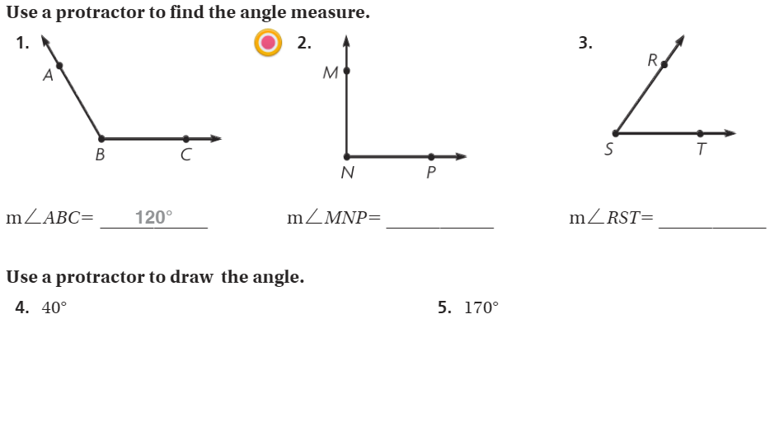
The Friday Quiz – Pg. 617

Slide 18
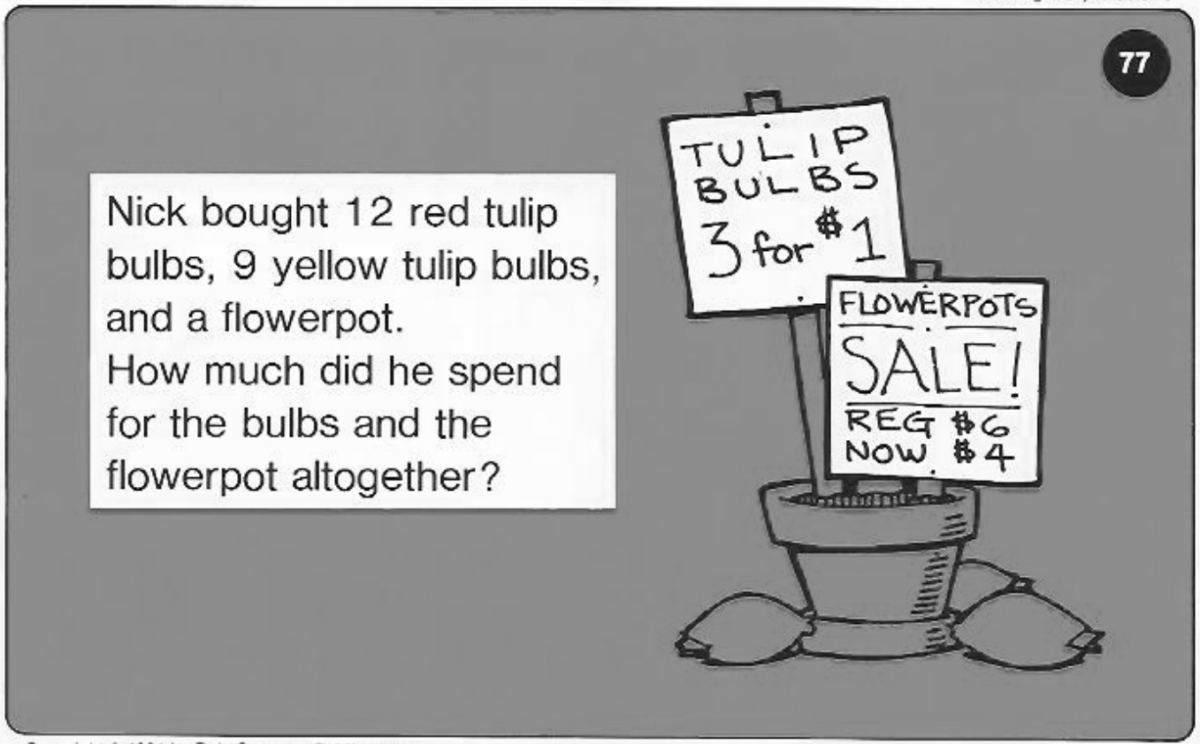
Calculator Problem

Slide 19

Exit Ticket – pg. 616

