Slide 1

Chapter 11
Lesson 11.4

Slide 2

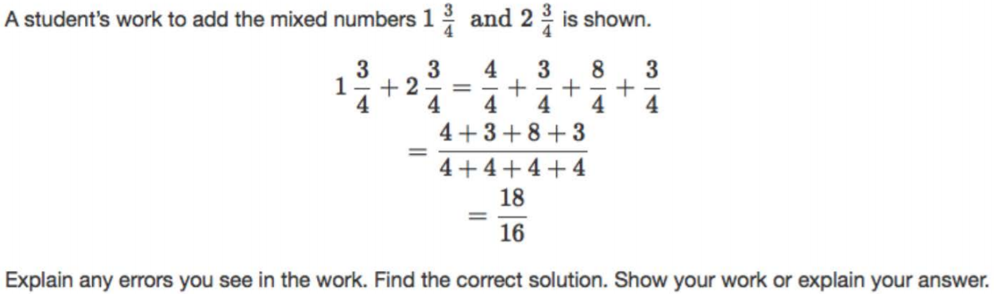

Slide 3

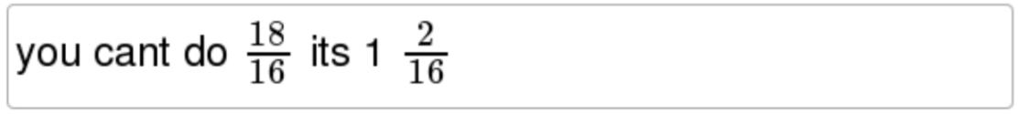
No Points
Scooter McGillicutty

Slide 4
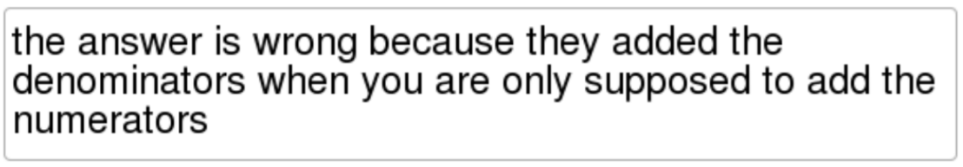
Half Points
Mugsy McGillicutty

Slide 5
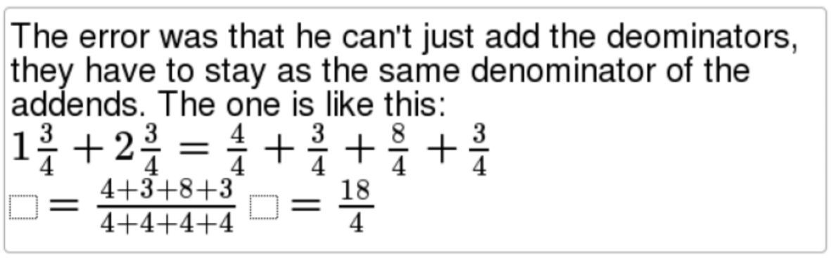
Full Points
Bruno McGillicutty

Slide 6
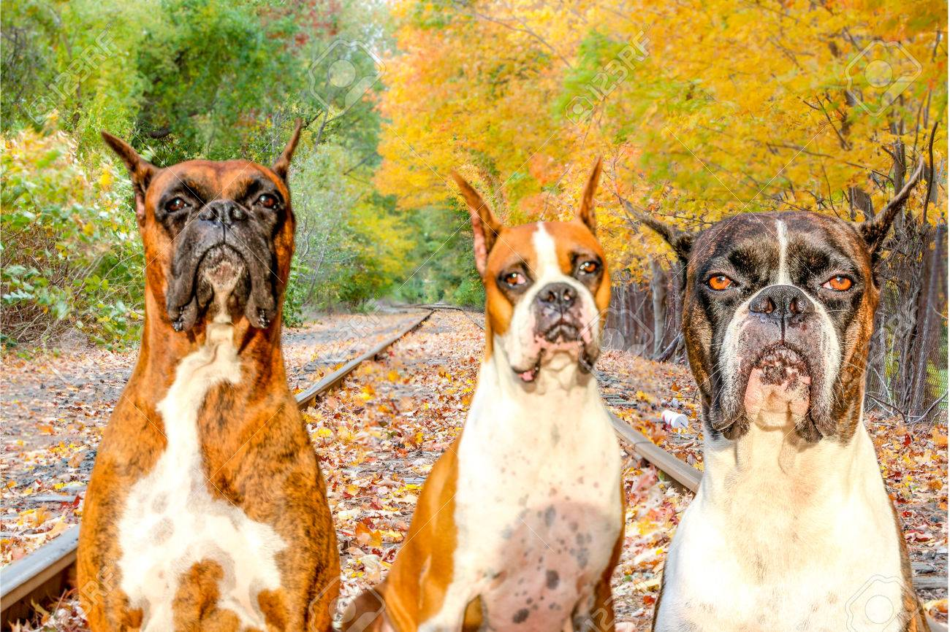

Slide 7
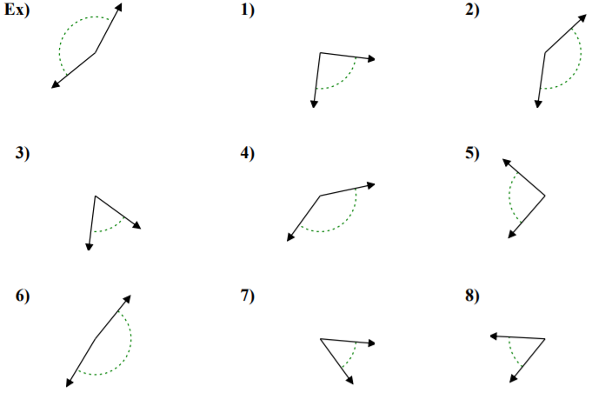
Fluency – Right, Acute, Obtuse

Slide 8
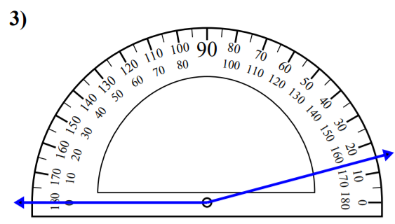
Let’s Look Back!

Slide 9
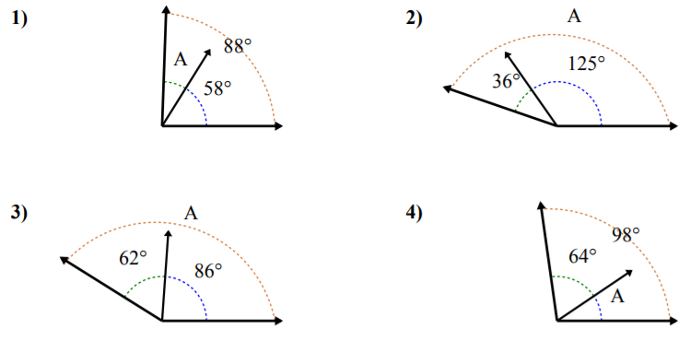
Teach and Reteach – Bar Models

Slide 10
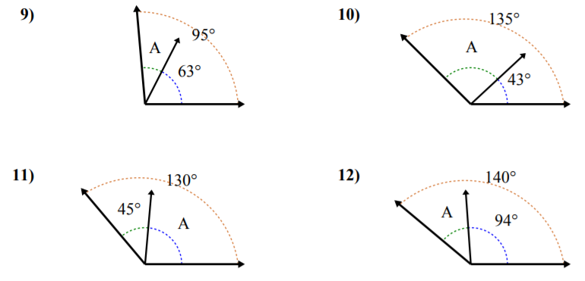
Teach and Reteach – Bar Models

Slide 11
I can add angles.
Will you be able to do this?
Yes! | Maybe | No

Slide 12
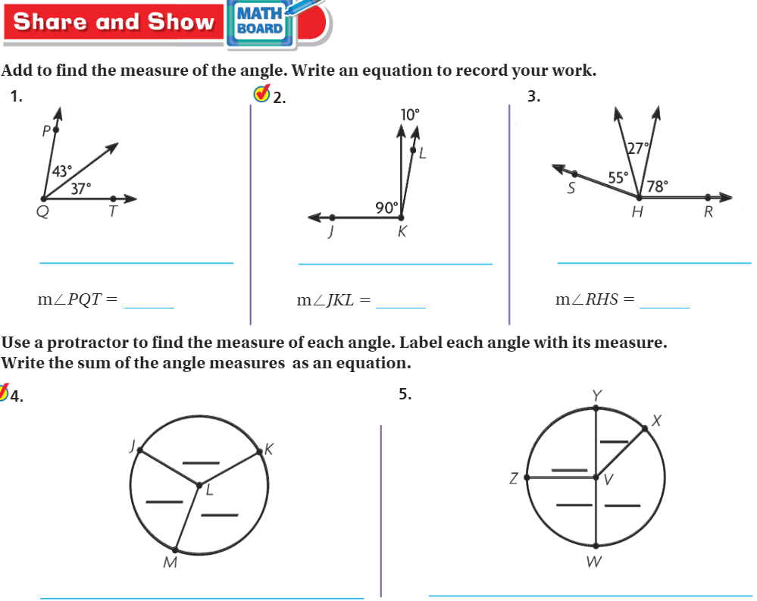
Share and Show pg. 623

Slide 13
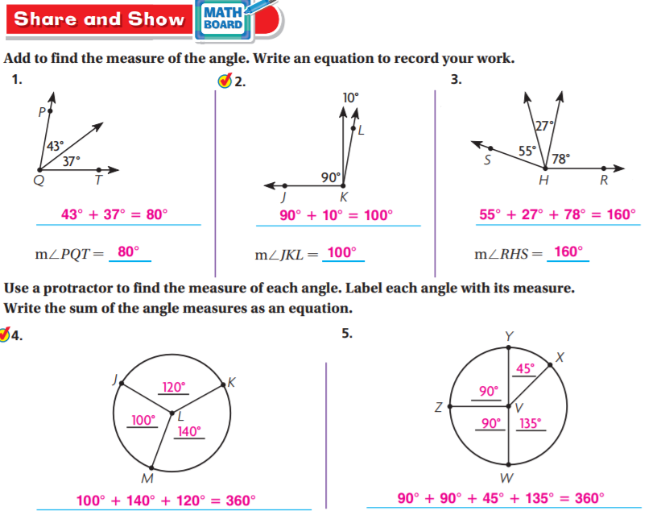
Share and Show pg. 623

Slide 14
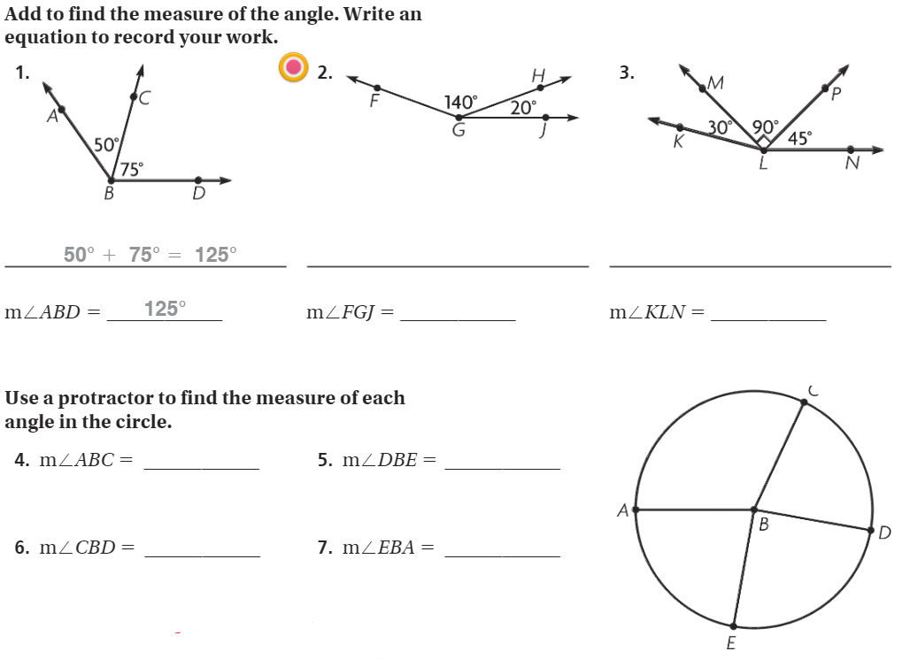
The Friday Quiz – Pg. 625

Slide 15
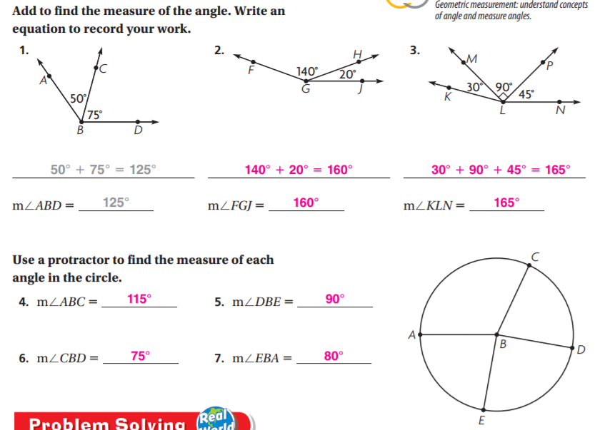
The Friday Quiz – Pg. 625

Slide 16
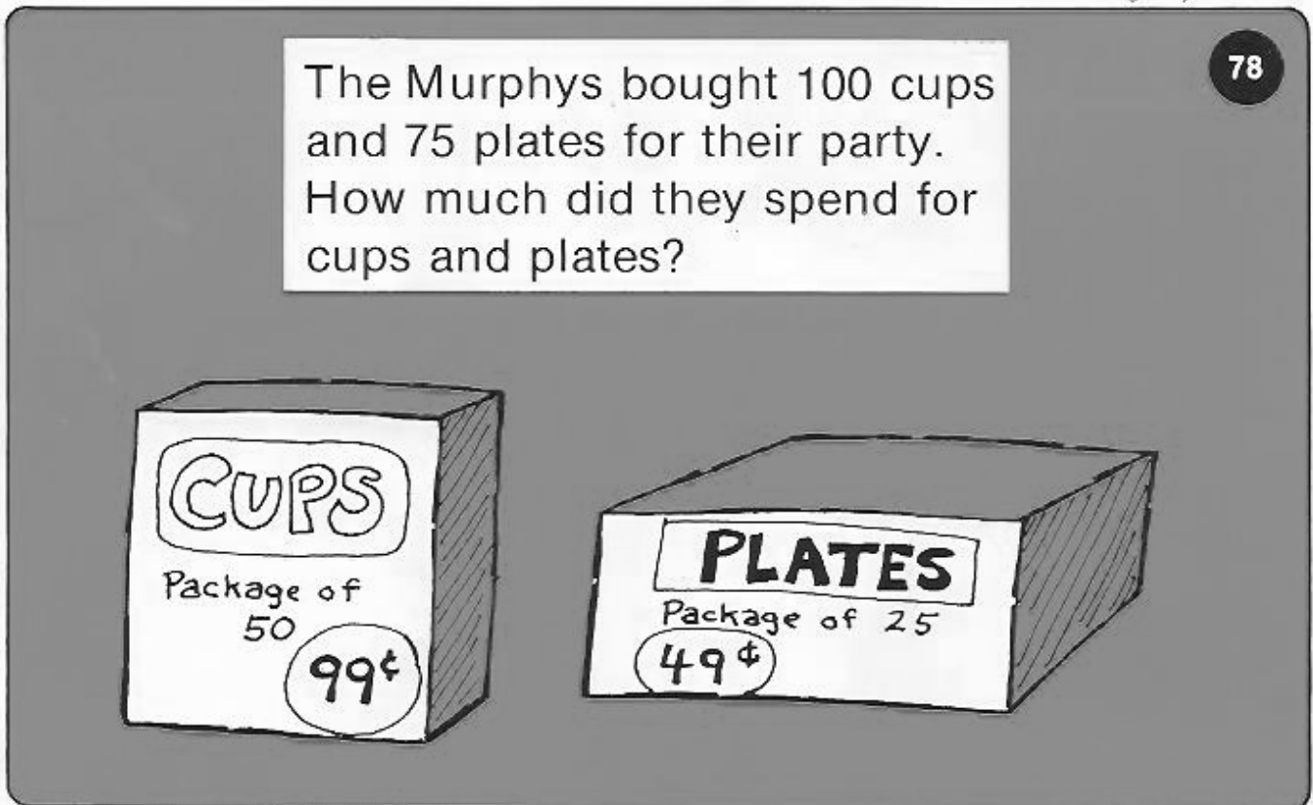
Calculator Problem

Slide 17
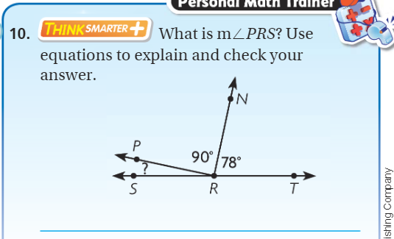
Exit Ticket – pg. 624

