Slide 1

Chapter 11
Lesson 11.5

Slide 2

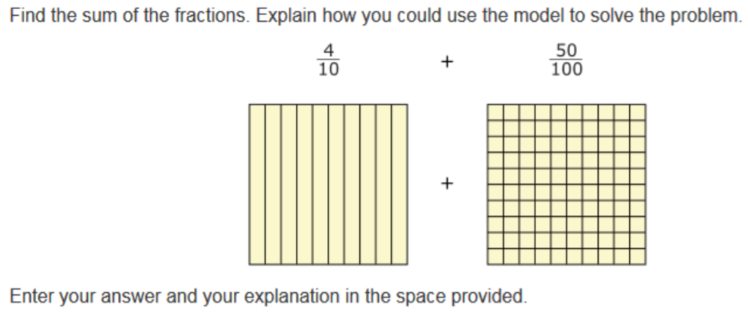

Slide 3


No Points
Milton Squawker

Slide 4


Slide 5
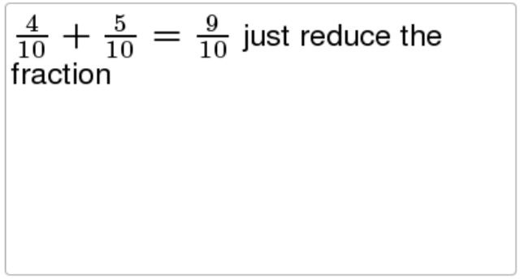
Half Points
Oscar Yeller

Slide 6


Slide 7
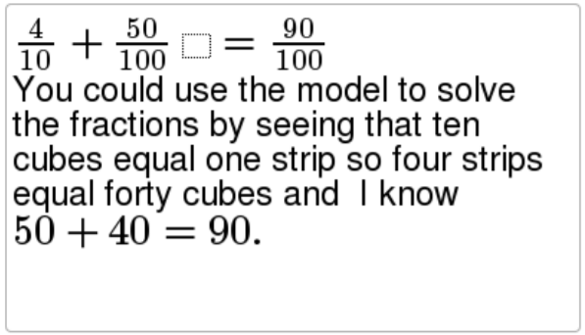
Full Points
Mimi Screamer

Slide 8
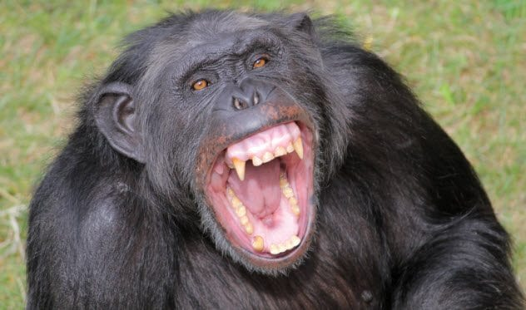

Slide 9
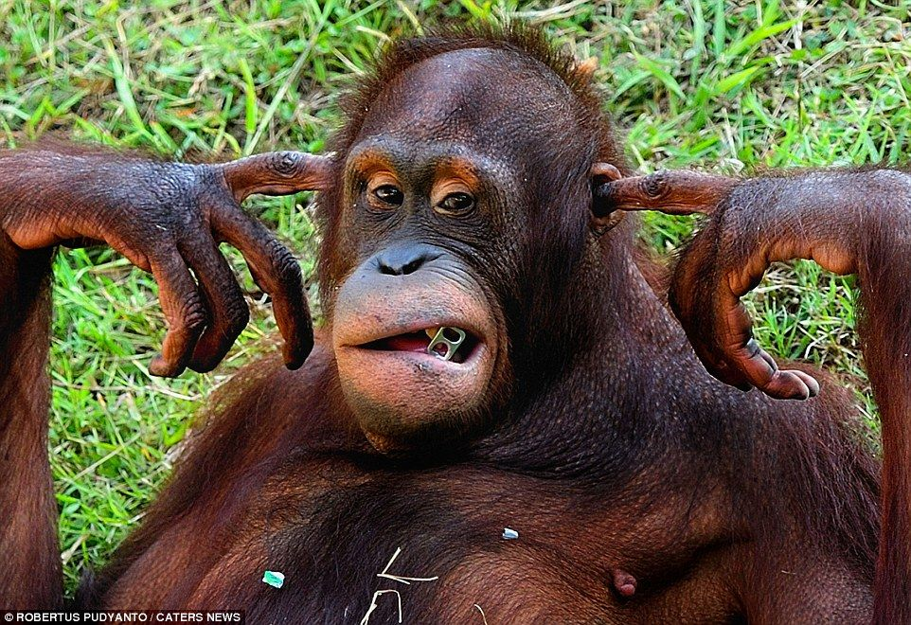

Slide 10
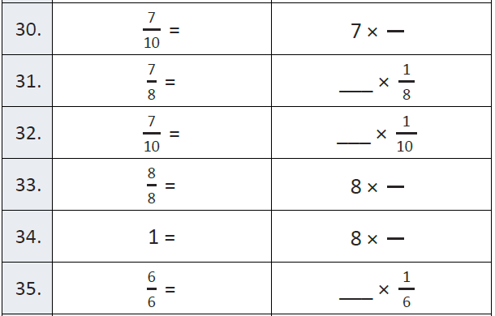
Fluency – Right, Acute, Obtuse

Slide 11

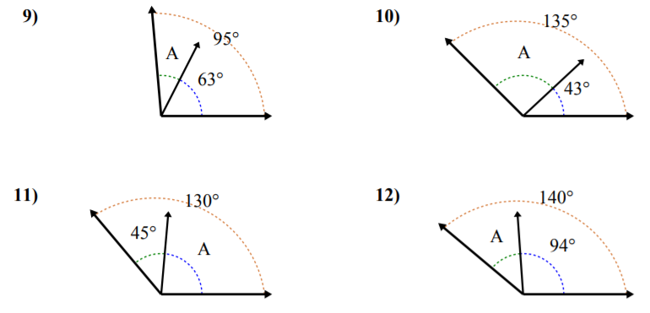
Let’s Look Back!

Slide 12
I can find complimentary and supplementary angles.
Will you be able to do this?
Yes! | Maybe | No

Slide 13

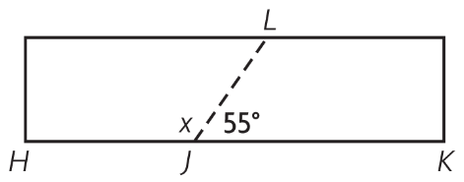

Slide 14

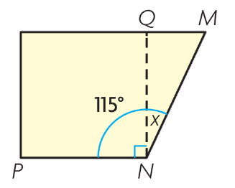

Slide 15

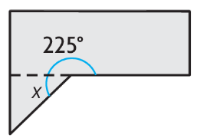

Slide 16
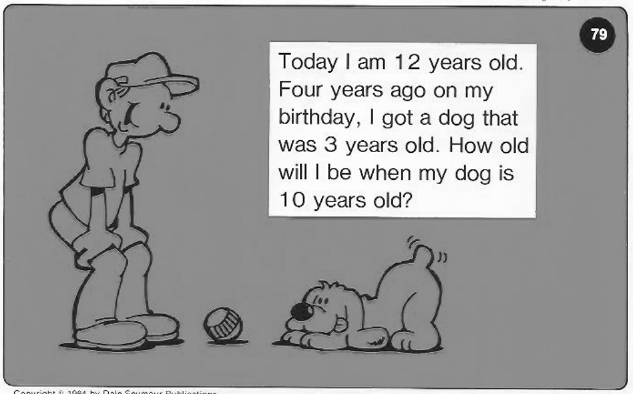
Calculator Problem

Slide 17
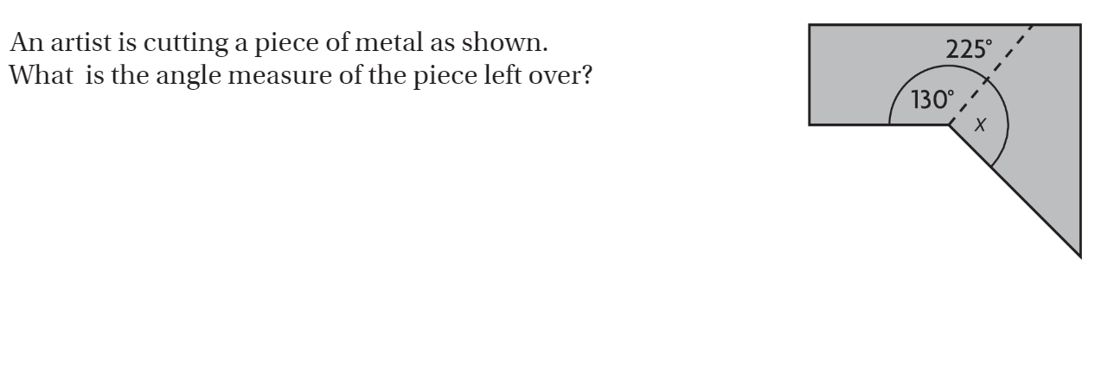
The Friday Quiz – Pg. 631

Slide 18

Exit Ticket – pg.630

