Slide 1

Chapter 11
Lesson 11.5

Slide 2

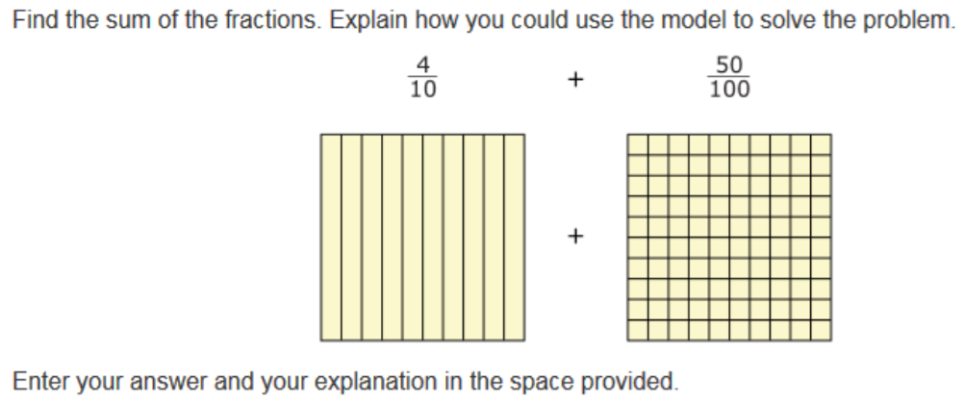

Slide 3

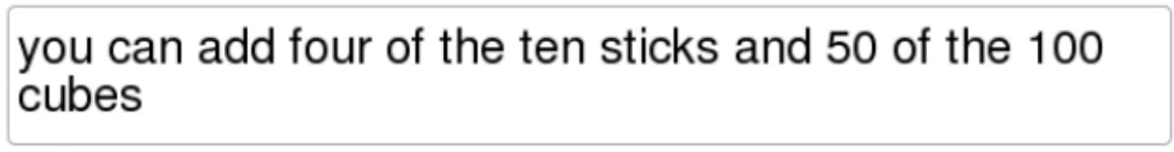
No Points

Slide 4
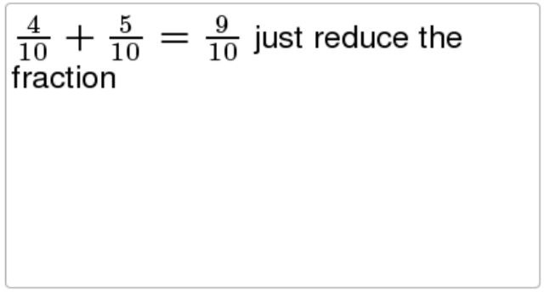
Half Points

Slide 5
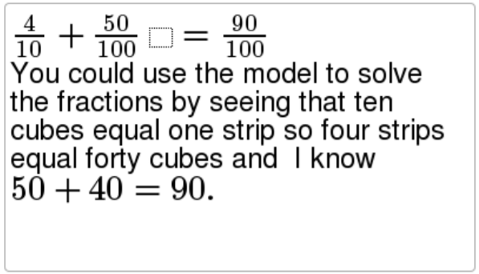
Full Points

Slide 6
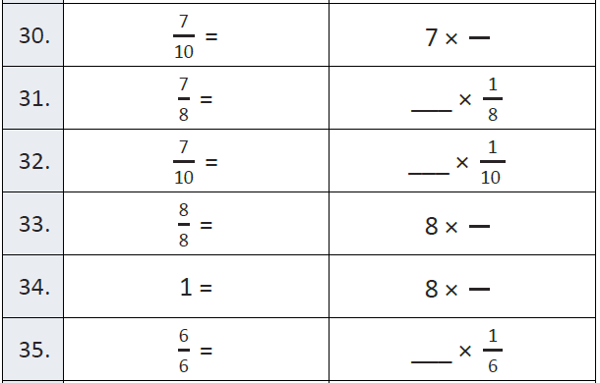
Fluency – Right, Acute, Obtuse

Slide 7

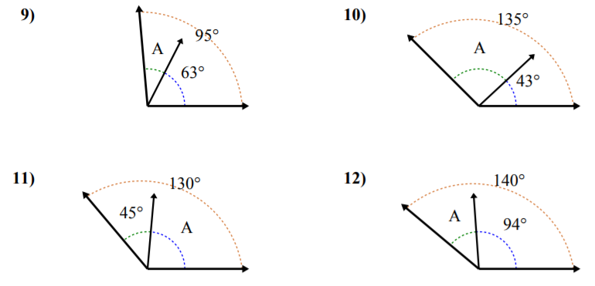
Let’s Look Back!

Slide 8
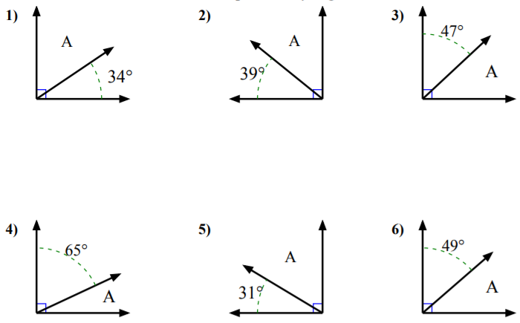
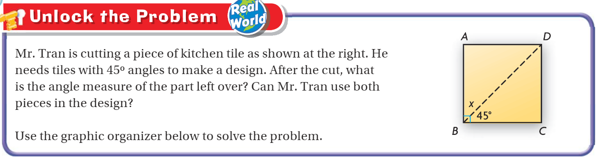
Teach and Reteach – Bar Models

Slide 9
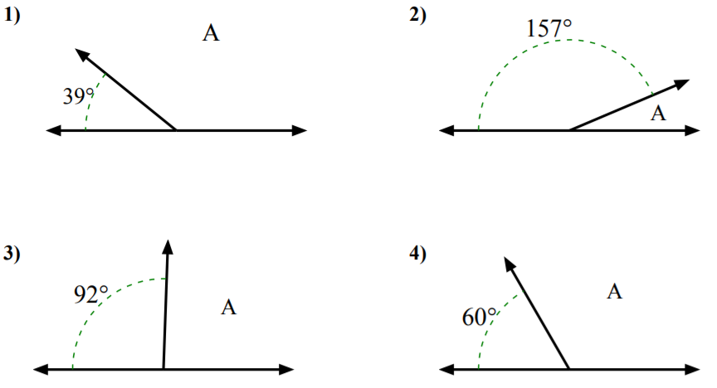
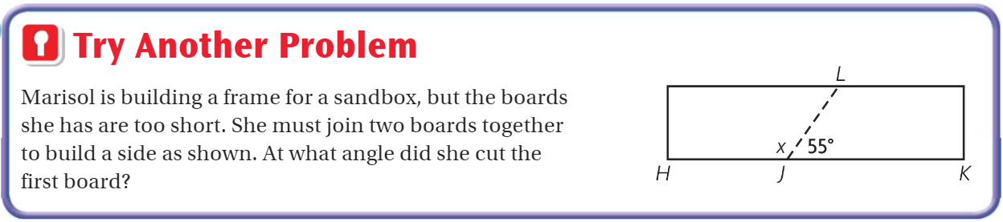
Teach and Reteach – Bar Models

Slide 10
I can find complimentary and supplementary angles.
Will you be able to do this?
Yes! | Maybe | No

Slide 11
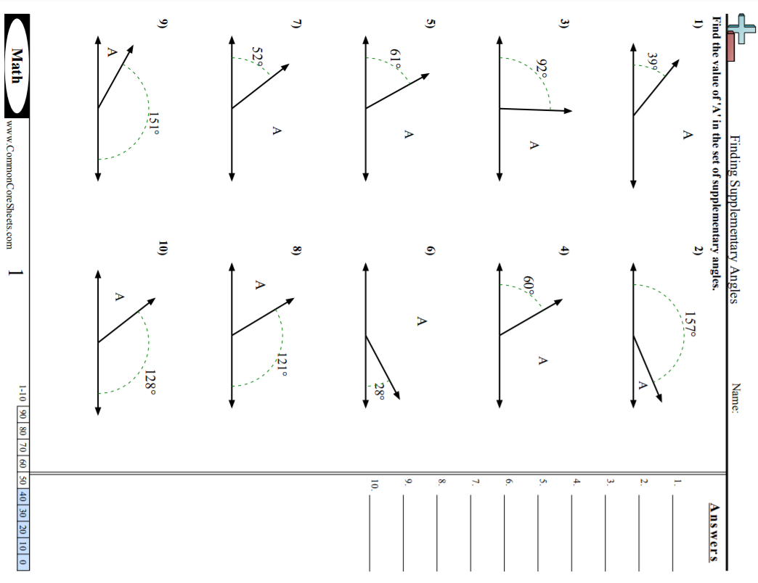
Practice

Slide 12
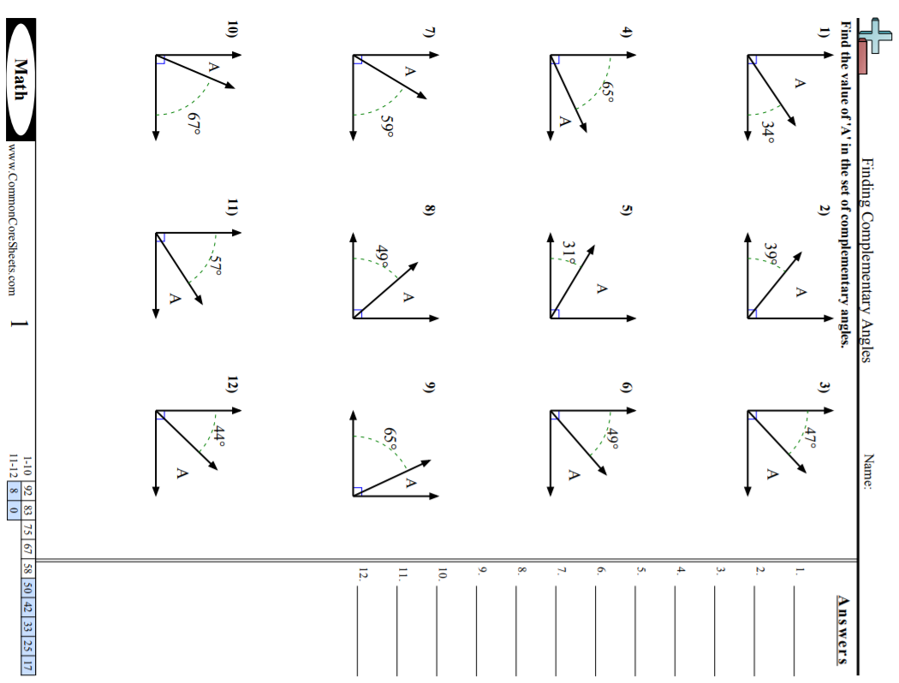
Practice

Slide 13
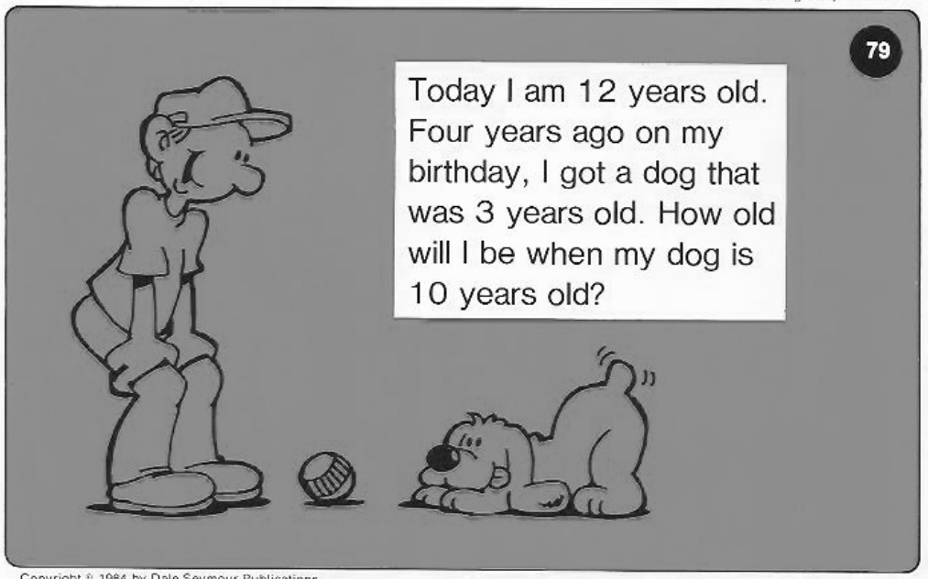
Calculator Problem

Slide 14
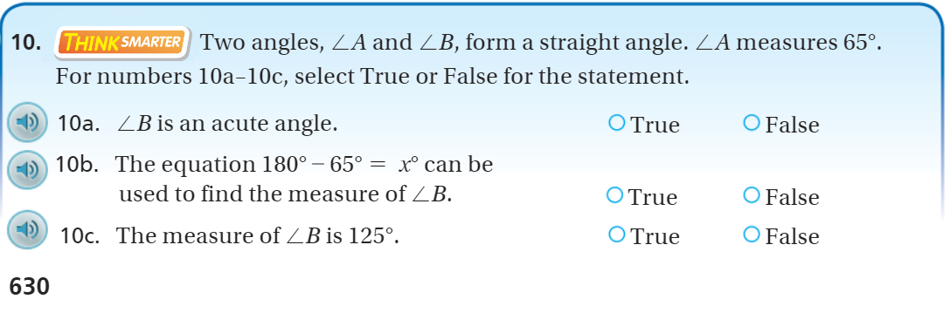
Exit Ticket – pg.630

