Slide 1

Chapter 12
Lesson 12.2

Slide 2




Slide 3

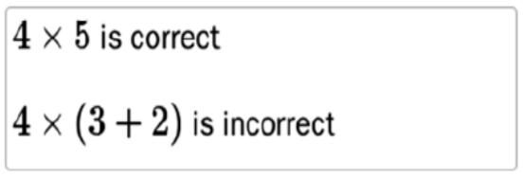
No Points
Peter Cheater

Slide 4
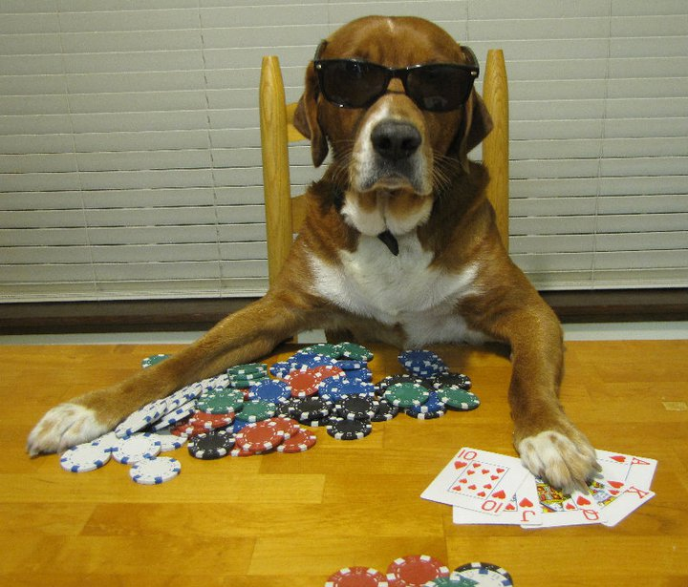

Slide 5
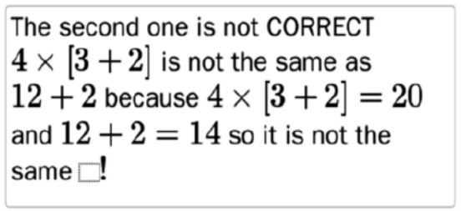
Half Points
Mary Starey

Slide 6
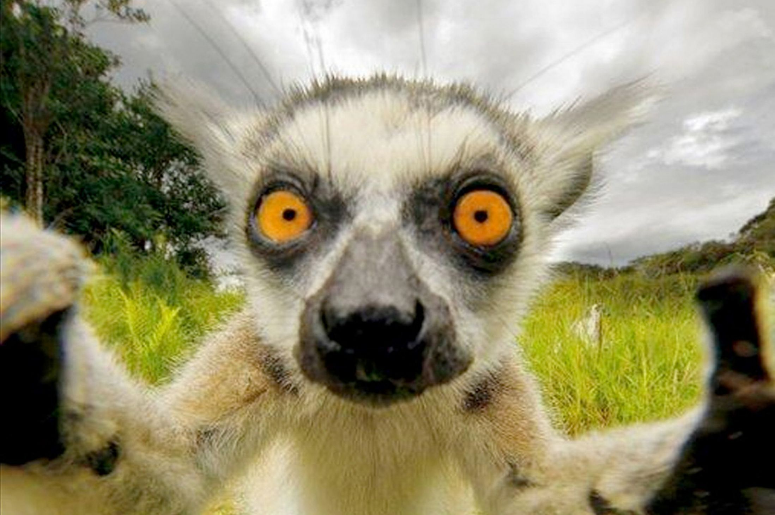

Slide 7
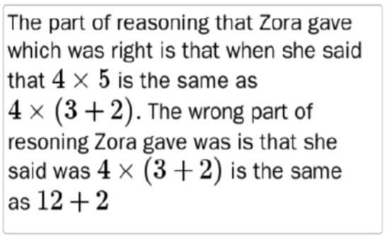
Full Points
Jessy Chessy

Slide 8
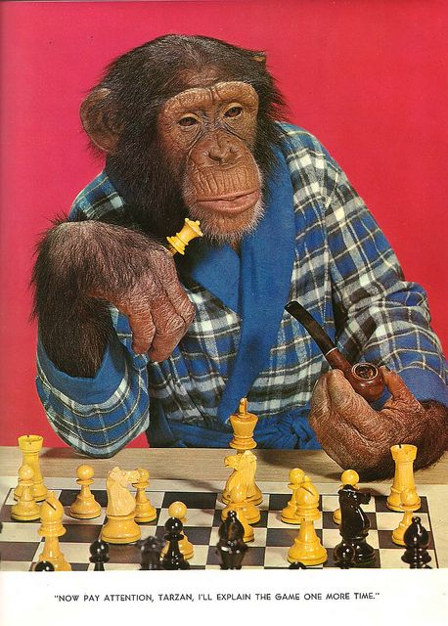

Slide 9
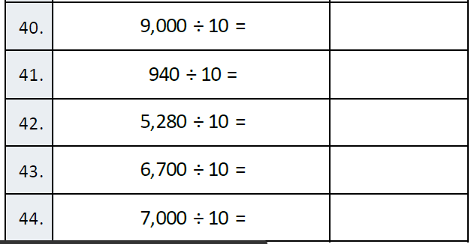
Fluency

Slide 10
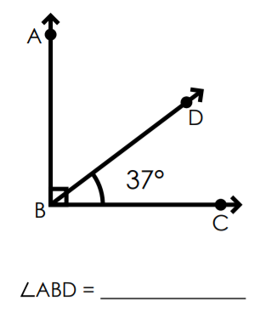
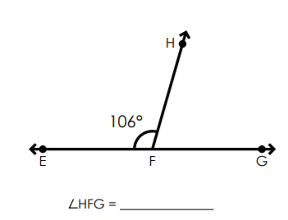
Let’s Look Back!

Slide 11
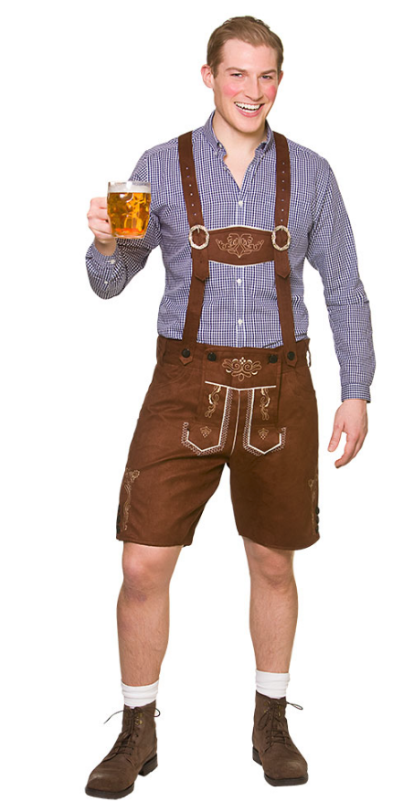


Peter!
Metric System X 10

Slide 12
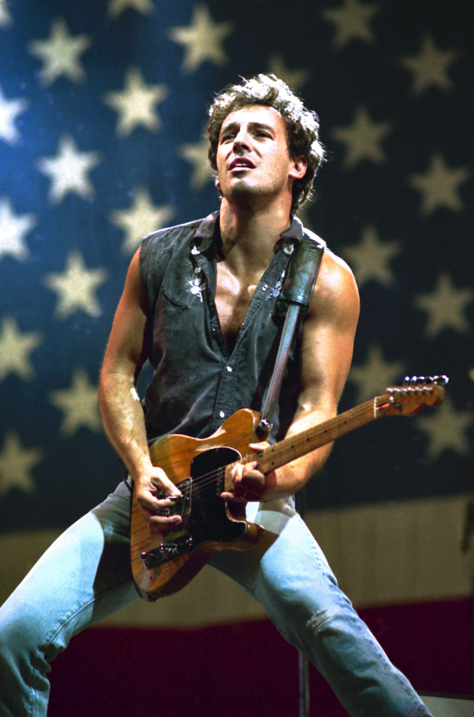



Bruce!
Customary System

Slide 13
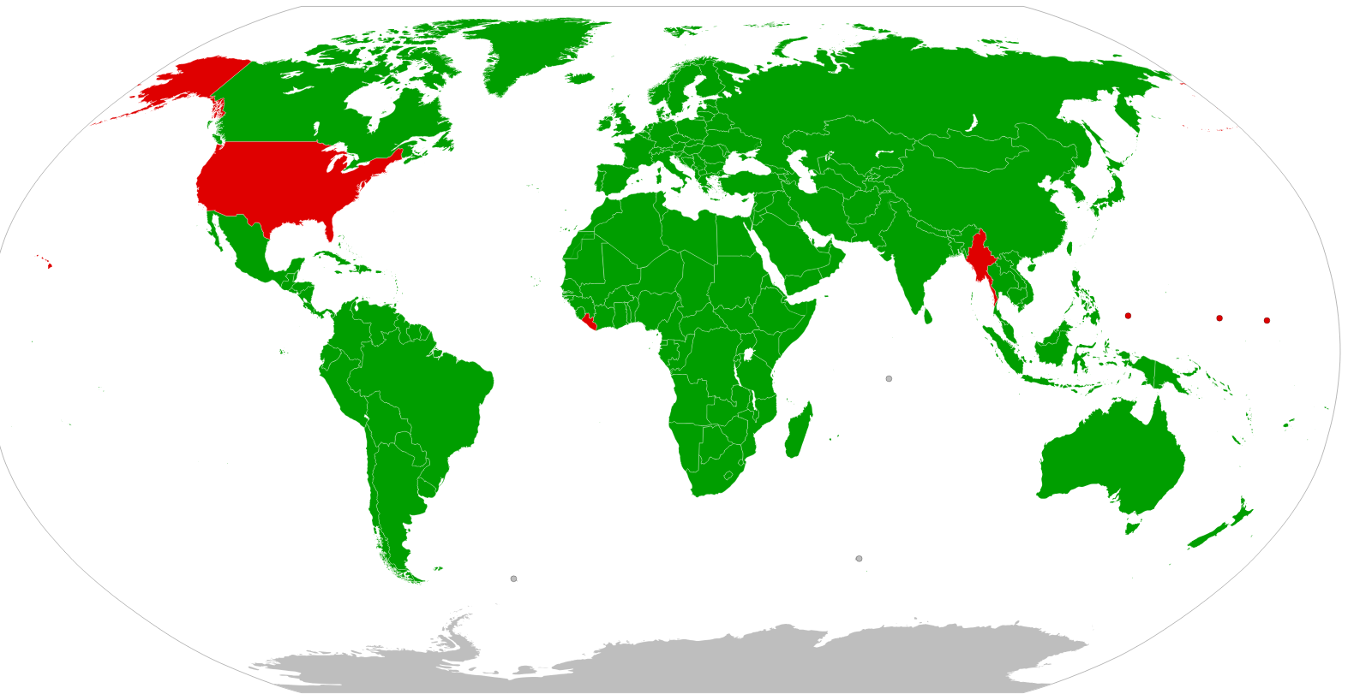
Metric vs. Customary

Slide 14


Customary Benchmarks

Slide 15

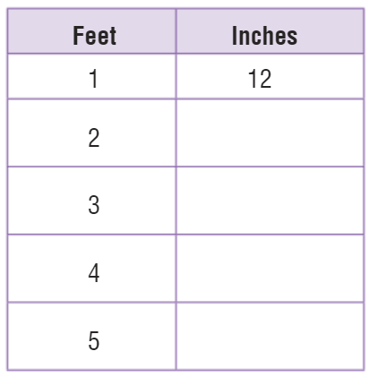
Teach & Reteach – pg. 648

Slide 16
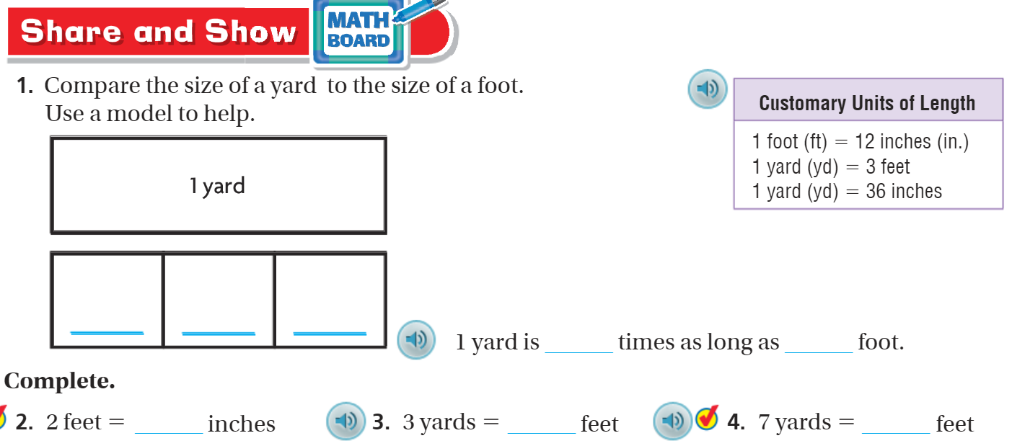
Share & Show – pg. 649

Slide 17
I can find customary units of length.
Will you be able to do this?
Yes! | Maybe | No

Slide 18
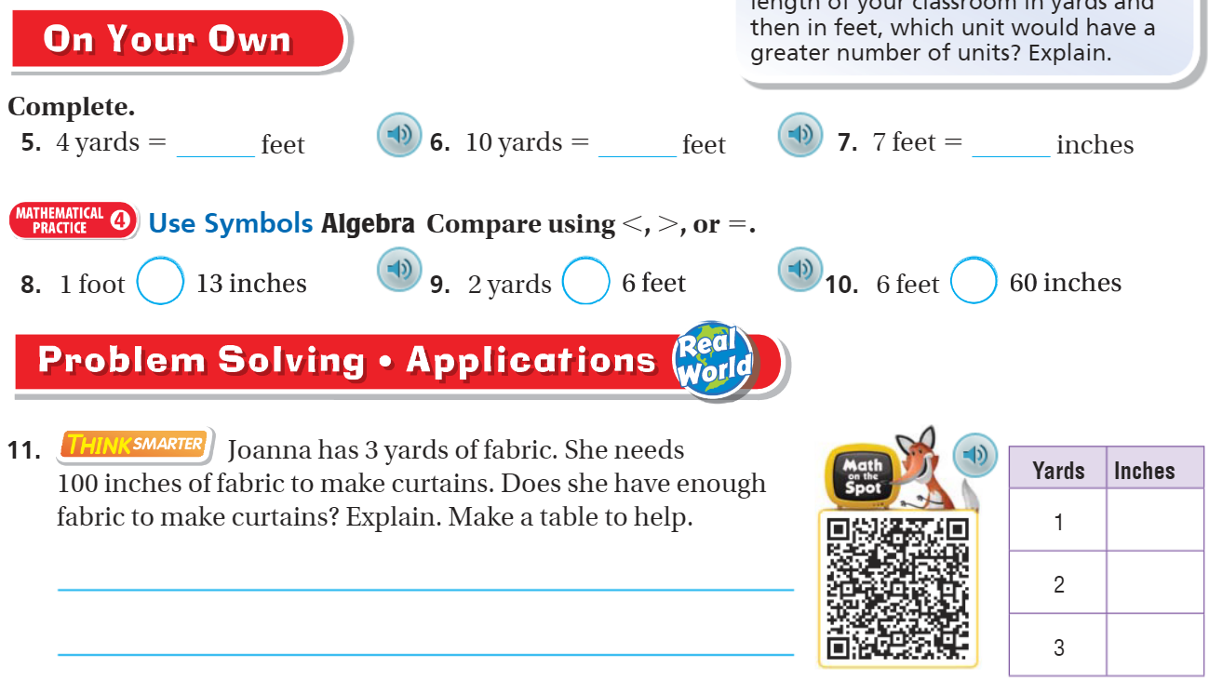
On your own – pg. 649

Slide 19
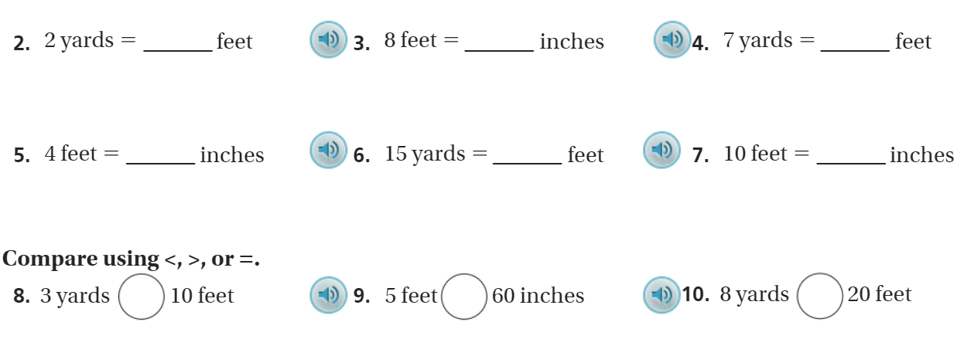
The Friday Quiz – pg. 651

Slide 20
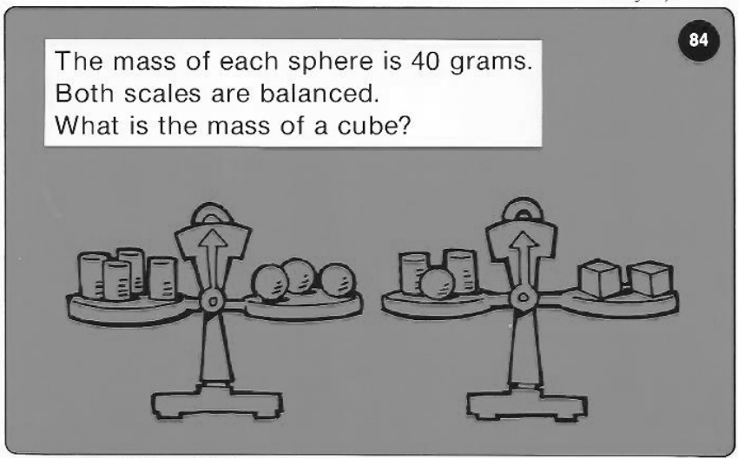
Calculator Problem

Slide 21

Exit Ticket – pg. 649

