Slide 1

Chapter 12
Lesson 12.3

Slide 2
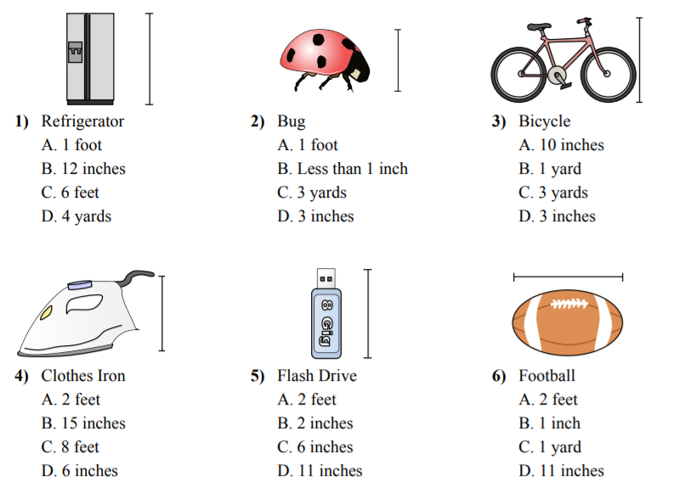
Fluency

Slide 3
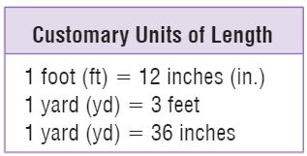

Let’s Look Back!

Slide 4
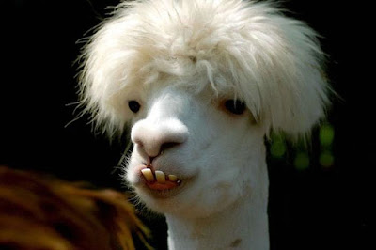

Slide 5
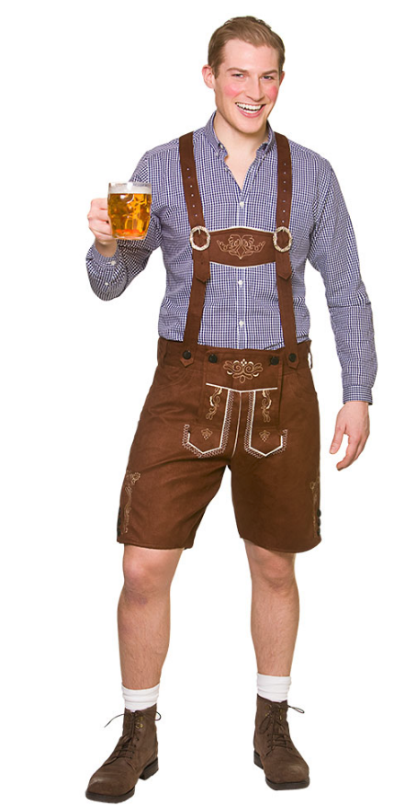


Peter!
Metric System X 10

Slide 6




Bruce!
Customary System

Slide 7
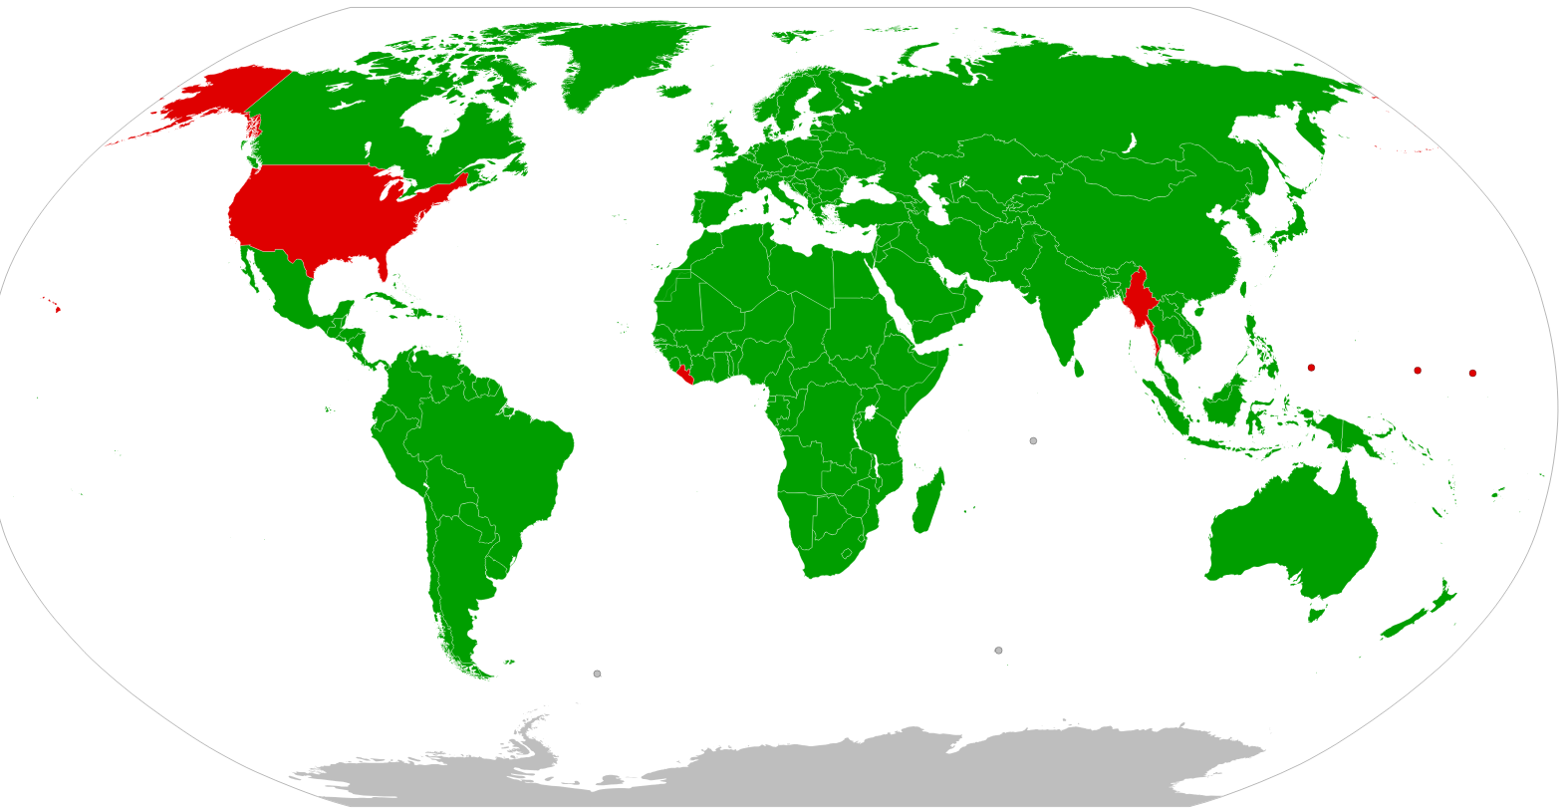
Metric vs. Customary

Slide 8


Customary Benchmarks

Slide 9

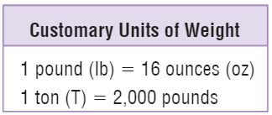
Customary Units of Weight

Slide 10
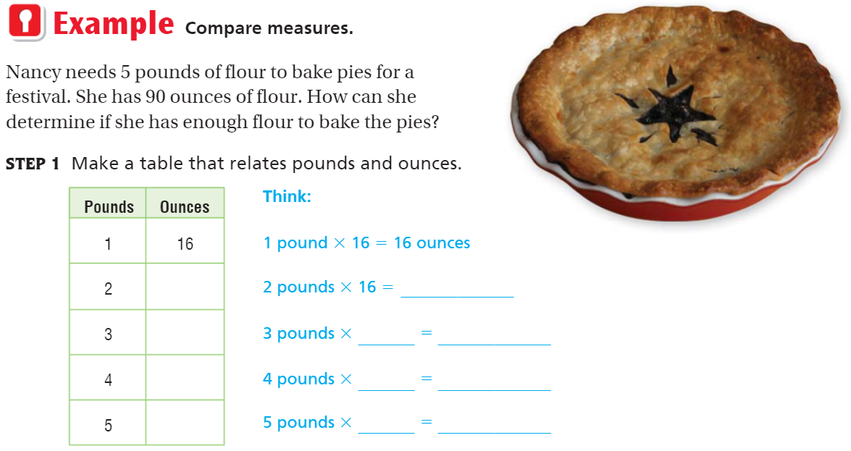
Teach & Reteach – pg.654

Slide 11

Share & Show – pg. 655

Slide 12
I can find customary units of weight.
Will you be able to do this?
Yes! | Maybe | No

Slide 13

On your own – pg. 655

Slide 14
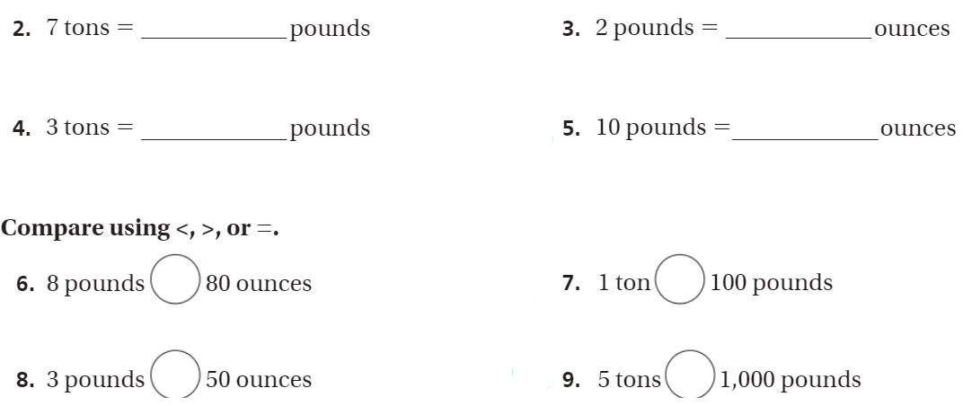
The Friday Quiz – pg. 657

Slide 15
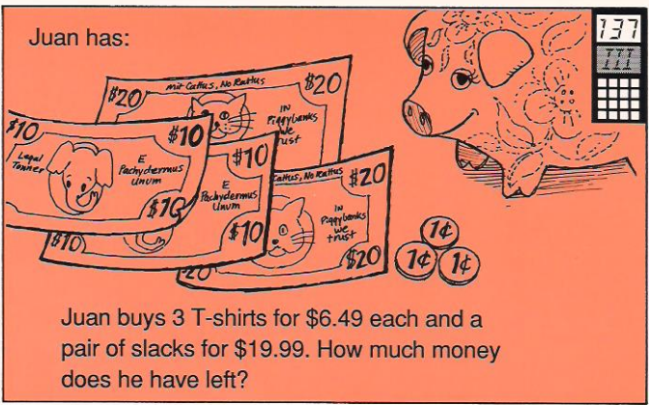
Calculator Problem

