Slide 1

Chapter 12
Lesson 12.4

Slide 2

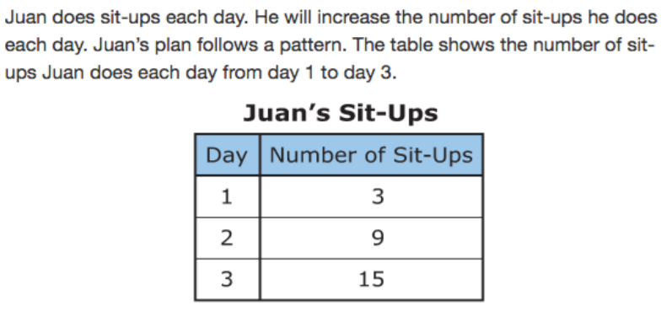


Slide 3


No Points
Wilma Toothy

Slide 4
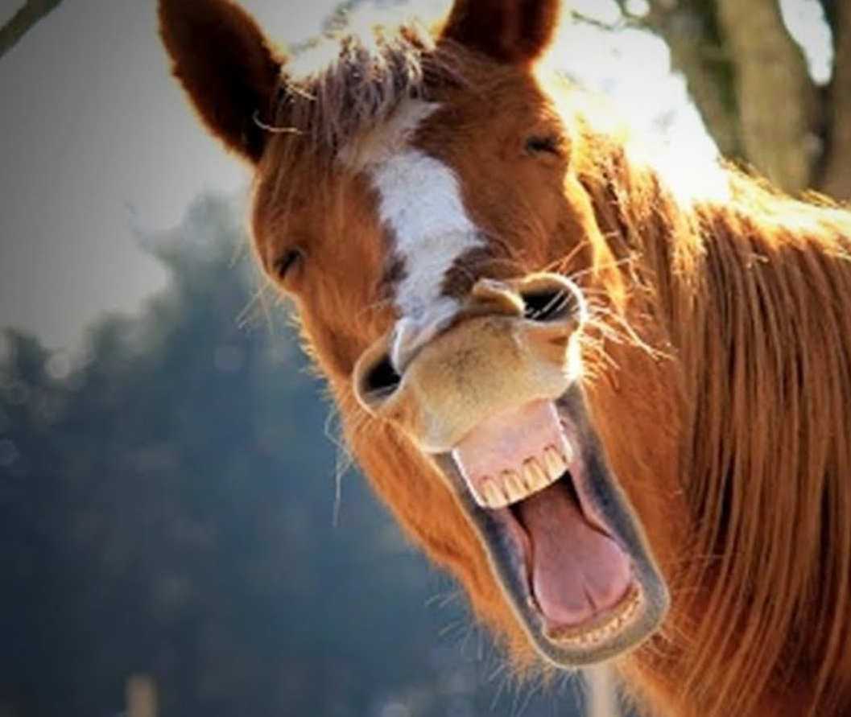

Slide 5

Half Points
Barny Tonguey

Slide 6
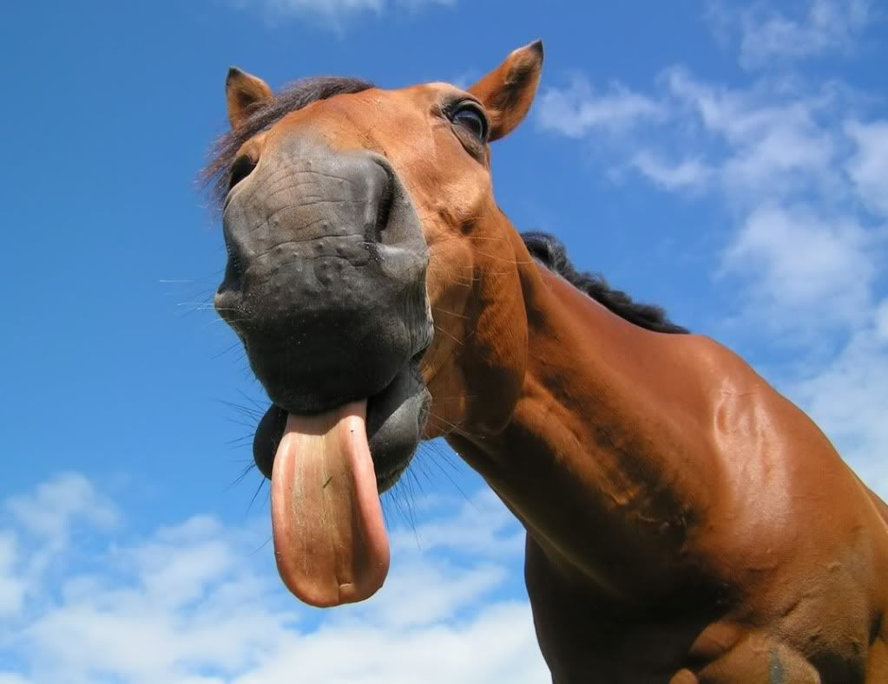

Slide 7
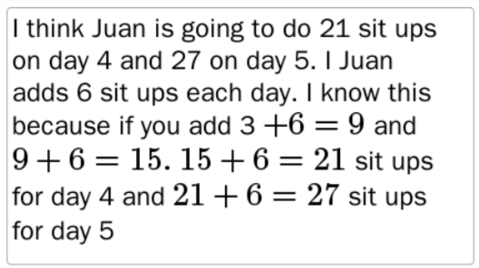
Full Points
Freddy Taily

Slide 8
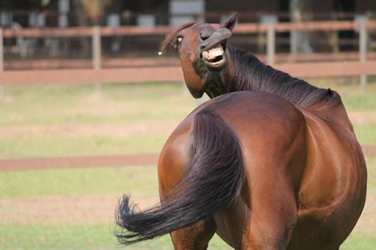

Slide 9
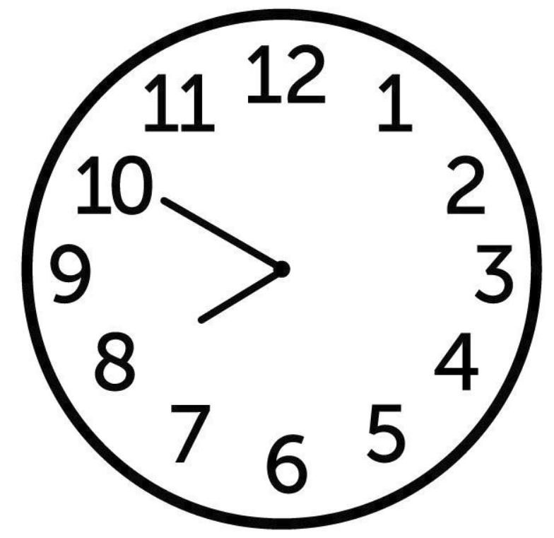
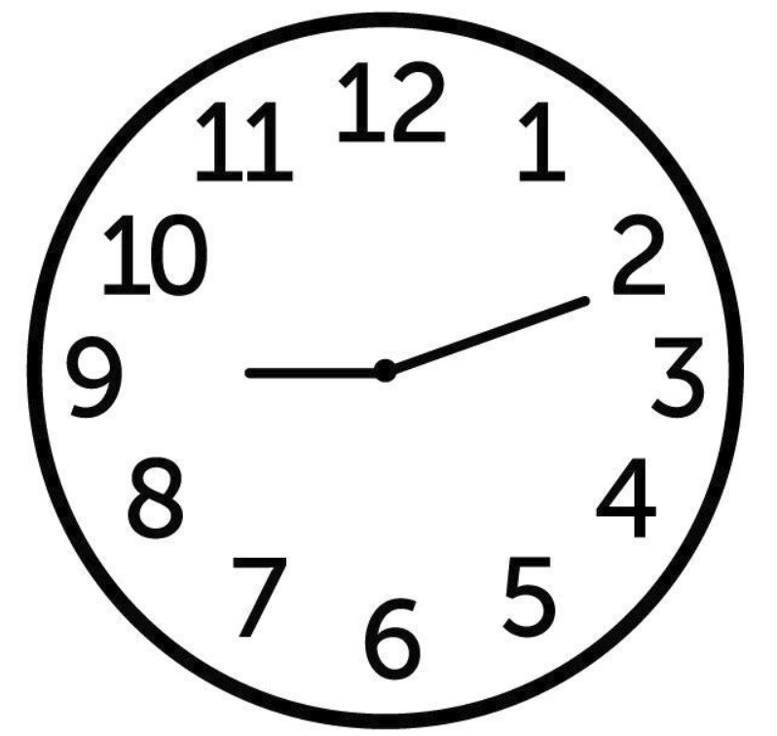
Let’s Look Back!
How many degrees are there between the hour and minute hand?
How much time has passed between the first clock and second?

Slide 10
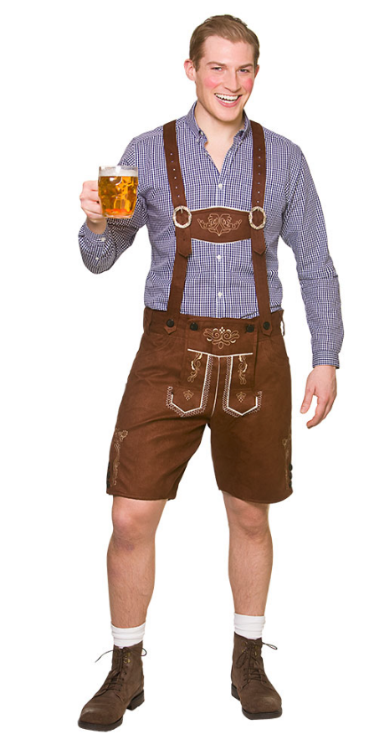


Peter!
Metric System X 10

Slide 11
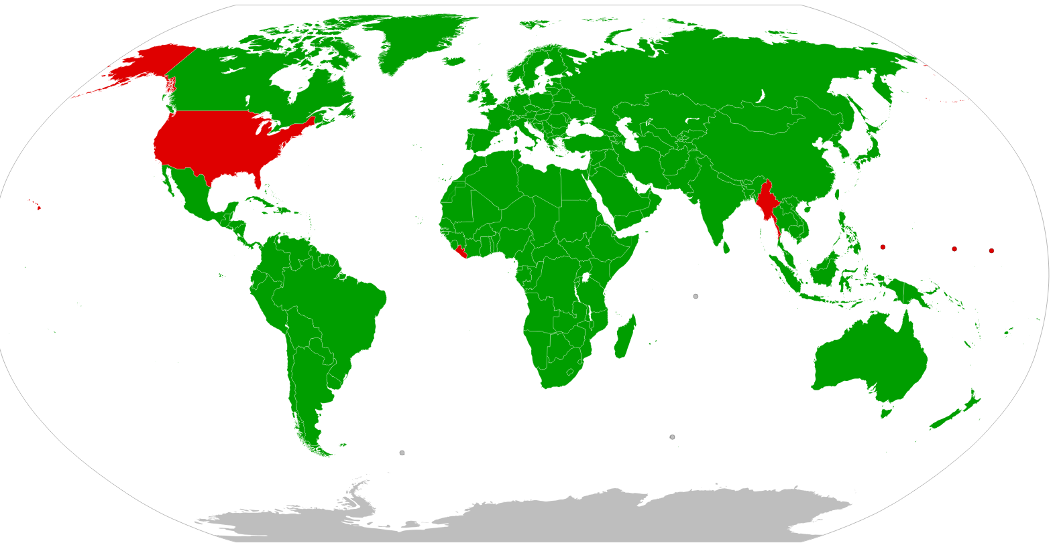
Metric vs. Customary

Slide 12




Bruce!
Customary System

Slide 13


Customary Benchmarks

Slide 14
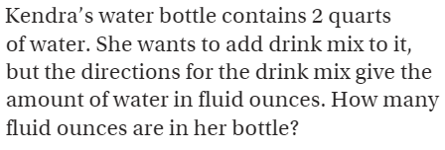
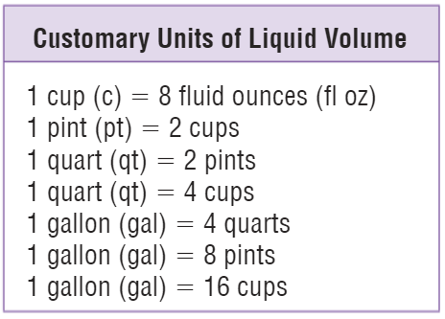
Teach & Reteach – pg.663

Slide 15
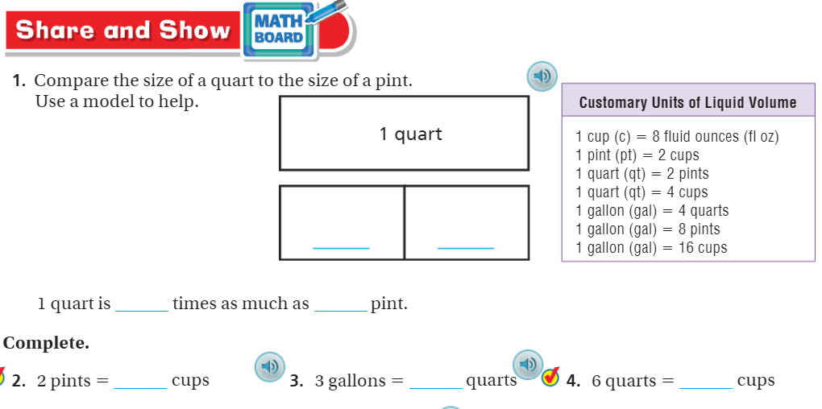
Share & Show – pg.661

Slide 16
I can find customary units of volume.
Will you be able to do this?
Yes! | Maybe | No

Slide 17
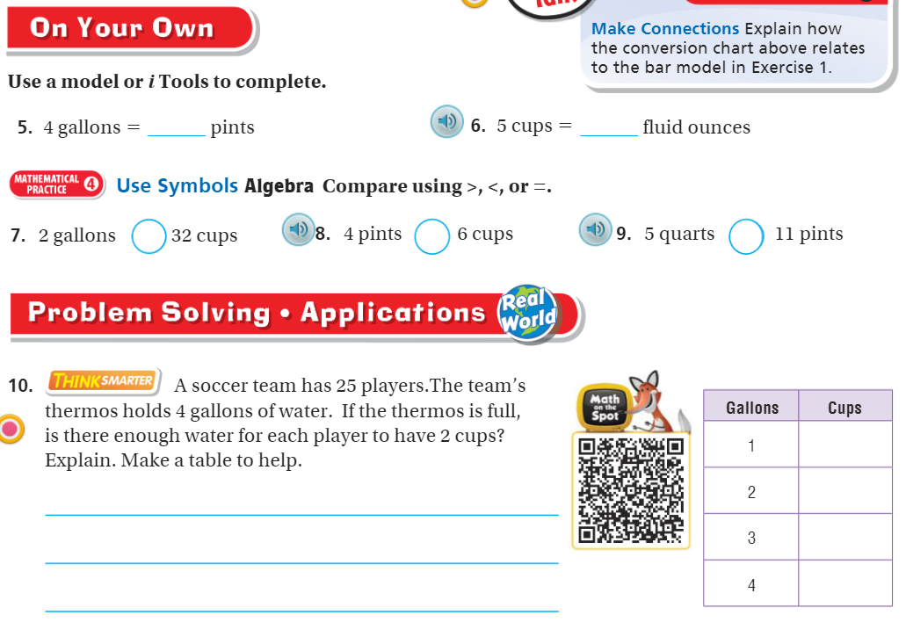
On your own – pg.661

Slide 18
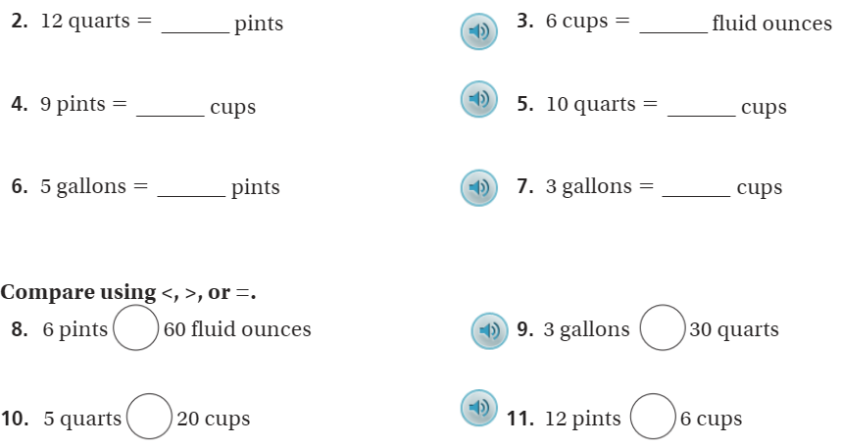
The Friday Quiz – pg.663

Slide 19
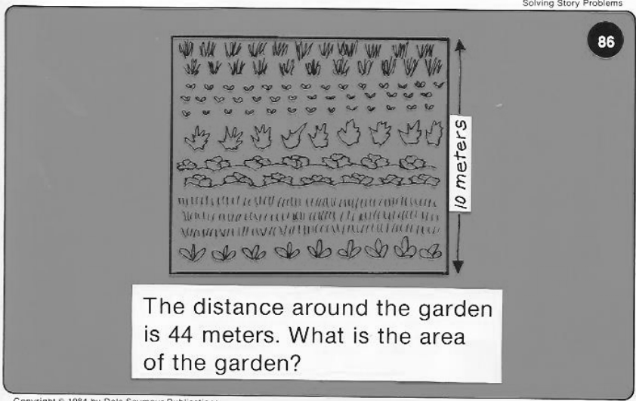
Calculator Problem

Slide 20
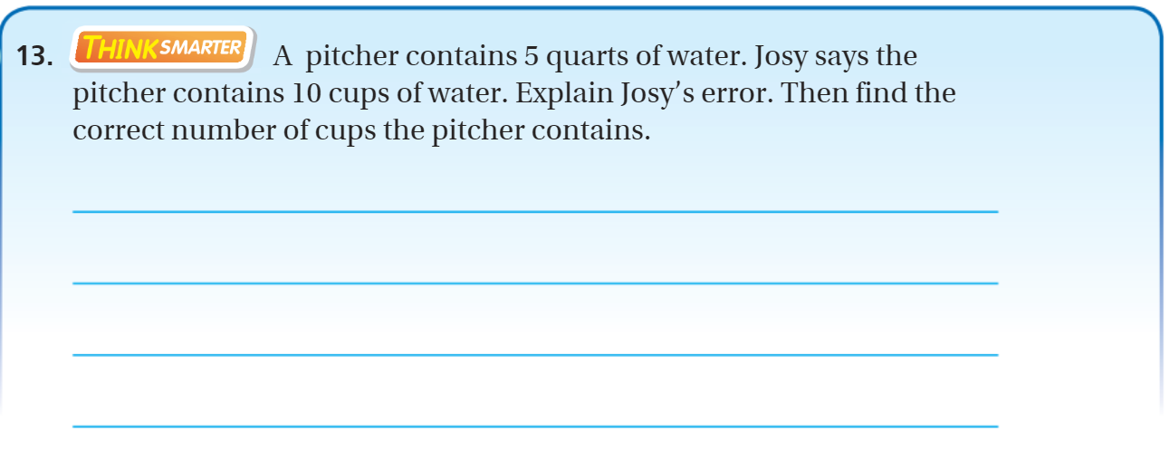
Exit Ticket – pg. 662

