Slide 1

Chapter 11
Lesson 11.2

Slide 2

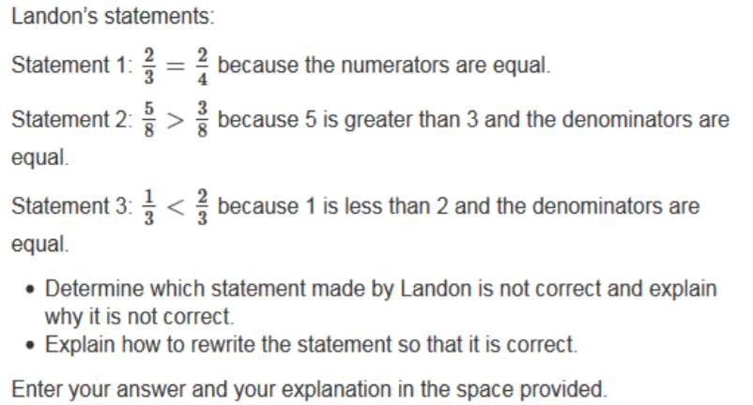

Slide 3

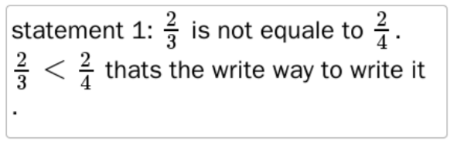
No Points
Lisa Flappipants

Slide 4
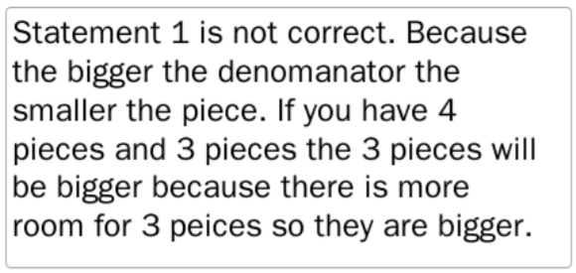
Half Points
Scotty Doodie

Slide 5
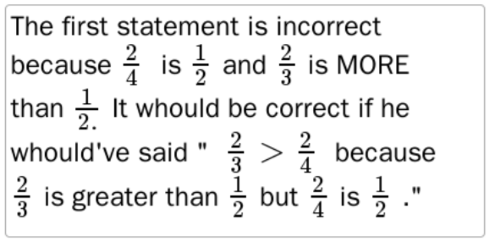
Full Points
Shelly Tickle

Slide 6
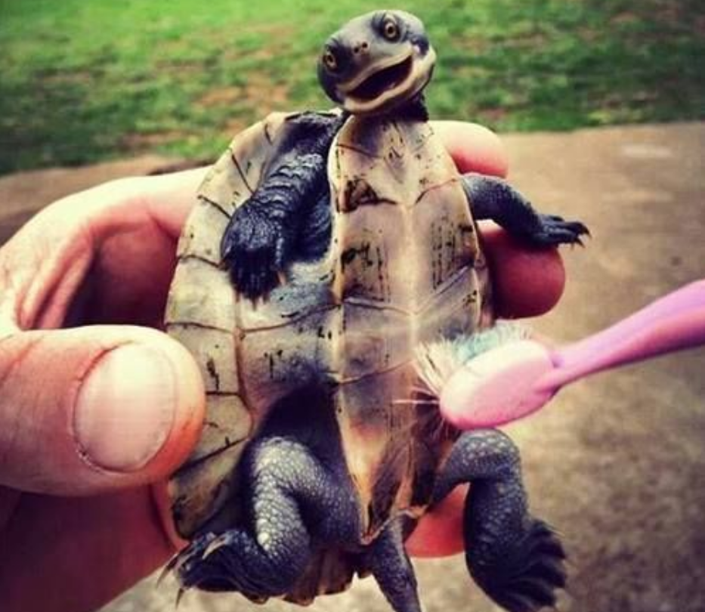

Slide 7
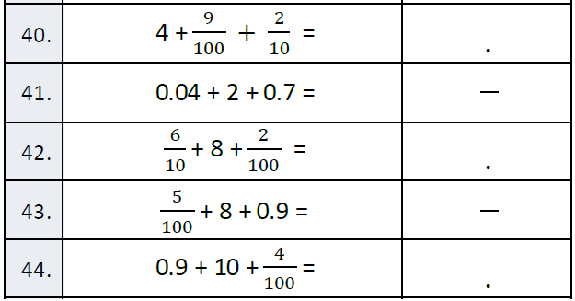
Fluency

Slide 8
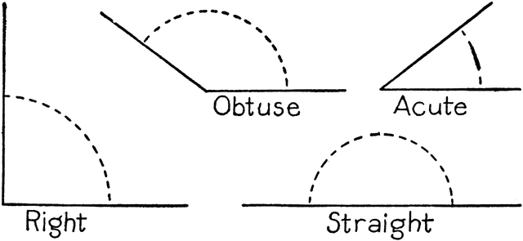
Let’s Look Back!

Slide 9
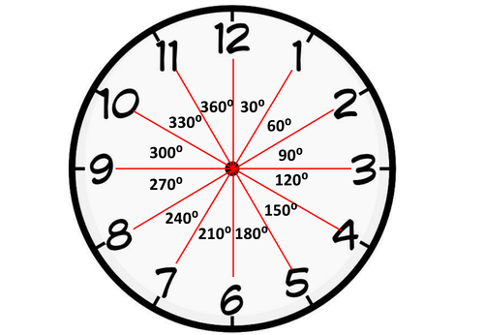
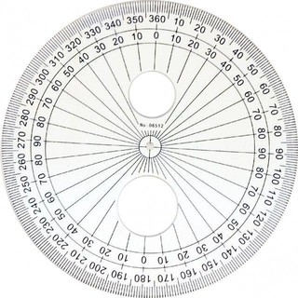
Protractor Degrees

Slide 10

Minutes to degrees

Slide 11

Minutes to degrees

Slide 12

Minutes to degrees

Slide 13

Minutes to degrees

Slide 14

Minutes to degrees

Slide 15
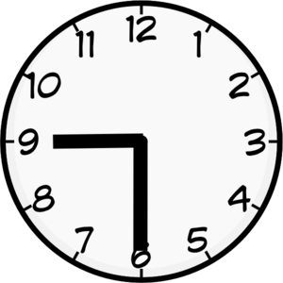
Minutes to degrees

Slide 16
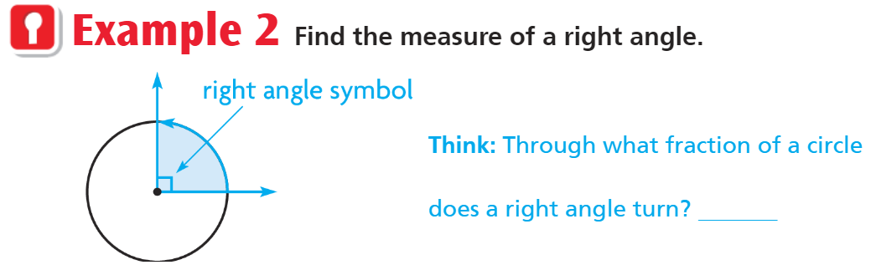
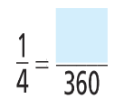
Teach and Reteach - Pg. 608

Slide 17
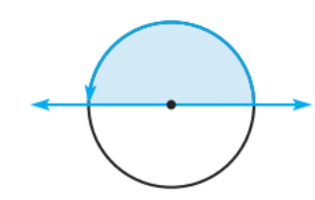
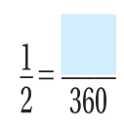
Teach and Reteach pg. 608

Slide 18
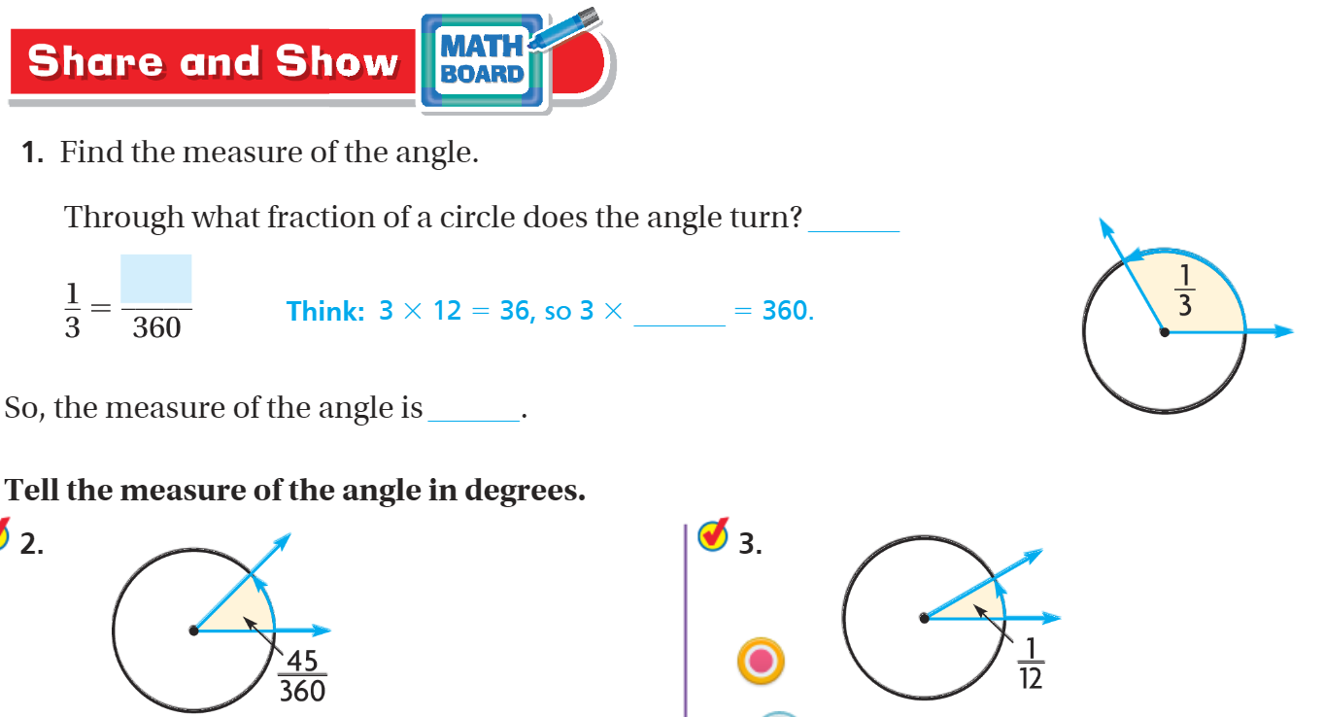
Share and Show pg. 609

Slide 19
I can name degrees of a circle.
Will you be able to do this?
Yes! | Maybe | No

Slide 20
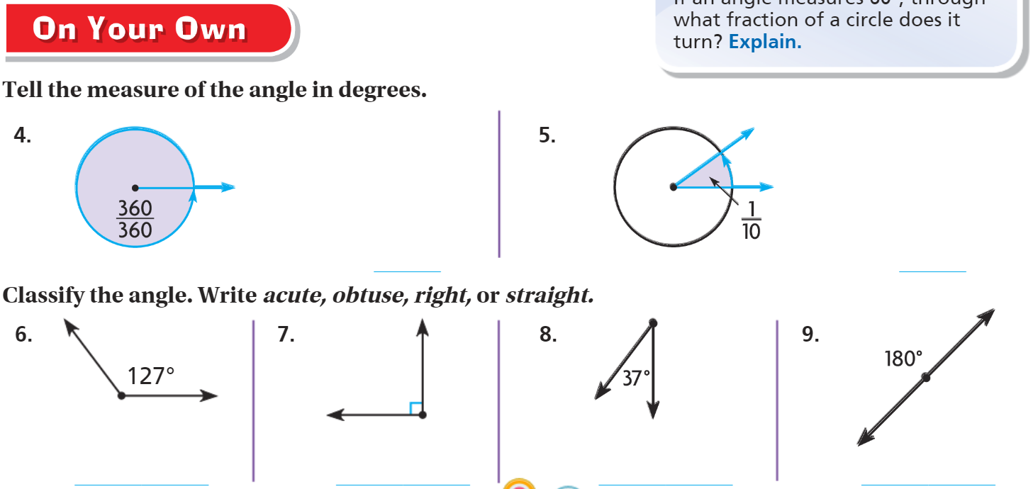
On your own – Pg. 609

Slide 21
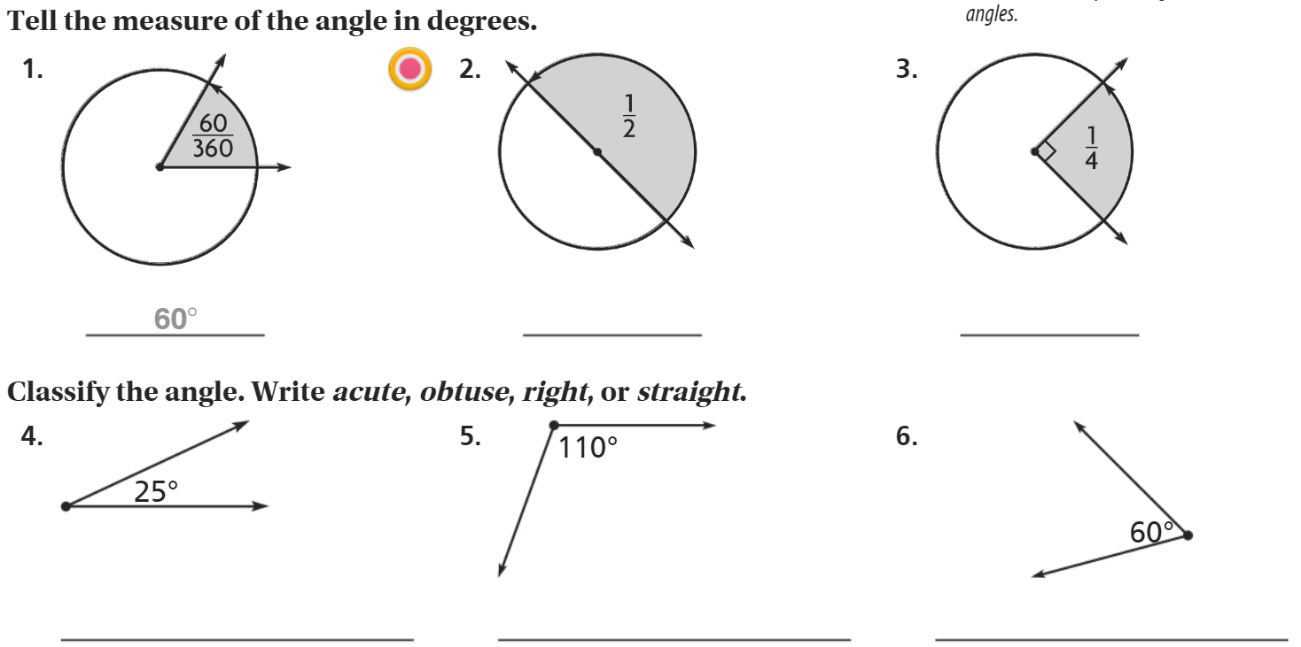
The Friday Quiz – Pg. 611

Slide 22
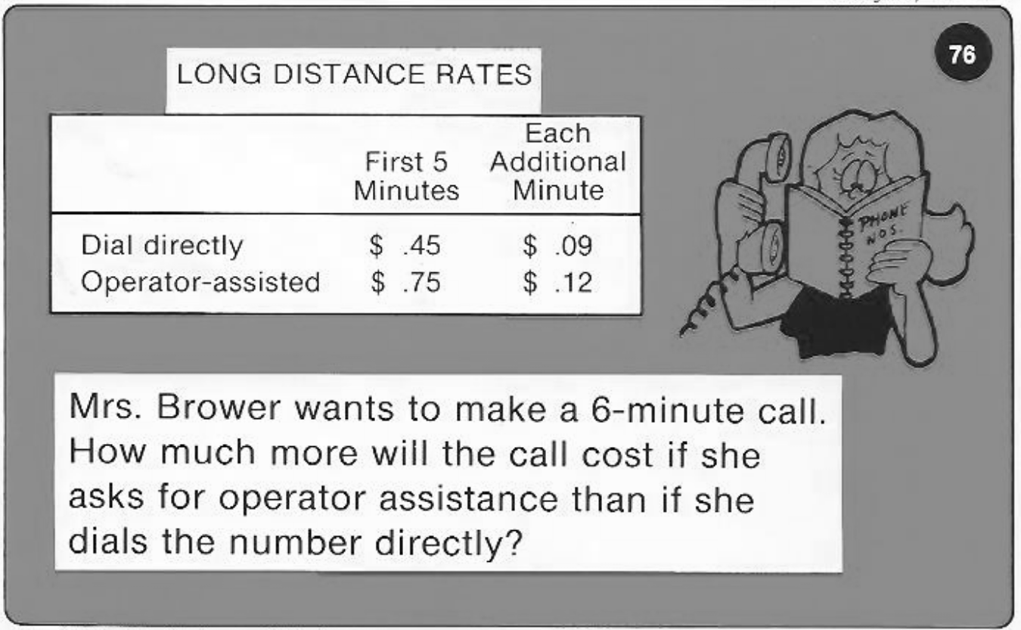
Calculator Problem

Slide 23
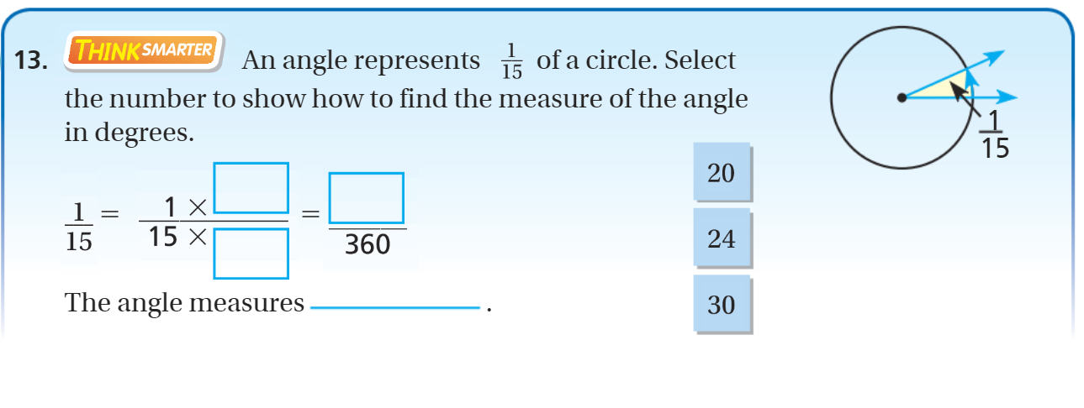
Exit Ticket – pg. 610

