Slide 1

Chapter 12
Lesson 12.10

Slide 2

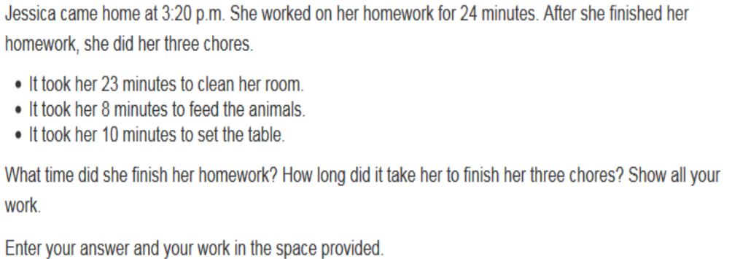

Slide 3

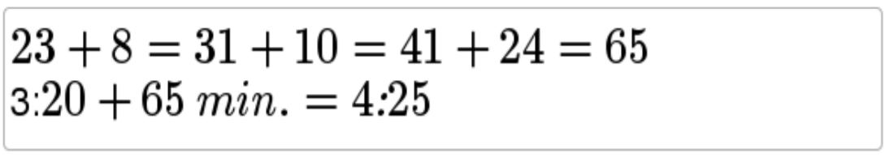
No Points

Slide 4
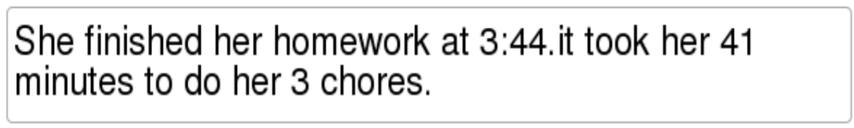
Half Points

Slide 5
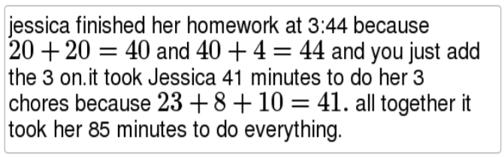
Full Points

Slide 6
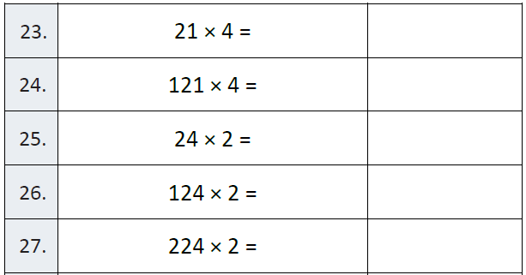
Fluency
Find the prime number

Slide 7
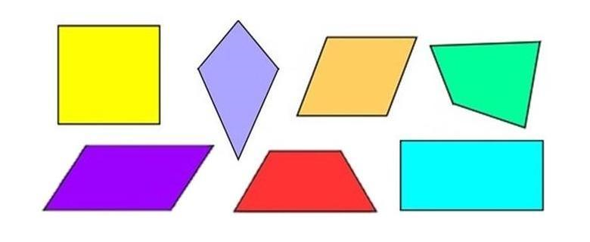
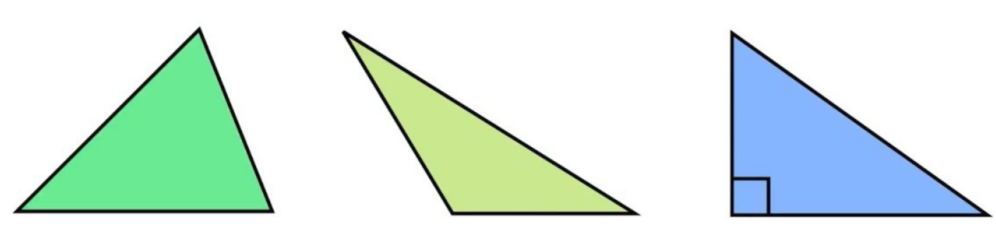
Let’s Look Back!

Slide 8
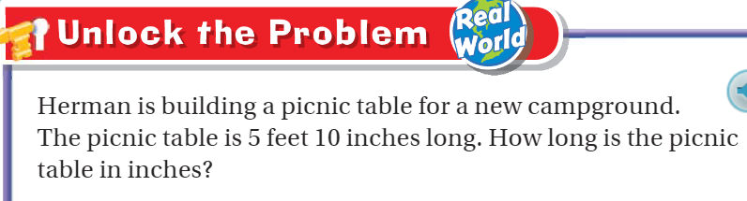
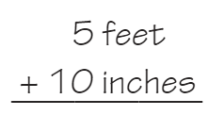
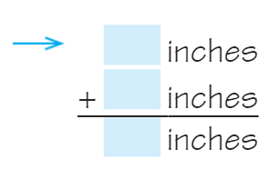
Teach & Reteach Pg. 697

Slide 9
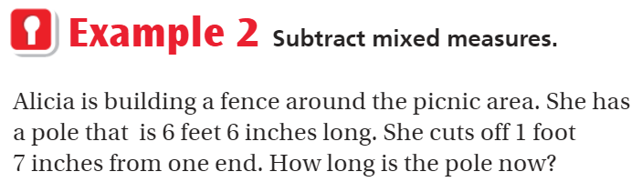
Teach & Reteach – pg. 698

Slide 10
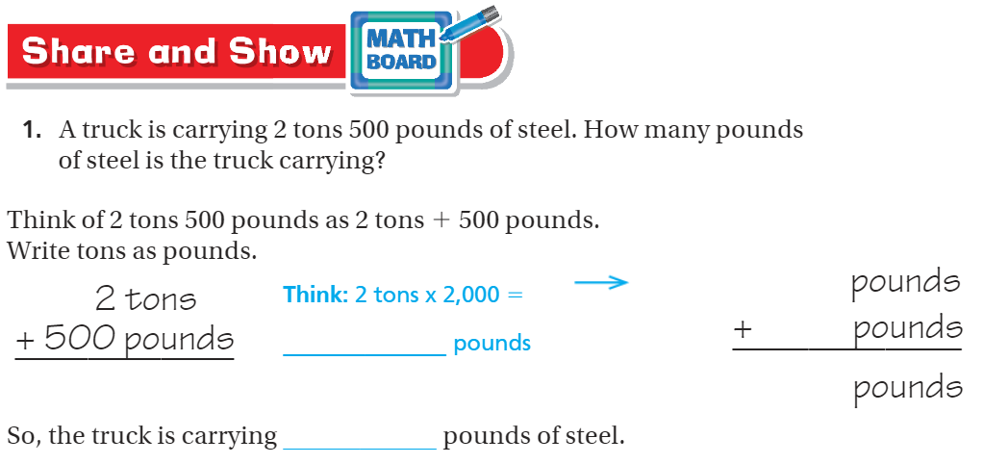
Share and Show pg. - 698

Slide 11
I can find elapsed time.
Will you be able to do this?
Yes! | Maybe | No

Slide 12
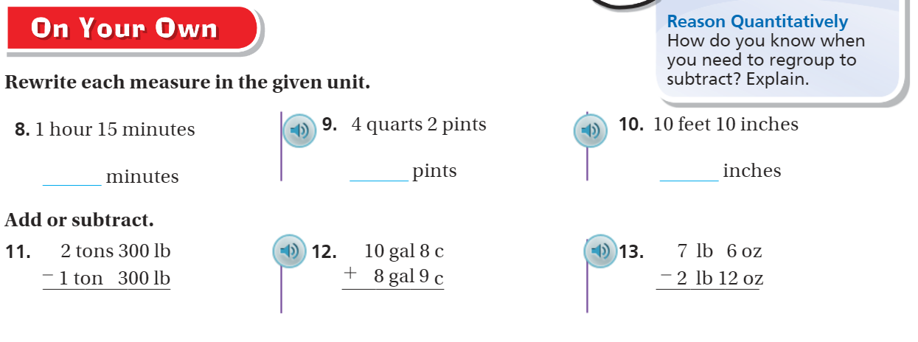
On your own – pg. 699

Slide 13
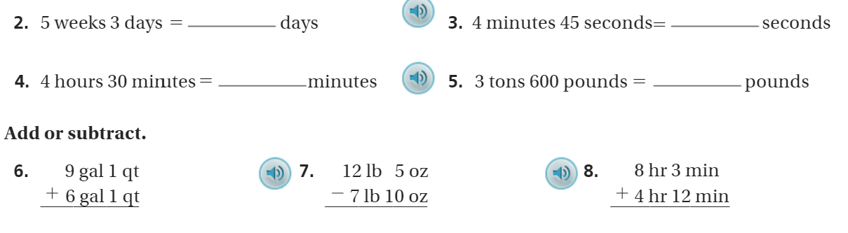
The Friday Quiz – pg.701

Slide 14
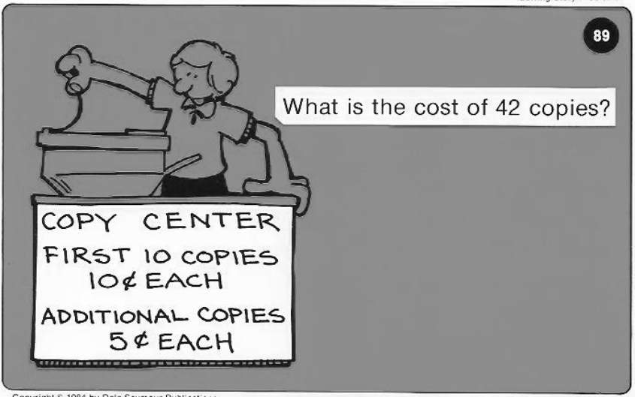
Calculator Problem

Slide 15
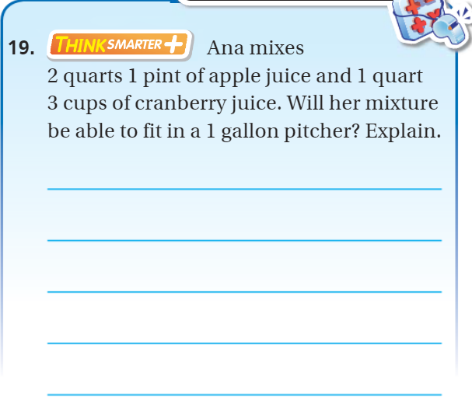
Exit Ticket – pg. 700

