Slide 1

Chapter 12
Lesson 12.5

Slide 2
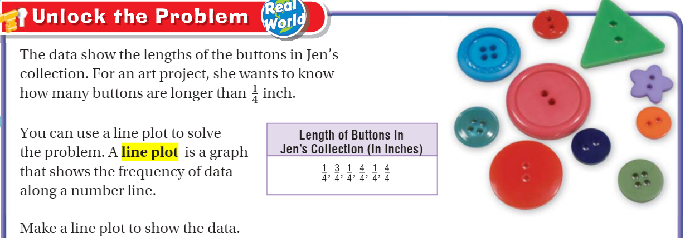
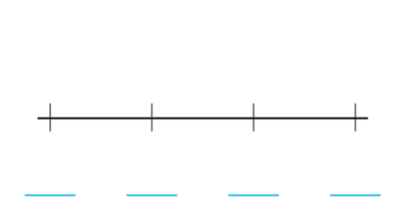
Teach & Reteach – pg. 665

Slide 3
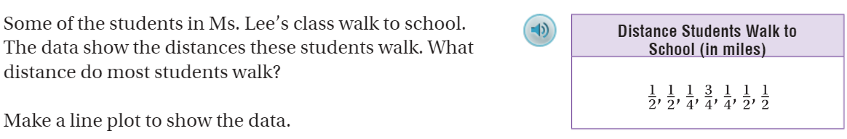
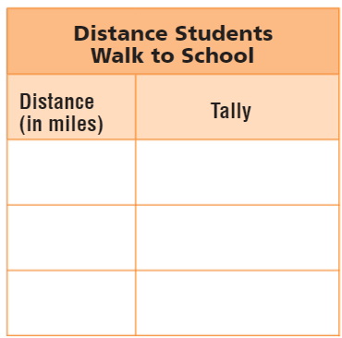
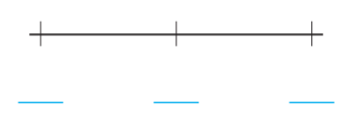
Share & Show – pg.

Slide 4
I can make a line plot graph.
Will you be able to do this?
Yes! | Maybe | No

Slide 5
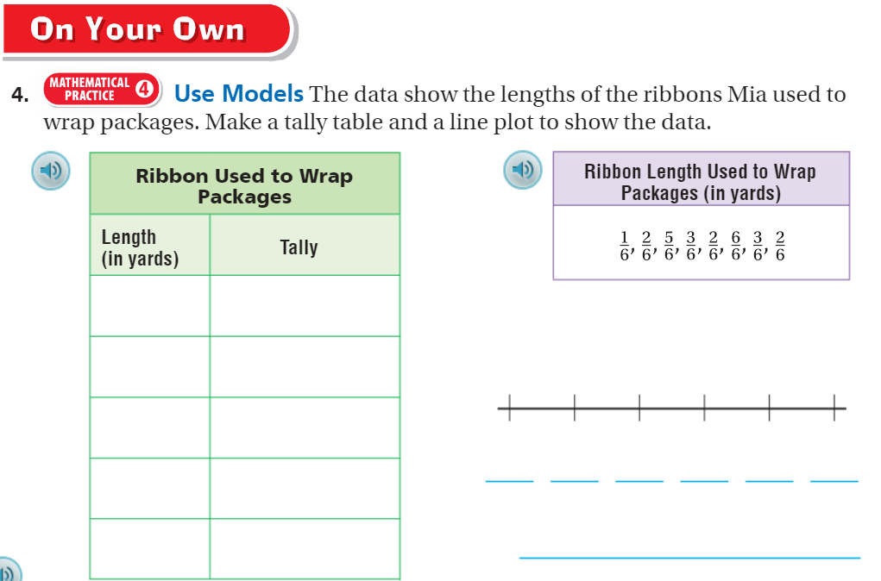
On your own – pg. 667

Slide 6
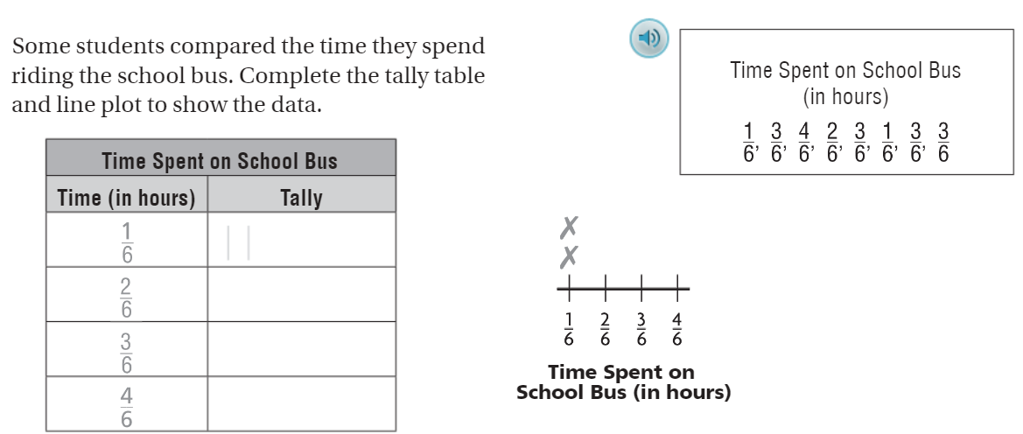
The Friday Quiz – pg. 669

Slide 7
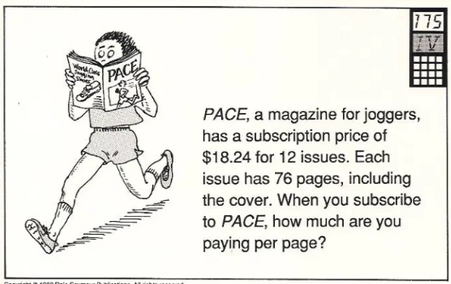
Calculator Problem

