Slide 1

Chapter 12
Lesson 12.6

Slide 2




Bruce!
Customary System

Slide 3




Peter!
Metric System X 10

Slide 4

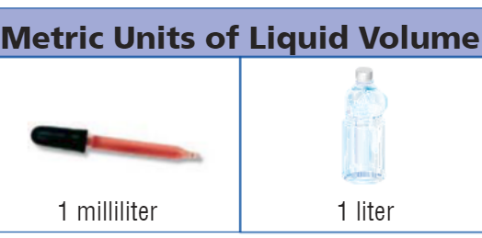
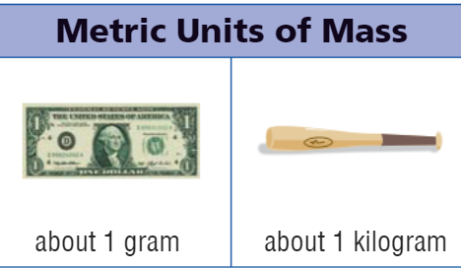
Metric Benchmarks

Slide 5
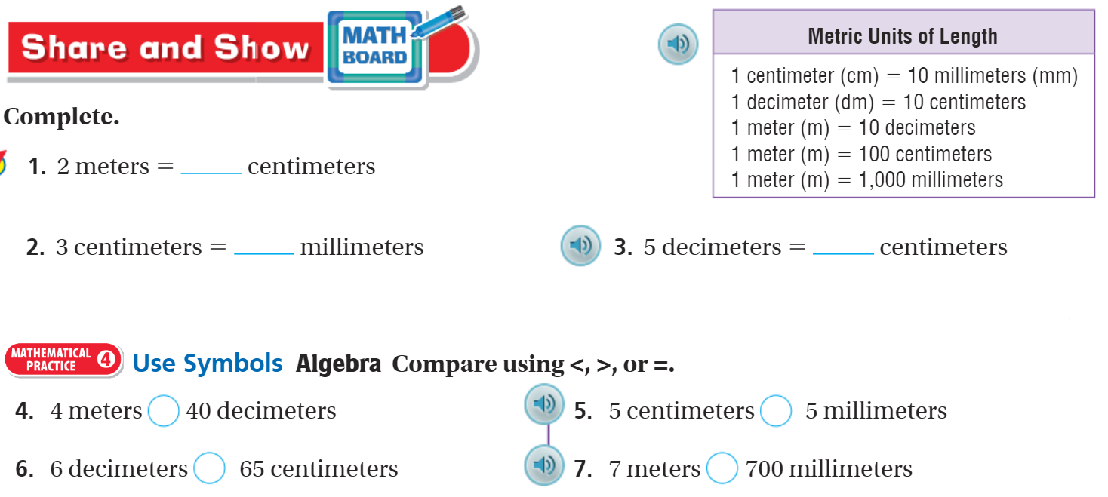
Share and Show – pg. 675

Slide 6

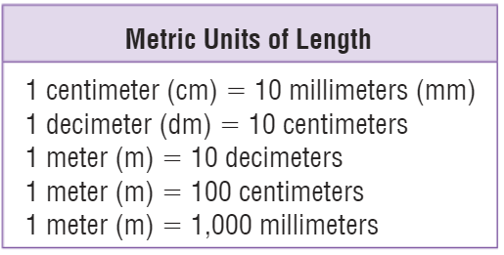
Metric – Decimals and Fractions

Slide 7
I can find metric units of length.
Will you be able to do this?
Yes! | Maybe | No

Slide 8
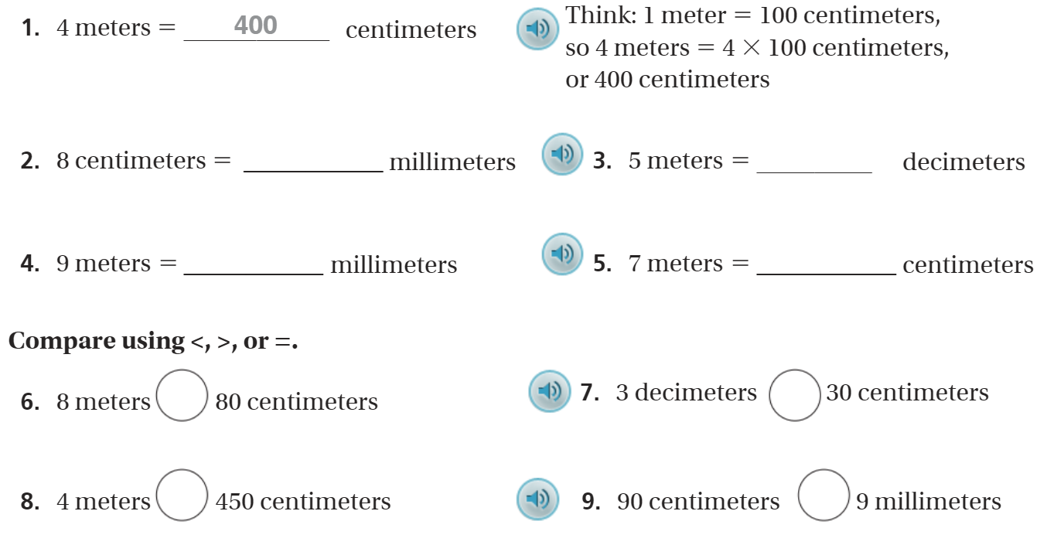
The Friday Quiz – pg.677

Slide 9
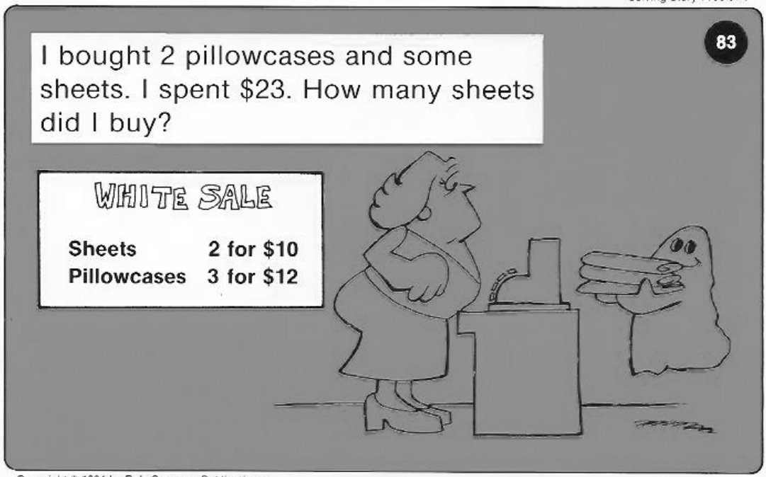
Calculator Problem

Slide 10
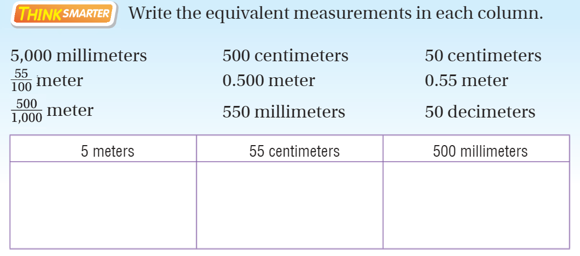
Exit Ticket – pg.676

