Slide 1

Chapter 12
Lesson 12.6

Slide 2




Slide 3

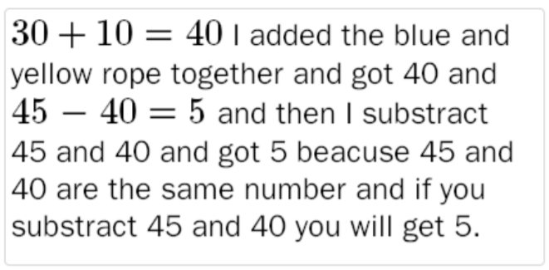
No Points
Roscoe Evil

Slide 4
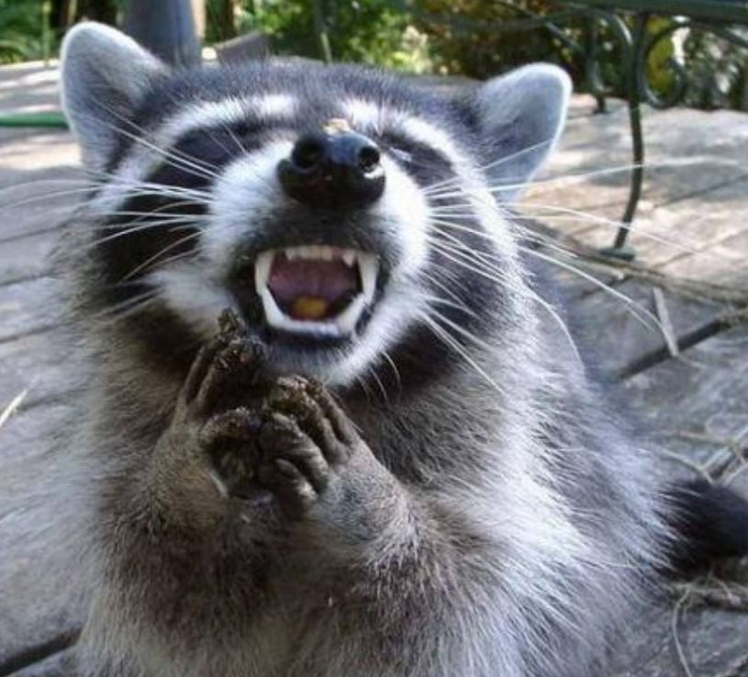

Slide 5
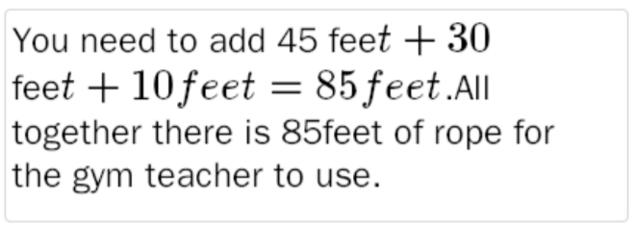
Half Points
Rocky Coon

Slide 6


Slide 7
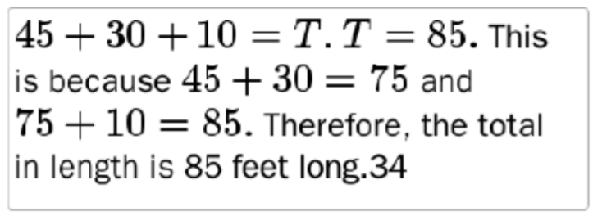
Full Points
Debby Scarey

Slide 8
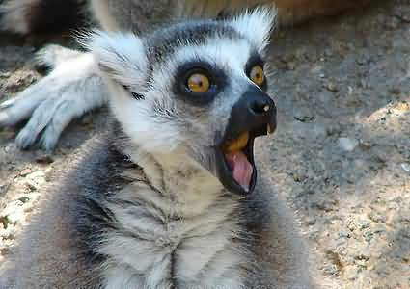

Slide 9
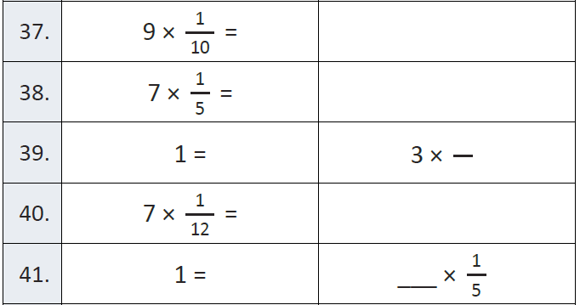
Fluency

Slide 10
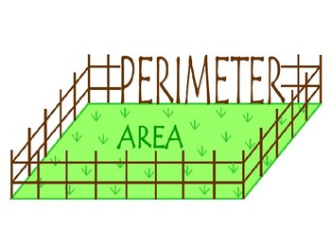
Let’s Look Back!

Slide 11
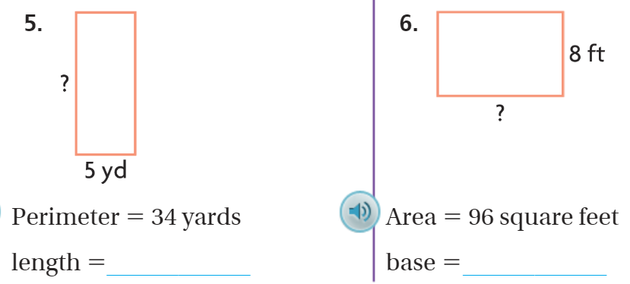
Let’s Look Back!

Slide 12




Bruce!
Customary System

Slide 13




Peter!
Metric System X 10

Slide 14
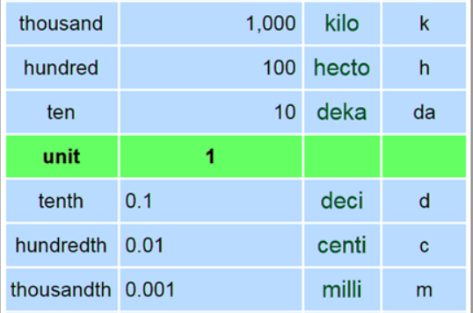

Slide 15

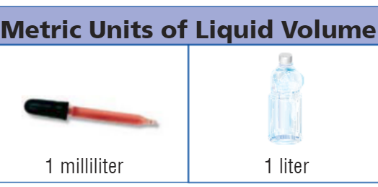
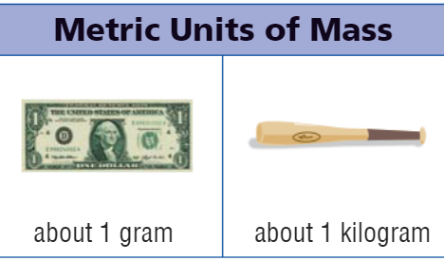
Metric Benchmarks

Slide 16
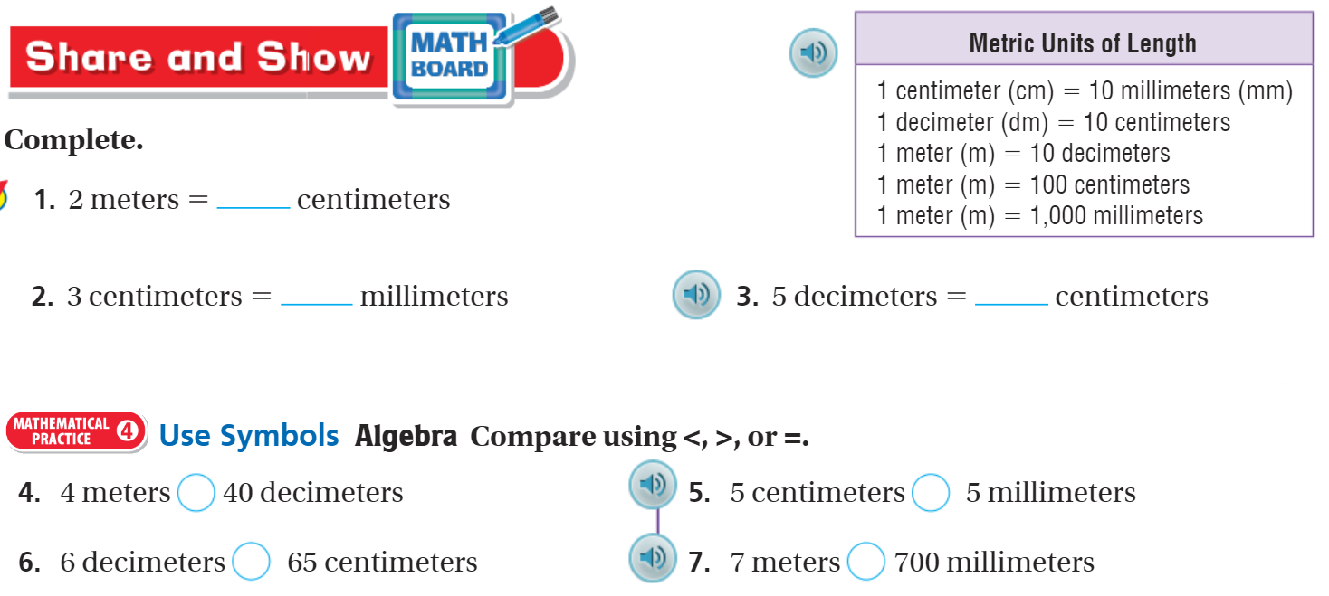
Share and Show – pg. 675

Slide 17

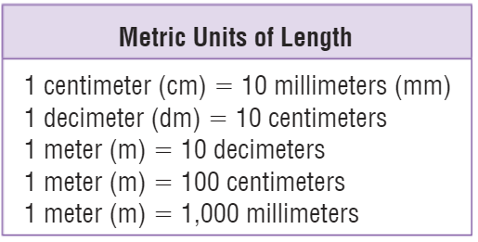
Metric – Decimals and Fractions

Slide 18
I can find metric units of length.
Will you be able to do this?
Yes! | Maybe | No

Slide 19
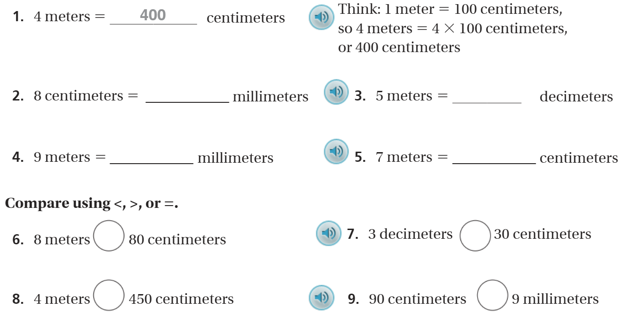
The Friday Quiz – pg.677

Slide 20
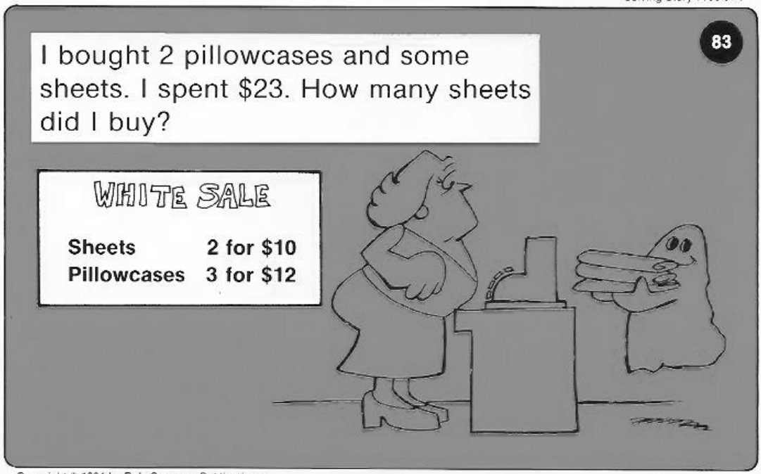
Calculator Problem

Slide 21
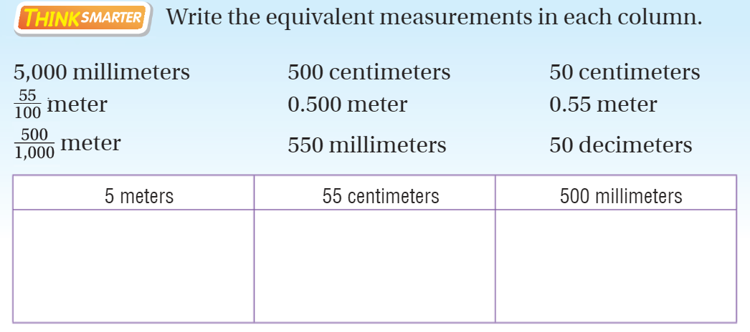
Exit Ticket – pg.676

