Slide 1

Chapter 12
Lesson 12.7

Slide 2



Slide 3

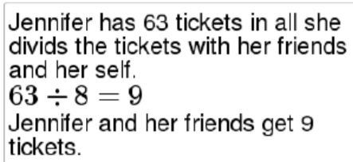
No Points
Heidi Hyper

Slide 4


Slide 5

Half Points
Bernie Skinny

Slide 6
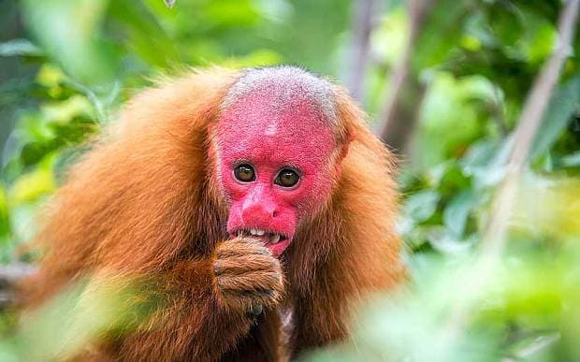

Slide 7

Full Points
Gabriel Grumpy

Slide 8
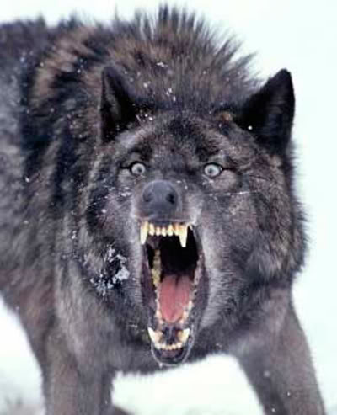

Slide 9
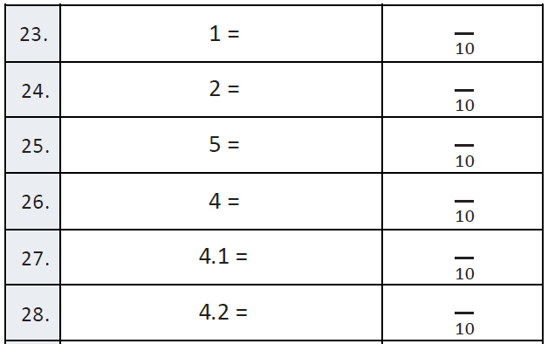
Fluency

Slide 10
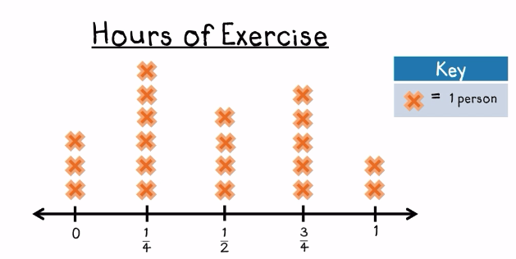
Let’s Look Back!

Slide 11




Bruce!
Customary System

Slide 12
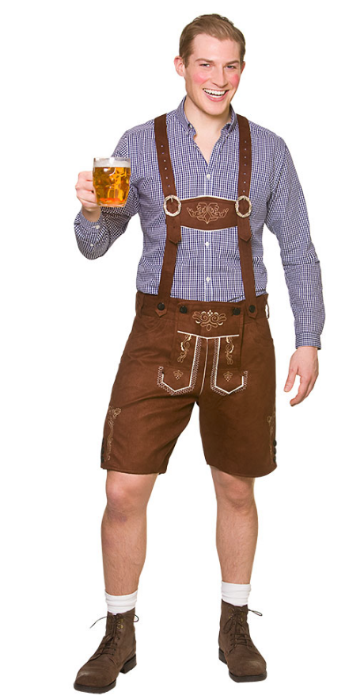



Peter!
Metric System X 10

Slide 13

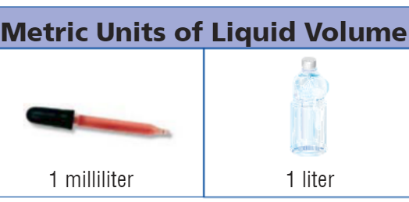
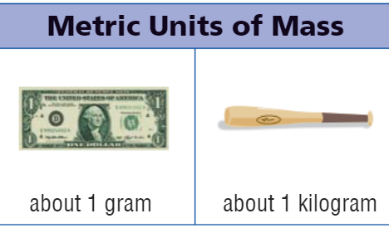
Metric Benchmarks

Slide 14
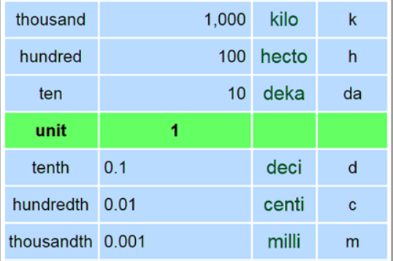

Slide 15


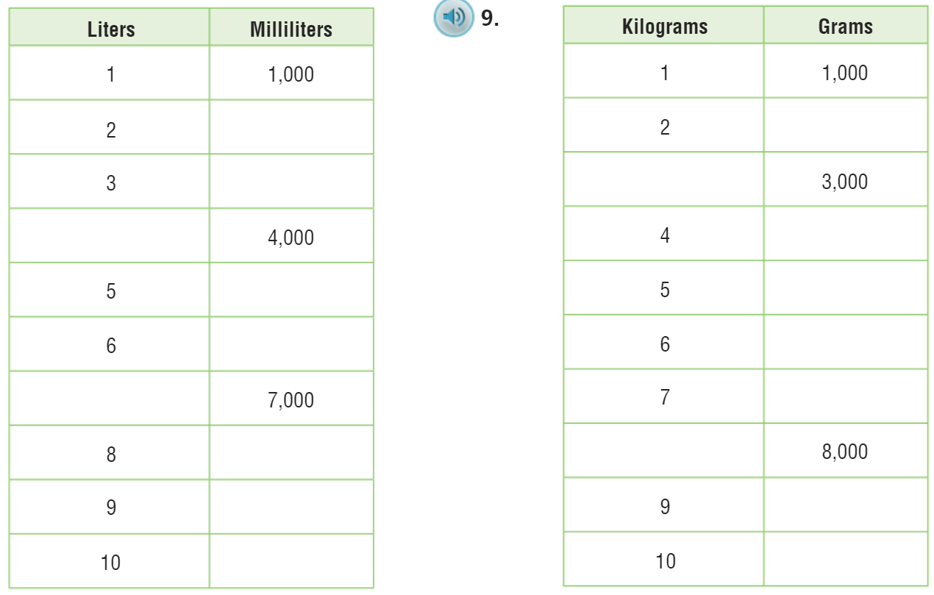

Slide 16
I can find metric units of volume.
Will you be able to do this?
Yes! | Maybe | No

Slide 17

Metric – pg. 680

Slide 18

The Friday Quiz – pg. 683

Slide 19
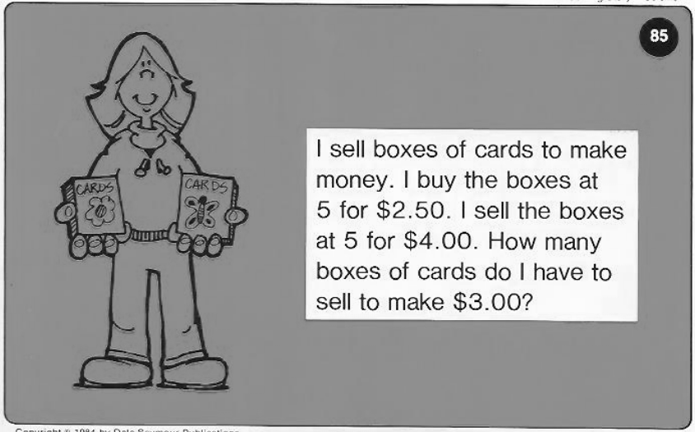
Calculator Problem

Slide 20
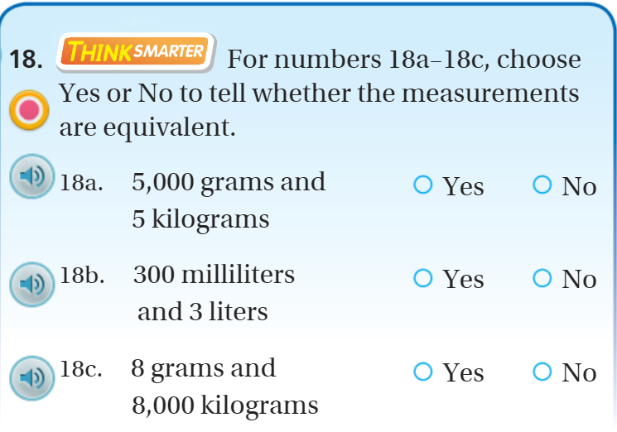
Exit Ticket – pg. 682

