Slide 1

Chapter 12
Lesson 12.7

Slide 2
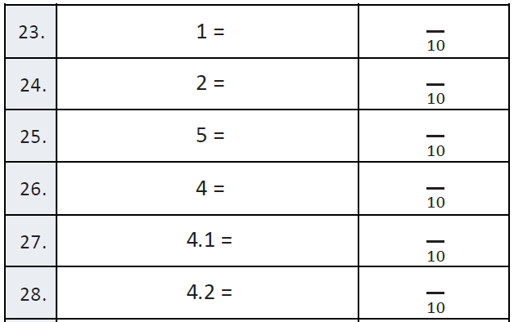
Fluency

Slide 3




Bruce!
Customary System

Slide 4
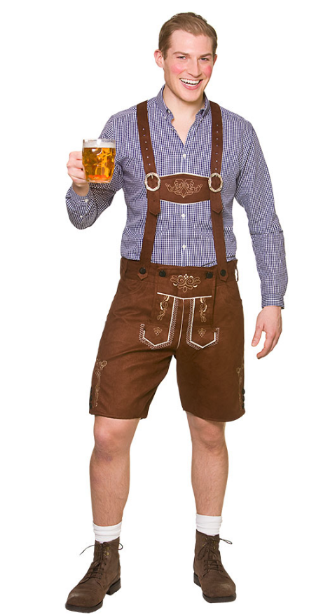



Peter!
Metric System X 10

Slide 5

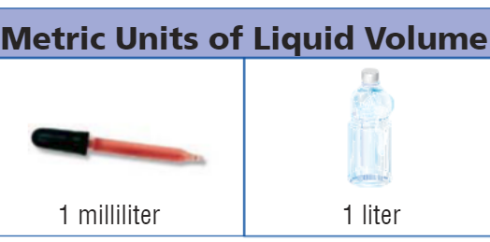
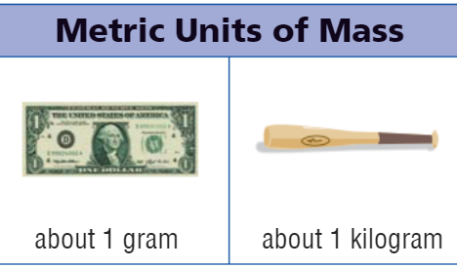
Metric Benchmarks

Slide 6
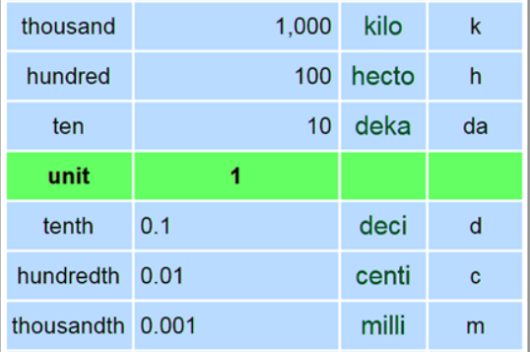

Slide 7


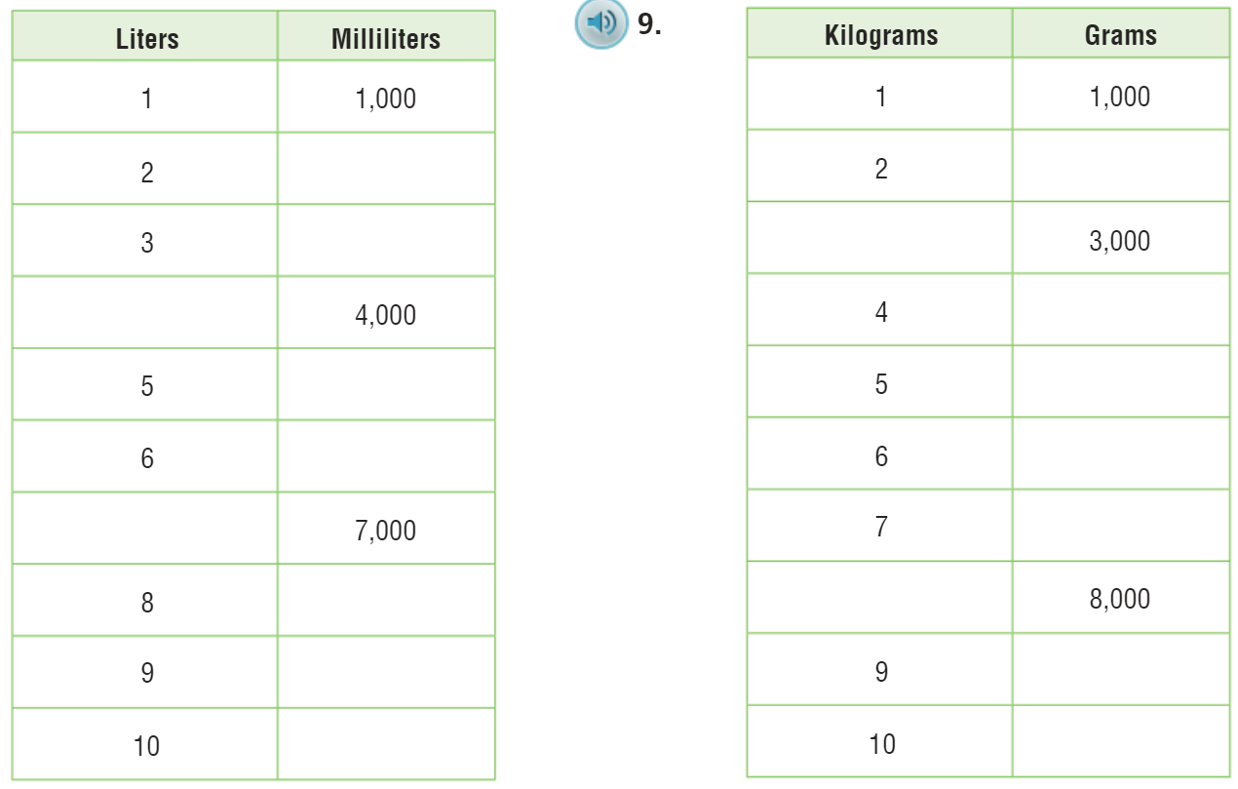

Slide 8
I can find metric units of volume.
Will you be able to do this?
Yes! | Maybe | No

Slide 9

Metric – pg. 680

Slide 10

The Friday Quiz – pg. 683

Slide 11
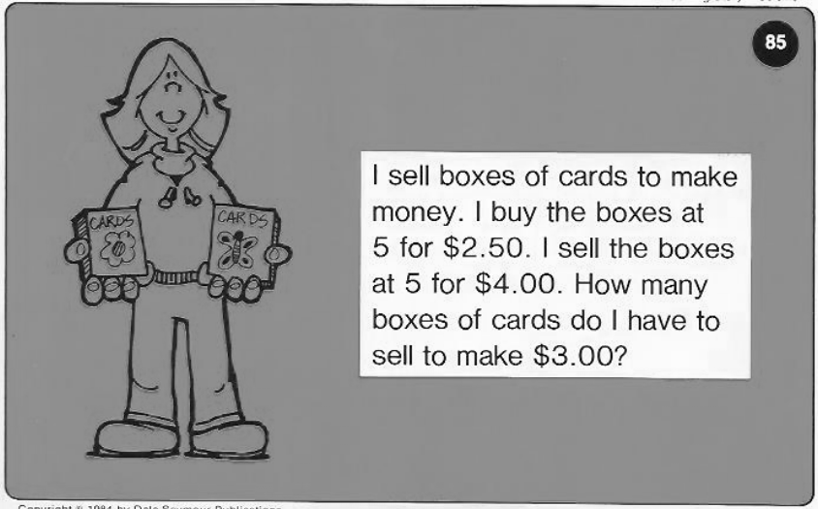
Calculator Problem

Slide 12
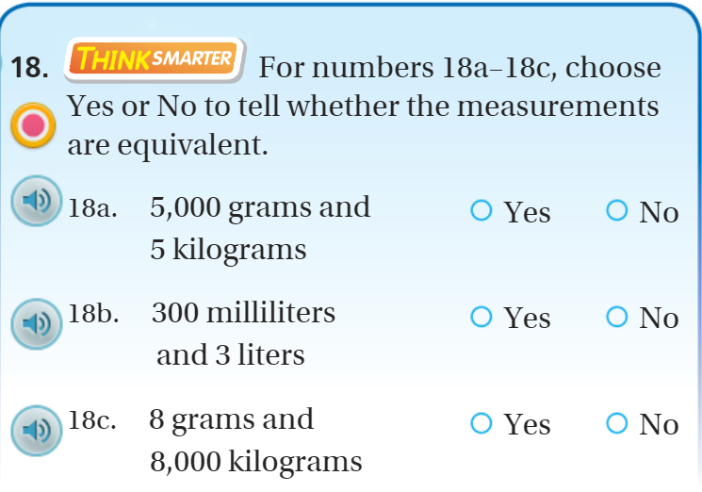
Exit Ticket – pg. 682

