Slide 1

Chapter 12
Lesson 12.8

Slide 2

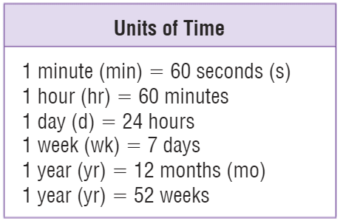
Teach & Reteach – pg.
Exactly what time is it?

Slide 3
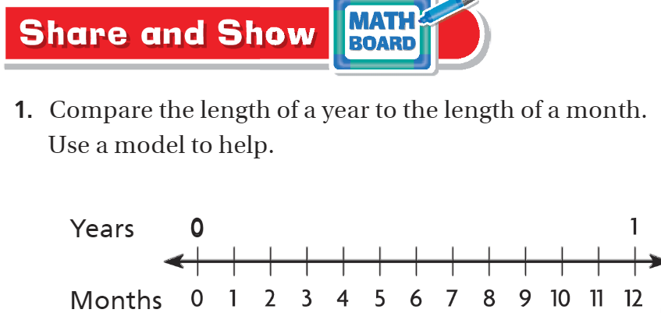
Share & Show – pg.687

Slide 4
I can find missing units of time.
Will you be able to do this?
Yes! | Maybe | No

Slide 5
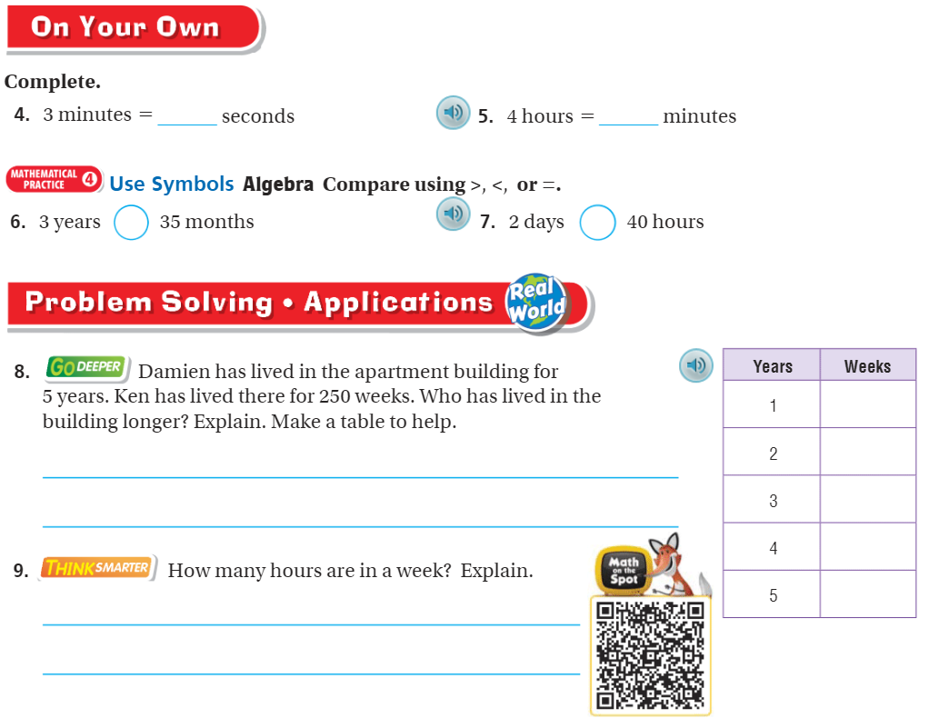
On your own – pg.687

Slide 6
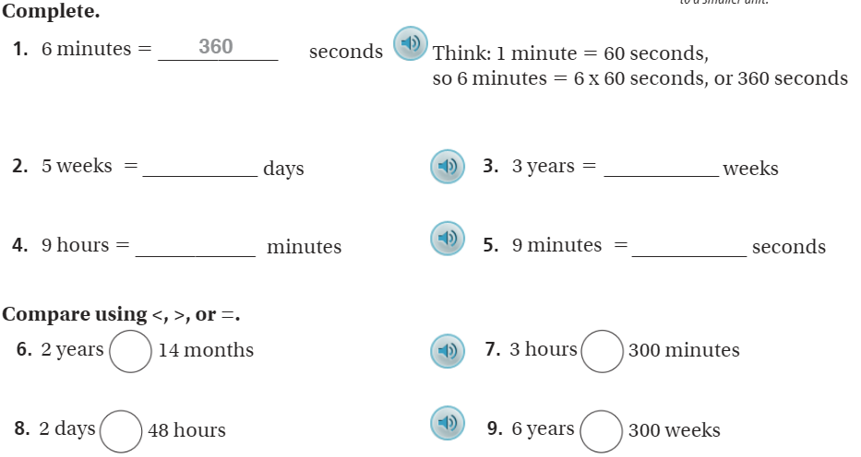
The Friday Quiz – pg.689

Slide 7
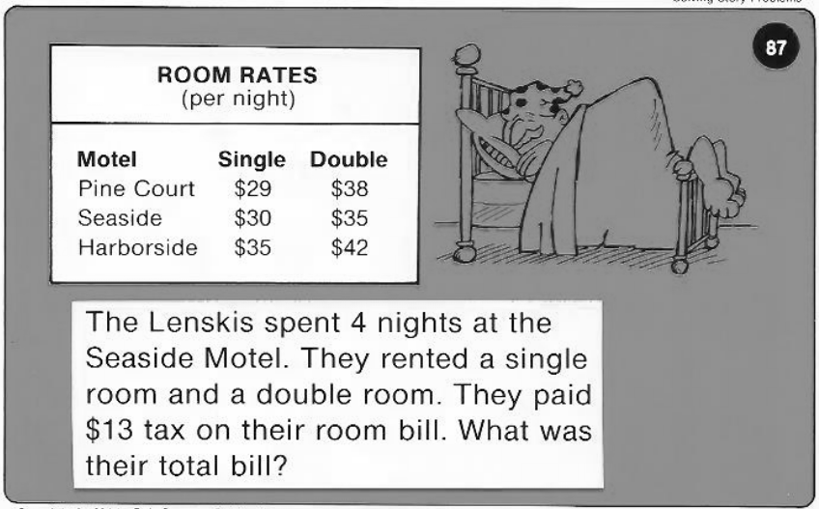
Calculator Problem

Slide 8
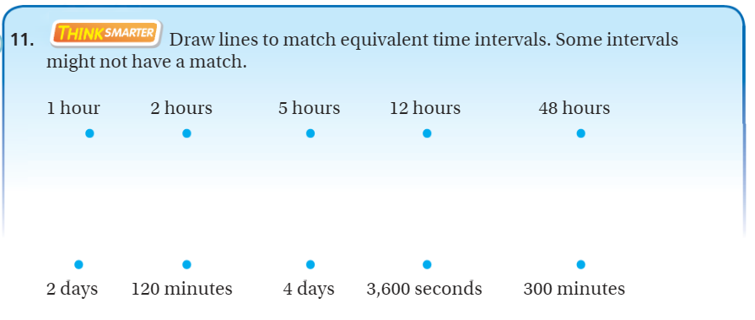
Exit Ticket – pg.688

