Slide 1

Chapter 12
Lesson 12.8

Slide 2

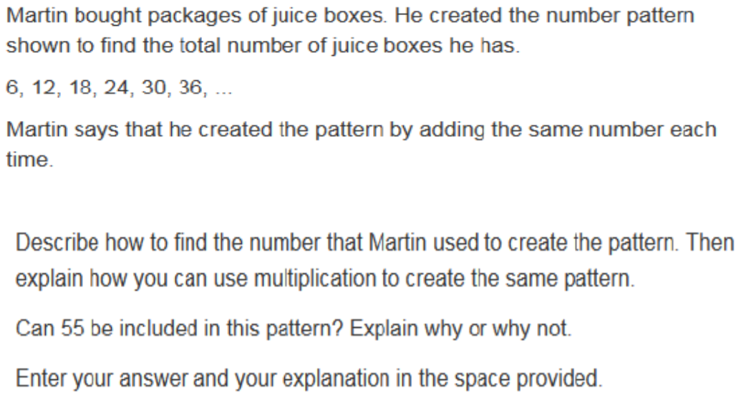

Slide 3

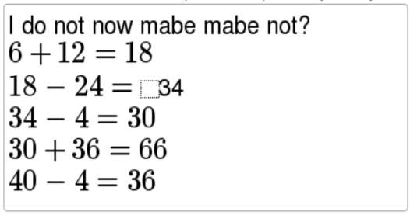
No Points
Butch Yawner

Slide 4
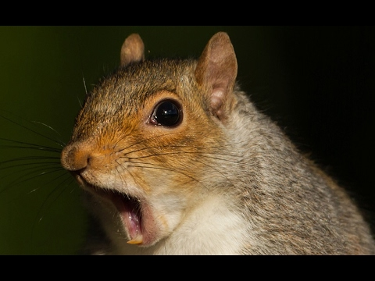

Slide 5
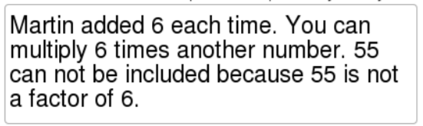
Half Points
Stretch McGuilicutty

Slide 6
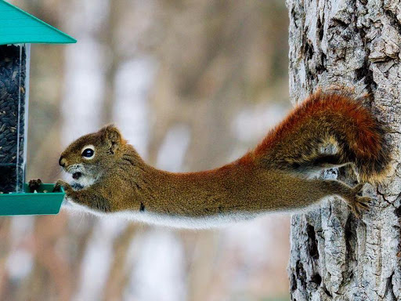

Slide 7
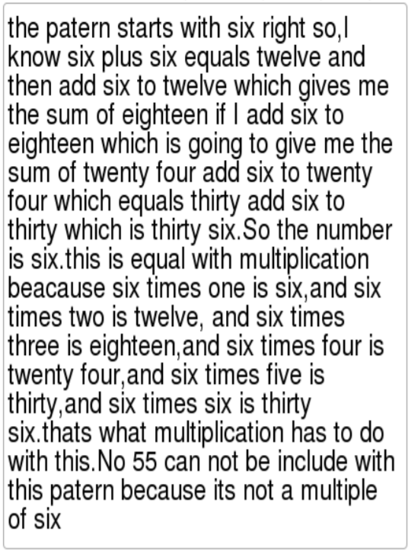
Full Points
Peter Peeker

Slide 8
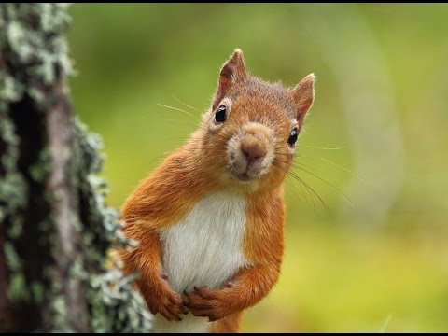

Slide 9
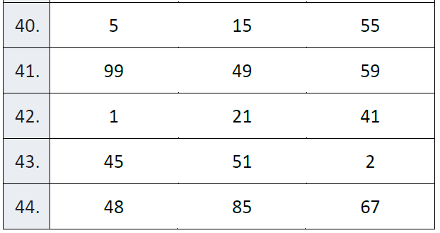
Fluency
Find the prime number

Slide 10
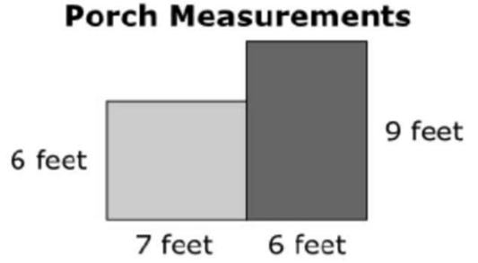
Let’s Look Back!

Slide 11

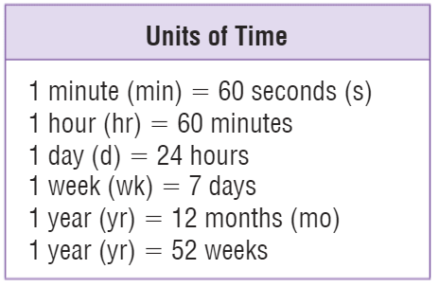
Teach & Reteach – pg.
Exactly what time is it?

Slide 12
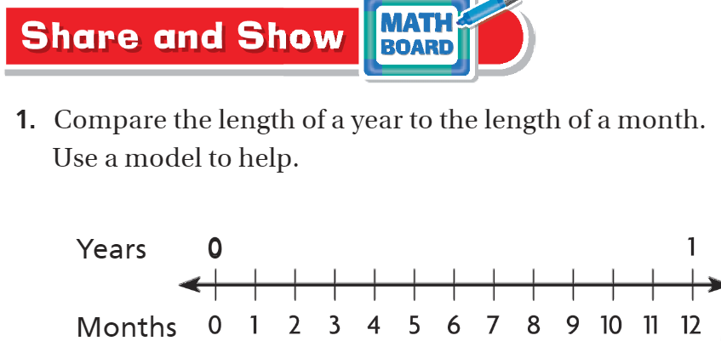
Share & Show – pg.687

Slide 13
I can find missing units of time.
Will you be able to do this?
Yes! | Maybe | No

Slide 14
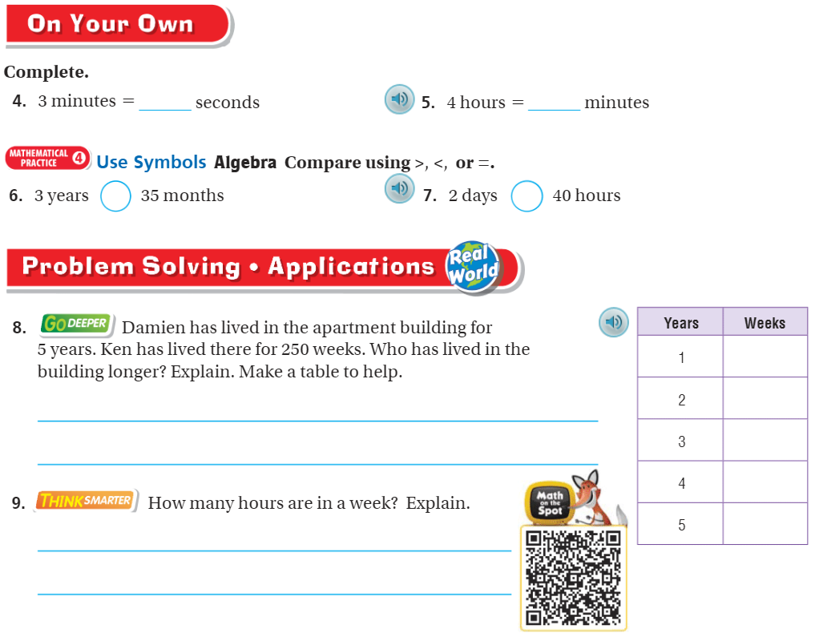
On your own – pg.687

Slide 15
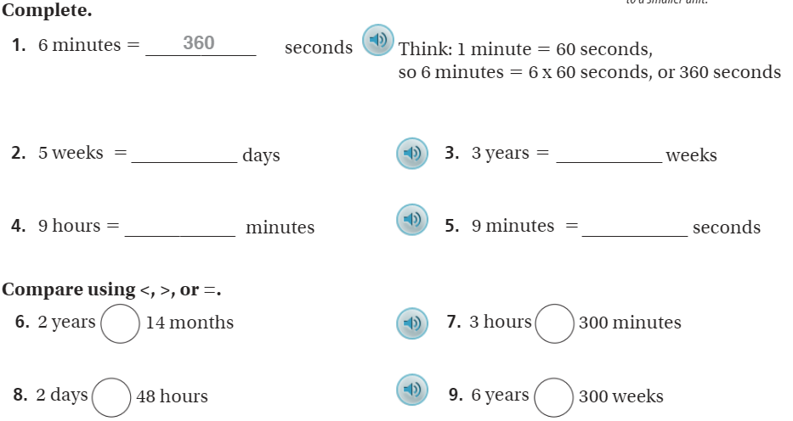
The Friday Quiz – pg.689

Slide 16
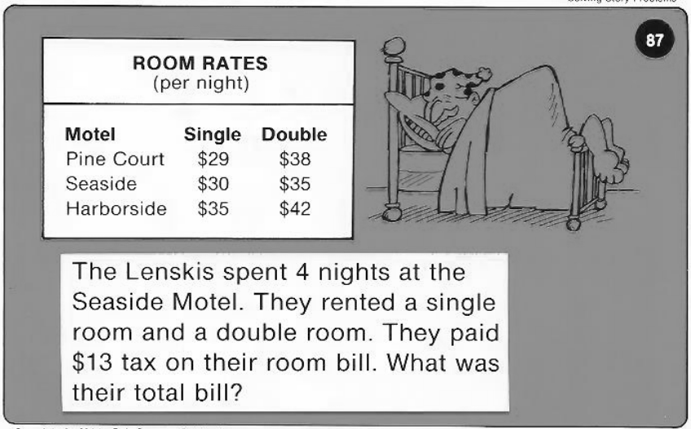
Calculator Problem

Slide 17
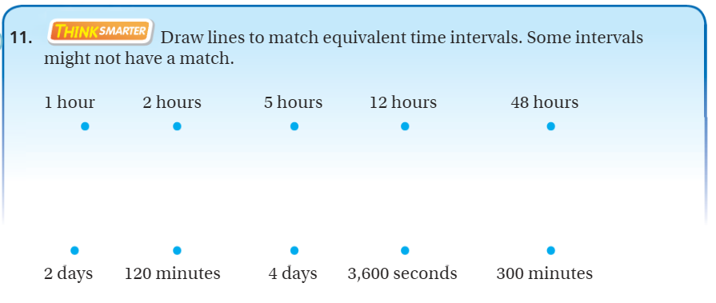
Exit Ticket – pg.688

